Slide 1
Technology
Sistem Informasi UPN “Veteran” Yogyakarta

Slide 2
Why study technology
Technological innovation is one of the key features of contemporary society. It affects :
Communication
Trading
Travelling
Job recruitment
Leisure time
Security
etc

Slide 3
Why technology predictions are often false
Material technology tools, machinery, and equipment that can be seen, touched and heard
Social technology the methods which order the behavior and relationships of people in systematic, purposive ways through structures of coordination, control motivation, and reward

Slide 4
The myth of technological unemployment
Replacement effects process through which intelligent machines, substitute for people at work, leading to unemployment
Compensatory effects processes that delay or defect employment replacement effects, and which lead to the creation of new products and services and new jobs.

Slide 5
The myth of technological deskilling
If technology does not create unemployment, then surely the remaining jobs will be deskilled? The evidence suggests that ‘technological implications’ are not as one dimensional as that. Technology can deskill, but it can also increase the demands on skill and understanding.
The development of nonstandard work
Nonstandard work employment that does not involve a fixed schedule at the same physical location for an extended time.

Slide 6
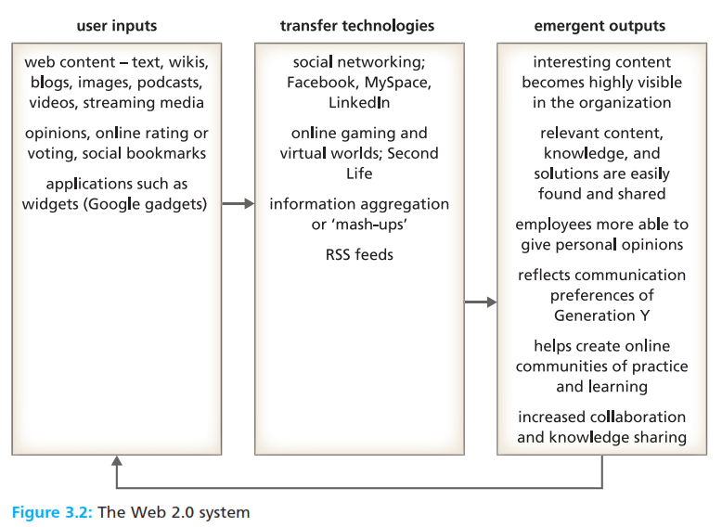
Web 2.0 : the impact
Web 2.0 technologies internet based information systems that allow high levels of user interaction, such as blogs, wikis (collaborative databases), and social networking.

Slide 7
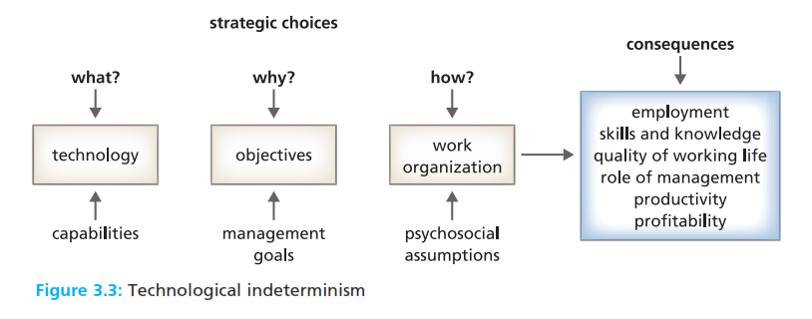
Determinism or choice?
Technological determinism the argument that technology explains the nature of jobs, work groupings, hierarchy, skills, values, and attitudes in organizations.

Slide 8
Classic studies on work and technology
Characteristics of mass production mechanical pacing of work, no choice of tools or methods, repetitiveness, minute subdivision of product, minimum skill requirements, and surface mental attention.
Job rotation a work design method in which employees are switched from task to task at regular intervals.
Job enlargement a work design method in which tasks are combined to widen the scope of a job.
Autonomous work group or team a group or team allocated to a significant segment, of the workflow, with discretion over how their work will be carried out.
System something that functions through the interdependence of its component parts
Open system a system that interacts, in a purposive way, with its external environment in order to survive.

Slide 9
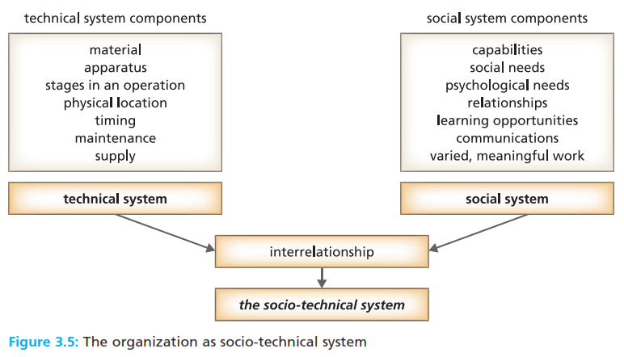
Socio-technical systems
Socio-technical system system which has both a material technology (machinery, equipment) and a social organization (job specifications, management structure)

Slide 10
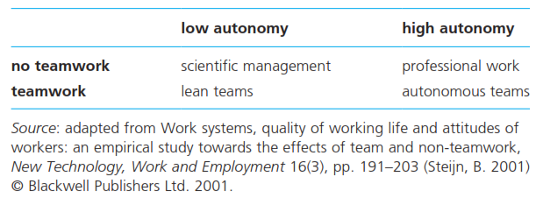
Socio-technical systems
Organizational choice the argument that work design is not determined by technology, and that the technical system does not determine the social system.
Team versus lean : competing socio-technical paradigms
Lean production a manufacturing method which combines machines pacing, work standardization, just in time materials flow, continuous improvement, problem solving teams, and powerful supervision.

Slide 11
Reference
Huczynski, Buchanan, 2013 , Organizational Behaviour, Pearson
Umam, Khaerul, 2012, Manajemen Organisasi, Pustaka Setia.
Wardiah, Mia Lasmi, Teori perilaku dan budaya organisasi, Pustaka Setia.

