Slide 1
Produce Safety
Good Agricultural Practices (GAPs)

Slide 2
Objectives
After this session, participants will be able to:
identify the common produce items associated with foodborne illness outbreaks.
describe the eight GAPs principles.
discuss the importance of traceability in food recalls.
apply GAPs principles when purchasing local produce.

Slide 3
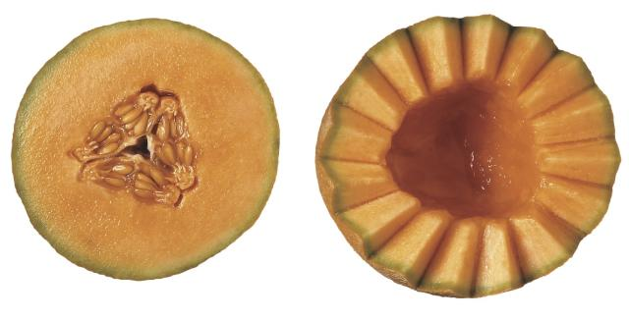
Produce Benefits
Benefits of consuming fresh produce far outweigh the risks
Produce safety is important
Food safety risks can be minimized

Slide 4
Produce Outbreaks by Item, 1998-2008
Source: FDA 2009

Slide 5
Produce Contamination Sources
Water, manure, and soil
Insects, rodents, and other wild life
Equipment cross contamination
Human handling
Chemicals and pesticides
Physical hazards (glass, plastic, wood, etc.)

Slide 6
Microbial Growth at Different Temperatures
Time | Refrigeration 36°F | Room 70°F | Body 98°F
0 | 1 cell | 1 cell | 1 cell
4 hours | 1 cell | 16 cells | 4,096 cells
6 hours | 1 cell | 64 cells | 262, 144 cells
24 hours | 2 cells | 16,777,216 | 4,722,336,483,000,000,000,000 cells
 | Ohio State University Bulletin 901

Slide 7
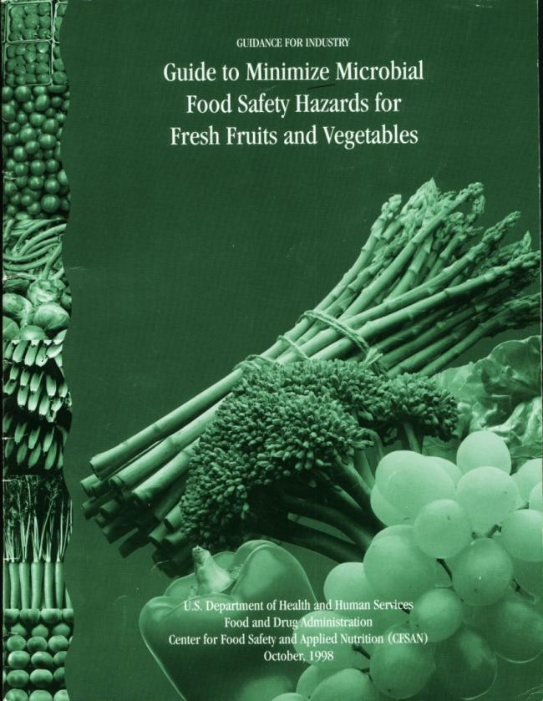
GAP and GHP Programs

Slide 8
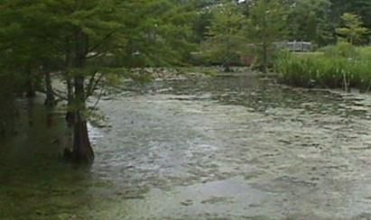
Principle 1: Water Source
Principle 1: Water Source
Use safe drinking water
When in contact with plant or produce
When harvest washing produce
Use surface water source (example: ponds)
When not in contact with plant or produce
Use for drip irrigation
Test for fecal coliforms and/or E.coli prior to use
Test soil for coliforms in frequently flooded farm land

Slide 9
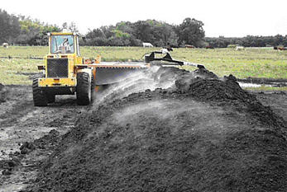
Principle 2: Manure Use and Handling
Composted manure
Aged manure
Location of manure

Slide 10
Raw Manure
Is raw manure incorporated at least 2 weeks prior to planting or 120 days prior to harvest?
Planting
Harvest
14 Days
120 Days

Slide 11
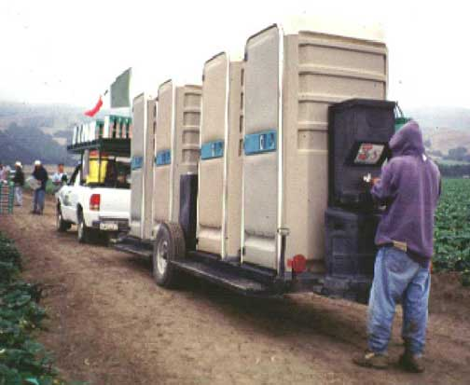
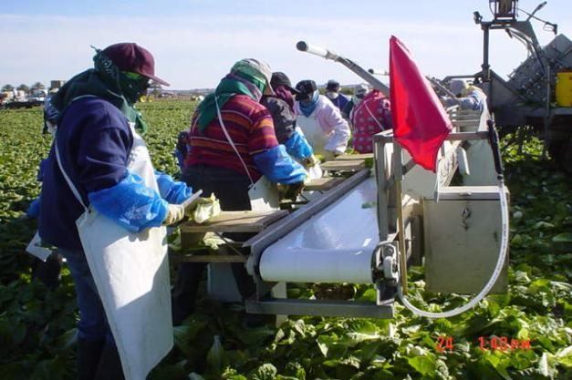
Principle 3: Worker Health and Hygiene Principle 4: Sanitary Facilities

Slide 12
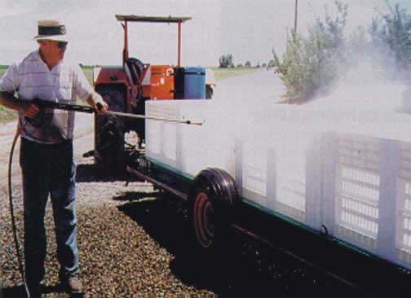
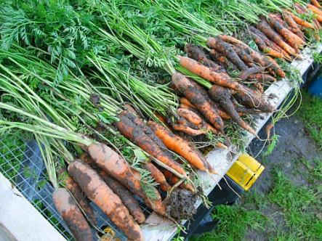
Principle 5: Field Sanitation
Harvest containers cleaned and sanitized
Equipment cleaned periodically
Avoid soil or unsafe water contamination
Create reasonable barriers to animals

Slide 13
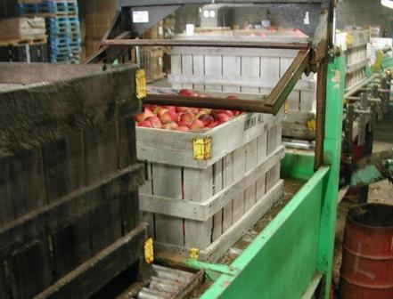
Principle 6: Packing Facility Sanitation
Good handling practices (SOPs)
Avoid cross contamination with equipment or animals (wild and domestic birds)
Pest prevention program

Slide 14
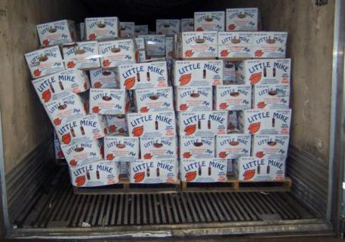
Principle 7: Transportation
Maintain temperatures
Maintain refrigeration units (check for leaks)
Load trucks to prevent damage
Clean transport vehicles regularly

Slide 15
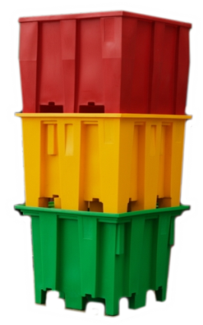
Principle 8: Traceability
One step back; one step forward
Date of harvest/pack date
Field identification (may be color coded)
Worker identification
Recordkeeping

Slide 16
Why GAPs?
Required by some buyers
Enhances marketability
Good Business Practice

Slide 17
GAPs Audits
USDA GAPs audit
Third party company GAPs audit

Slide 18
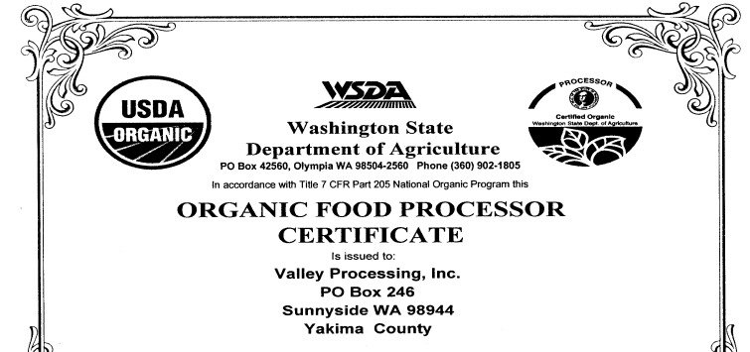
Organic Certification
Certified by USDA accredited agent
Annual renewal just like GAPs
Organic certification does not address food safety or nutrition

Slide 19
What are your options?
Require a formal GAPs audit
Require self-assessment checklist

Slide 20
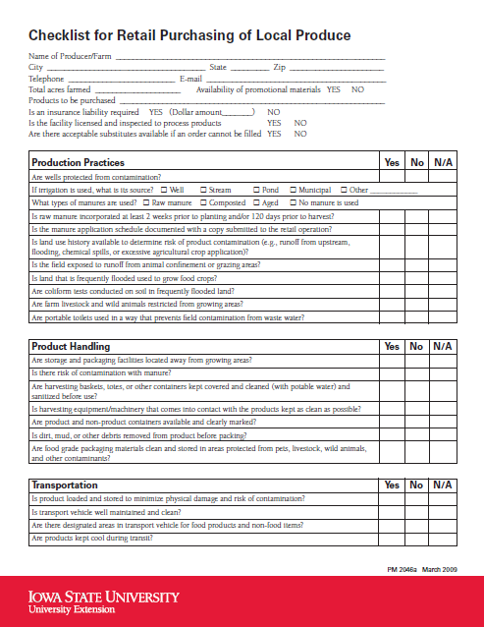
What are your options?
Checklists
Iowa State
Cornell
UC Davis
Penn State
Initiates conversation

Slide 21
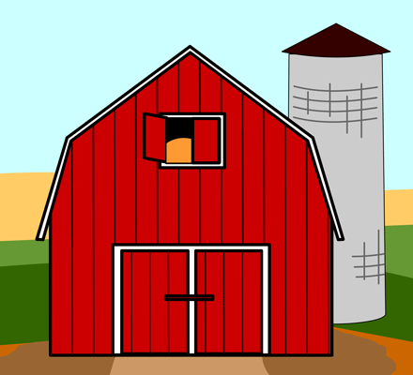
GAPs Resources
GAP Websites
FDA, Cornell, Penn State, UC Davis, and others
Extension Offices
State Agricultural Departments
Health Departments
Farm to school
Other farmers

Slide 22
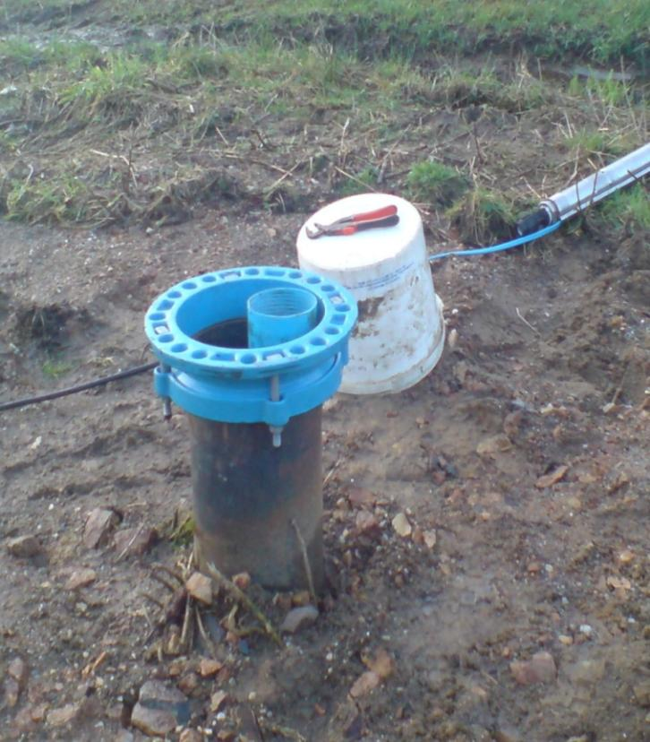
GAPs Activity

Slide 23
GAPs Activity

Slide 24
GAPs Activity

Slide 25
GAPs Activity

Slide 26
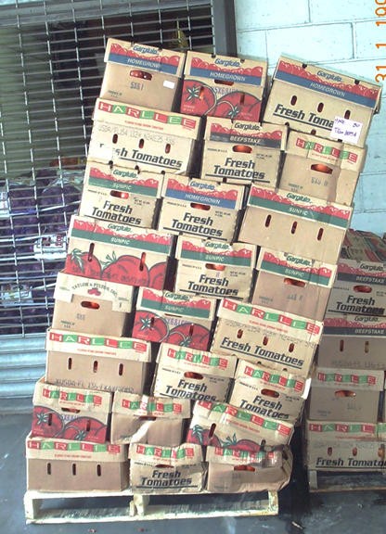
GAPs Activity

Slide 27
GAPs Activity

Slide 28
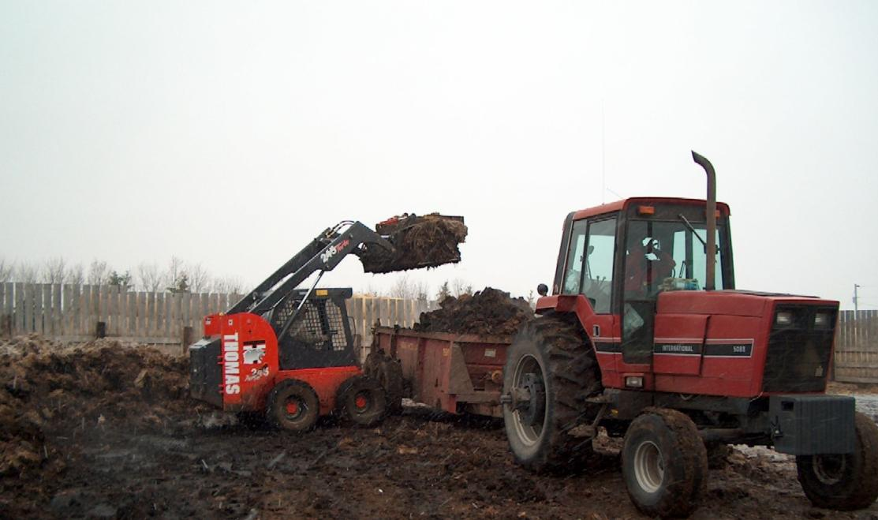
GAPs Activity

Slide 29
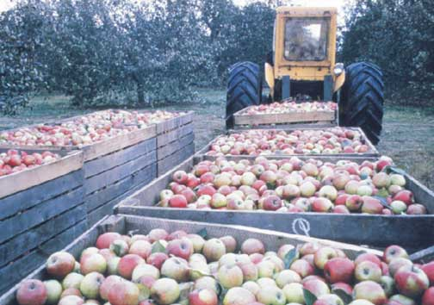
GAPs Activity

Slide 30
GAPs Activity

Slide 31
GAPs Activity

Slide 32
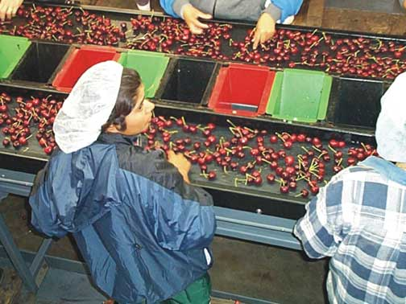
GAPs Activity

Slide 33
GAPs Activity

Slide 34
General Fresh handling activities : * Refrigeration >>> kind of refregerant ! * Packaging >>> packing material ! * Wrapping >>> source of wax ! The safety >>> Proved by Eco Label

