Slide 1
ROCK MASS MOVEMENTS

Slide 2
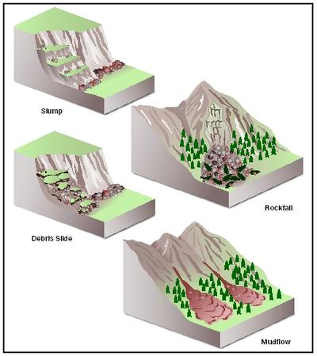
Slope Movements

Slide 3
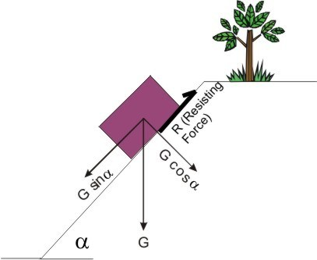
Stress Distribution in Slope
Gsinα = Driving Force (Gaya Penggerak)
Resisting Force (Gaya Penahan) = Gcosα.tanφ
φ = friction angle

Slide 4
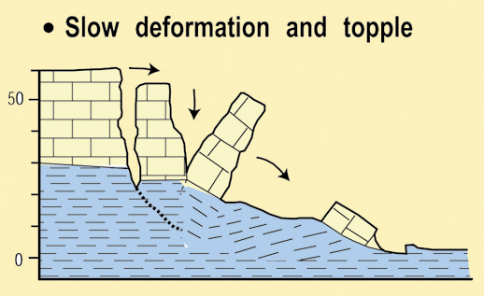
TYPES of ROCK MOVEMENTS
Block Gliding
Wedge
Slump
Topling

Slide 5
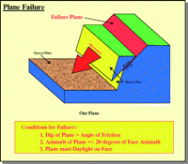
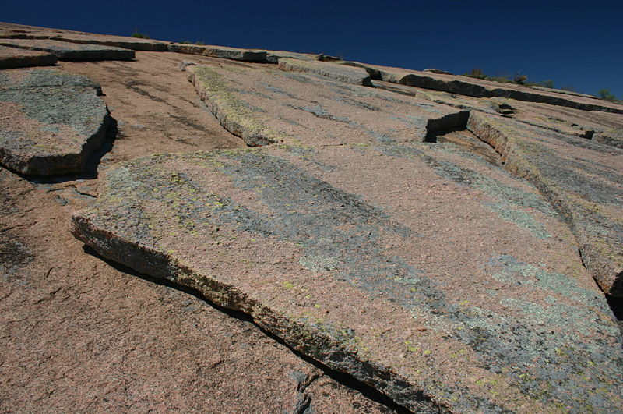
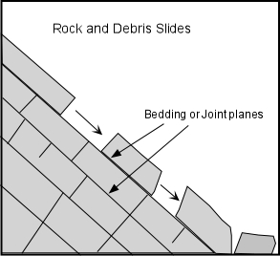
Block Glides

Slide 6
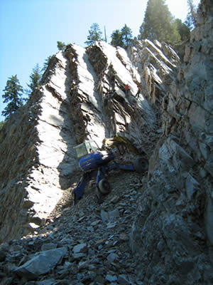
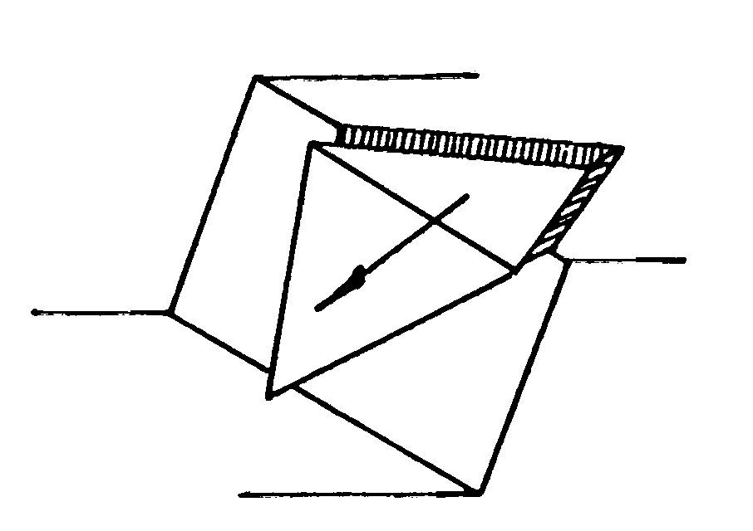
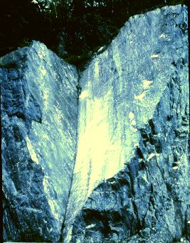
Wedge

Slide 7
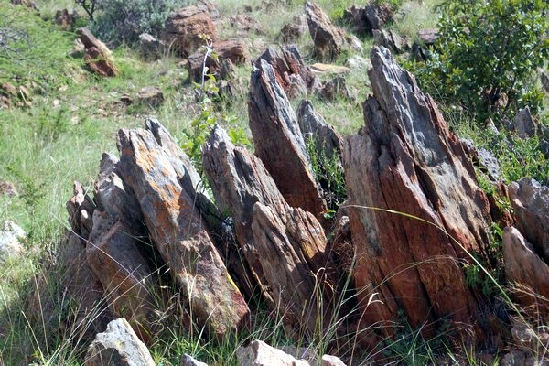
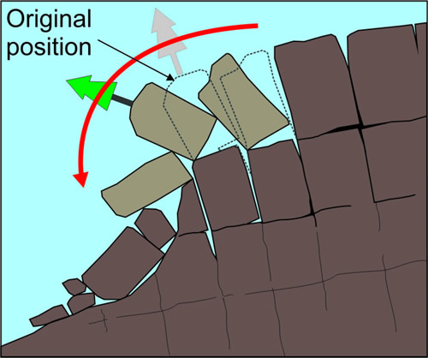
Topple/ Toppling

Slide 8
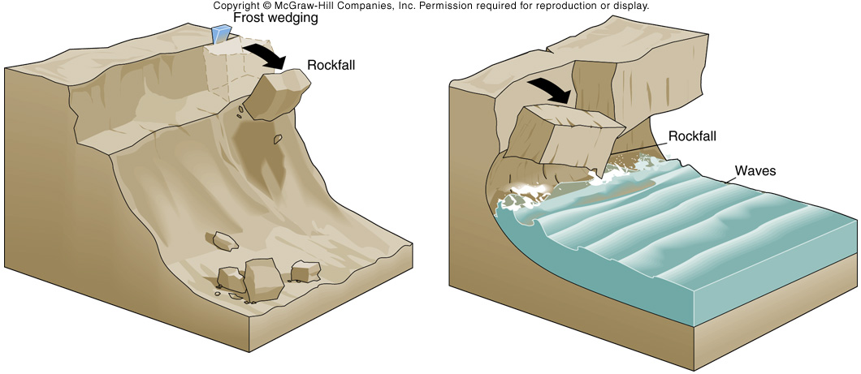
Mass Movement Cases
Rockfalls

Slide 9
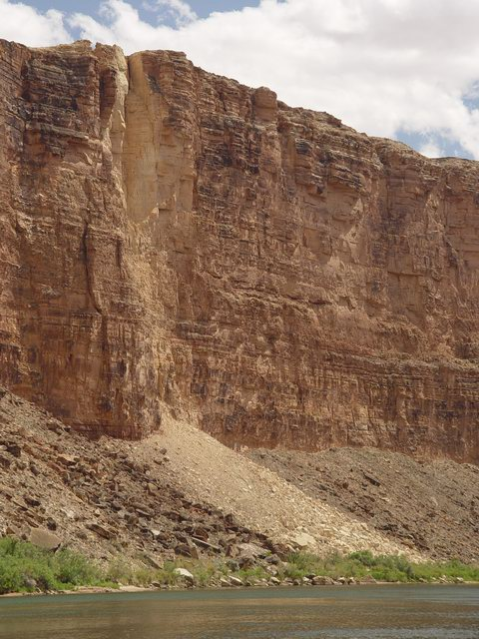
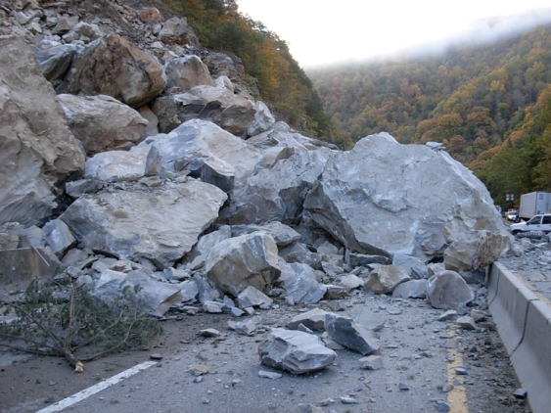

Slide 10
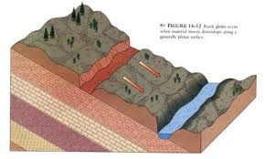
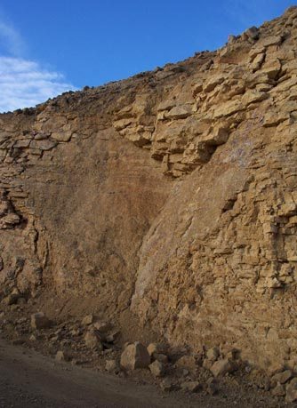
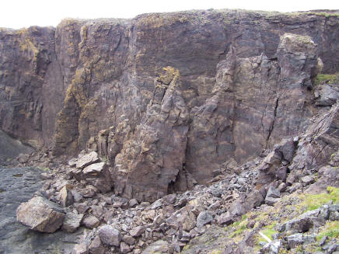

Slide 11
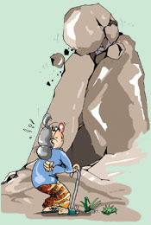
When does the slope move?
Stable: Driving Force < Resisting Force
Critical: Driving Force = Resisting Force
Fail: Driving Force > Resisting Force

Slide 12
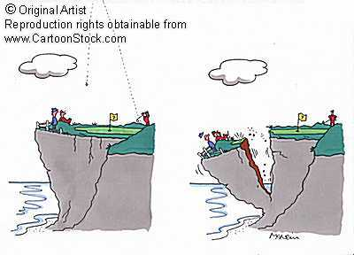
FACTOR OF SAFETY
SF > 1 : Safe
SF = 1 : Critical
SF < 1 : Fail

Slide 13
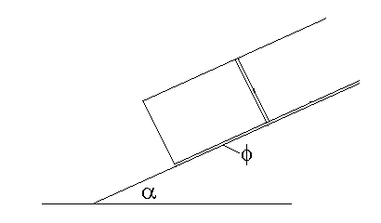
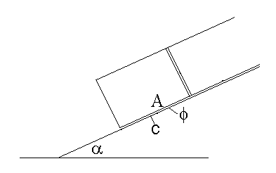
ANALYTIC METHOD
Without cohesion force and pore water pressure
With cohesion force

Slide 14
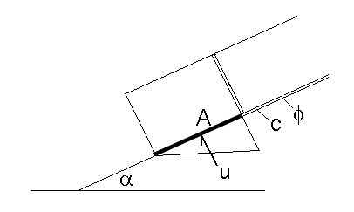
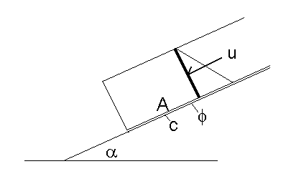
With cohesion and upward pore water pressure
With cohesion and downslope pore water pressure

Slide 15
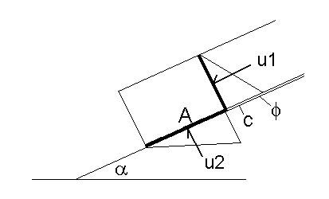
With cohesion, upward, and downslope pore water pressures

Slide 16
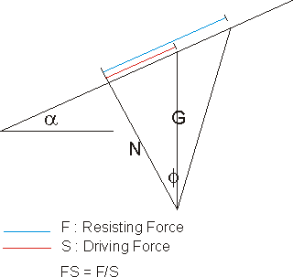
GRAPHIC (FORCE POLYGON) METHOD
Without cohesion force and pore water pressure

Slide 17
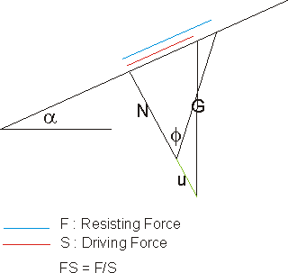
With cohesion and upward pore water pressure

Slide 18
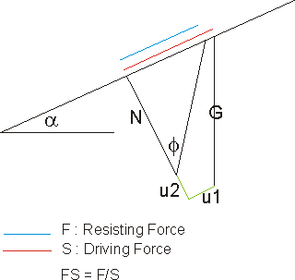
With cohesion, upward, and downslope pore water pressures

Slide 19
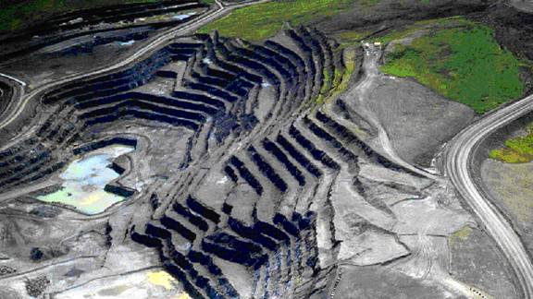
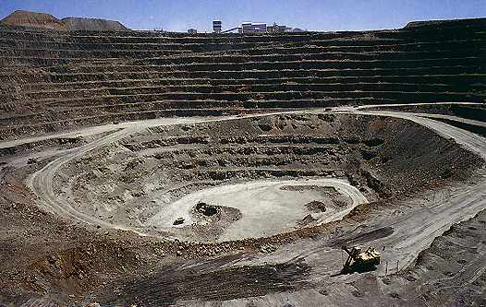
Potential Slope Stability of an Open Pit Mine

Slide 20
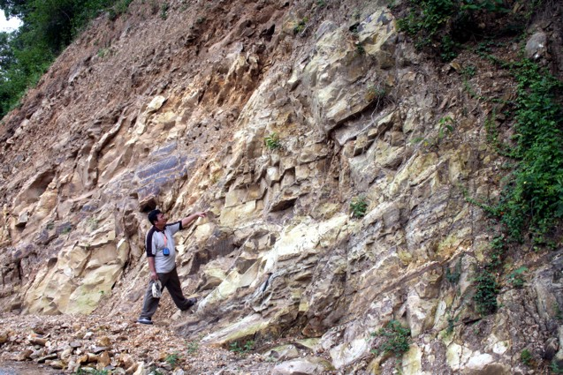

Slide 21
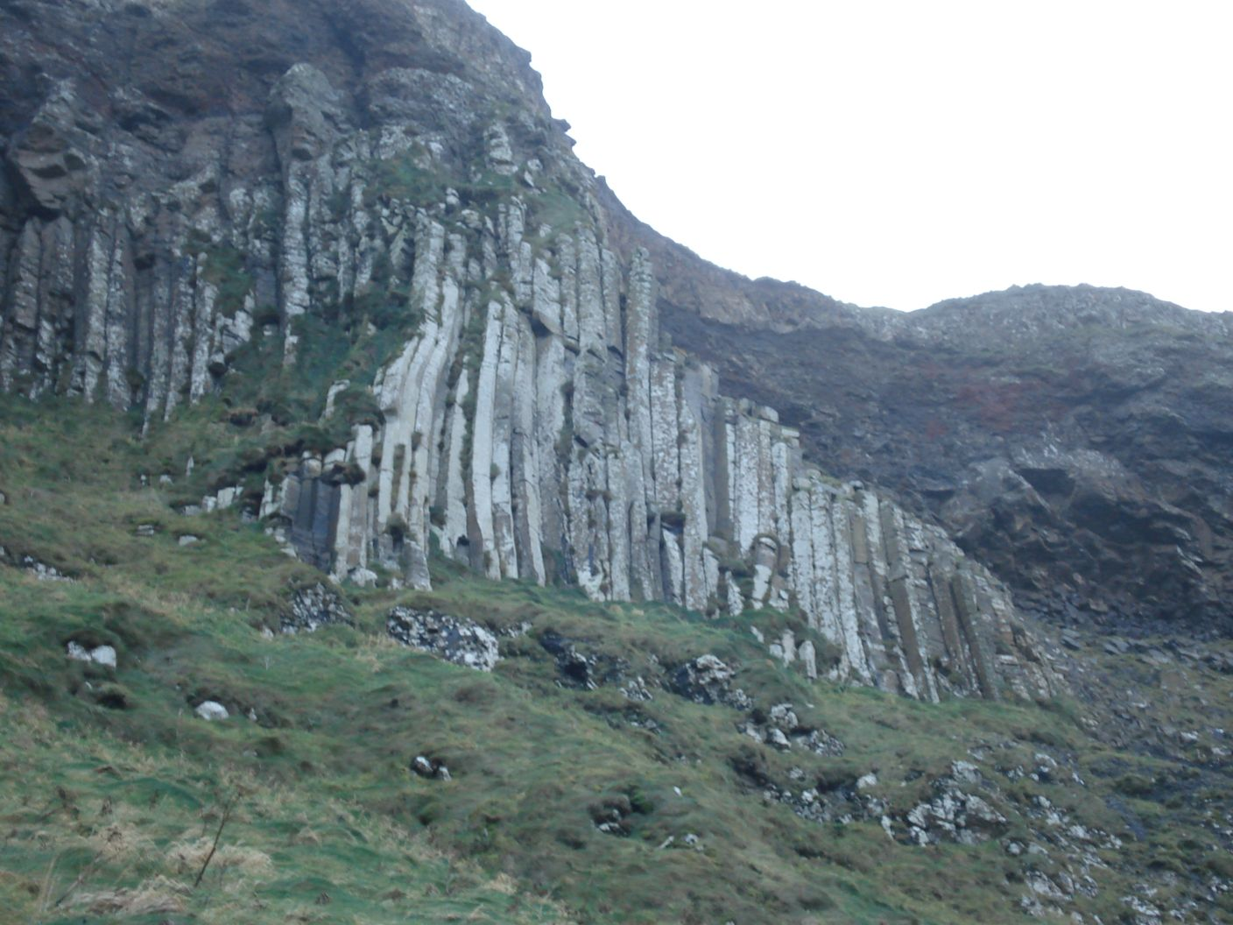

Slide 22
Latihan Markland Method
Suatu lereng yang mempunyai kemiringan N200ºE/40º disusun oleh batupasir, dengan sisipan lapisan batulempung berkedudukan N25ºE/30º setebal 5 cm. Batupasir tersebut dipotong oleh kekar-kekar dengan kedudukan, N132ºE/70, dan N260º/55º. Selain itu terdapat bidang sesar dengan kedudukan N228ºE/80º. Diketahui φ = 34º. Bagaimana potensi terjadinya slope failure pada lereng tersebut berdasarkan analisi Markland? Jika berpotensi, sebutkan prakiraan jenis longsoran dan arah longsorannya.

Slide 23
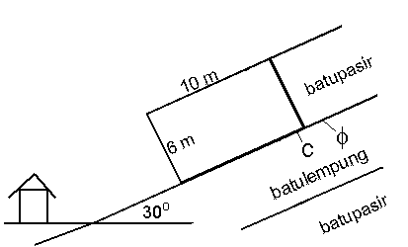
UAS 2011 Safety Factor
Diketahui φ = 36o, gaya kohesi = 10Ton/m2, γbatupasir = 2,7,
γbatulempung = 2,5, γair = 1

Slide 24
UAS 2011 Safety Factor
Determine the pore water pressures

Slide 25
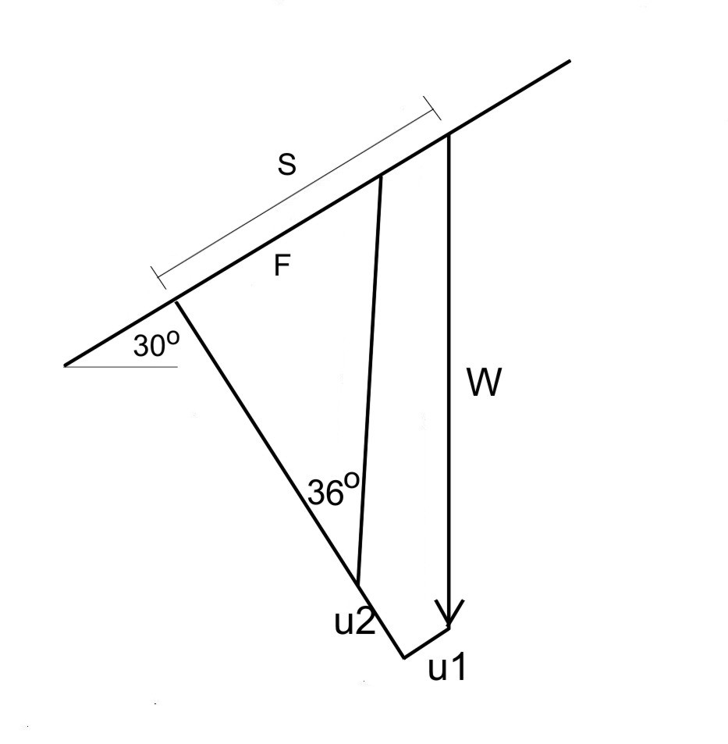
Jawaban FS metode Force Polygon
W = 10 x 6 x 2,7 = 162 Ton/m2
U1 = ½ x 6 x 6 = 18 Ton/m2
U2 = ½ x 6 x 10 = 30 Ton/m2
C = 10 Ton/m2
Jika Skala grafik: 1 cm = 20 Ton/m2
F = 3,8 cm = 76 Ton/m2
S = 5,3 cm = 106 Ton/m2
FS =
=
Kesimpulan: Lereng dalam keadaan aman (stabil)

Slide 26
TERIMA KASIH
ATAS
PERHATIANNYA

