Slide 1
Organizational Behaviour
Sistem Informasi UPN “Veteran” Yogyakarta

Slide 2
What is organizational behavior?
Organizational behavior the study of the structure and management of organizations, their environments and the actions and interactions of their individual members and groups.
Organization is a social arrangement for achieving controlled performance in pursuit of collective goals.
Controlled performance setting standards, measuring performance, comparing actual with standard and taking corrective action if necessary.
Organizational dilemma how to reconcile inconsistency between individual needs and aspirations on the one hand, and the collective purpose of the organization on the other.

Slide 3
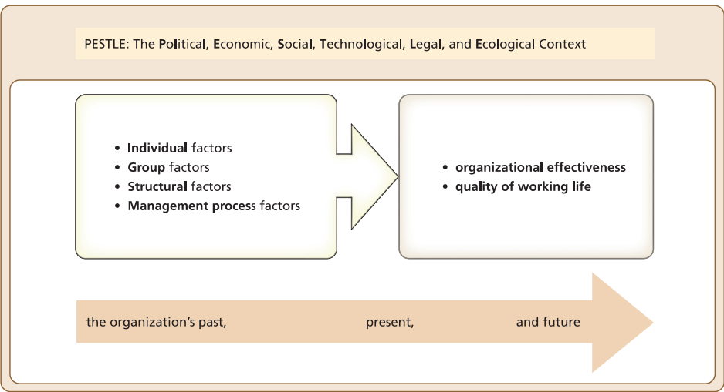
A field map of the organizational behavior terrain

Slide 4
A field map of the organizational behavior terrain
Fundamental attribution error the tendency to emphasize explanations of the behavior of others based on their personality or disposition, and to overlook the influence of wider contextual influences.
Organizational effectiveness a multidimensional concept defined differently by different stakeholders, including a range of quantitative and qualitative measures.
Balanced scorecard an approach to defining organizational effectiveness using a combination of quantitative and qualitative measures to asses performance.
Quality of working life an individual’s overall assessment of satisfaction with their job, working conditions, pay, colleagues, management style, organization culture, work-life balance and training, development and career opportunities.

Slide 5
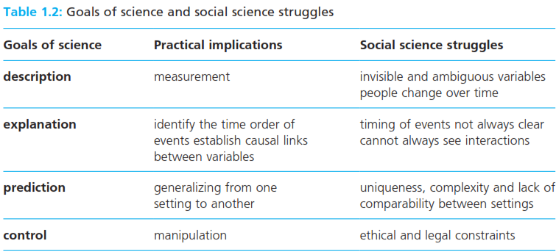
The problem with social science

Slide 6
Explaining organizational behavior
Positivism a perspective which assumes that the world can be understood in terms of causal relationship between observable and measureable variables, and that these relationships can be studied objectively using controlled experiments.
Operational definition the method used to measure the incidence of a variable in practice.
Variance theory an approach to explaining organizational behavior based on universal relationships between independent and dependent variables which can be defined and measured precisely.
Constructivism a perspective which argues that our social and organizational worlds have no ultimate objective truth or reality, but are instead determined by our shared experiences meanings and interpretations.

Slide 7
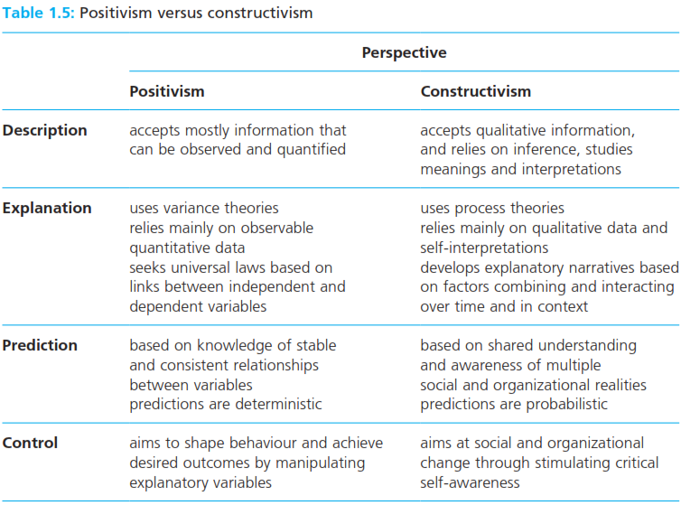
Explaining organizational behavior
Process theory an approach to explaining organizational behavior based on narratives which show how many factors, combining and interacting over time in a particular context, are likely to produce the outcomes of interest.

Slide 8
Research and practice: evidence based management
Evidence base management systematically using the best available research evidence to inform decisions about how to manage people and organizations.

Slide 9
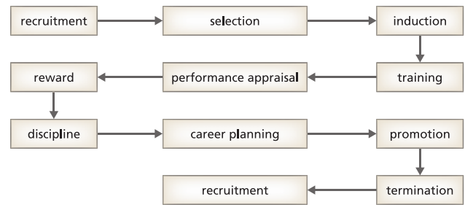
Human resource management : OB in action
Human resource management the function responsible for establishing integrated personnel policies to support organization strategy.
Employment cycle the sequence of stages through which all employees pass in each working position they hold, from recruitment and selection to termination.

Slide 10
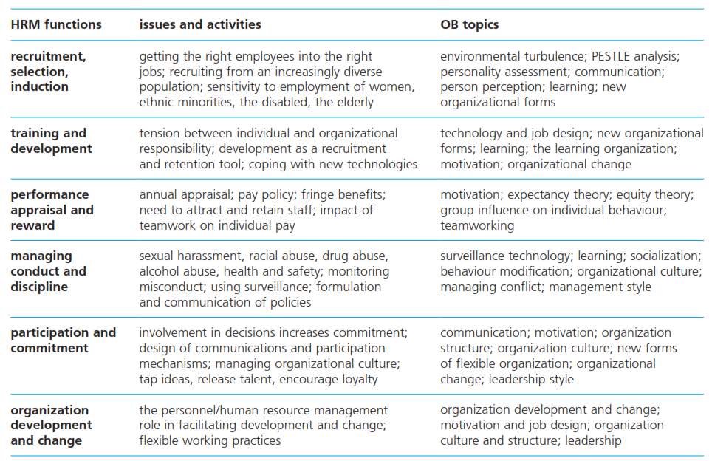
Human resource management : OB in action

Slide 11
The Bath model of HRM

Slide 12
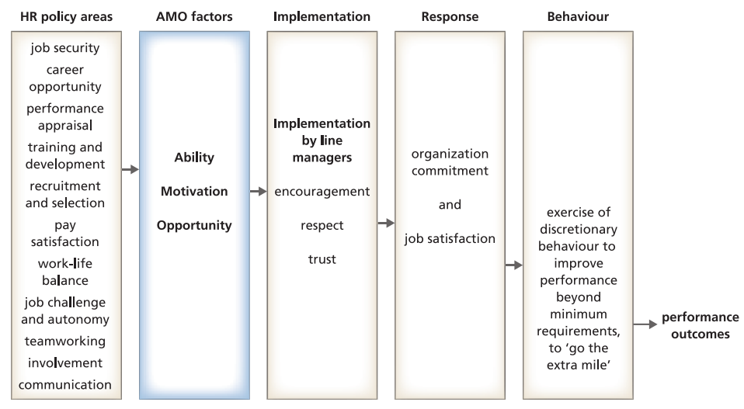

Slide 13
The Bath model of HRM
Discretionary behavior freedom to decide how work is going to be performed; organizational behavior can be positive, such as putting in extra time and effort, or it can be negative, such as withholding information and cooperation.

Slide 14
Reference
Huczynski, Buchanan, 2013 , Organizational Behaviour, Pearson
Umam, Khaerul, 2012, Manajemen Organisasi, Pustaka Setia.
Wardiah, Mia Lasmi, Teori perilaku dan budaya organisasi, Pustaka Setia.

