Slide 1
Personality
Sistem Informasi UPN “Veteran” Yogyakarta

Slide 2
Why study personality
Personality the psychological qualities that influence an individual’s characteristics behavior patterns, in a stable and distinctive manner
Psychometrics the systematic testing measurement and assessment of intelligence, aptitudes and personality.
Chronotype a cluster of personality traits that can affect whether someone is more active and performs better in the morning or in the evening.
Type a descriptive label for a distinct pattern of personality characteristics, such as introvert, extravert, or neurotic.

Slide 3
Why study personality
Personality the psychological qualities that influence an individual’s characteristics behavior patterns, in a stable and distinctive manner
Psychometrics the systematic testing measurement and assessment of intelligence, aptitudes and personality.
Chronotype a cluster of personality traits that can affect whether someone is more active and performs better in the morning or in the evening.
Type a descriptive label for a distinct pattern of personality characteristics, such as introvert, extravert, or neurotic.

Slide 4
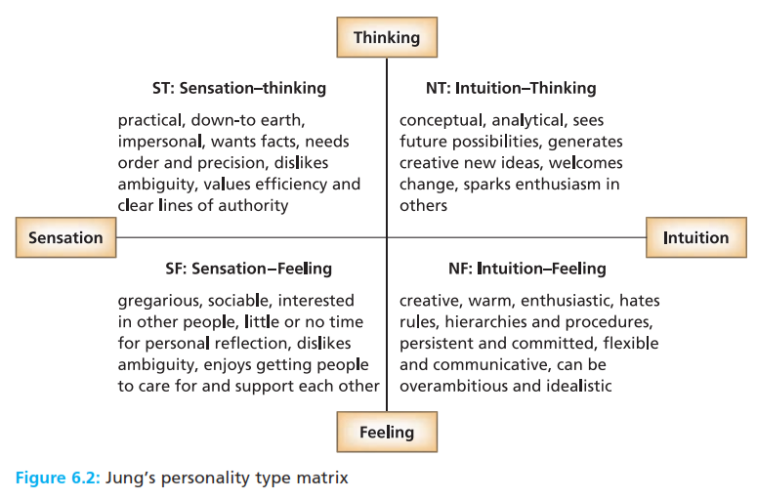
Why study personality
Personality the psychological qualities that influence an individual’s characteristics behavior patterns, in a stable and distinctive manner
Psychometrics the systematic testing measurement and assessment of intelligence, aptitudes and personality.
Chronotype a cluster of personality traits that can affect whether someone is more active and performs better in the morning or in the evening.
Type a descriptive label for a distinct pattern of personality characteristics, such as introvert, extravert, or neurotic.

Slide 5
Why study personality
Trait a relatively stable quality or attribute of an individual’s personality influencing behavior in a particular direction.
Nomothetic an approach to the study of personality emphasizing the identification of traits, and the systematic relationship between different aspects of personality

Slide 6
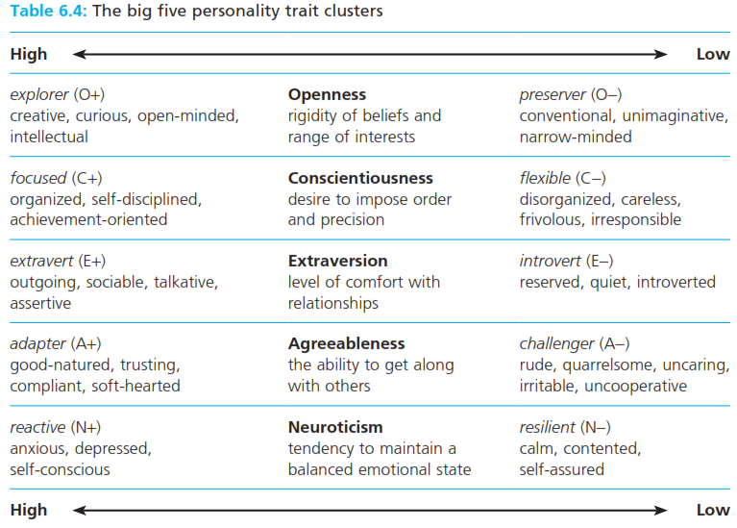
Why study personality
Big five trait clusters that appear consistently to capture main personality traits : openness, conscientiousness, extraversion, agreeableness, and neuroticism.

Slide 7
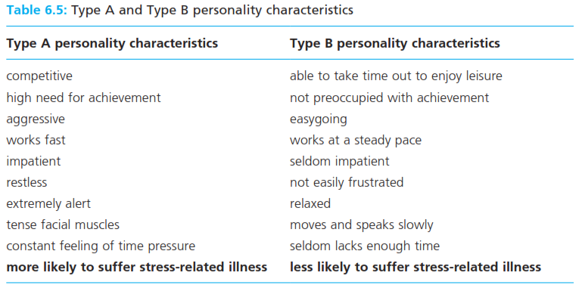
Personality types A dan B
Type A personality a combinations of emotions and behaviours characterized by ambition, hostility, impatience, and a sense of constant time pressure.
Type B personality a combination of emotion and behaviours characterized by relaxation, low focus on achievement, and ability to take time to enjoy leisure.

Slide 8
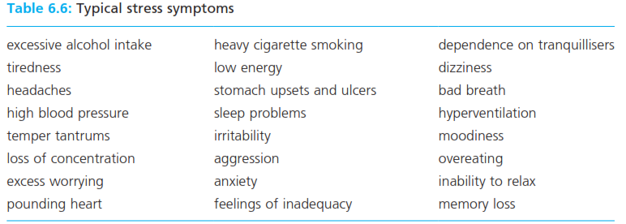
Stress management : individual and organization
Type A personality a combinations of emotions and behaviours characterized by ambition, hostility, impatience, and a sense of constant time pressure.
Type B personality a combination of emotion and behaviours characterized by relaxation, low focus on achievement, and ability to take time to enjoy leisure.

Slide 9
Stress management : individual and organization
Idiographic an approach to the study of personality emphasizing the uniqueness of the individual, rejecting the assumption that we can all be measured on the same dimensions.

Slide 10
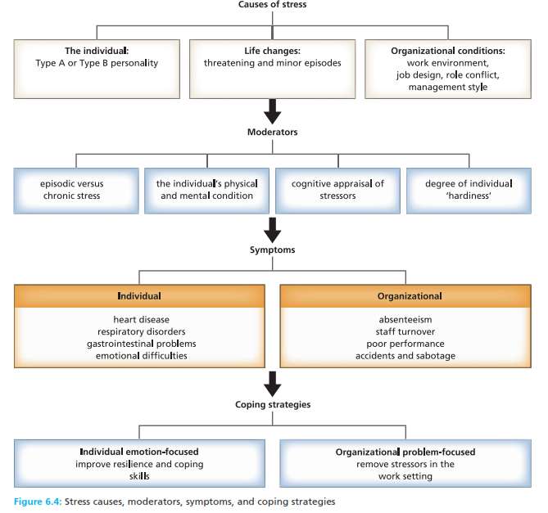
Stress management : individual and organization
Idiographic an approach to the study of personality emphasizing the uniqueness of the individual, rejecting the assumption that we can all be measured on the same dimensions.

Slide 11
The development of the self
Self-concept the set of perceptions that we have about ourselves.
Generalized other what we think other people expect of us, in terms of our attitudes, values, beliefs, and behavior.
Unconditional positive regard unqualified, non judgemental approval and respect for the traits and behaviours of the other person ( a term used in counselling)
Thematic apperception test an assessment in which the individual is shown ambigious pictures and is asked to create stories of what may be happening in them
Need for achievement a concern with meeting standard of excellence, the desire to be successful in competition, and the motivation to excel.
Projective test an assessment based on abstract or ambigious images, which the subject is asked to interpret by projecting their feelings, preoccupations, and motives into their responses.

Slide 12
Selection method
Reliability the degree to which an assessment delivers consistent results when repeated.
Predictive validity the extent to which assessment scores accurately predict behaviours such as job performance.
Psychometrics
Improved interview techniques
Assessment centres

Slide 13
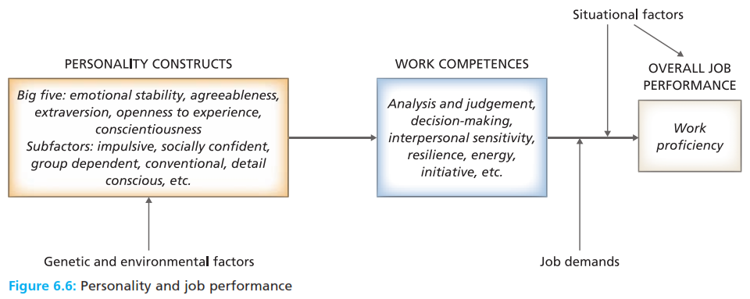
Selection method
Reliability the degree to which an assessment delivers consistent results when repeated.
Predictive validity the extent to which assessment scores accurately predict behaviours such as job performance.
Psychometrics
Improved interview techniques
Assessment centres

Slide 14
Reference
Huczynski, Buchanan, 2013 , Organizational Behaviour, Pearson
Umam, Khaerul, 2012, Manajemen Organisasi, Pustaka Setia.
Wardiah, Mia Lasmi, Teori perilaku dan budaya organisasi, Pustaka Setia.

