Slide 1
Culture
Sistem Informasi UPN “Veteran” Yogyakarta

Slide 2
Why study organizational culture?
Culture can be thought of as the personality of an organization. It is also often referred to as corporate culture. It deals how things are done in a company on a daily basis. Ann cunlife (2008) states that Organizational culture is important because it:
Shapes the image that the public has of an organization
Influences organizational effectiveness
Provides direction for the company
Helps to attract, retain and motivate staff.

Slide 3
Rise of organizational culture?
Organizational culture the shared values, beliefs, and norms which influence the way employees think, feel, and act towards others inside and outside the organization.
Culture: surface manifestations, values, and basic assumptions
Surface manifestations of organizational culture culture’s most accessible forms, which are visible and audible behavior patterns and objects.
Three schein model surface levels, values levels and basic assumptions.

Slide 4
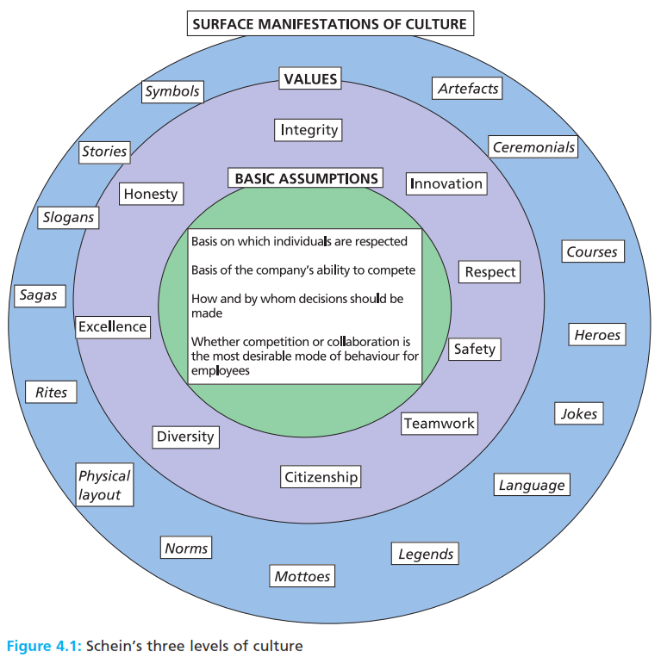
Rise of organizational culture?
Organizational culture the shared values, beliefs, and norms which influence the way employees think, feel, and act towards others inside and outside the organization.
Culture: surface manifestations, values, and basic assumptions
Surface manifestations of organizational culture culture’s most accessible forms, which are visible and audible behavior patterns and objects.

Slide 5
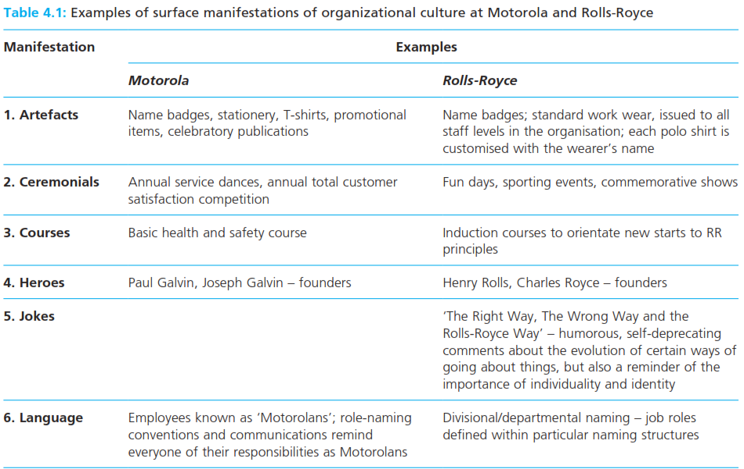
Rise of organizational culture?
Organizational culture the shared values, beliefs, and norms which influence the way employees think, feel, and act towards others inside and outside the organization.
Culture: surface manifestations, values, and basic assumptions
Surface manifestations of organizational culture culture’s most accessible forms, which are visible and audible behavior patterns and objects.

Slide 6
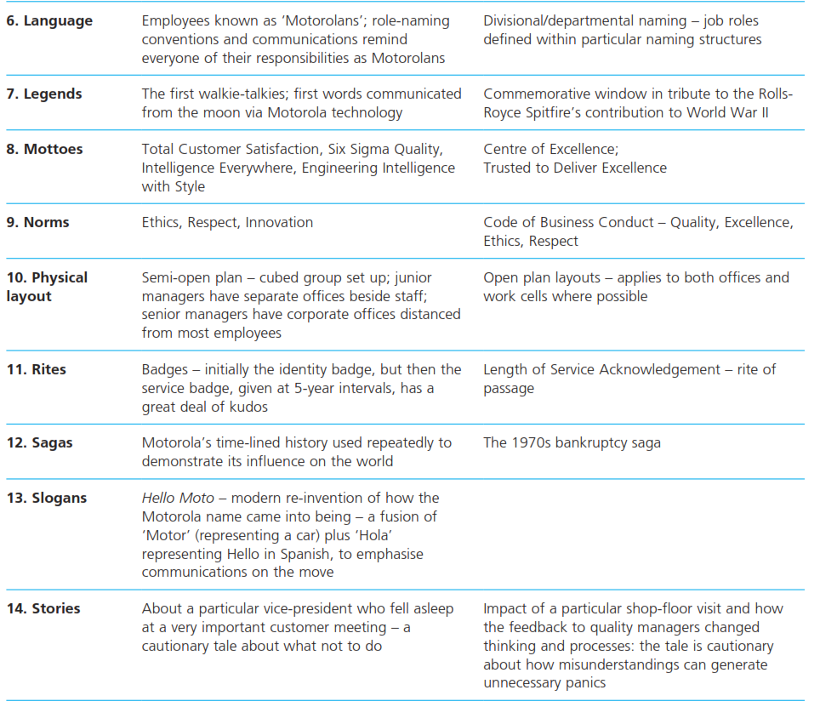
Rise of organizational culture?
Organizational culture the shared values, beliefs, and norms which influence the way employees think, feel, and act towards others inside and outside the organization.
Culture: surface manifestations, values, and basic assumptions
Surface manifestations of organizational culture culture’s most accessible forms, which are visible and audible behavior patterns and objects.

Slide 7
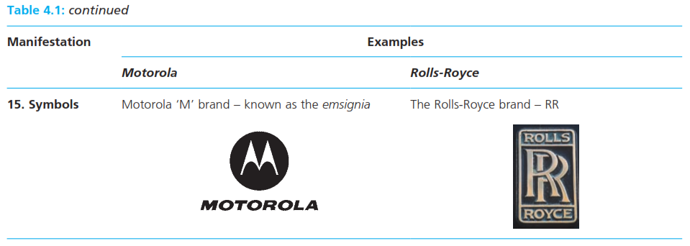

Slide 8
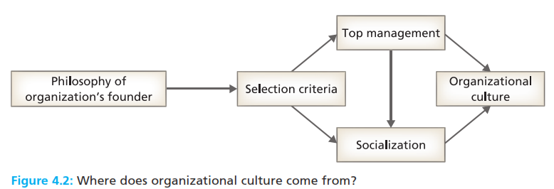
Organizational values
The accumulated beliefs held about how work should be done and situations dealt with that guide employee behavior.
Sources of values

Slide 9
Organizational values
Mechanistic organization structure an organization structure that possesses a high degree of task specialization, many rules, tight specification of individual responsibility and authority, and centralized decision making.
Organic organization structure an organization structure that possesses little task specialization, few rules, and a high degree of individual responsibility and authority, and in which decision making is delegated.
Basic assumptions invisible, preconscious, unspoken, ‘taken-for granted’ understandings held by individuals within an organization concerning human behavior, the nature of reality, and the organization’s relationship to its environments.

Slide 10
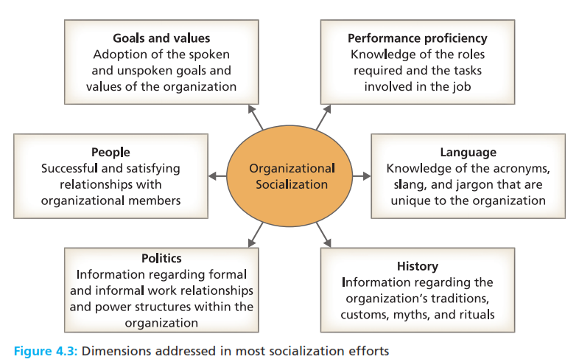
Organizational socialization
Organizational socialization the process through which an employee’s pattern of behavior, values, attitudes, and motives is influenced to conform to that of the organization.

Slide 11
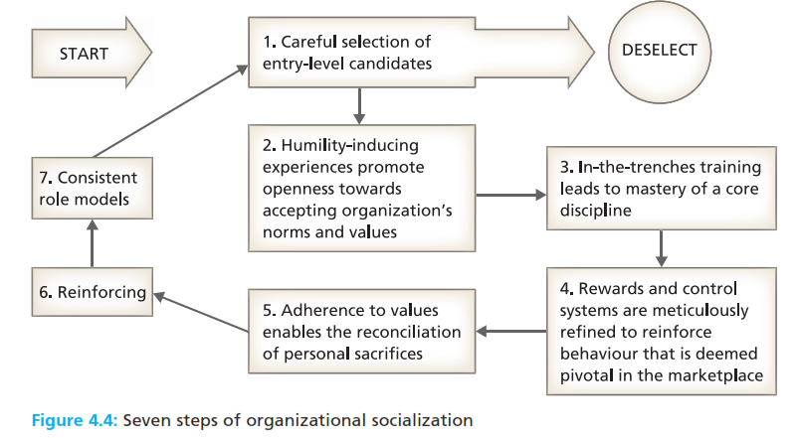
Organizational socialization
Organizational socialization the process through which an employee’s pattern of behavior, values, attitudes, and motives is influenced to conform to that of the organization.

Slide 12
Organizational socialization
Pre arrival stage of socialization the period of learning in the process that occurs before an applicant joins an organization.
Encounter stage of socialization the period during which the new recruit learns about organizational expectations.
Role modelling a form of socialization in which an individual learns by example, copying the behavior of established organization members.
Metamorphosis stage of socialization the period in which the new employee adjust to their organization’s values, attitudes, motives, norms, and required behavior.

Slide 13
Perspectives on culture contrasted

Slide 14
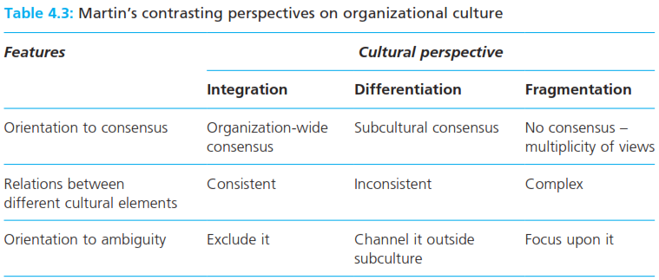
Perspectives on culture contrasted
Integration (or unitary) perspective on culture a perspective which regards culture as monolithic, characterized by consistency, organization-wide condensus, and clarity.

Slide 15
Perspectives on culture contrasted
Differentiation perspective on culture a perspective which sees organizations as consisting of subcultures, each with its own characteristics, which differ from those of its neighbours.
Fragmentation (or conflict) perspective on culture a perspective which regards culture as consisting of an incompletely shared set of elements that are loosely structured, constantly changing, and generally in conflict.

Slide 16
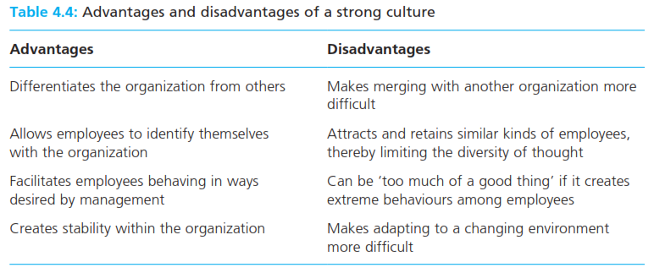
Culture strength and organizational performance
Strong culture a culture in which an organization’s core values are widely shared among employees and intensely held by them, and which guides their behavior.
Weak culture a culture in which there is little agreement among employees about their organization’s core values, the way things are supposed to be, or what is expected of them.

Slide 17
Culture strength and organizational performance
Internal integration the process through which employees adjust to each other, work together, and perceive themselves as a collective entity.
External adaptation the process through which employees adjust to changing environmental circumstances to attain organizational goals.

Slide 18
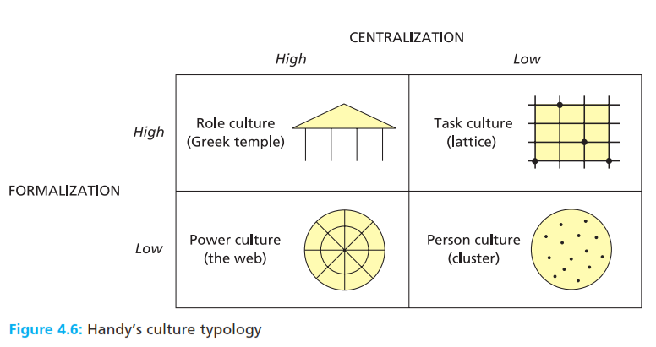
Types of organizational culture
Internal integration the process through which employees adjust to each other, work together, and perceive themselves as a collective entity.
External adaptation the process through which employees adjust to changing environmental circumstances to attain organizational goals.

Slide 19
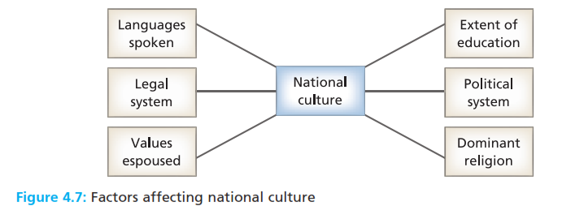
National culture
Internal integration the process through which employees adjust to each other, work together, and perceive themselves as a collective entity.
External adaptation the process through which employees adjust to changing environmental circumstances to attain organizational goals.

Slide 20
National culture
Social orientation the relative importance of the interests of the individual versus the interest of the individual versus the interest of the group – individualism vs collectivism
Power orientation the appropriateness of power/authority within organizations – respect versus tolerance.
Uncertainty orientation the emotional response to uncertainty and change – acceptance versus avoidance.
Goal orientation the motivation to achieve goals – aggressive masculinity versus passive feminity.
Time orientation the time outlook on work and life – short term versus long term.

Slide 21
Reference
Huczynski, Buchanan, 2013 , Organizational Behaviour, Pearson
Umam, Khaerul, 2012, Manajemen Organisasi, Pustaka Setia.
Wardiah, Mia Lasmi, Teori perilaku dan budaya organisasi, Pustaka Setia.

