Slide 1
UPN “VETERAN” YOGYAKARTA
E-Commerce
Chapter 6
Hari Prapcoyo,S.Kom., M.ICT
Sistem Informasi

Slide 2
E-commerce marketing & advertising concepts
Learning objective:
The key features of the internet audience, the basic concepts of consumer behavior and purchasing and how consumer behave online.
Identify and describe the basic digital commerce marketing and advertising strategies and tools.
Identify and describe the main technologies that support online marketing
Understand the costs and benefits of online marketing communications.

Slide 3
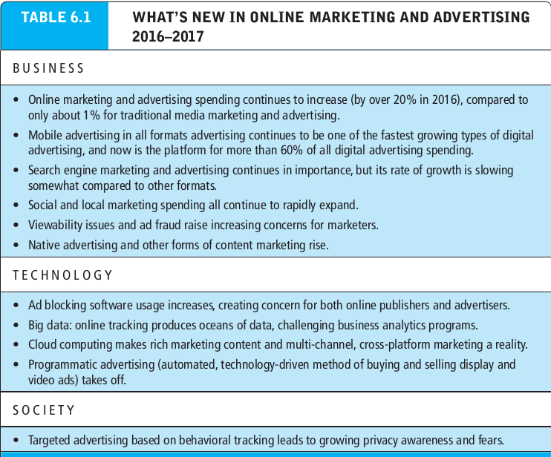
Consumer online : the internet audience and consumer behavior
What’s the idea? (the visioning process)
Where’s the money: business and revenue model.
Who and where is the target audience?
Characterize the marketplace
Where’s the content coming from?

Slide 4
Consumer online : the internet audience and consumer behavior
Intensity and scope of usage
Demographics and access
Type of internet connection : broadband and mobile impacts
Community effects : social contagion in social networks

Slide 5
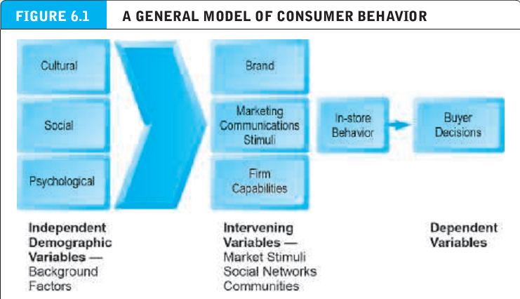
Consumer behavior
Consumer behavior : a social science discipline that attempts to model and understand the behavior of humans in a marketplace.

Slide 6
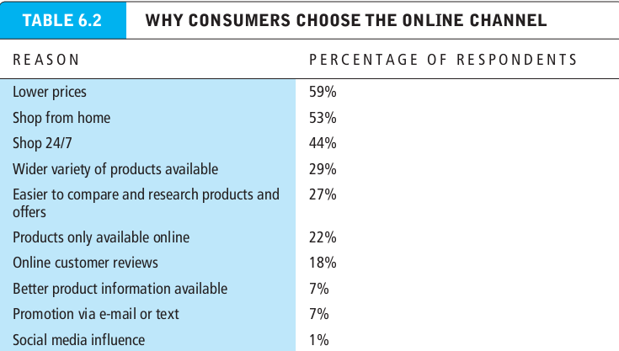
The online purchasing decision

Slide 7
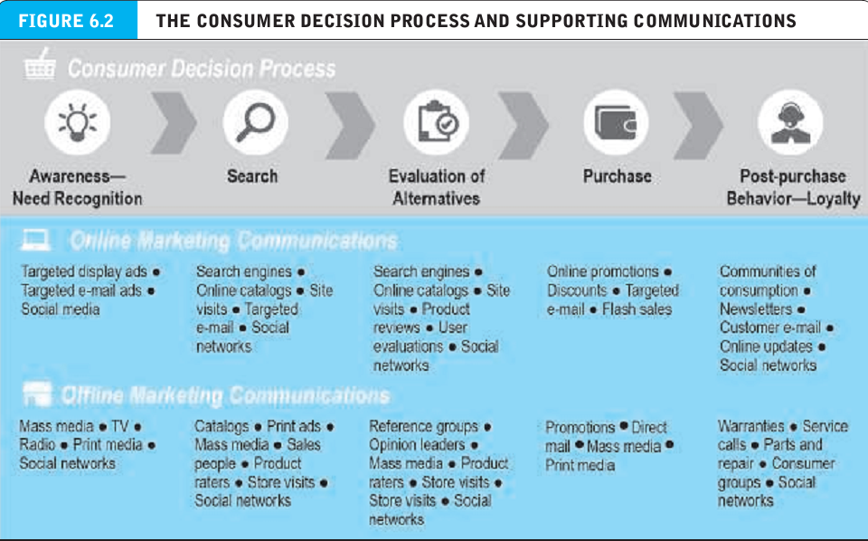
The online purchasing decision

Slide 8
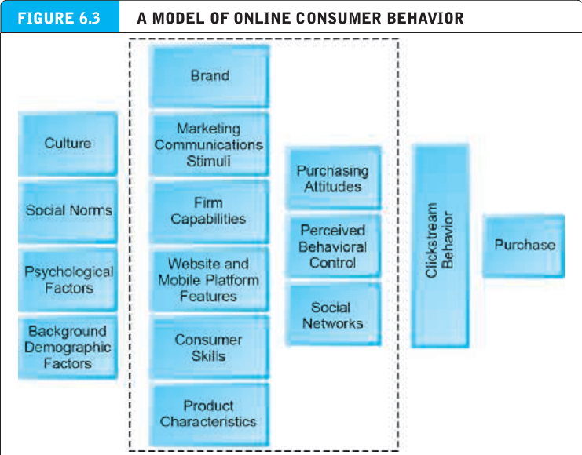
The online purchasing decision

Slide 9
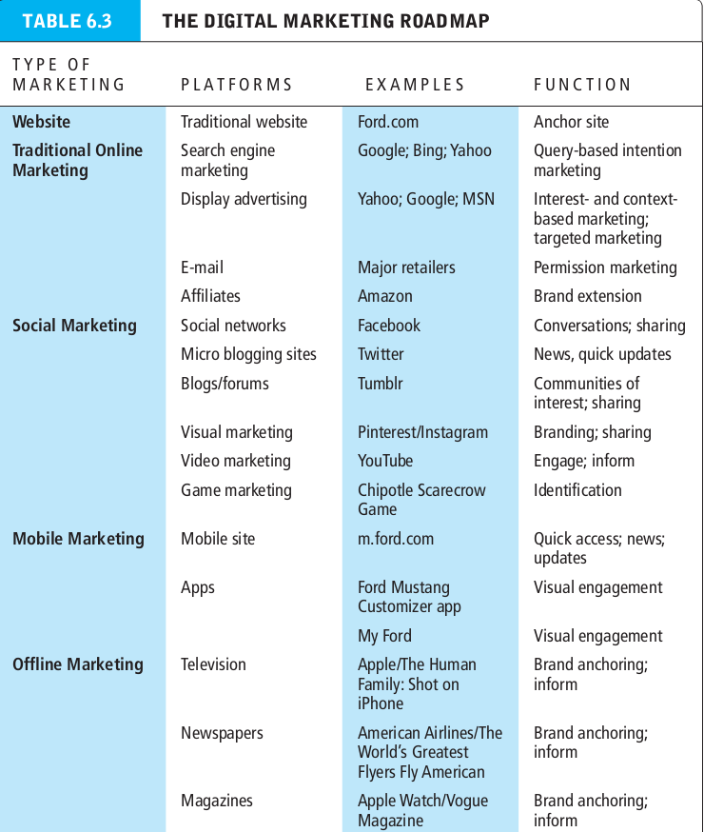
Digital commerce marketing and advertising strategies and tools
Clickstream behavior : the transaction log that consumers establish as they move about the web.

Slide 10
The website as a marketing platform : establishing the customer relationship
Customer experience : the totality of experiences that a customer has with a firm, including the search, informing, purchase, consumption, and after sales support for its products, services and various retail channels.

Slide 11
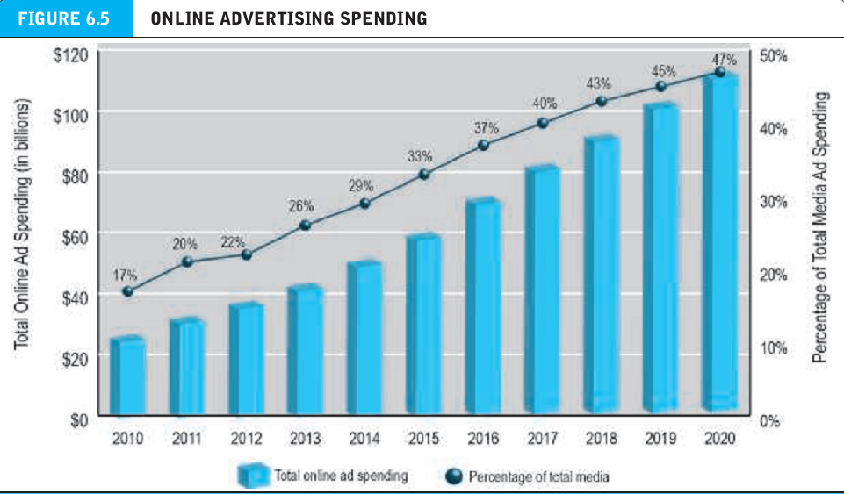
Traditional online marketing and advertising tools
Online advertising : a paid message on a website, online service, or other interactive medium

Slide 12
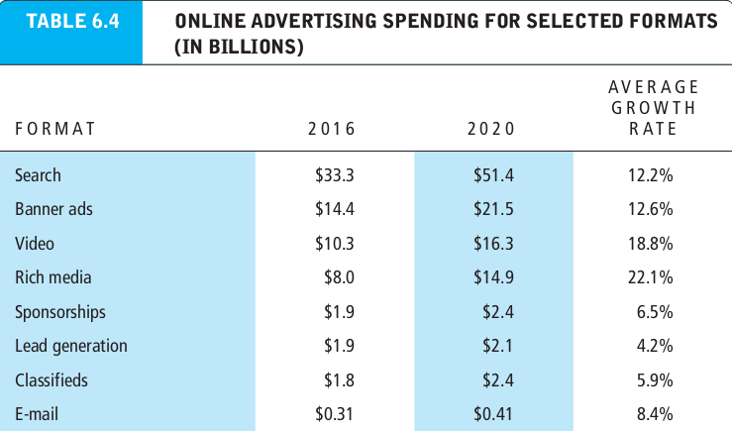
Traditional online marketing and advertising tools
Online advertising : a paid message on a website, online service, or other interactive medium

Slide 13
Traditional online marketing and advertising tools
Ad targeting : the sending of market messages to specific subgroups in the population
Search engine marketing (SEM) : involves the use of search engines to build and sustain brands.
Search engine advertising : involves the use of search engines to support direct sales to online.
Organic search : inclusion and ranking of sites depends on a more or less unbiased application of a set of rules imposed by the search engine.
Paid inclusion : for a fee, guarantees a website’s inclusion in its list of sites, more frequent visits by its web crawler, and suggestions for improving the results of organic searching.

Slide 14
Traditional online marketing and advertising tools
Pay-per-click (PPC)search ad : primary type of search engine advertising.
Keyword advertising : merchants purchase keywords through a bidding process at search sites and whenever a consumer searches for that word, their advertisement shows up somewhere on the page.
Network keyword advertising (context advertising) : publishers accept ads placed by google on their websites, and receive a fee for any click-through from those ads
Search engine optimization (SEO) : techniques to improve the ranking of web pages generated by search engine algorithms

Slide 15
Display ad marketing
Banner ad : displays a promotional message in a rectangular box at the top or bottom of a computer screen.
Rich media ad : ad employing animation, sound and interactivity, using flash, HTML5, java and javascript.
Interstitial ad : a way of placing a fullpage message between the current and destination pages of a user.
Video ad : TV-like advertisement that appears as an in page video commercial or before during, or after content.
Sponsorship : a paid effort to tie an advertiser’s name to information, an event, or a venue in a way that reinforces its brand in a positive yet not overtly commercial manner.
Native advertising : advertising that looks similar to editorial content

Slide 16
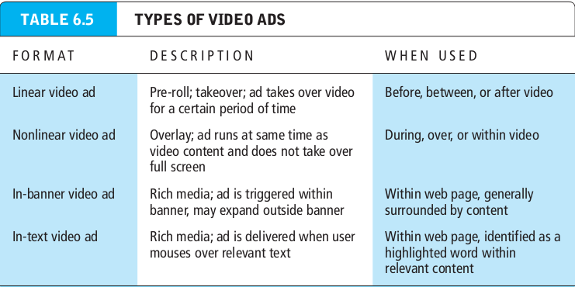
Display ad marketing
Banner ad : displays a promotional message in a rectangular box at the top or bottom of a computer screen.
Rich media ad : ad employing animation, sound and interactivity, using flash, HTML5, java and javascript.
Interstitial ad : a way of placing a fullpage message between the current and destination pages of a user.

Slide 17
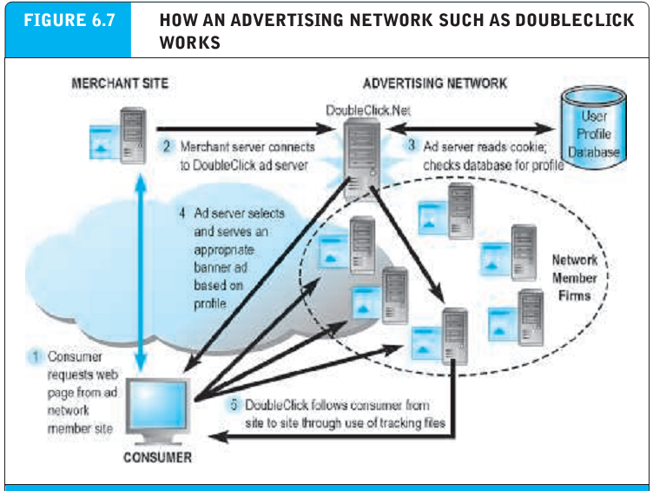
Display ad marketing
Banner ad : displays a promotional message in a rectangular box at the top or bottom of a computer screen.
Rich media ad : ad employing animation, sound and interactivity, using flash, HTML5, java and javascript.
Interstitial ad : a way of placing a fullpage message between the current and destination pages of a user.

Slide 18
Display ad marketing
Advertising networks : connect online marketers with published by displaying ads to consumers based on detailed customer information.
Ad exchanges : auction-based digital marketplace where ad networks sell ad space to marketers.
Programmatic advertising : automated, auction-based method for matching demand and supply for online display ads.
Real-time bidding(RTB)process : used to match advertiser demand for display ads with publisher supply of web page space.
Ad fraud : falsifying web or mobile traffic in order to charge advertisers for impressions, clicks, or other actions that never actually occurred.
Direct e-mail marketing : email marketing messages sent directly to interested users

Slide 19
Display ad marketing
Affiliate marketing : commissions paid by advertisers to affiliate websites for referring potential customers to their websites.
Viral marketing : the process of getting customers to pass along a company’s marketing message to friends, family and colleagues.
Lead generation marketing : uses multiple e-commerce presences to generate leads for businesses who later can be contacted and converted into customers.
One to one marketing (personalization) : segmenting the market based on a precise and timely understanding of an individual’s needs, targeting specific marketing messages to these individuals, and then positioning the product vis a vis competitors to be truly unique.

Slide 20
Display ad marketing
Behavioral targeting : involves using online and offline behavior of consumers to adjust the advertising messages delivered to them online.
Interest-based advertising (IBA) (behavioral targeting) : another name for behavior targeting.
Retargeting : showing the same ad to individuals across multiple websites.
Customization : changing the product, not just the marketing message, according to user preferences.
Customer co-production : in the web environment takes customization one step further by allowing the customer to interactively create the product.

Slide 21
Display ad marketing
Frequently Asked Questions (FAQ) : a text based listing of common questions and answers.
Real time customer service chat systems : a company’s customer service representatives interactively exchange text-based messages with one or more customers on a real time basis.
Automated response system : sends e-mail order confirmations and acknowledgements of e-mailed inquiries

Slide 22
Pricing strategies
Law of one price : with complete price transparency in a perfect information marketplace, there will be one world price for every product.
Pricing : putting a value on goods and services.
Demand curve: the quantity of goods that can be sold at various prices.
Price discrimination : selling products to different people and groups based on their willingness to pay.
Versioning : creating multiple versions of information goods and selling essentially

Slide 23
Pricing strategies
Bundling : offers consumers two or more goods for a reduced price.
Dynamic pricing : the price of the product varies, depending on the demand characteristics of the customer and the supply situation of the seller.
Long tail marketing : a colloquial name given to various statistical distributions characterized by a small number of events of high amplitude and a very large number of events with low amplitude.

Slide 24
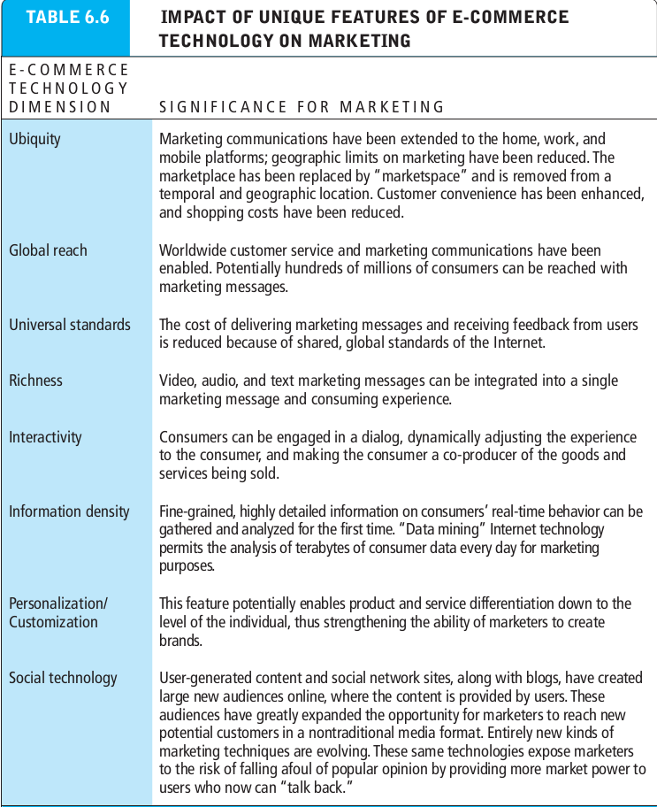
Internet marketing technologies
Bundling : offers consumers two or more goods for a reduced price.
Dynamic pricing : the price of the product varies, depending on the demand characteristics of the customer and the supply situation of the seller.
Long tail marketing : a colloquial name given to various statistical distributions characterized by a small number of events of high amplitude and a very large number of events with low amplitude.

Slide 25
Internet marketing technologies(web transaction logs)
Transaction log : records user activity at a website
Registration forms : gather personal data on name, address, phone, zip code, e-mail address, and other optional self-confessed information on interests and tastes.
Shopping cart database : captures all the item selection, purchase, and payment data.

Slide 26
Supplementing the logs : cookies and other tracking files
Cookie : small text file that websites place on the hard disk of visitors’ client computers that allows the website to store data about the visitor on the computer and later retrieve it.
Deterministic cross device tracking : relies on personally identifiable information such as e-mail address used to log into an app and website on different devices.
Probabilistic cross device tracking : uses algorithms to analyze thousands of anonymous data points to create a possible match.

Slide 27
Databases, data warehouse, data mining and big data
Profiling : uses a variety of tools to create a digital image for each consumer.
Database : a software application that stores records and attributes.
Database management system : a software application used by organization to create maintain, and access databases.
SQL : industry-standard database query language used in relational databases.
Relational databases : represent data as two dimensional tables with records in rows and attributes in columns; data within different tables can be flexibly related as long as the tables share a common data element.

Slide 28
Databases, data warehouse, data mining and big data
Data warehouse : a database that collects a firm’s transactional and customer data in a single location for offline analysis.
Data mining : a set of analytical techniques that look for patterns in the data of database or data warehouse, or seek to model the behavior of customers.
Customer profile : a description of the typical behavior of a customer or a group of customer at a website.
Query-driven data mining : data mining based on specific queries.
Model-driven data mining : involves the use of a model that analyzes the key variables of interest to decision makers.

Slide 29
Databases, data warehouse, data mining and big data
Big data : huge data sets, often from different sources, in the petabyte and Exabyte range.
Hadoop : a software framework for working with various big data sets.

Slide 30
Marketing automation and CRM systems
Marketing automation systems : software tools that marketers use to track all the steps in the lead generation part of the marketing process.
CRM system : a repository of customer information that records all of the contacts that a customer has with a firm and generates a customer profile available to everyone in the firm with a need to “know the customer”
Customer touchpoints : the ways in which customers interact with the firm.

Slide 31
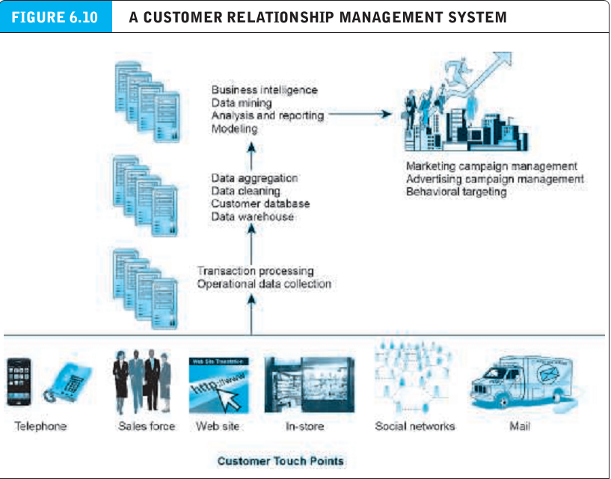
Marketing automation and CRM systems
Marketing automation systems : software tools that marketers use to track all the steps in the lead generation part of the marketing process.
CRM system : a repository of customer information that records all of the contacts that a customer has with a firm and generates a customer profile available to everyone in the firm with a need to “know the customer”
Customer touchpoints : the ways in which customers interact with the firm.

Slide 32
Understanding the costs & benefits of online marketing communications
Impressions : number of times an ad is served.
Click-through rate (CTR) : the percentage of people exposed to an online advertisement who actually click on the banner.
View-through rate (VTR) : measures the 30-day response rate to an ad.
Hits : number of http requests received by a firm’s server.
Page views : number of pages requested by visitors.
Viewability rate : percentage of ads that are actually seen by people online.

Slide 33
Understanding the costs & benefits of online marketing communications
Unique visitors : the number of distinct, unique visitors to a site.
Loyalty : percentage of purchasers who return in a year.
Reach : percentage of the total number of consumers in a market who will visit a site.
Recency : average number of days elapsed between visits.
Stickness (duration) : average length of time visitors remain at a site.
Acquisition rate : percentage of visitors who register or visit product pages.

Slide 34
Understanding the costs & benefits of online marketing communications
Conversion rate : percentage of visitors who purchase something.
Browse-to-buy ratio : ratio of items purchased to product views.
View to cart ratio : ratio of “add to cart” clicks to product views.
Cart conversion rate : ratio of actual orders to “add to cart” clicks.
Checkout conversion rate : ratio of actual order to checkouts started.
Abandonment rate : % of shoppers who begin a shopping cart, but then fail to complete it.

Slide 35
Understanding the costs & benefits of online marketing communications
Retention rate : % of existing customers who continue to buy.
Attrition rate : % of customers who purchase once, but do not return within a year.
View time : how long the video ad actually stays in view while it plays.
Completion rate : how many viewers watch the complete video ad.
Open rate : % of customers who open e-mail.
Delivery rate : % of e-mail recipients who received e-mail.

Slide 36
Understanding the costs & benefits of online marketing communications
Click-through rate (e-mail) : % of e-mail recipients who clicked through to the offer.
Bounce-back rate : percentage of e-mails that could not be delivered.

Slide 37
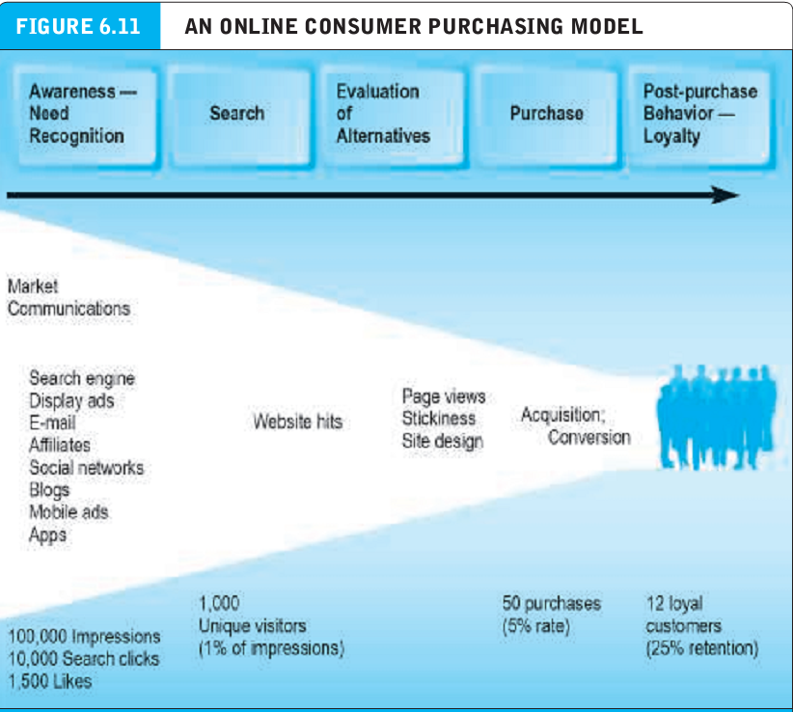
Understanding the costs & benefits of online marketing communications
Click-through rate (e-mail) : % of e-mail recipients who clicked through to the offer.
Bounce-back rate : percentage of e-mails that could not be delivered.

Slide 38
How well does online advertising work?
Cross-platform attribution : understanding how to assign appropriate credit to different marketing initiatives that may have influenced a consumer on the way to a purchase.

Slide 39
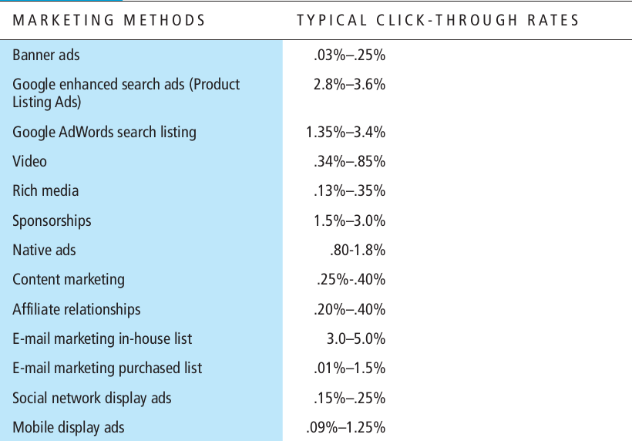
How well does online advertising work?
Cross-platform attribution : understanding how to assign appropriate credit to different marketing initiatives that may have influenced a consumer on the way to a purchase.

