Slide 1
UPN “VETERAN” YOGYAKARTA
E-Commerce
Chapter 10
Hari Prapcoyo,S.Kom., M.ICT
Sistem Informasi

Slide 2
Online contenct and media
Learning objective:
Understand the major trends in the consumption of media and online content, the major revenue models for digital content delivery, digital rights management, and the concept of media convergence.
Understand the key factors affecting the online publishing industry.
Understand the key factors affecting the online entertainment industry.

Slide 3
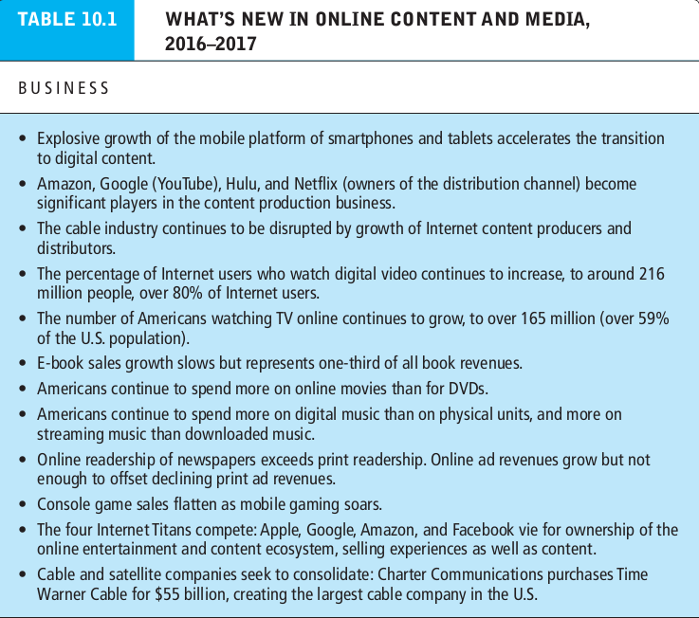
Online content
What’s the idea? (the visioning process)
Where’s the money: business and revenue model.
Who and where is the target audience?
Characterize the marketplace
Where’s the content coming from?

Slide 4
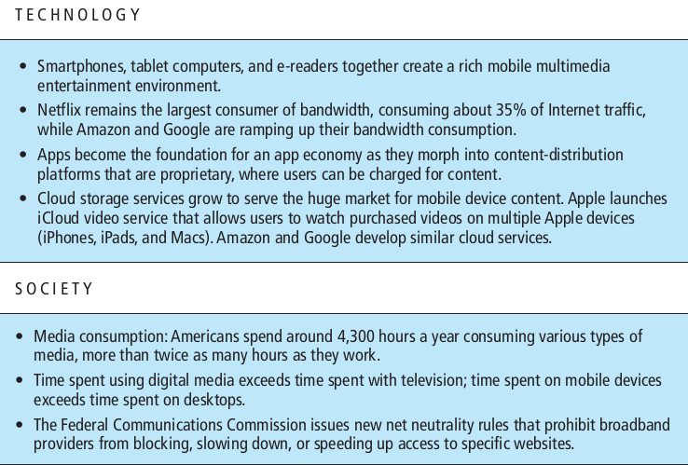
Online content
What’s the idea? (the visioning process)
Where’s the money: business and revenue model.
Who and where is the target audience?
Characterize the marketplace
Where’s the content coming from?

Slide 5
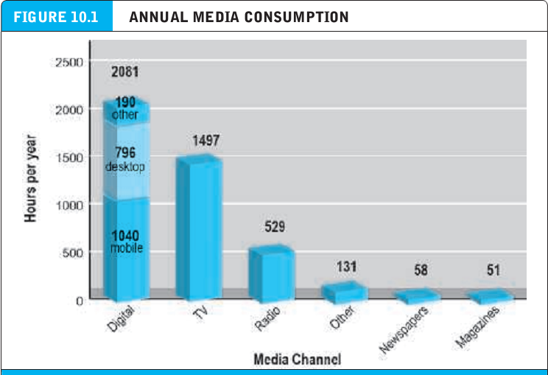
Online content
What’s the idea? (the visioning process)
Where’s the money: business and revenue model.
Who and where is the target audience?
Characterize the marketplace
Where’s the content coming from?

Slide 6
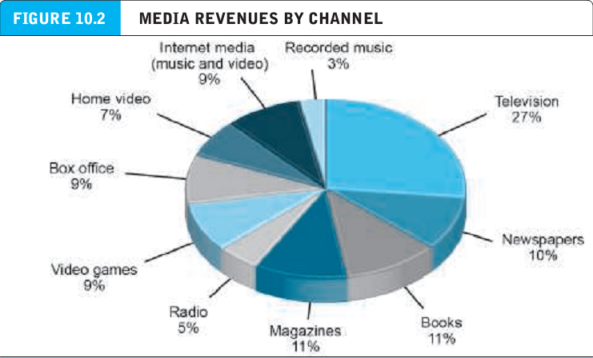
Online content
What’s the idea? (the visioning process)
Where’s the money: business and revenue model.
Who and where is the target audience?
Characterize the marketplace
Where’s the content coming from?

Slide 7
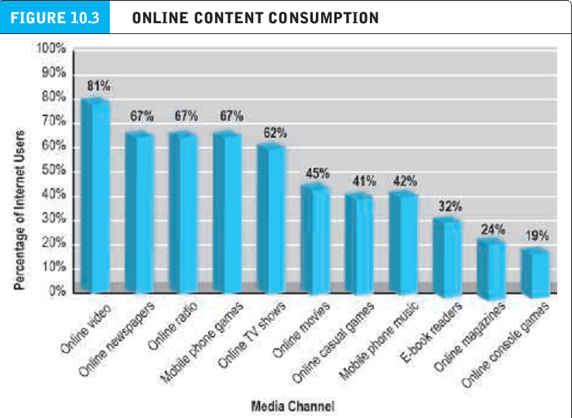
Online content
What’s the idea? (the visioning process)
Where’s the money: business and revenue model.
Who and where is the target audience?
Characterize the marketplace
Where’s the content coming from?

Slide 8
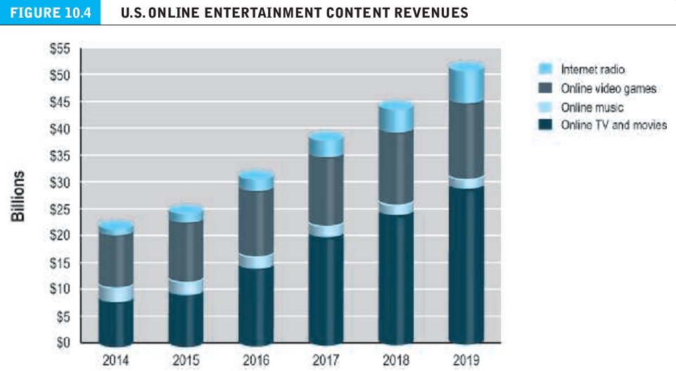
Online content
What’s the idea? (the visioning process)
Where’s the money: business and revenue model.
Who and where is the target audience?
Characterize the marketplace
Where’s the content coming from?

Slide 9
Media convergence:technology, content, and industry structure.
Technological convergence : development of hybrid devices that can combine the functionality of two or more existing media platforms into a single device.
Content convergence : convergence in the design production, and distribution of content.
Industry convergence : merger of media enterprises into synergistic combinations that create and cross market content on different platforms.

Slide 10
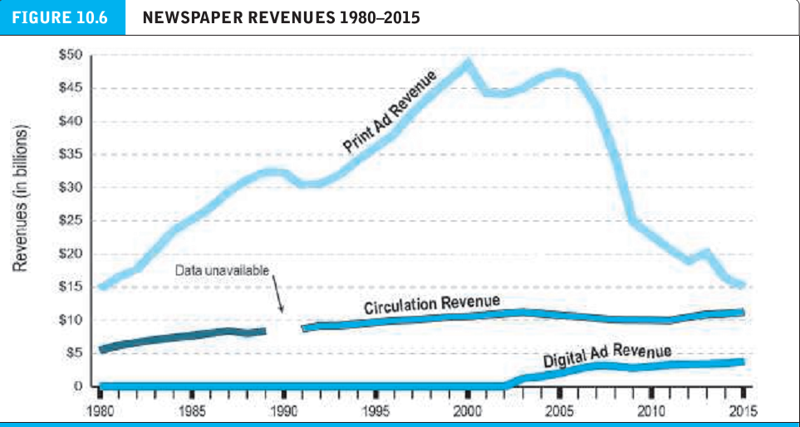
The online publishing industry
Technological convergence : development of hybrid devices that can combine the functionality of two or more existing media platforms into a single device.
Content convergence : convergence in the design production, and distribution of content.
Industry convergence : merger of media enterprises into synergistic combinations that create and cross market content on different platforms.

Slide 11
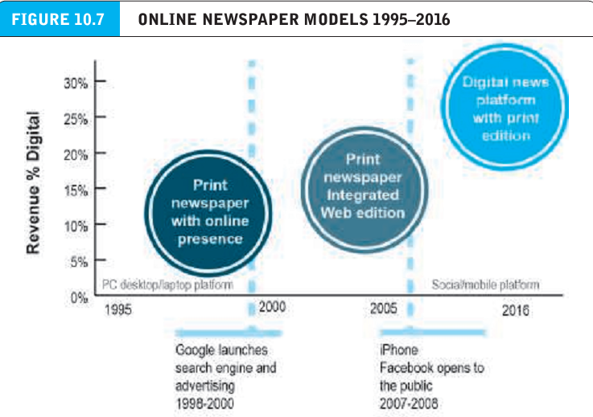
The online publishing industry
Instant articles : a new facebook feature that inserts selected articles from mainstream new outlets in a user’s news feed.

Slide 12
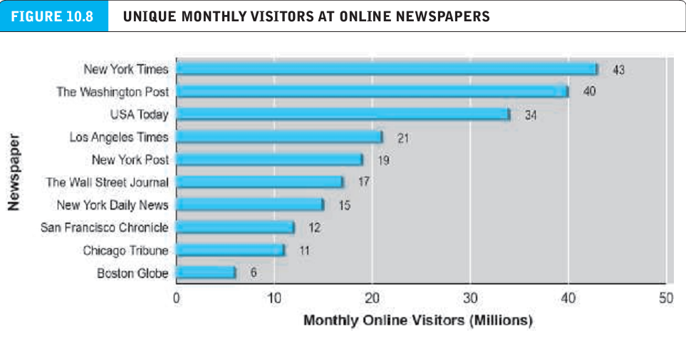
The online publishing industry
Instant articles : a new facebook feature that inserts selected articles from mainstream new outlets in a user’s news feed.

Slide 13
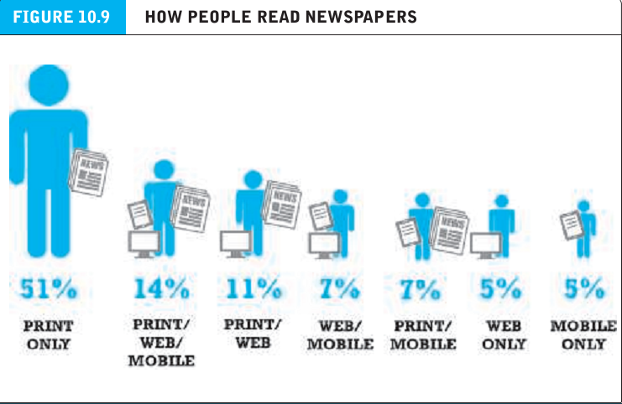
The online publishing industry
Instant articles : a new facebook feature that inserts selected articles from mainstream new outlets in a user’s news feed.

Slide 14
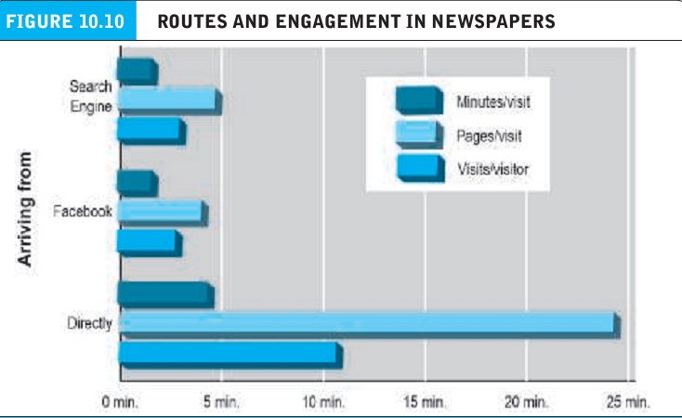
The online publishing industry
Instant articles : a new facebook feature that inserts selected articles from mainstream new outlets in a user’s news feed.

Slide 15
The online publishing industry
Paywall : paid subscription service.
Metered subscription : provides access to a limited number of articles fro free, but requires payment of a subscription fee

Slide 16
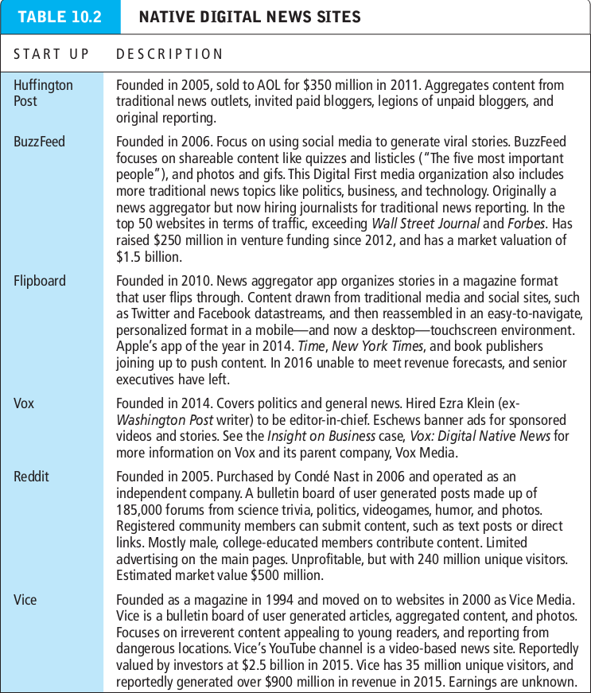
The online publishing industry
Paywall : paid subscription service.
Metered subscription : provides access to a limited number of articles fro free, but requires payment of a subscription fee

Slide 17
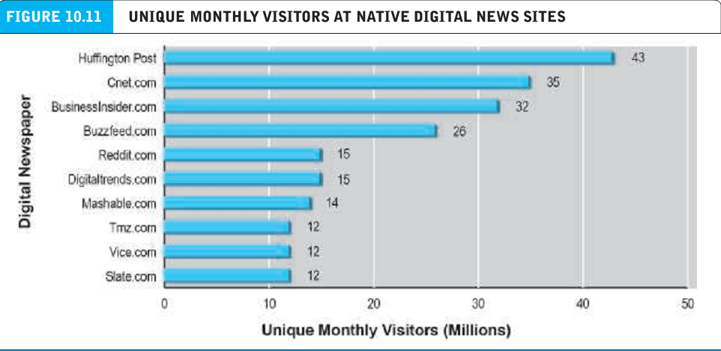
The online publishing industry
Paywall : paid subscription service.
Metered subscription : provides access to a limited number of articles fro free, but requires payment of a subscription fee

Slide 18
The online publishing industry
Magazine aggregator : a websites or app that provides subscriptions and sales of many digital magazines.
E-books and online book publishing
Wholesale model : prices are determined by the retailer.
Agency model : the retailer is an agent and prices are set by the manufacturer.

Slide 19
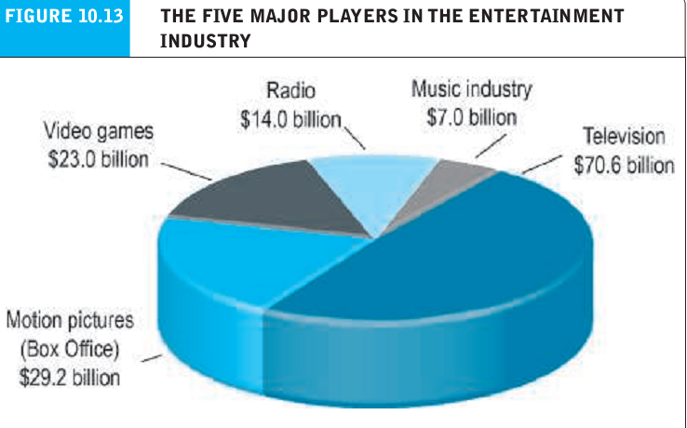
The online publishing industry
Magazine aggregator : a websites or app that provides subscriptions and sales of many digital magazines.
E-books and online book publishing
Wholesale model : prices are determined by the retailer.
Agency model : the retailer is an agent and prices are set by the manufacturer.

Slide 20
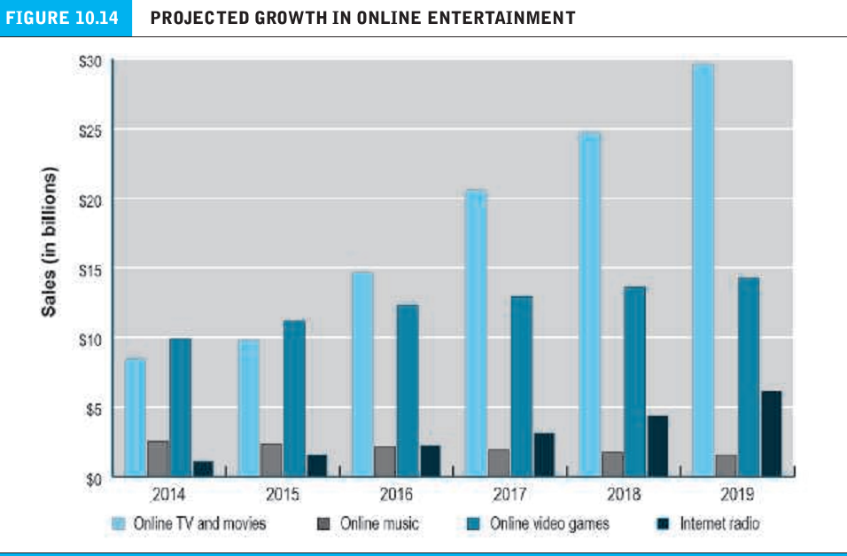
Online entertainment market size and growth
Magazine aggregator : a websites or app that provides subscriptions and sales of many digital magazines.
E-books and online book publishing
Wholesale model : prices are determined by the retailer.
Agency model : the retailer is an agent and prices are set by the manufacturer.

Slide 21
Online entertainment market size and growth
Linear tv : watching a television series in installments over an entire season
Binge watching : watching a television series in its entirely in single or multiple sittings in a brief period of time.
Social tv : involves consumers sharing comments via social networks while viewing television.
Over the top (OTT) : use of the internet to deliver entertainment services to the home on cable TV or FIOS networks.

Slide 22
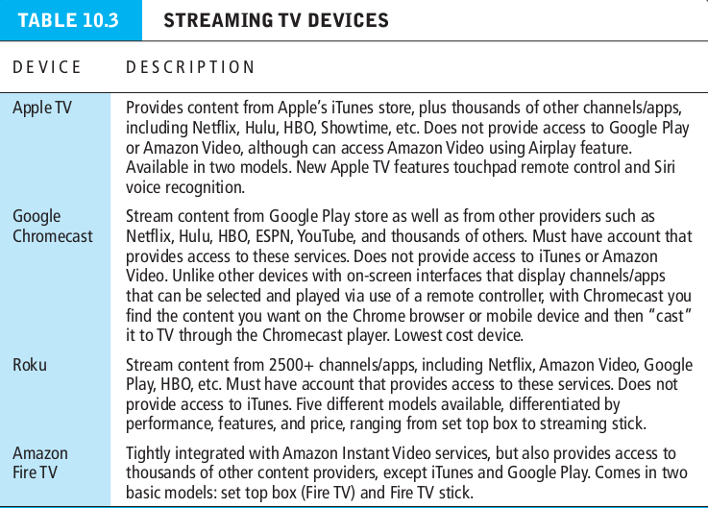
Online entertainment market size and growth
Linear tv : watching a television series in installments over an entire season
Binge watching : watching a television series in its entirely in single or multiple sittings in a brief period of time.

Slide 23
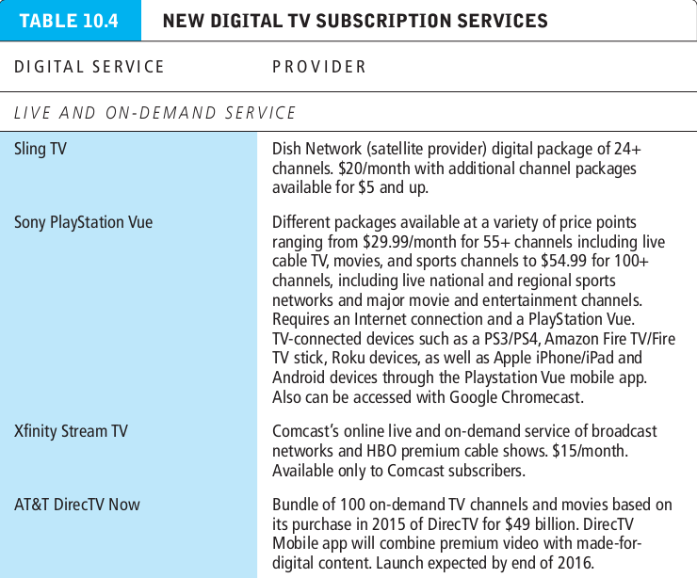
Online entertainment market size and growth
Linear tv : watching a television series in installments over an entire season
Binge watching : watching a television series in its entirely in single or multiple sittings in a brief period of time.

Slide 24
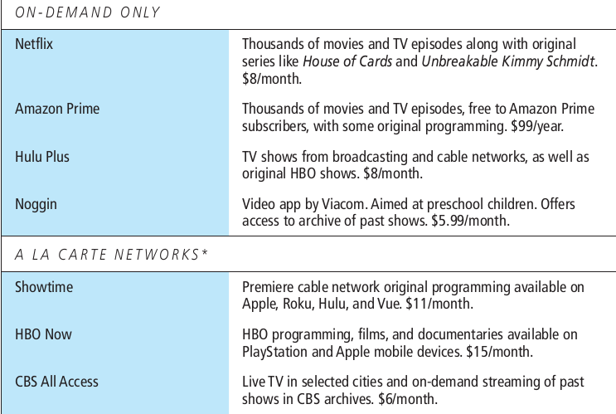
Online entertainment market size and growth
Linear tv : watching a television series in installments over an entire season
Binge watching : watching a television series in its entirely in single or multiple sittings in a brief period of time.

