Slide 1
UPN “VETERAN” YOGYAKARTA
E-Commerce
Chapter 7
Hari Prapcoyo,S.Kom., M.ICT
Sistem Informasi

Slide 2
Social, mobile, and local marketing
Learning objective:
Understanding the difference between traditional online marketing and new social mobile marketing platforms and the relationships between social, mobile, and local marketing.
The social marketing process from fan acquisition to sales and the marketing capabilities of social marketing platforms
The key elements of a mobile marketing campaign
The capabilities of location based local marketing.

Slide 3
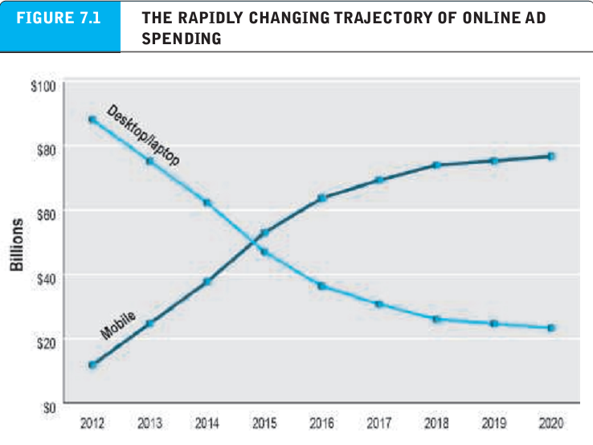
Introduction to social, mobile and local marketing
What’s the idea? (the visioning process)
Where’s the money: business and revenue model.
Who and where is the target audience?
Characterize the marketplace
Where’s the content coming from?

Slide 4
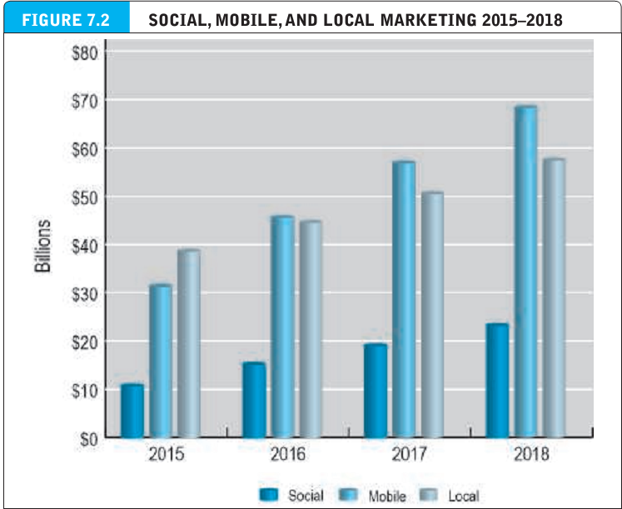
Introduction to social, mobile and local marketing
What’s the idea? (the visioning process)
Where’s the money: business and revenue model.
Who and where is the target audience?
Characterize the marketplace
Where’s the content coming from?

Slide 5
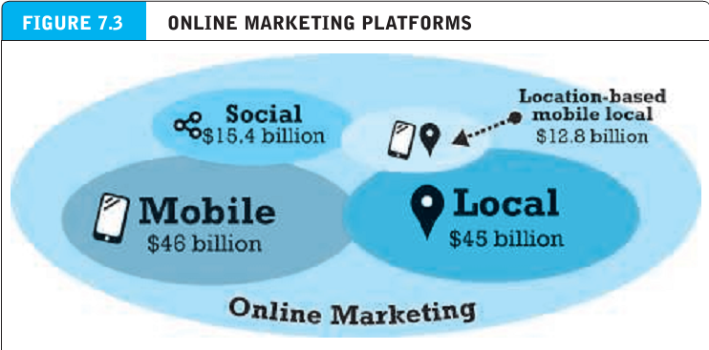
Introduction to social, mobile and local marketing
What’s the idea? (the visioning process)
Where’s the money: business and revenue model.
Who and where is the target audience?
Characterize the marketplace
Where’s the content coming from?

Slide 6
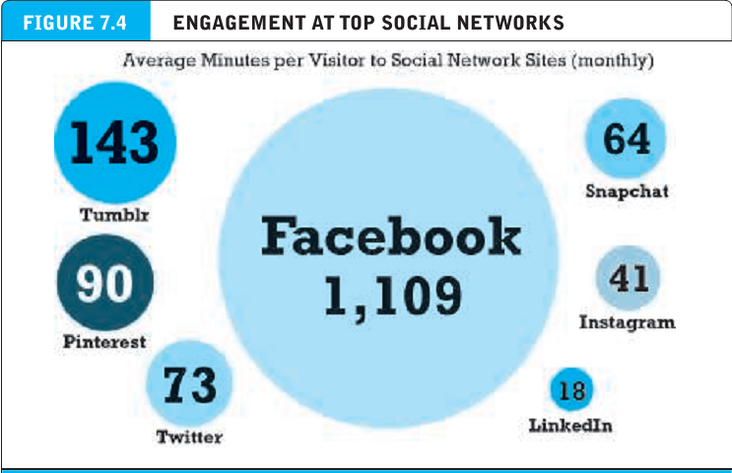
Social marketing
What’s the idea? (the visioning process)
Where’s the money: business and revenue model.
Who and where is the target audience?
Characterize the marketplace
Where’s the content coming from?

Slide 7
Social marketing players
Dark social : those forms of social sharing that occurs off the major social networks, through alternative communication tools such as e-mail, instant messages, texts and mobile messaging apps.

Slide 8
The social marketing process
Fan acquisition : attracting people to your marketing messages.
Engagement : encouraging visitors to interact with your content and brand.
Amplification : encouraging visitors to share their likes and comments with their friends.
Community : a stable group of fans engaged and communication with one another over a substantial period of time about your brand.

Slide 9
Facebook marketing
Social density : refers to the number of interactions among members of a group and reflects the “connectedness” of a group, even if these connections are forced on users.
Reaction buttons : gives users a chance to share their feelings about content and other objects they are viewing.
Facebook exchange (FBX) : a real-time bidding system that allows advertiser to target their ads based on personal information provided by facebook.

Slide 10
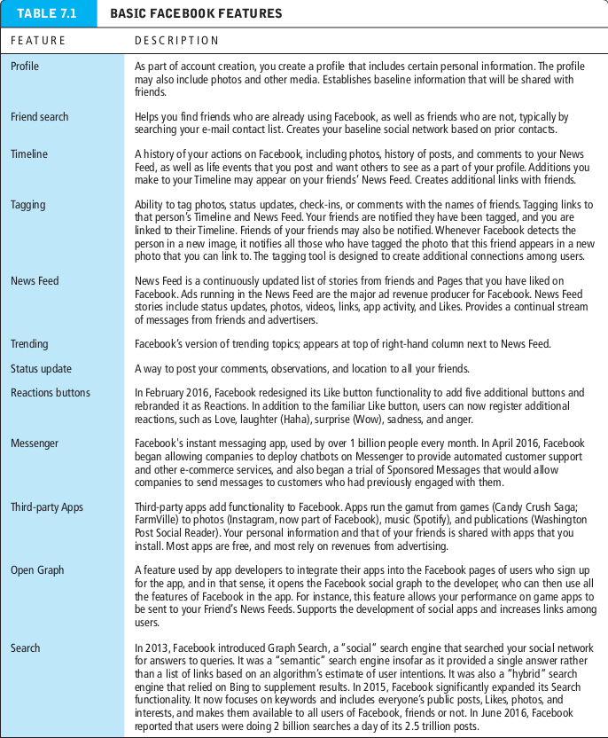
Facebook marketing
Social density : refers to the number of interactions among members of a group and reflects the “connectedness” of a group, even if these connections are forced on users.
Reaction buttons : gives users a chance to share their feelings about content and other objects they are viewing.
Facebook exchange (FBX) : a real-time bidding system that allows advertiser to target their ads based on personal information provided by facebook.

Slide 11
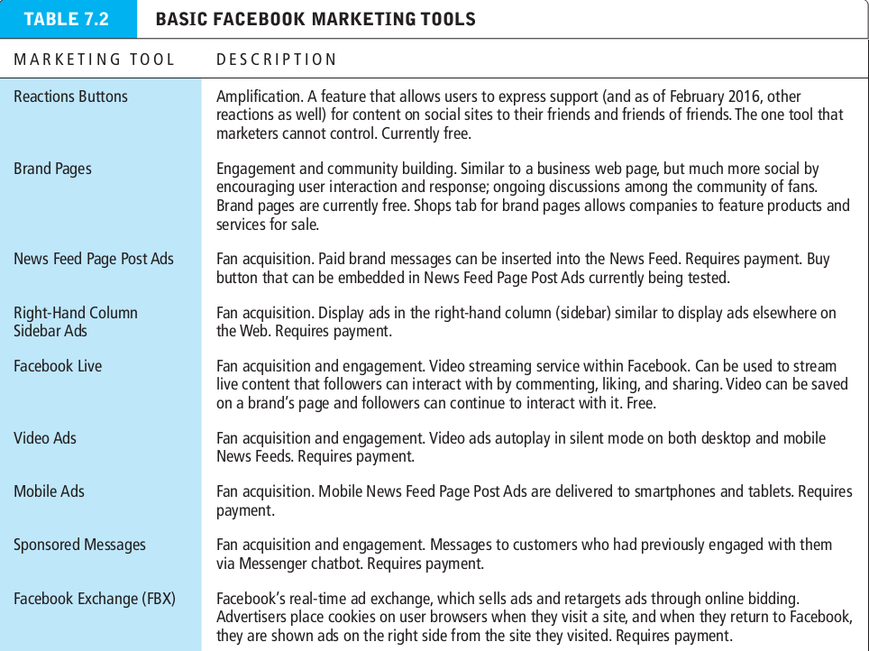
Facebook marketing
Social density : refers to the number of interactions among members of a group and reflects the “connectedness” of a group, even if these connections are forced on users.
Reaction buttons : gives users a chance to share their feelings about content and other objects they are viewing.
Facebook exchange (FBX) : a real-time bidding system that allows advertiser to target their ads based on personal information provided by facebook.

Slide 12
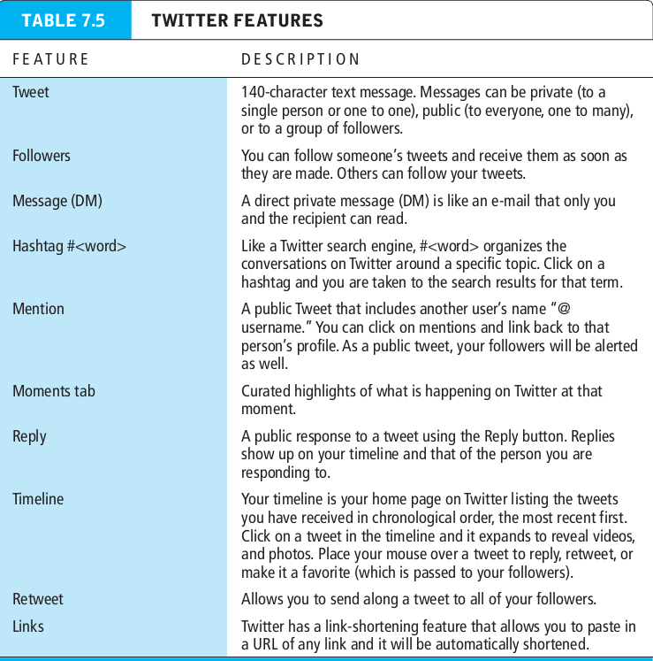
Twitter marketing
Social density : refers to the number of interactions among members of a group and reflects the “connectedness” of a group, even if these connections are forced on users.
Reaction buttons : gives users a chance to share their feelings about content and other objects they are viewing.
Facebook exchange (FBX) : a real-time bidding system that allows advertiser to target their ads based on personal information provided by facebook.

Slide 13
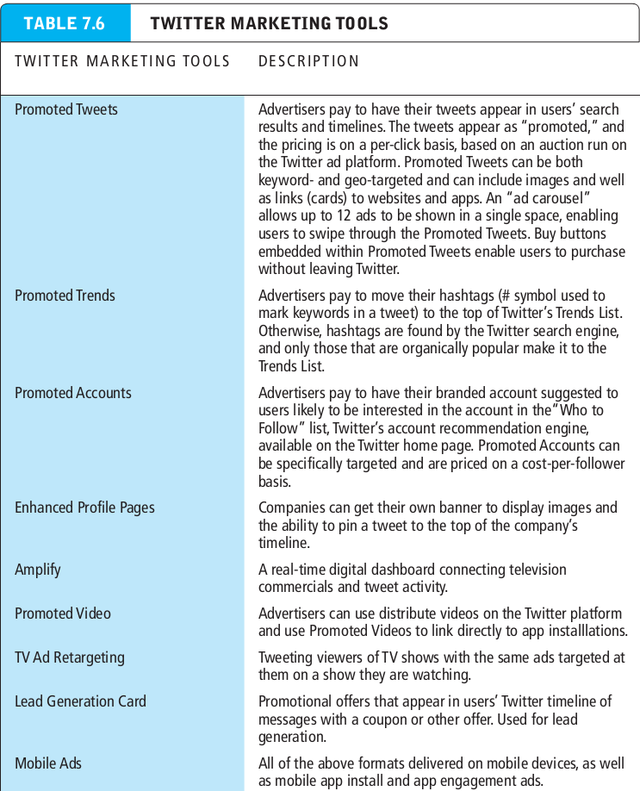
Twitter marketing
Social density : refers to the number of interactions among members of a group and reflects the “connectedness” of a group, even if these connections are forced on users.
Reaction buttons : gives users a chance to share their feelings about content and other objects they are viewing.
Facebook exchange (FBX) : a real-time bidding system that allows advertiser to target their ads based on personal information provided by facebook.

Slide 14
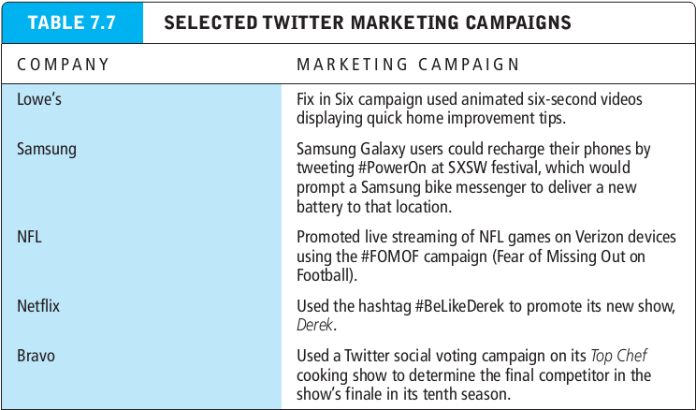
Twitter marketing
Social density : refers to the number of interactions among members of a group and reflects the “connectedness” of a group, even if these connections are forced on users.
Reaction buttons : gives users a chance to share their feelings about content and other objects they are viewing.
Facebook exchange (FBX) : a real-time bidding system that allows advertiser to target their ads based on personal information provided by facebook.

Slide 15
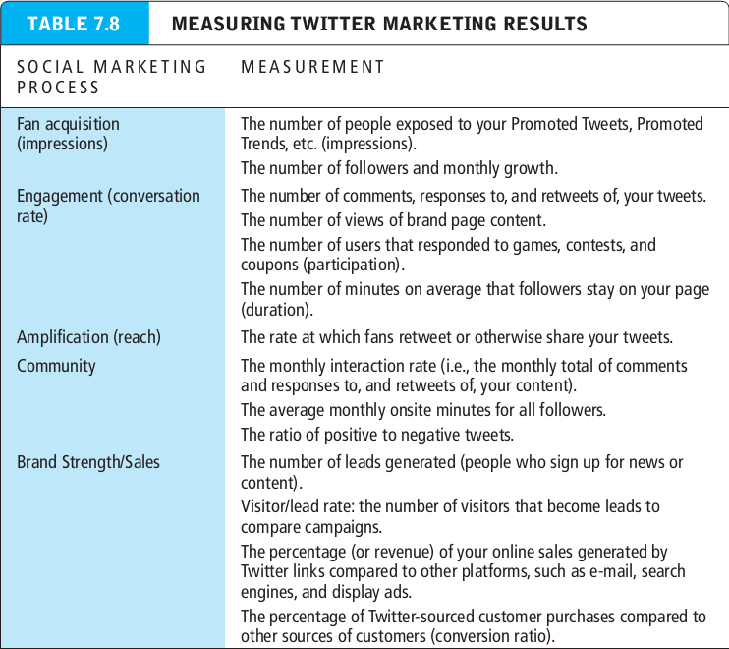
Twitter marketing
Social density : refers to the number of interactions among members of a group and reflects the “connectedness” of a group, even if these connections are forced on users.
Reaction buttons : gives users a chance to share their feelings about content and other objects they are viewing.
Facebook exchange (FBX) : a real-time bidding system that allows advertiser to target their ads based on personal information provided by facebook.

Slide 16
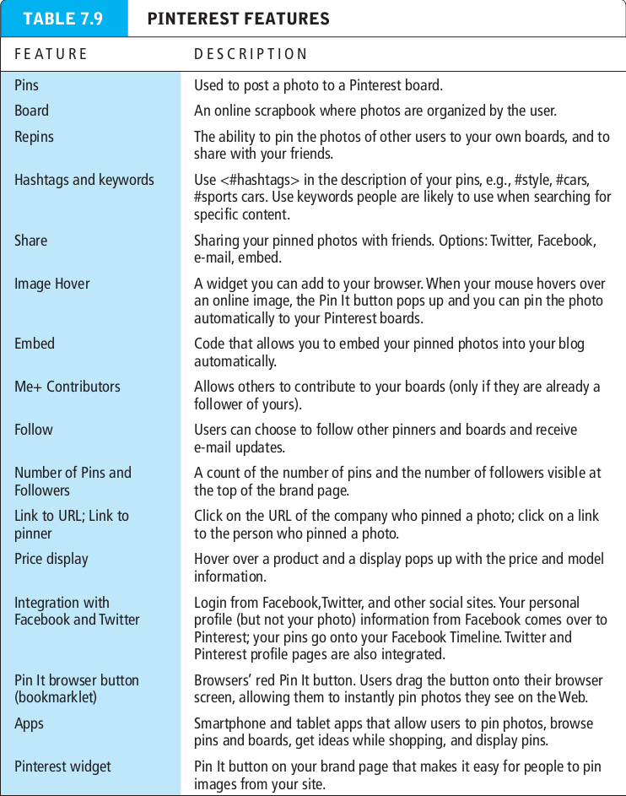
Pinterest marketing
Social density : refers to the number of interactions among members of a group and reflects the “connectedness” of a group, even if these connections are forced on users.
Reaction buttons : gives users a chance to share their feelings about content and other objects they are viewing.
Facebook exchange (FBX) : a real-time bidding system that allows advertiser to target their ads based on personal information provided by facebook.

Slide 17
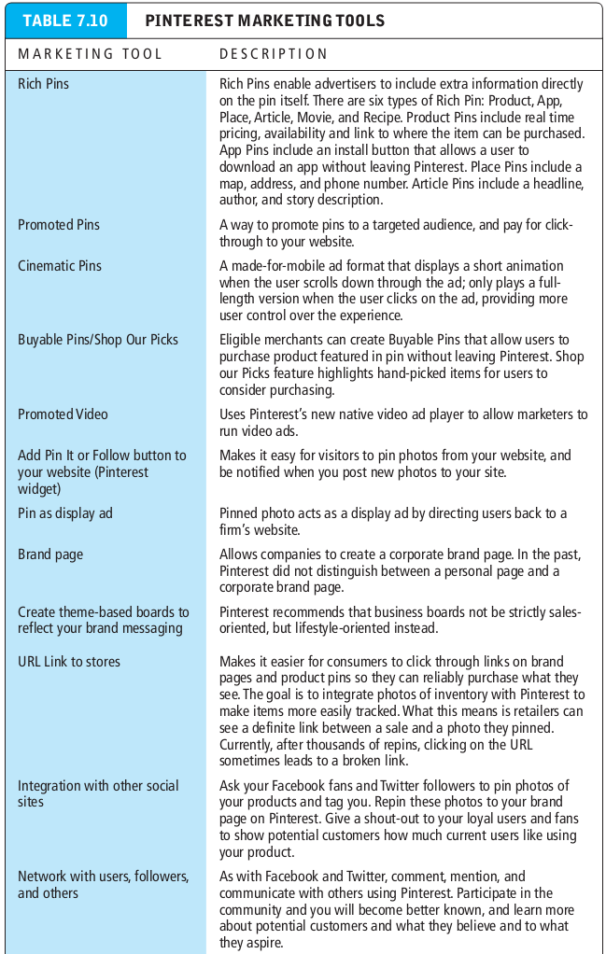
Twitter marketing
Social density : refers to the number of interactions among members of a group and reflects the “connectedness” of a group, even if these connections are forced on users.
Reaction buttons : gives users a chance to share their feelings about content and other objects they are viewing.
Facebook exchange (FBX) : a real-time bidding system that allows advertiser to target their ads based on personal information provided by facebook.

Slide 18
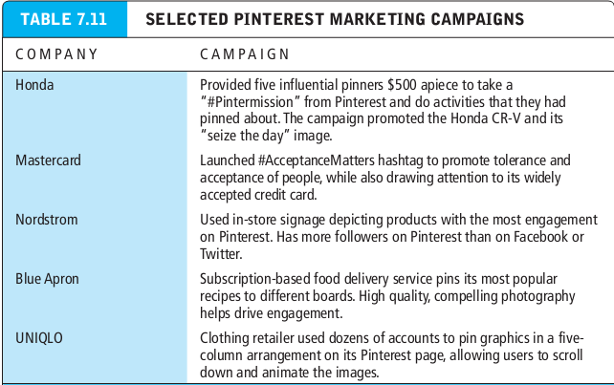
Twitter marketing
Social density : refers to the number of interactions among members of a group and reflects the “connectedness” of a group, even if these connections are forced on users.
Reaction buttons : gives users a chance to share their feelings about content and other objects they are viewing.
Facebook exchange (FBX) : a real-time bidding system that allows advertiser to target their ads based on personal information provided by facebook.

Slide 19
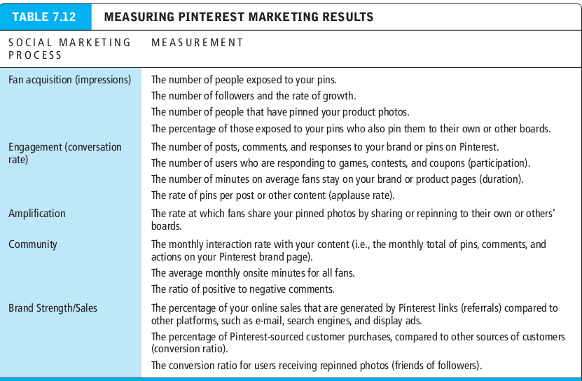
Marketing on other social networks
Social density : refers to the number of interactions among members of a group and reflects the “connectedness” of a group, even if these connections are forced on users.
Reaction buttons : gives users a chance to share their feelings about content and other objects they are viewing.
Facebook exchange (FBX) : a real-time bidding system that allows advertiser to target their ads based on personal information provided by facebook.

Slide 20
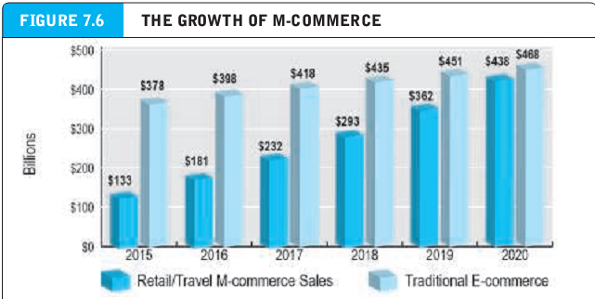
Mobile marketing
Social density : refers to the number of interactions among members of a group and reflects the “connectedness” of a group, even if these connections are forced on users.
Reaction buttons : gives users a chance to share their feelings about content and other objects they are viewing.
Facebook exchange (FBX) : a real-time bidding system that allows advertiser to target their ads based on personal information provided by facebook.

Slide 21
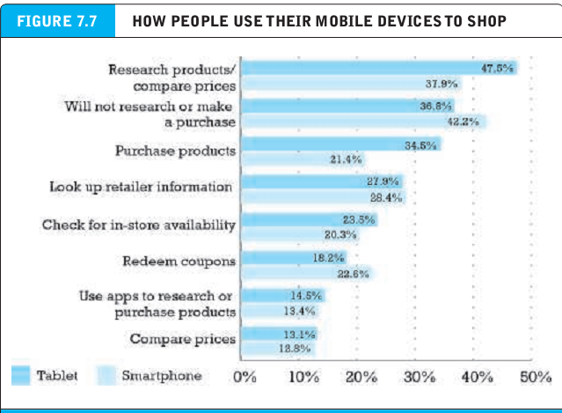
Mobile marketing
Social density : refers to the number of interactions among members of a group and reflects the “connectedness” of a group, even if these connections are forced on users.
Reaction buttons : gives users a chance to share their feelings about content and other objects they are viewing.
Facebook exchange (FBX) : a real-time bidding system that allows advertiser to target their ads based on personal information provided by facebook.

Slide 22
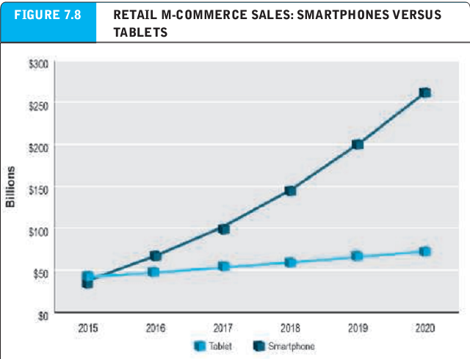
Mobile marketing
Social density : refers to the number of interactions among members of a group and reflects the “connectedness” of a group, even if these connections are forced on users.
Reaction buttons : gives users a chance to share their feelings about content and other objects they are viewing.
Facebook exchange (FBX) : a real-time bidding system that allows advertiser to target their ads based on personal information provided by facebook.

Slide 23
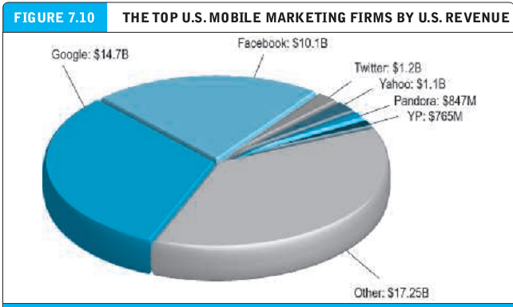
Mobile marketing
Social density : refers to the number of interactions among members of a group and reflects the “connectedness” of a group, even if these connections are forced on users.
Reaction buttons : gives users a chance to share their feelings about content and other objects they are viewing.
Facebook exchange (FBX) : a real-time bidding system that allows advertiser to target their ads based on personal information provided by facebook.

Slide 24
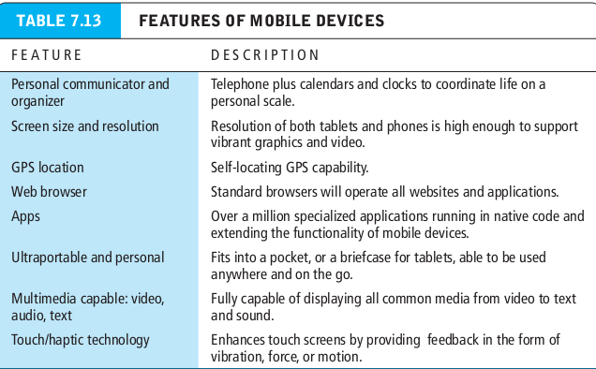
Mobile marketing tools : ad formats
Social density : refers to the number of interactions among members of a group and reflects the “connectedness” of a group, even if these connections are forced on users.
Reaction buttons : gives users a chance to share their feelings about content and other objects they are viewing.
Facebook exchange (FBX) : a real-time bidding system that allows advertiser to target their ads based on personal information provided by facebook.

Slide 25
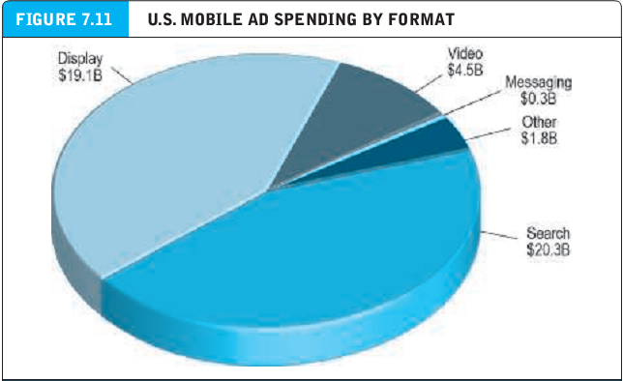
Mobile marketing tools : ad formats
Social density : refers to the number of interactions among members of a group and reflects the “connectedness” of a group, even if these connections are forced on users.
Reaction buttons : gives users a chance to share their feelings about content and other objects they are viewing.
Facebook exchange (FBX) : a real-time bidding system that allows advertiser to target their ads based on personal information provided by facebook.

Slide 26
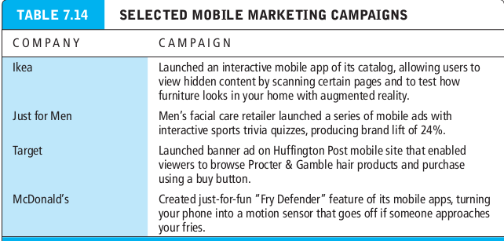
Mobile marketing tools : ad formats
Social density : refers to the number of interactions among members of a group and reflects the “connectedness” of a group, even if these connections are forced on users.
Reaction buttons : gives users a chance to share their feelings about content and other objects they are viewing.
Facebook exchange (FBX) : a real-time bidding system that allows advertiser to target their ads based on personal information provided by facebook.

Slide 27
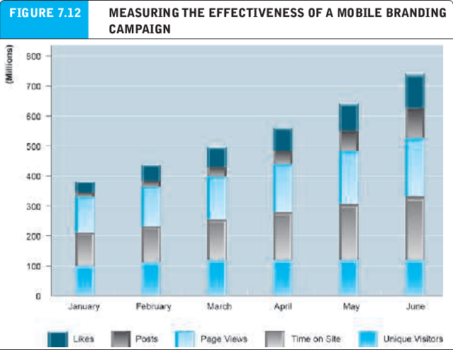
Measuring mobile marketing results
Social density : refers to the number of interactions among members of a group and reflects the “connectedness” of a group, even if these connections are forced on users.
Reaction buttons : gives users a chance to share their feelings about content and other objects they are viewing.
Facebook exchange (FBX) : a real-time bidding system that allows advertiser to target their ads based on personal information provided by facebook.

Slide 28
Local and location based mobile marketing
Location-based marketing : targets marketing messages to users based on their location
Location-based services : involve providing services to users based on their location.

Slide 29
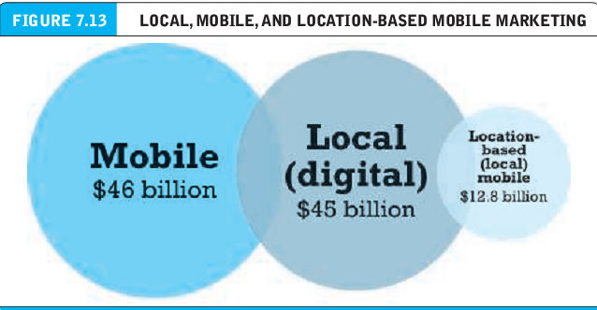
Local and location based mobile marketing

Slide 30
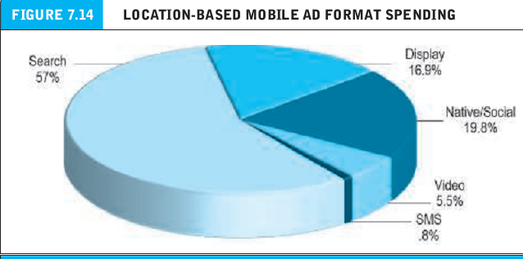
Local and location based mobile marketing

Slide 31
Location based marketing platforms : the technologies
Geo-aware : techniques that identify the location of a user’s device and then target marketing to the device.
Proximity marketing : techniques that identify a perimeter around a physical location, and then target ads to users within the perimeter, recommending actions possible within the fenced-in area.

Slide 32
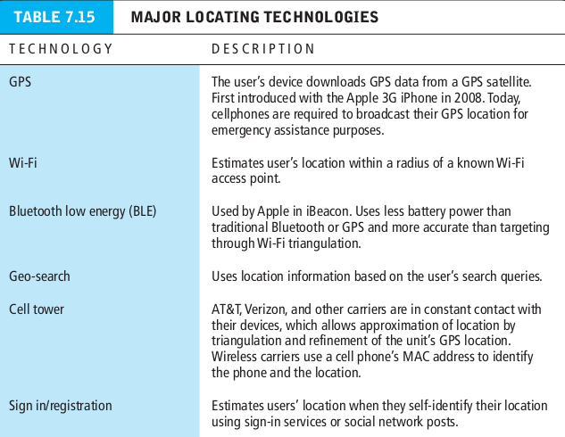
Location based marketing platforms : the technologies
Geo-aware : techniques that identify the location of a user’s device and then target marketing to the device.
Proximity marketing : techniques that identify a perimeter around a physical location, and then target ads to users within the perimeter, recommending actions possible within the fenced-in area.

Slide 33
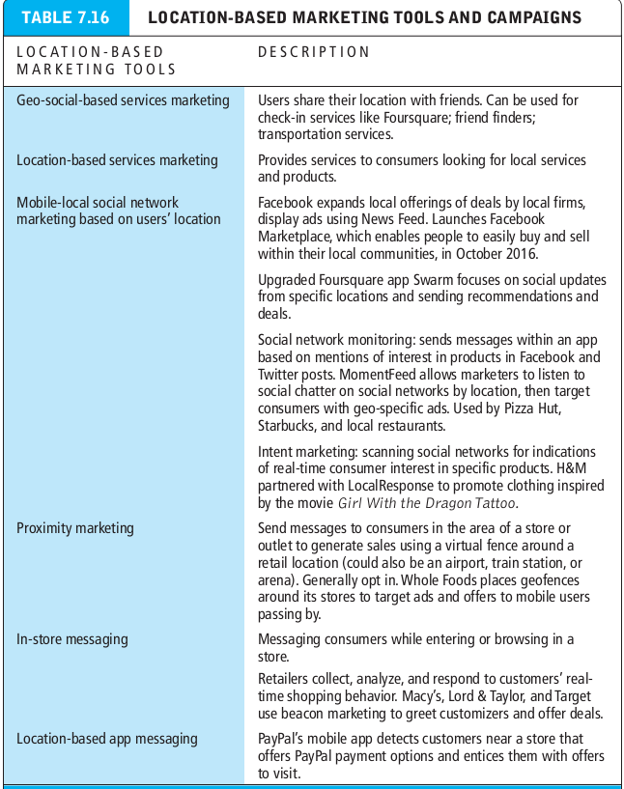
Location based marketing platforms : the technologies
Geo-aware : techniques that identify the location of a user’s device and then target marketing to the device.
Proximity marketing : techniques that identify a perimeter around a physical location, and then target ads to users within the perimeter, recommending actions possible within the fenced-in area.

Slide 34
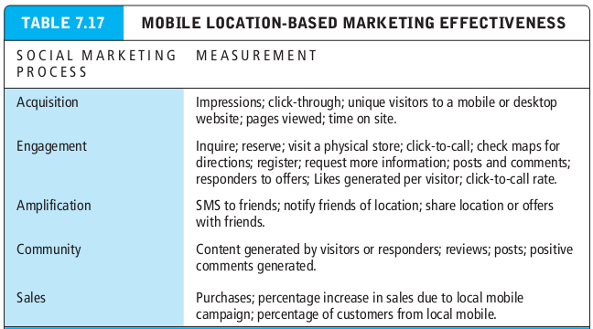
Measuring location-based marketing results
Geo-aware : techniques that identify the location of a user’s device and then target marketing to the device.
Proximity marketing : techniques that identify a perimeter around a physical location, and then target ads to users within the perimeter, recommending actions possible within the fenced-in area.

