Slide 1
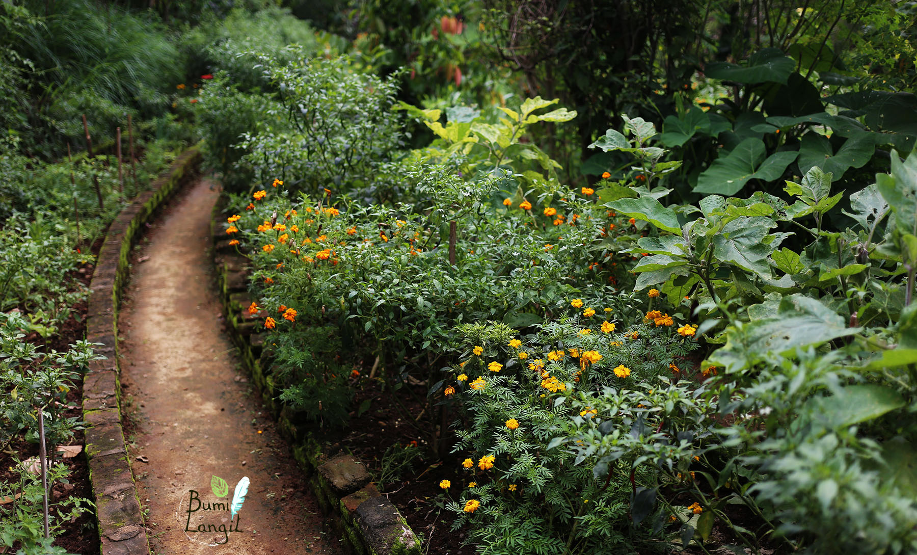
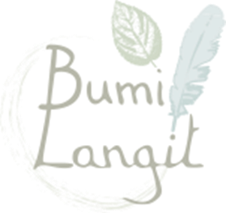
Introduction to Permaculture
A design science for sustainable land use

Slide 2
- Filsafat dan gaya hidup berkelanjutan yang menggabungkan komponen-komponen:
* Pengetahuan ekologis
Design produksi
Teknologi Tepat Guna ramah lingkungan
Budaya setempat
Merupakan pengelolaan pertanian dan peternakan yang dapat meningkatkan kualitas lahan agar memberikan hasil bumi dan pendapatan serta tetap berkelanjutan hingga masa depan.
Integrasi harmonis alam, binatang dan manusia dengan menerapkan teknologi yang sesuai untuk menghindari rusaknya alam dan punahnya habitas berbagai spesies
Perusak >>> manusia >>> mind set dan aktivitasnya harus dirubah >>> perhatikan lingkungan dan budaya

Slide 3
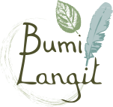
Permaculture [Per·ma·kul·tur] noun from roots words ‘Permanent Agriculture’ & ‘Permanent Culture’
“The core of Permaculture is design based on the working relationships and connections between all things.”
- Bill Mollison
“Permaculture uses a set of principles and practices to design sustainable human settlements.”
- Toby Hemenway
"Permaculture is the science of applied ecological design.”
- Rosemary Morrow

Slide 4
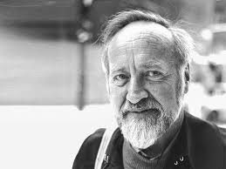
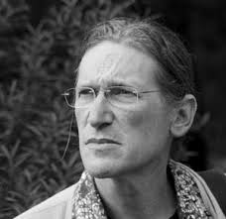
Permaculture [Per·ma·kul·tur] noun
Permaculture as a design science was created in the 1970's by Bill Mollison & David Holgrem, an Australian ecologist and University professor and his pHd student who became very disturbed by the wasteful destruction of our increasingly industrialized society and the segregation and fragmentation of academic response in higher education to these interconnected global issues.

Slide 5
Permaculture ethics are distilled from research into community ethics, learning from cultures that have existed in relative balance with their environment for much longer than more recent civilizations. This does not mean that we should ignore the great teachings of modern times, but in the transition to a sustainable future, we need to consider values and concepts outside the current social norm.

Slide 6
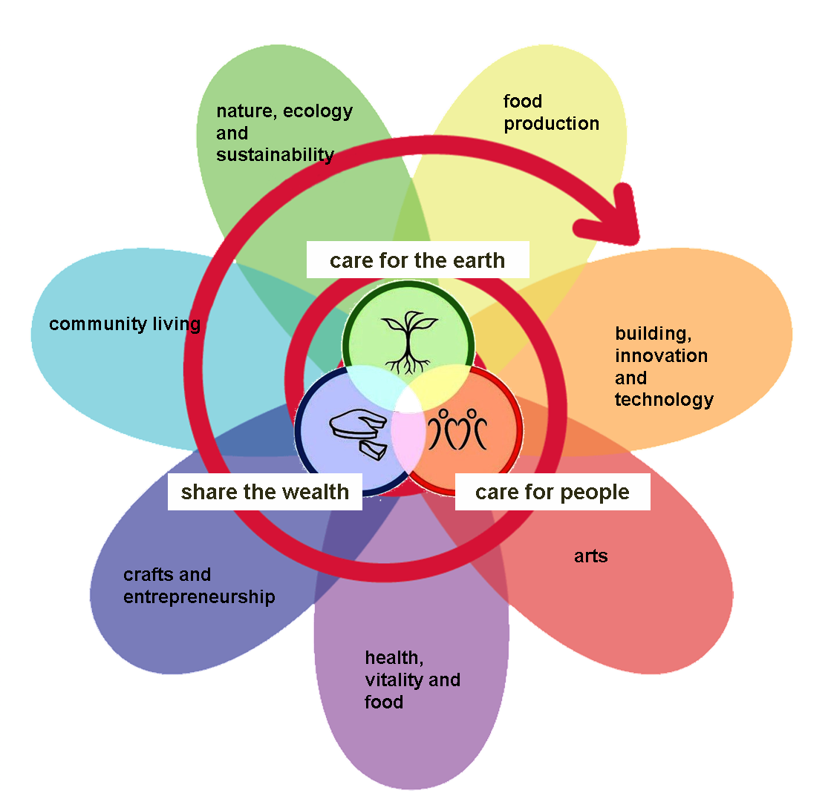
Permaculture Flower

Slide 7
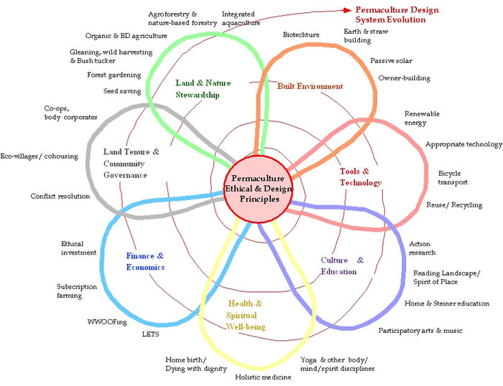

Slide 8
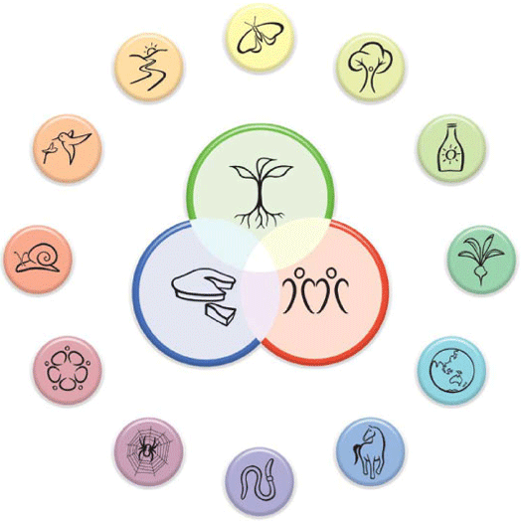
Permaculture Ethics & Principles

Slide 9
12 Permaculture Principles
Observe & Interact
Catch & Store Energy
Obtain a yield
Apply Self-regulation & Accept Feedback
Use & Value renewable resources
Produce no waste
7. Design from patterns to details
8. Integrate rather then segregate
9. Use Small & Slow Solutions
10. Use & Value Diversity
11. Use edges & value the Marginal
12. Creatively Use & Respond to Change

Slide 10
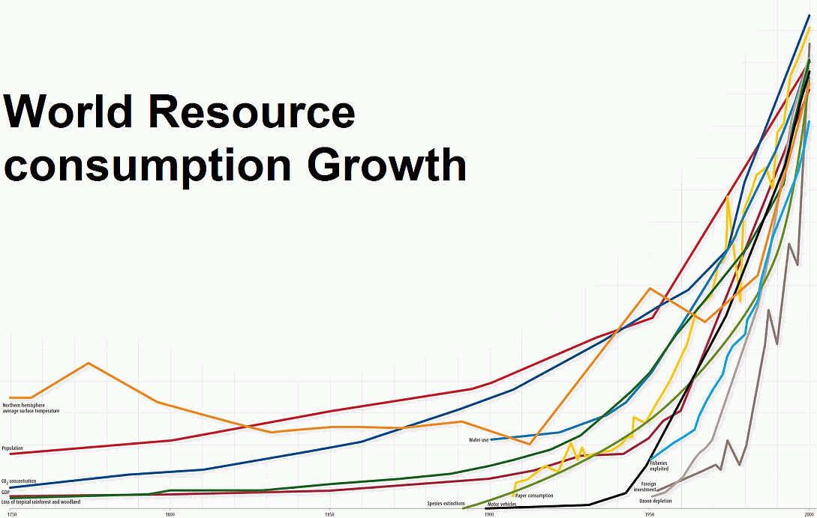
A response to globally interconnected issues

Slide 12
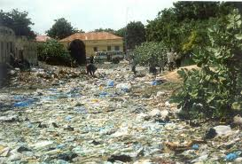
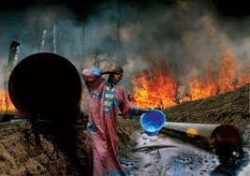
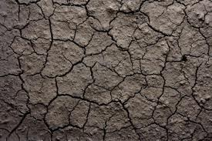
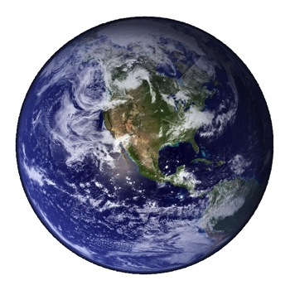
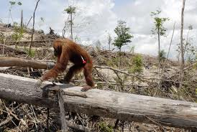
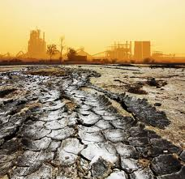
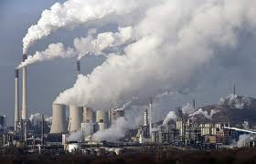
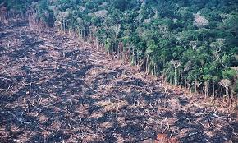
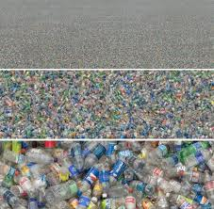

Slide 13
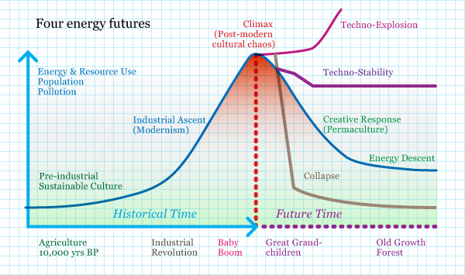
Designing and Planning for the future…

Slide 14
“The greatest change we need to make is from consumption to production,
even if on a small scale,
in our own gardens.
If only 10% of us do this, there is enough for everyone. Hence the futility of revolutionaries who have no gardens, who depend on the very system they attack, and who produce words and bullets, not food and shelter.”
― Bill Mollison

Slide 15
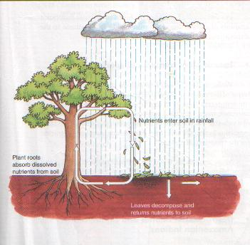
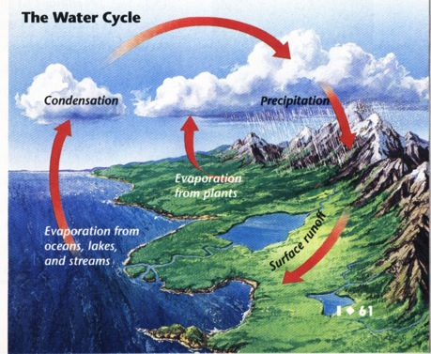
Permaculture design is based on the natural patterns and cycles found in nature

Slide 16
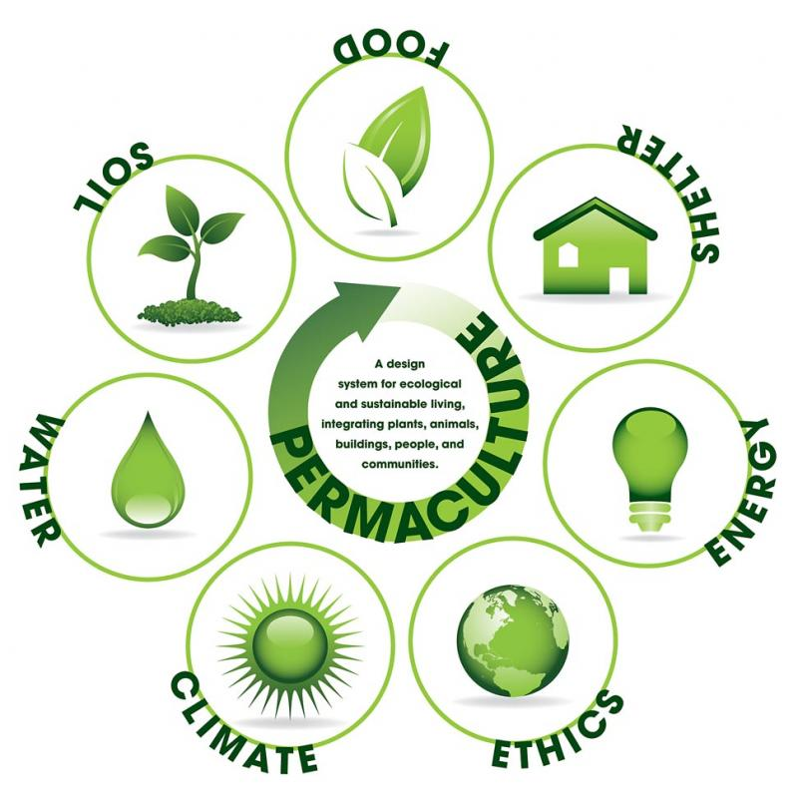

Slide 17
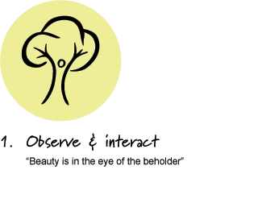
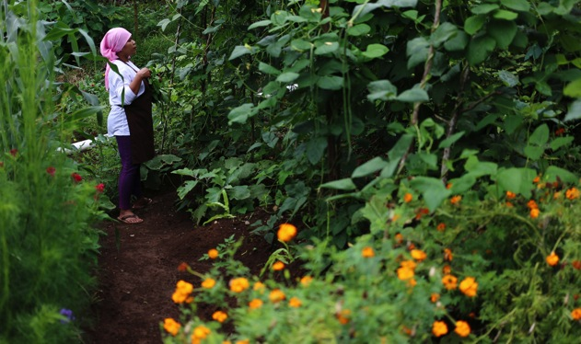
By taking the time to slow down and engage with nature and our community we can design solutions that suit our particular situation. Observe and interact with your community and the land.

Slide 18
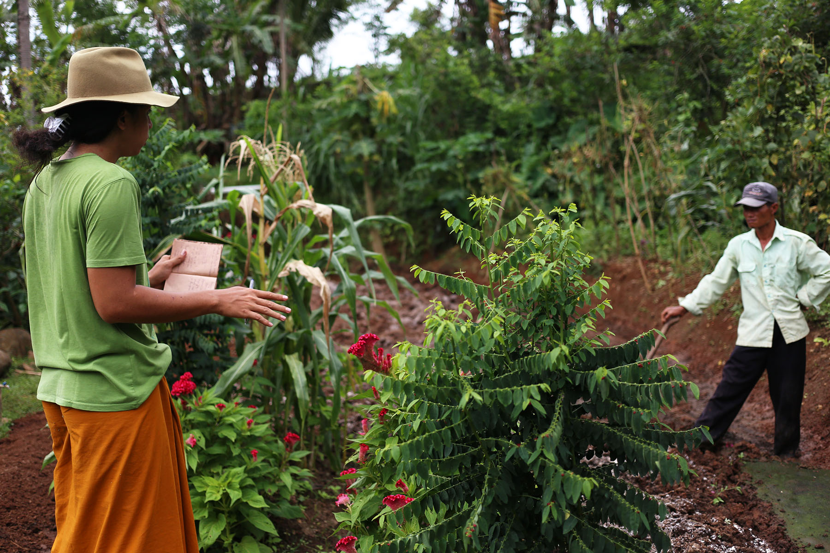

Slide 19
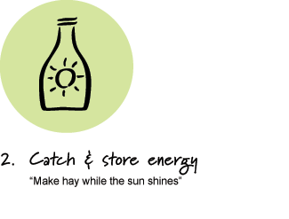
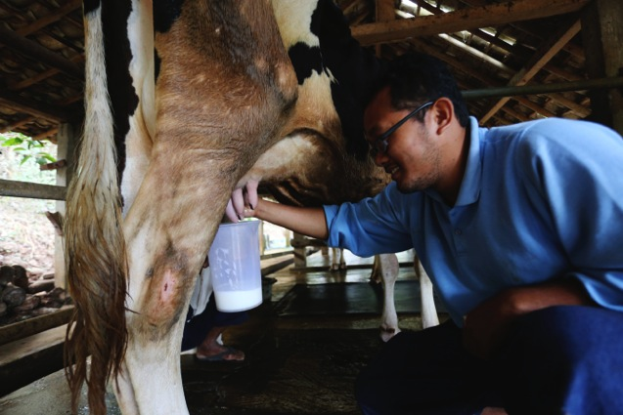
Develop systems that collect and utilize naturally abundant resources; such as energy from the sun (photosynthesis) catch and store water in the landscape and use gravity to utilize.

Slide 20
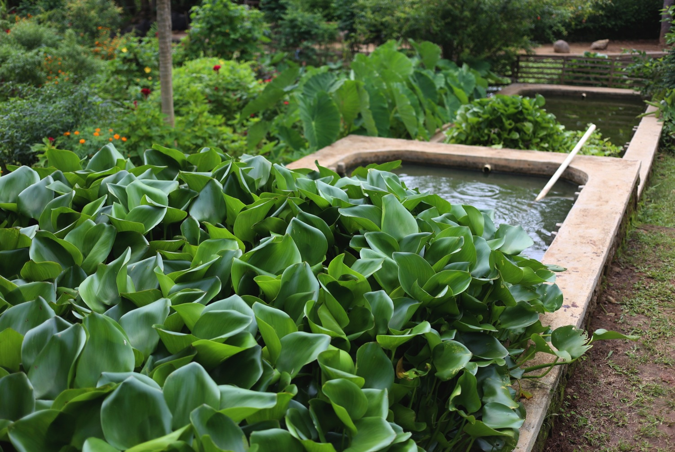

Slide 21
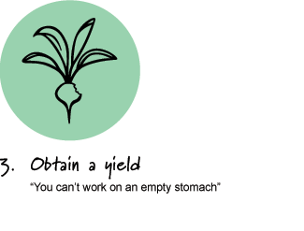
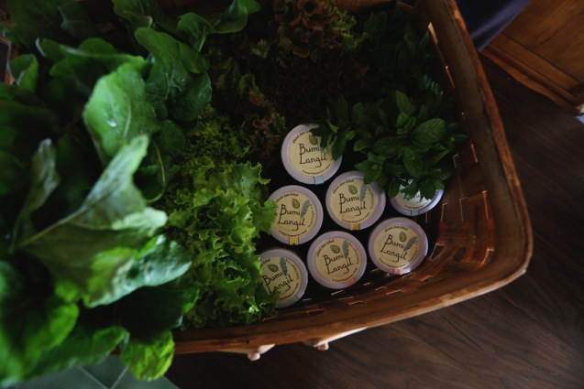
Ensure that you are getting truly useful
rewards as part of the working you are doing.
Get creative with your yield (value adding)

Slide 22
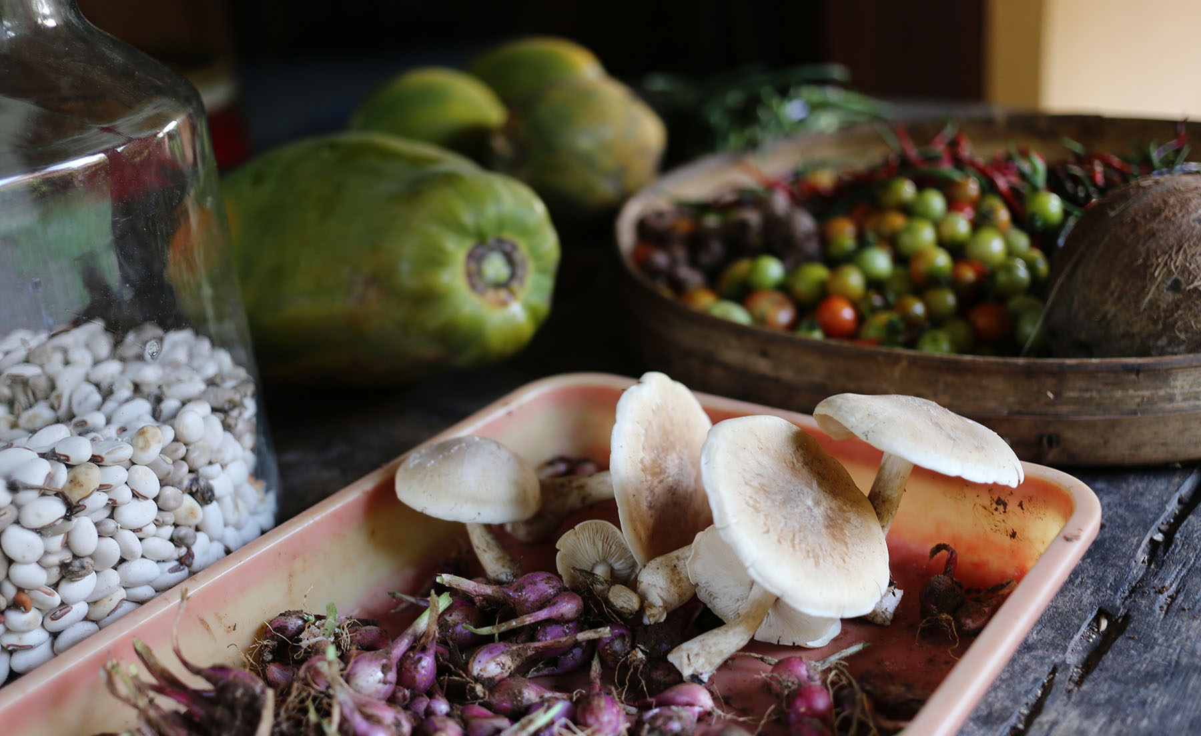

Slide 23
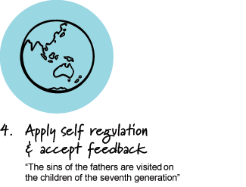
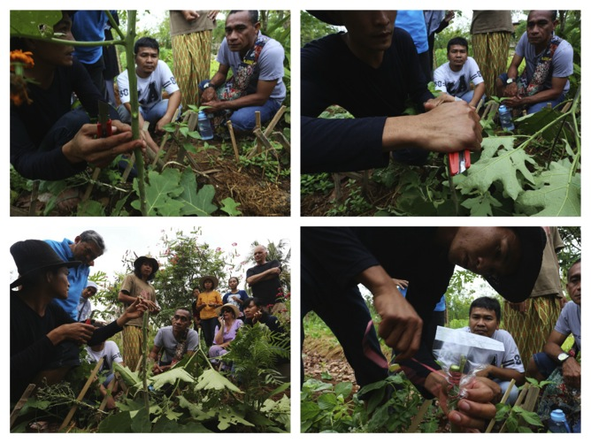
Be open to change within the system and
accept feedback on alternative perspectives

Slide 25
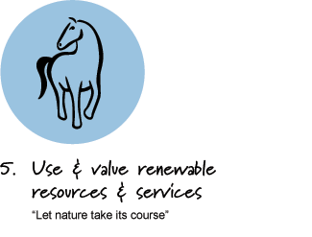
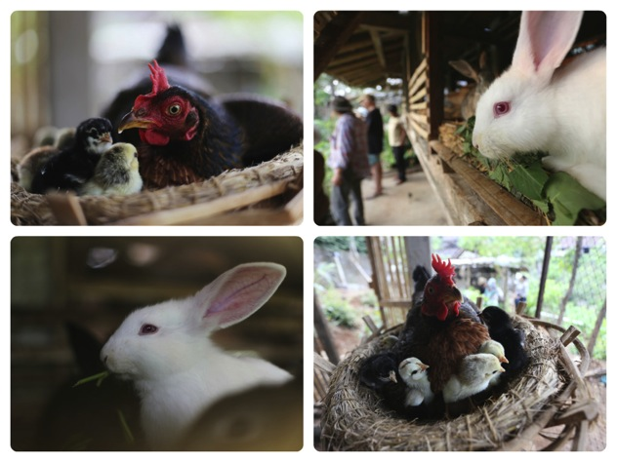
Make the best use of nature’s abundance to reduce our consumptive behavior and dependence on non-renewable resources.

Slide 26
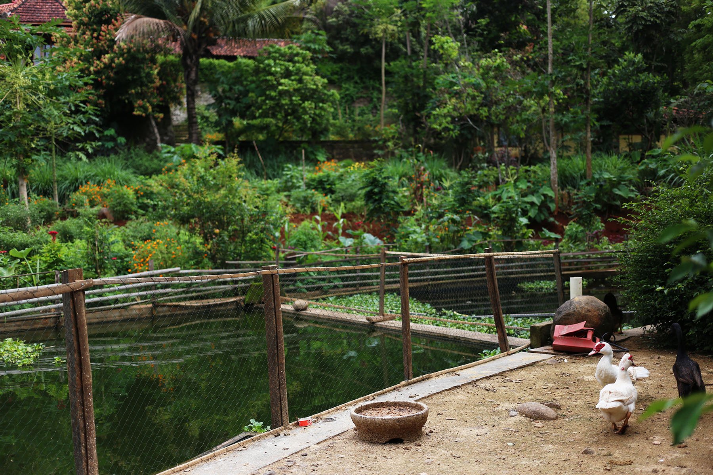

Slide 27
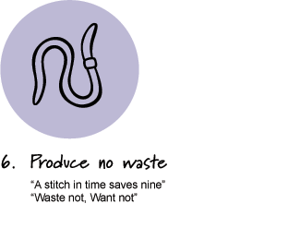
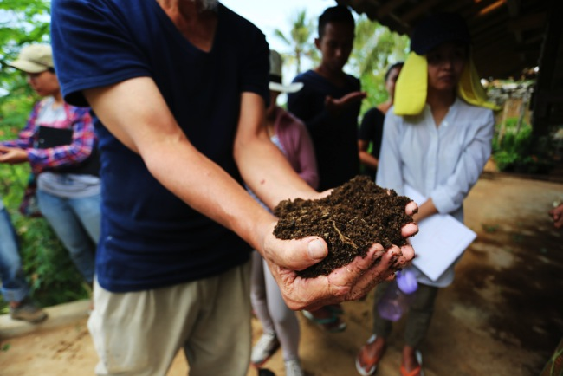
By valuing and making use of all the resources that are available to us, nothing goes to waste. Outputs from one system become inputs for another, like turning manure into healthy soil to grow more food.

Slide 28
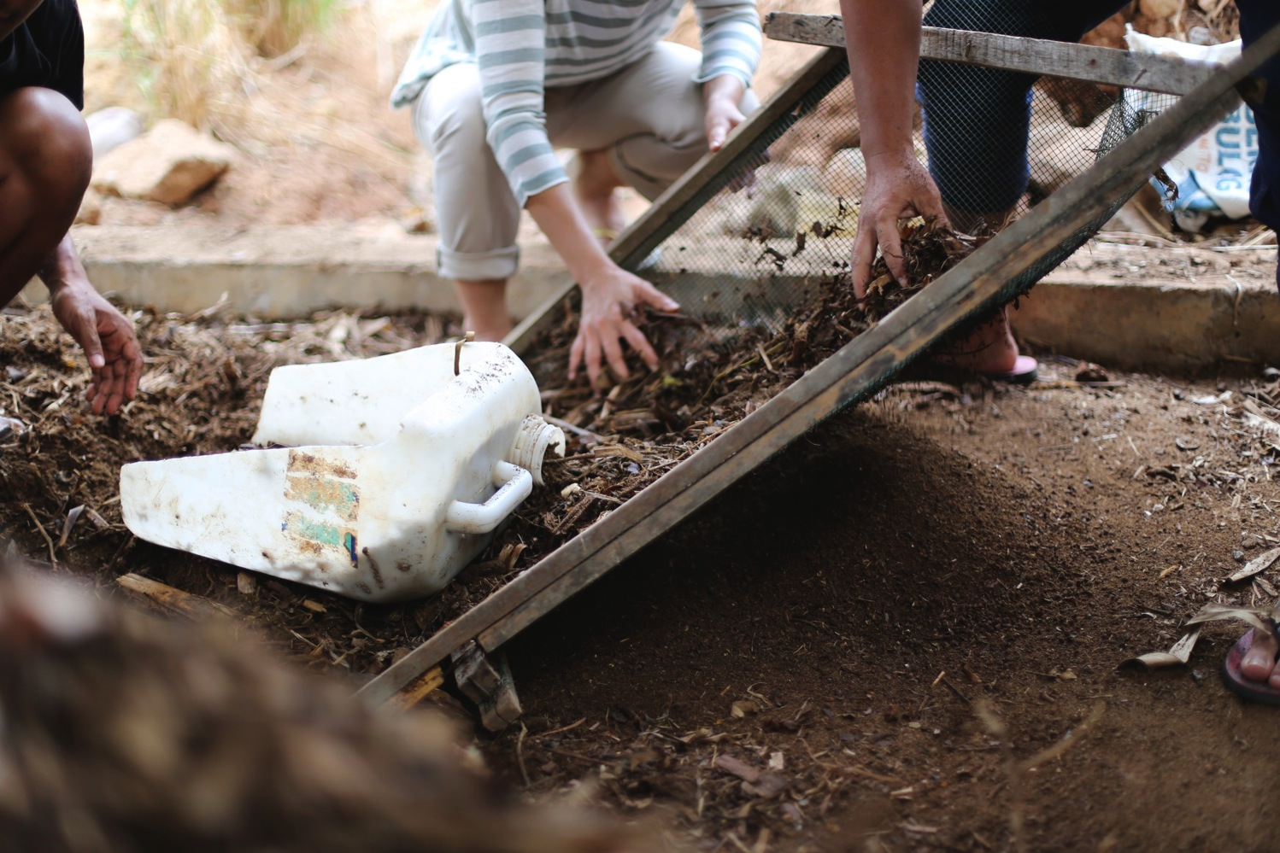

Slide 29
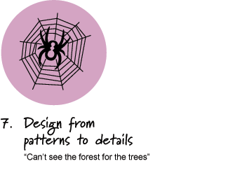
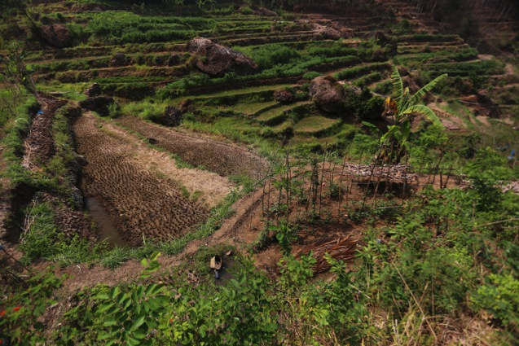
By stepping back, we can observe patterns in the landscape and society. These can form the backbone of our designs, with the details filled in as we go.

Slide 30
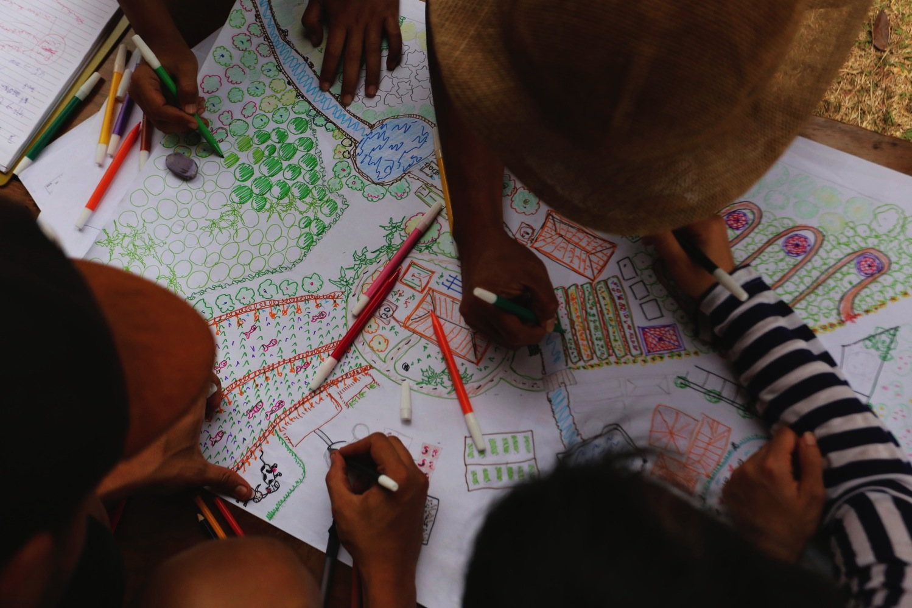

Slide 31
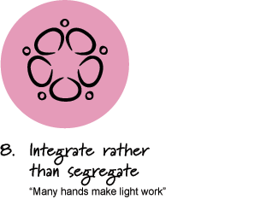
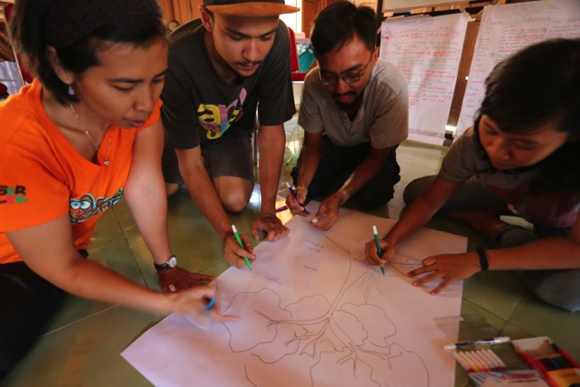
Work towards co-operation rather then competition. Draw on the power of Synergy, which is working together with two or more elements to produce a result greater than the sum of their individual effects.

Slide 32
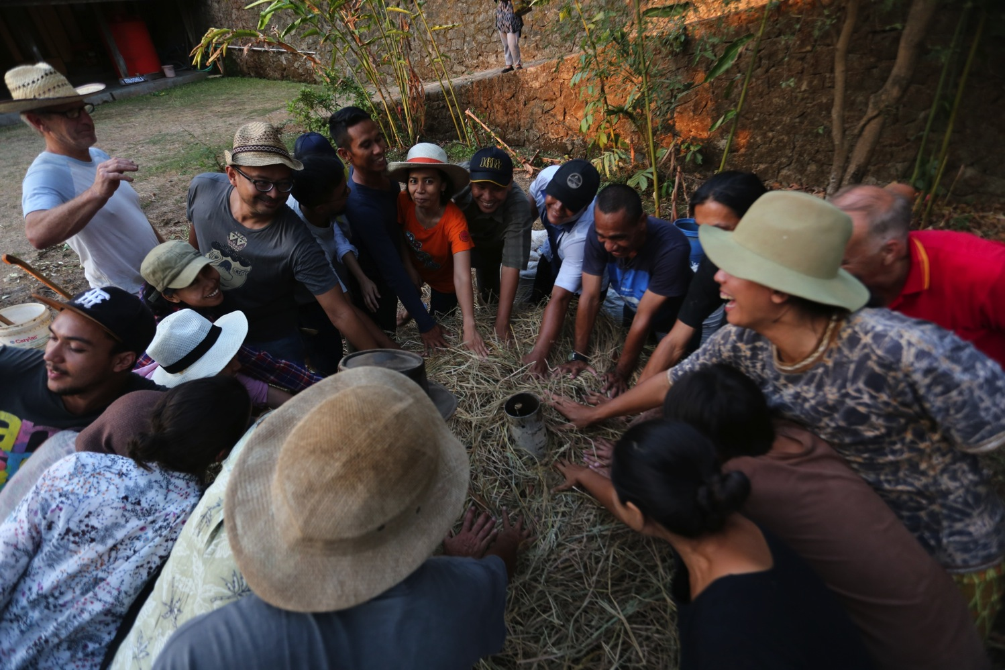

Slide 33
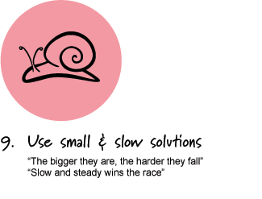
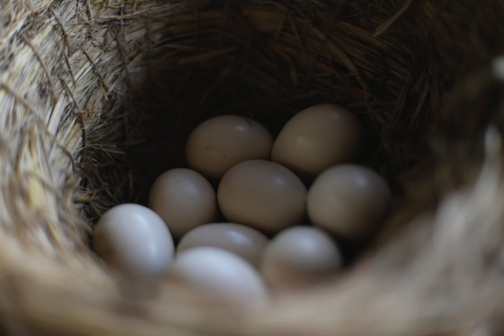
Small and slow systems are easier to maintain than big ones, making better use of local resources and systems that are regenerative rather than degenerative

Slide 34
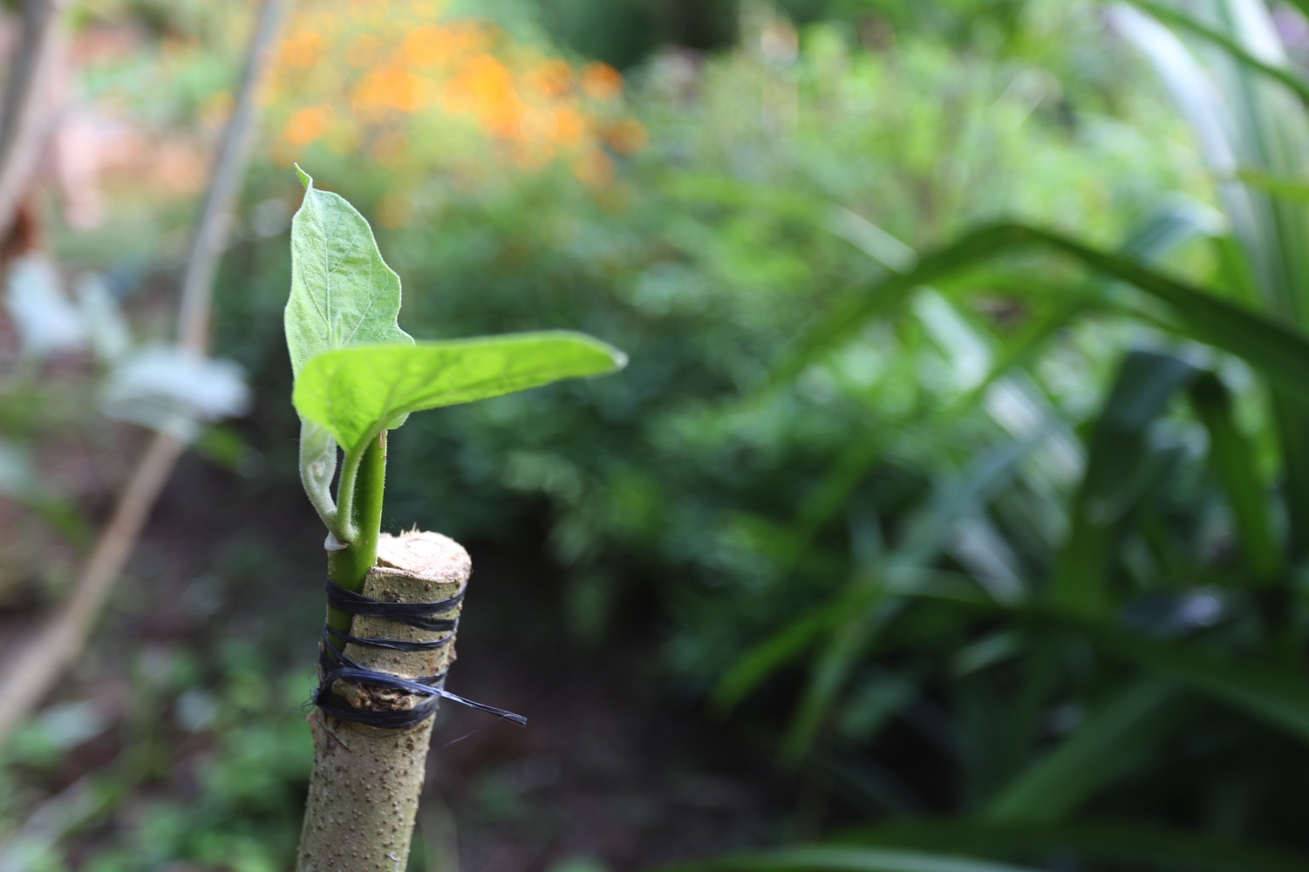

Slide 35
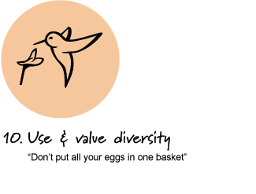
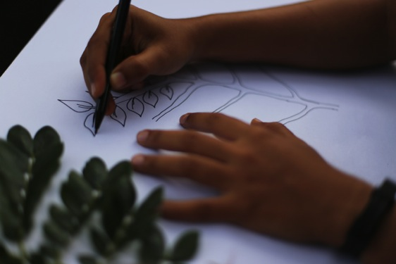
Diversity reduces a variety of threats and takes advantage of the unique nature of the environment in which it resides.

Slide 37
In ecology the edge is often the most valuable, diverse and productive area in an eco-system. The edge can also exist when two or more cultures or different ways of thinking come together and interact.

Slide 39
We can use unpredictable change as a catalyst for positive renewal and re-design by carefully observing and adapting our system creatively.

