Slide 1
Learning
Sistem Informasi UPN “Veteran” Yogyakarta

Slide 2
Why study learning
In an economy dominated by knowledge work and rapid, unpredictable change, the ability to learn, and to continue learning, for individuals and organizations is crucial. Leaning theories thus affect many management practices including
Induction of new recruits
The design and delivery of job training
Design of payment systems
How supervisor evaluate performance and provide feedback
Methods for modifying employee behavior.
Creation of learning organizations.
Design and operation of knowledge management systems.

Slide 3
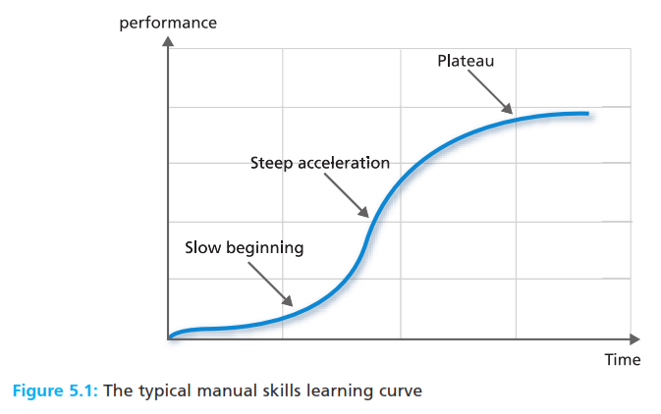
The learning process
Learning the process of acquiring knowledge through experience which leads to a lasting change in behavior.

Slide 4
The learning process
Behaviourist psychology a perspective which argues that what we learn are chains of muscle movements, and that mental processes are not observable, and are not valid issues for study.
Cognitive psychology a perspective which argues that what we learn are mental structures, and that mental process can be studied by inference, although they cannot be observed directly.

Slide 5
The behaviourist approach to learning
Feedback information about the outcomes of our behavior
Positive reinforcement the attempt to encourage desirable behaviours by introducing positive consequences when the desired behavior occurs.
Negative reinforcement the attempt to encourage desirable behaviours by withdrawing negative consequences when the desired behavior occurs
Pusnihment the attempt to discourage undesirable behaviours through the application of negative consequences, or by withholding a positive consequence, following the undesirable behavior
Extinction the attempt to eliminate undesirable behaviours by attaching no consequences,positive or negative such as indifference and silence.

Slide 6
The behaviourist approach to learning
Pavlovian conditioning a technique for associating an established response or behavior with a new stimulus
Skinnerian conditioning a technique for associating a response or a behavior with its consequence
Shaping the selective reinforcement of chosen behaviours in a manner that progressively establishes a desired behavior pattern.
Intermittent reinforcement a procedure in which a reward is provided only occasionaly following correct responses, and not for every correct response.
Schedule of reinforcement the pattern and frequency of rewards contingent on the display of desirable behavior

Slide 7
The cognitive approach to learning
Cybernetic analogy an explanation of the learning process based on the components and operation of a feedback control system.
Intrinsic feedback information which comes from within, from the muscles, joints, skin, and other mechanism such as that which controls balance
Extrinsic feedback information which comes from our environment, such as the visual and aural information needed to drive a car
Concurrent feedback information which arrives during our behavior and which can be used to control behavior as it unfolds.
Delayed feedback information which is received after a task is completed, and which can be used to influence future performance.

Slide 8
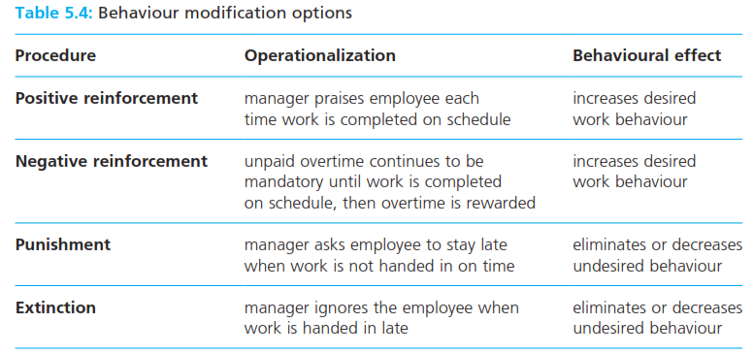
Behaviourism in practice
Behaviour modification a technique for encouraging desired behaviours and discouraging unwanted behaviours using operant conditioning

Slide 9
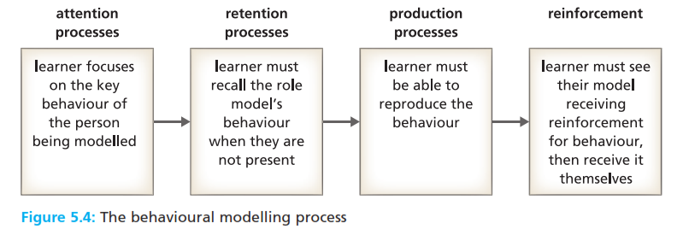
Cognitive perspective in practice
Socialization the process through which individual behaviours, values, attitudes, and motives are influenced to conform with those seen as desirable in a given social or organizational setting.
Behavioral modeling leaning how to act by observing and copying the behavior of others.

Slide 10
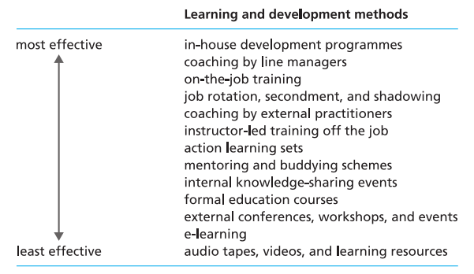
Cognitive perspective in practice
Provisional selves from observing others, the experiments that we make with the ways in which we act and interact in new organizational roles.

Slide 11
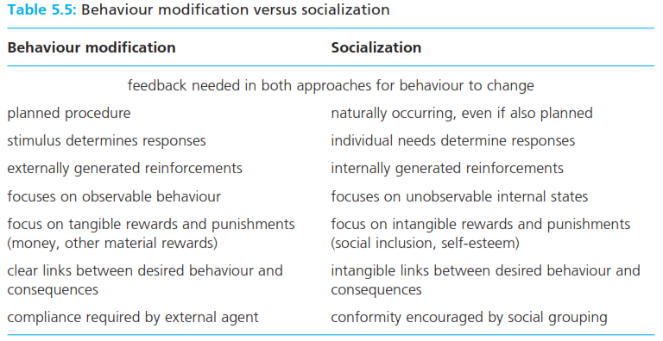
Behaviour modification versus socialization
Provisional selves from observing others, the experiments that we make with the ways in which we act and interact in new organizational roles.

Slide 12
Behaviour self management
Behavioural self management a technique for changing one’s own behavior by systematically manipulating cues, cognitive processes, and contingent consequences.
Leaning organization an organizational form that enables individual learning to create valued outcomes, such as innovation, efficiency, environmental alignment, and competitive advantage.

Slide 13
The learning organization
The learning organization concept has become significant for several reasons :
the production of goods and services increasingly involves sophisticated knowledge
Knowledge is, therefore, as valuable a resource as raw materials.
Many organizations have lost knowledgeable staff through retirements and de-layering
Information technologies are knowledge intensive
Some knowledge can have short lifespan, and be made obsolete by innovation.
Flexibility, creativity, and responsiveness are now prized capabilities
Knowledge can thus be a source of competitive advantage for an organization.

Slide 14
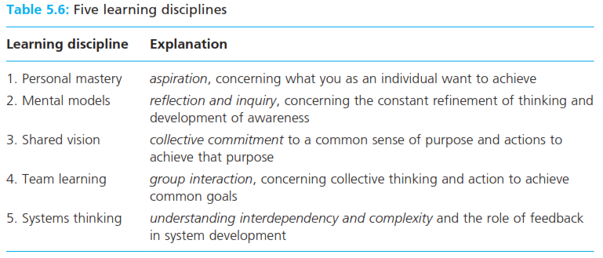
The learning organization

Slide 15
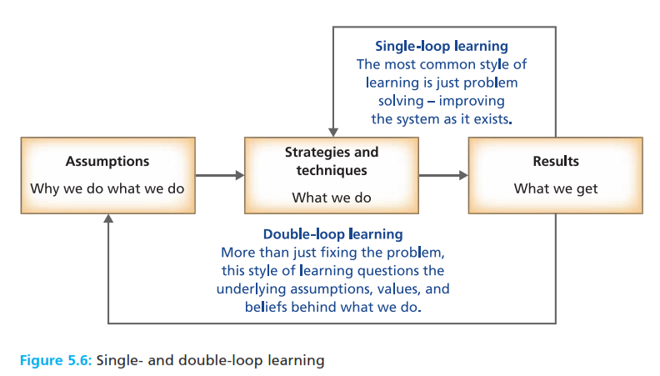
The learning organization
Single loop learning the ability to use feedback to make continuous adjusments and adaptation, to maintain performance at a predetermined standard
Double loop learning the ability to challenge and to redefine the assumptions underlying performance standards and to improve performance.

Slide 16
The learning organization
Tacit knowledge knowledge and understanding specific to the individual, derived from experience, and difficulty to codify and to communicate to others
Explicit knowledge knowledge and understanding which is codified, clearly articulated, and available to anyone.
Knowledge management the conversion of individual tacit knowledge so that it can be shared with others in the organization.

Slide 17
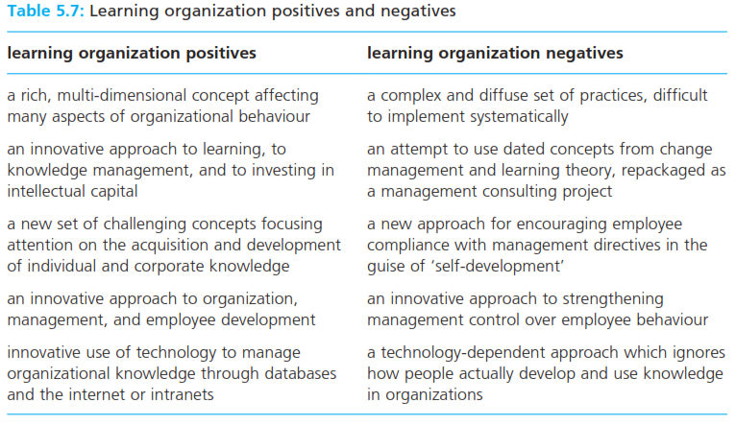
The learning organization
Tacit knowledge knowledge and understanding specific to the individual, derived from experience, and difficulty to codify and to communicate to others
Explicit knowledge knowledge and understanding which is codified, clearly articulated, and available to anyone.
Knowledge management the conversion of individual tacit knowledge so that it can be shared with others in the organization.

Slide 18
Reference
Huczynski, Buchanan, 2013 , Organizational Behaviour, Pearson
Umam, Khaerul, 2012, Manajemen Organisasi, Pustaka Setia.
Wardiah, Mia Lasmi, Teori perilaku dan budaya organisasi, Pustaka Setia.

