Slide 1
UPN “VETERAN” YOGYAKARTA
E-Commerce
Chapter 11
Hari Prapcoyo,S.Kom., M.ICT
Sistem Informasi

Slide 2
Online contenct and media
Learning objective:
The different types of social networks and online communities and their business models
The major types of auctions, their benefits and costs, how they operate, when to use them and the potential for auction abuse and fraud
Describe the major types of internet portal and their business models.

Slide 3
Social network and online communities
Social network : involves a group of people shared social interaction common ties among members and people who share an area for some period of time.
Online social network : an area online, where people who share common ties can interact with one another.

Slide 4
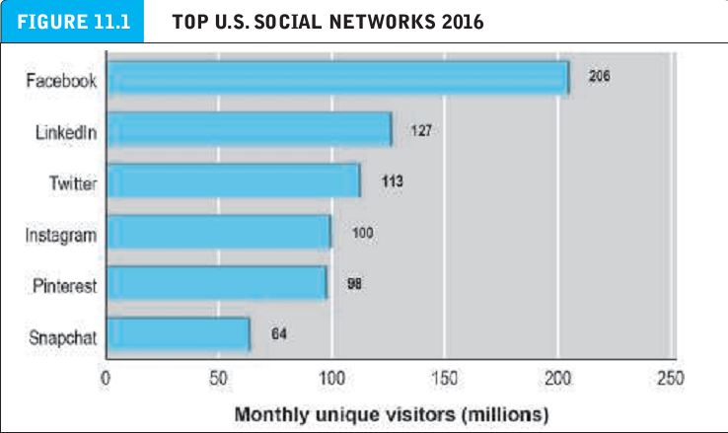
Social network and online communities
Social network : involves a group of people shared social interaction common ties among members and people who share an area for some period of time.
Online social network : an area online, where people who share common ties can interact with one another.

Slide 5
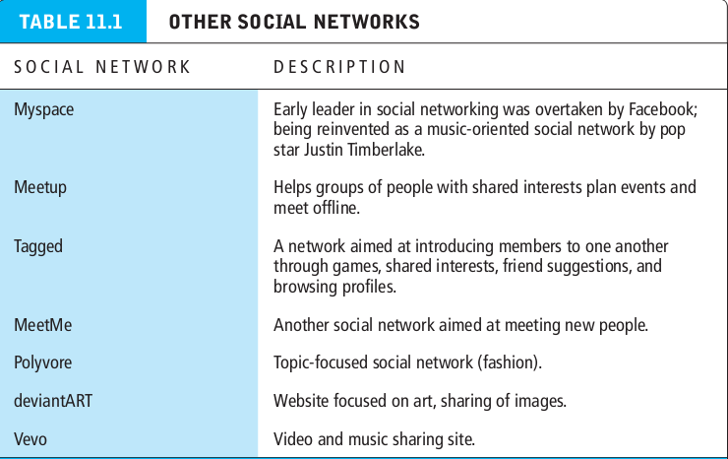
Social network and online communities
Social network : involves a group of people shared social interaction common ties among members and people who share an area for some period of time.
Online social network : an area online, where people who share common ties can interact with one another.

Slide 6
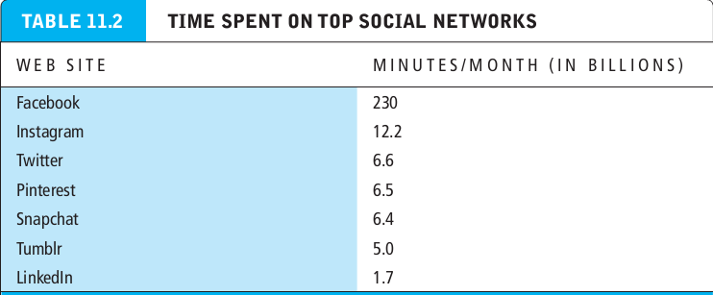
Social network and online communities
Social network : involves a group of people shared social interaction common ties among members and people who share an area for some period of time.
Online social network : an area online, where people who share common ties can interact with one another.

Slide 7
Types of social network and their business models
General communities : offer members opportunities to interact with a general audience organized into general topics.
Practice networks : offer members focused discussion groups, help, information, and knowledge relating to an area of shared practice.
Interest based social networks : offer members focused discussion groups based on a shared interest in some specific topic.

Slide 8
Types of social network and their business models
Affinity communities : offers members focused discussions and interaction with other people who share the same affinity.
Sponsored communities : online communities created for the purpose of pursuing organizational (and often commercial) goals.
Algorithms : set of step by step instructions, similar to a recipe, for producing a desired output from required inputs.
Computer algorithms : computer programs that carry out step by step instructions to produce desired outputs.
Affinity groups : generally composed of like-minded people who share views attitudes, purchase patterns and tastes in music and videos.

Slide 9
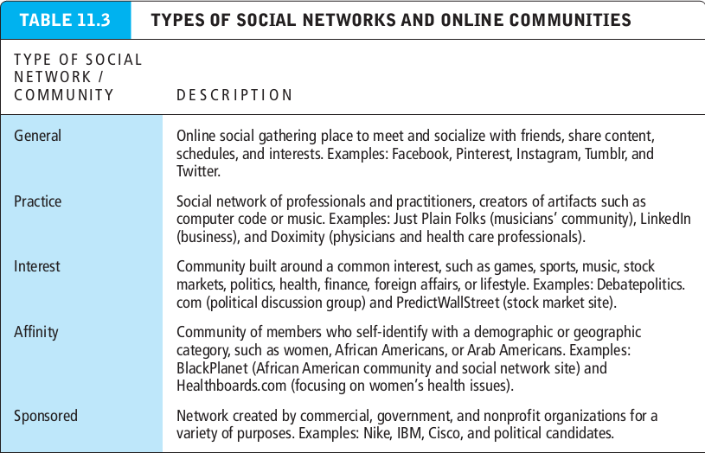
Types of social network and their business models
General communities : offer members opportunities to interact with a general audience organized into general topics.

Slide 10
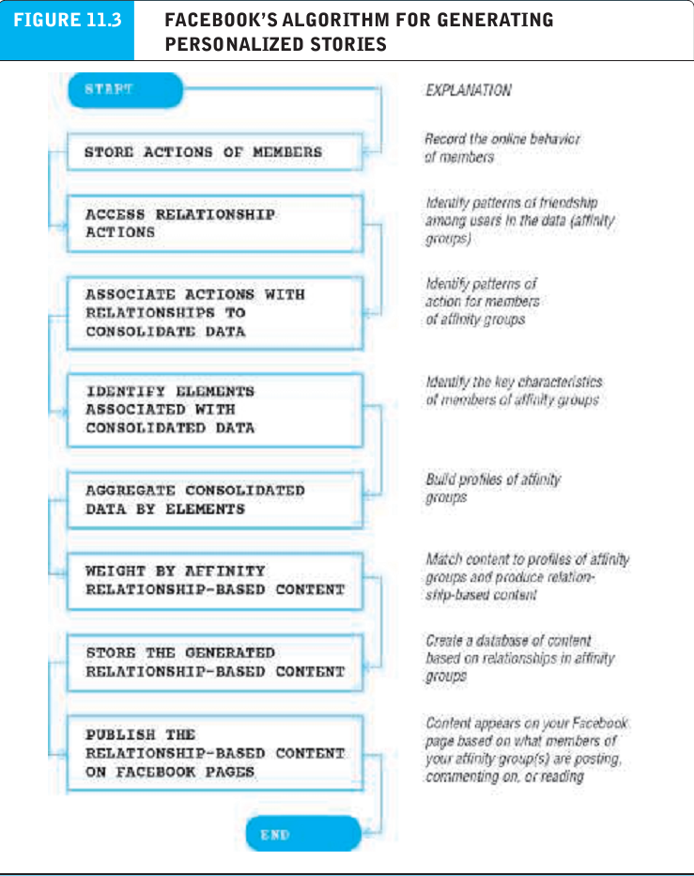
Types of social network and their business models
General communities : offer members opportunities to interact with a general audience organized into general topics.

Slide 11
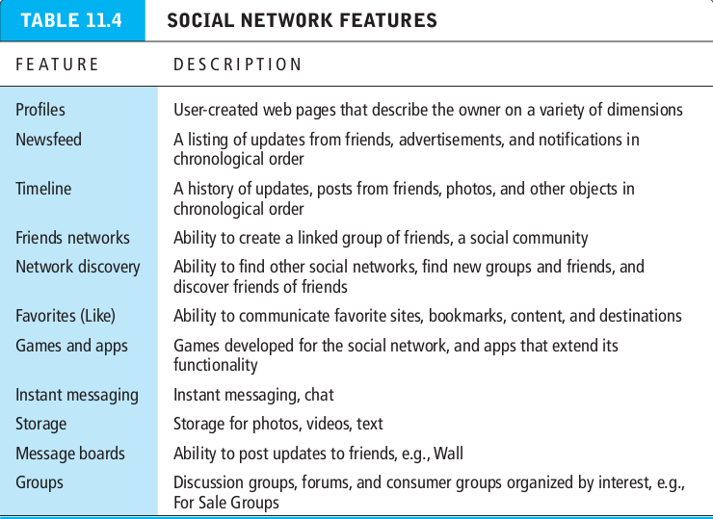
Types of social network and their business models
General communities : offer members opportunities to interact with a general audience organized into general topics.

