Slide 1
Teamworking
Sistem Informasi UPN “Veteran” Yogyakarta

Slide 2
Why study teamworking?
Teamworking provides a mechanism to bring together different employee expertise and skills that are required to complete increasingly complex work tasks in ever shorter time frames. Teams are popular in organization and are positively perceived by their members, by managers and by society at large. Companies appear to believe that teams are an effective way of :
Improving performance
Reducing production costs
Speeding up innovations
Improving product quality
Increasing work flexibility
Introducing new technologies
Increasing employee participation
Achieving better industrial relations
Meeting the challenge of global competition
Identifying and solving work related problems

Slide 3
The T-Word and team work design
Team a group whose members goal that they pursue collaboratively and who can only succeed or fail collectively

Slide 4
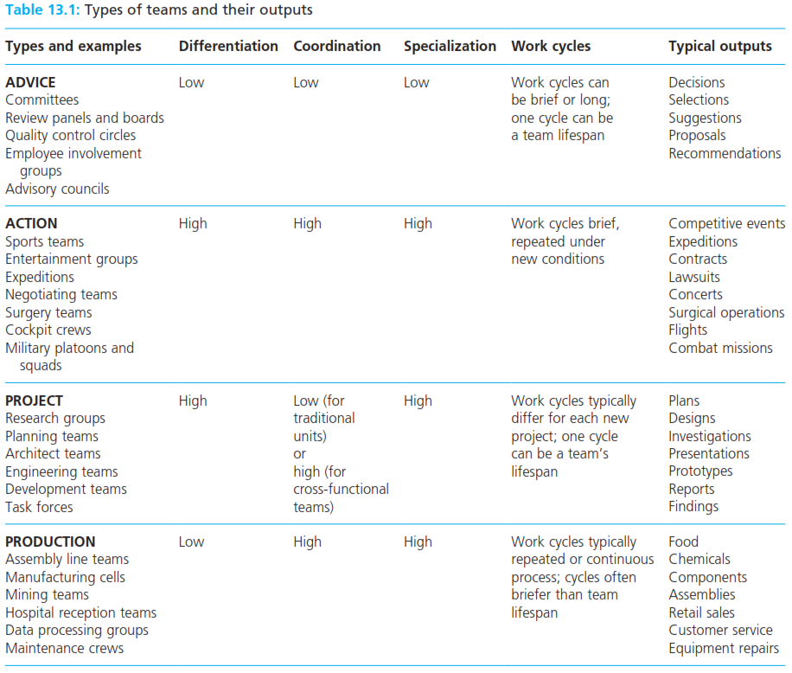
Types of teams
Team a group whose members goal that they pursue collaboratively and who can only succeed or fail collectively

Slide 5
Types of teams
Team autonomy the extent to which a team experiences freedom, independence and discretion in decisions relating to the performance of its tasks.
Advice teams
Advice team a team created by management to provide the later with information for its own decision making.
Quality circle shop floor employees from the same department who meet for a few hours each week to discuss ways of improving their work environment

Slide 6
Types of teams
Action team a team that executes brief performance that are repeated under new conditions. Its members are technically specialized, and need to coordinate their individual contributions with each other.
Project teams
Project team a collection of employees from different work areas in an organization brought together to accomplish a specific task within a finite time
Cross functional team employees from different functional departments who meet as a team to complete a particular task

Slide 7
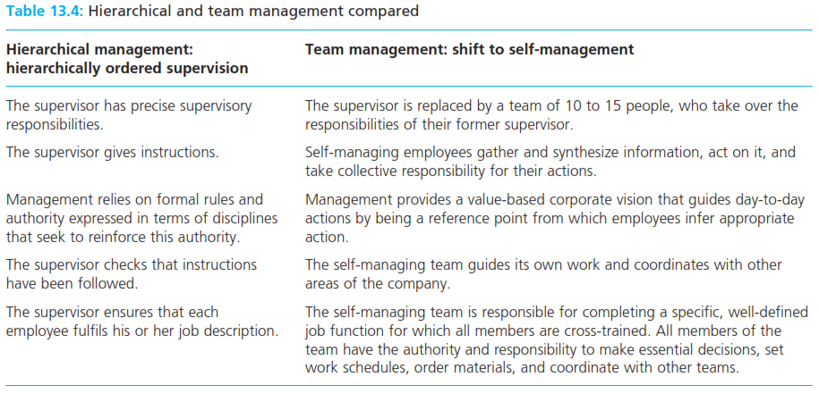
Production teams
Production team a stable number of individuals who share production goals, and who perform specific roles which are supported by a set of incentives and sanctions

Slide 8
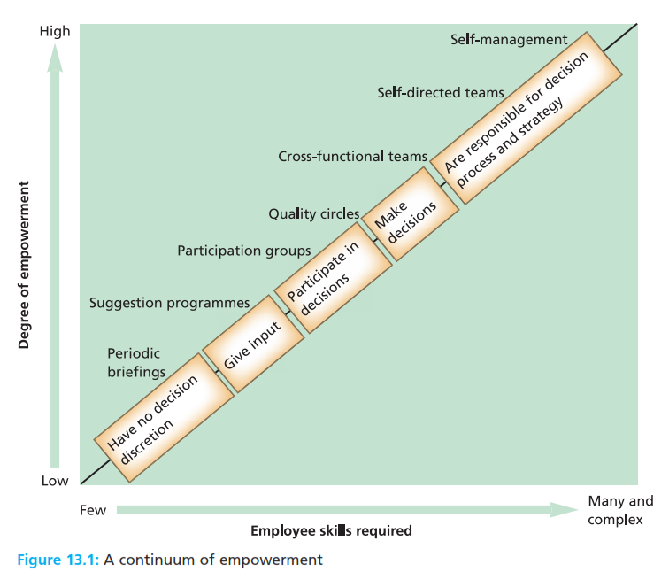
Production teams
Production team a stable number of individuals who share production goals, and who perform specific roles which are supported by a set of incentives and sanctions

Slide 9
Production teams
Japanese teamworking use of scientific management principles of minimum manning, multi tasking, multi machine operation, pre-defined work operations, repetitive short cycle work, powerful first line supervisors, and a conventional managerial hierarchy.
Total quality management a philosophy of management that is driven by customer needs and expectations, and which is committed to continuous improvement.
Just in time system a system of managing inventory (Stock) in which items are delivered when they are needed in the production process, instead of being stored by the manufacturer.

Slide 10
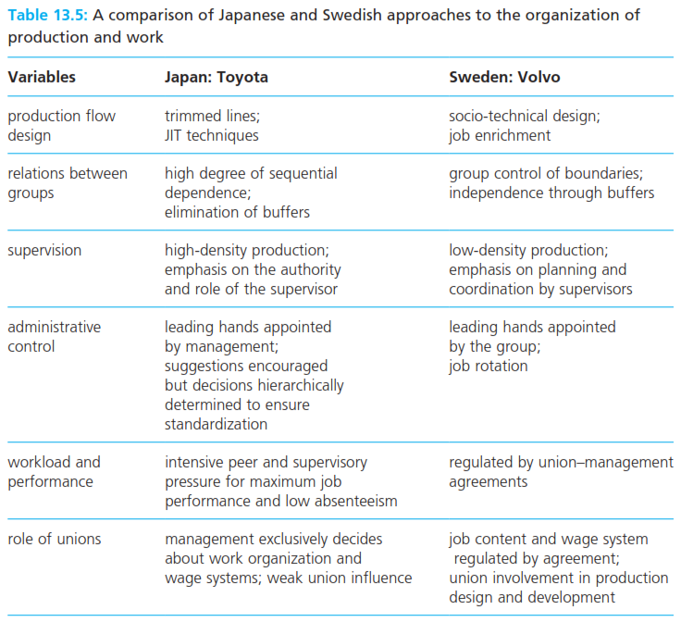
Production teams
Japanese teamworking use of scientific management principles of minimum manning, multi tasking, multi machine operation, pre-defined work operations, repetitive short cycle work, powerful first line supervisors, and a conventional managerial hierarchy.
Total quality management a philosophy of management that is driven by customer needs and expectations, and which is committed to continuous improvement.
Just in time system a system of managing inventory (Stock) in which items are delivered when they are needed in the production process, instead of being stored by the manufacturer.

Slide 11
Production teams
Kaizen Japanese term for ‘continuous improvement’ which refers to an element within total quality management in which employees are given responsibility, within limits, to suggest incremental changes to their work practices.

Slide 12
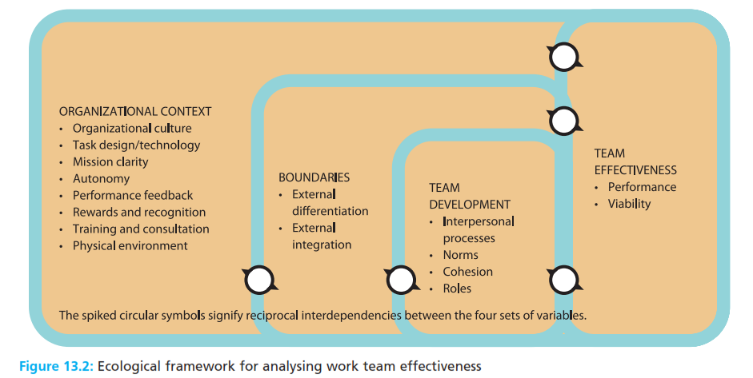
Ecological framework for analyzing work team effectiveness
Kaizen Japanese term for ‘continuous improvement’ which refers to an element within total quality management in which employees are given responsibility, within limits, to suggest incremental changes to their work practices.

Slide 13
Work team boundaries
External work team differentiates the degree to which a work team stands out from its organizational context, in terms of its membership, temporal scope and territory.
Internal work team differentiation the degree to which a team’s members possess different skills and knowledge that contributes towards the achievement of the team’s objective.
External work team integration the degree to which a work team is linked with the larger organizational of which it is a part.
Team performance a measure of how well a team achieves its task, and meets the needs and expectations of management, customers and shareholders
Team viability a measure of how well a team meets the needs and expectations of its members.

Slide 14
Reference
Huczynski, Buchanan, 2013 , Organizational Behaviour, Pearson
Umam, Khaerul, 2012, Manajemen Organisasi, Pustaka Setia.
Wardiah, Mia Lasmi, Teori perilaku dan budaya organisasi, Pustaka Setia.

