Slide 1
Motivation
Sistem Informasi UPN “Veteran” Yogyakarta

Slide 2
Why study motivation?
A motivated workforce can be a sign of a successful organization. How is that achieved? Each of us has a different reason for getting out of bed in the morning. Our motives – from the latin movere, to move – are key determinants of our behavior.

Slide 3
Extreme jobs and boreout: how work is changing
Extreme job a job that involves a working week of 60 hours or more, with high earnings, combined with additional performance pressures
Boreout boredom, demotivation, and lack of energy and enthusiasm caused by uninteresting. Unchallenging, and monotonous work.

Slide 4
Drives, motives, and motivation
Drive an innate, biological determinant of behavior, activated by deprivation.
Motive a socially acquired need activated by a desire for fulfilment.
Motivation the cognitive decision making process through which goal directed behavior is initiated, energized, directed, and maintained.

Slide 5
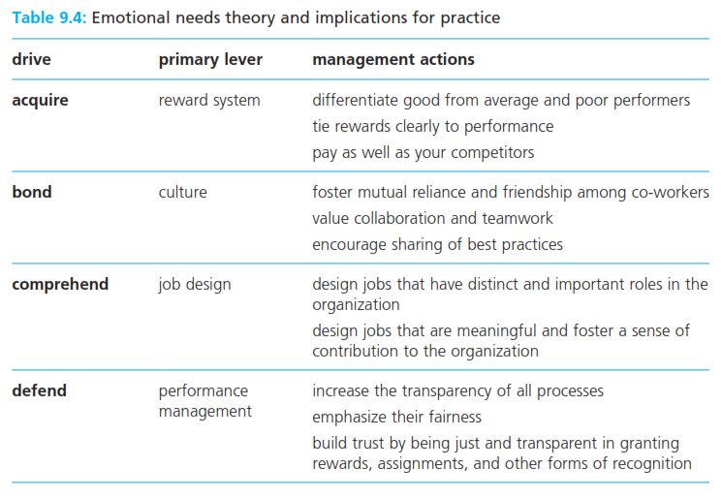
Content theories
Self-actualization the desire for personal fulfilment, to develop one’s potential, to become everything that one is capable of becoming.

Slide 6
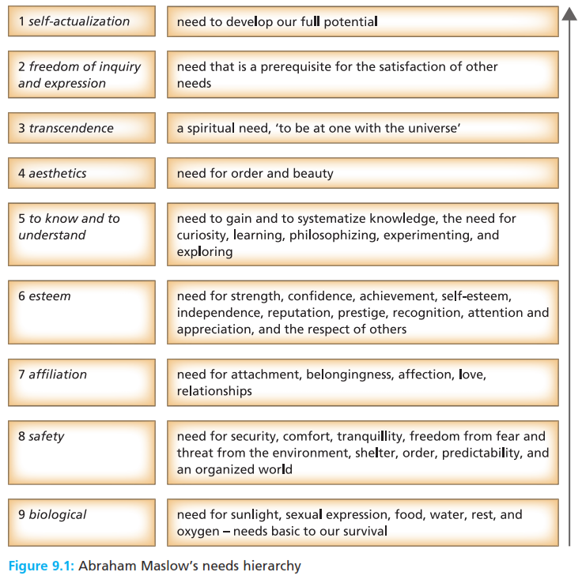
Content theories
Self-actualization the desire for personal fulfilment, to develop one’s potential, to become everything that one is capable of becoming.

Slide 7
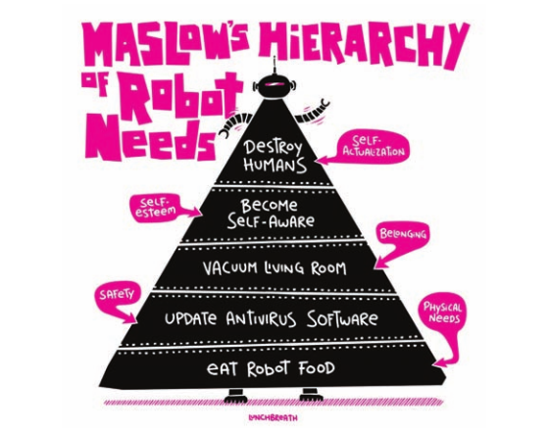
Content theories
Self-actualization the desire for personal fulfilment, to develop one’s potential, to become everything that one is capable of becoming.

Slide 8
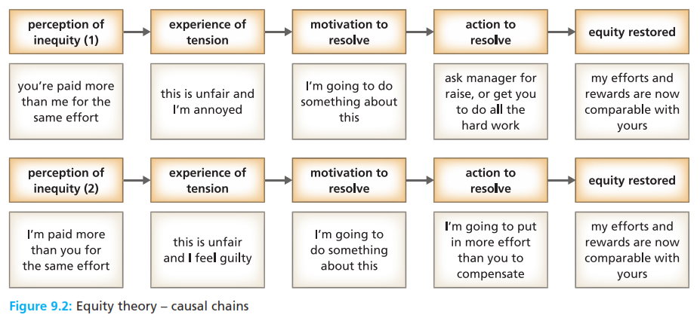
Process theories
Equity theory a process theory of motivation which argues that perception of unfairness leads to tension, which motivates the individual to resolve that unfairness.

Slide 9
Expectancy theories
Expectancy theory a process theory which argues that individual motivation depends on the valence of outcomes, the expectancy that effort will lead to good performance, and the instrumentality of performance in producing valued outcomes.
Valence the perceived value of preference that an individual has for a particular outcome; can be positive, negative or neutral.
Instrumentality the perceived probability that good performance will lead to valued rewards, measured on a scale from o (no chance) to 1 (certainty)
Expectancy the perceived probability that effort will result in good performance; measured on a scale from 0(no chance) to 1 (certainty)
Total rewards all aspects of work that are valued by employees, including recognition, development opportunities, organization culture, and attractive work environment, as well as pay and other financial benefits.

Slide 10
Goal settting theory
Goal setting theory a process theory of motivation which argues that work motivation is influence by goal difficulty, goal specificity, and knowledge of results.
Inner work life theory
Inner work life theory a process theory of motivation which argues that our behavior and performance at work are influenced by the interplay of our perceptions, emotions, and motives.

Slide 11
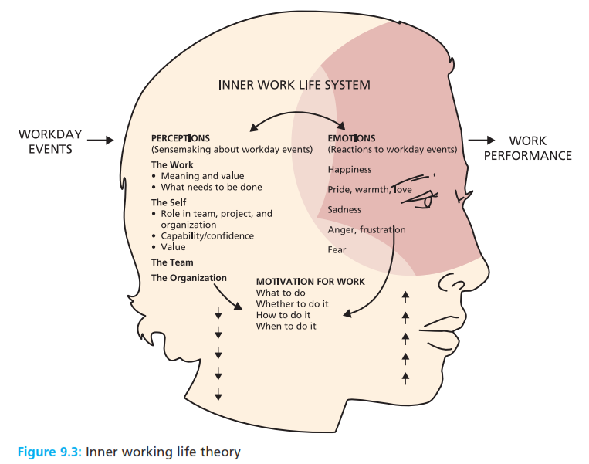
Goal settting theory
Goal setting theory a process theory of motivation which argues that work motivation is influence by goal difficulty, goal specificity, and knowledge of results.
Inner work life theory
Inner work life theory a process theory of motivation which argues that our behavior and performance at work are influenced by the interplay of our perceptions, emotions, and motives.

Slide 12
The social process of motivating others
Job enrichment a technique for broadening the experience of work to enhance employee need satisfaction and to improve motivation and performance.
Motivator factors aspects of work which lead to high levels of satisfaction, motivation, and performance, including achievement, recognition, responsibility, advancement, growth, and the work itself.
Hygiene factors aspects of work which remove dissatisfaction, but do not contribute to motivation and performance, including pay, company policy, supervision, status, security and physical working conditions.

Slide 13
The social process of motivating others
Vertical loading factors methods for enriching work and improving motivation, by removing controls and increasing accountability, and by providing feedback, new tasks, natural work units, special assignments, and additional authority.
Intrinsic rewards valued outcomes or benefits which come from the individual, such as feelings of satisfaction, competence, self esteem, and accomplishment.
Extrinsic rewards valued outcomes or benefits provided other, such as promotion, pay increases, a bigger office, desk, praise and recognition.

Slide 14
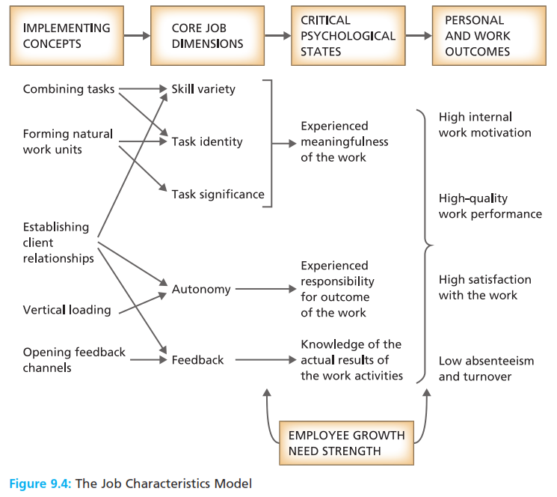
The social process of motivating others
Vertical loading factors methods for enriching work and improving motivation, by removing controls and increasing accountability, and by providing feedback, new tasks, natural work units, special assignments, and additional authority.
Intrinsic rewards valued outcomes or benefits which come from the individual, such as feelings of satisfaction, competence, self esteem, and accomplishment.
Extrinsic rewards valued outcomes or benefits provided other, such as promotion, pay increases, a bigger office, desk, praise and recognition.

Slide 15
The social process of motivating others
Growth need strength a measure of the readiness and capability of an individual to respond positively to job enrichment.
Job diagnostic survey a questionnaire which assesses the degree of skill variety, task identity, task significance, autonomy and feedback in jobs.
Motivating potential score an indicator of how motivating a job is likely to be for an individual, considering skill variety, task identity task significance, autonomy and feedback.

Slide 16
Empowerment, engagement, and high performance
Empowerment organizational arrangements that give employees more autonomy, discretion, and decision making responsibility.
Engagement the extent to which people enjoy and believe in what they do, and feel valued for doing it.
High performance work system a form of organization that operates at levels of excellence far beyond those of comparable systems.

Slide 17
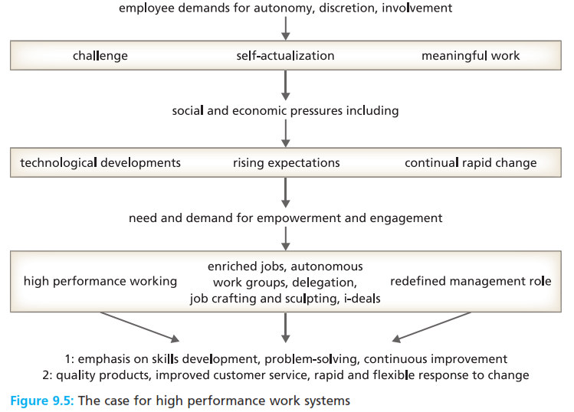
Empowerment, engagement, and high performance
Empowerment organizational arrangements that give employees more autonomy, discretion, and decision making responsibility.
Engagement the extent to which people enjoy and believe in what they do, and feel valued for doing it.
High performance work system a form of organization that operates at levels of excellence far beyond those of comparable systems.

Slide 18
Reference
Huczynski, Buchanan, 2013 , Organizational Behaviour, Pearson
Umam, Khaerul, 2012, Manajemen Organisasi, Pustaka Setia.
Wardiah, Mia Lasmi, Teori perilaku dan budaya organisasi, Pustaka Setia.

