Slide 1
Environments
Sistem Informasi UPN “Veteran” Yogyakarta

Slide 2
Why study an organization’s environment?
Environment issues, trends, and events outside the boundaries of the organization which influence internal decisions and behavious.
Stakeholder anyone who is concerned with how an organization operates, and who will be affected by its decisions and actions.
Environmental uncertainty the degree of unpredicatable turbulence and change in the political, economic, social, technological, legal and ecological context in which an organization operates.

Slide 3
Why study an organization’s environment?
Environment complexity the range of external factors relevant to the activities of the organization; the more factors, the higher the complexity.
Environmental dynamism the pace of change in relevant factors external to the organization; the greater the pace of change, the more dynamic the environment.

Slide 4
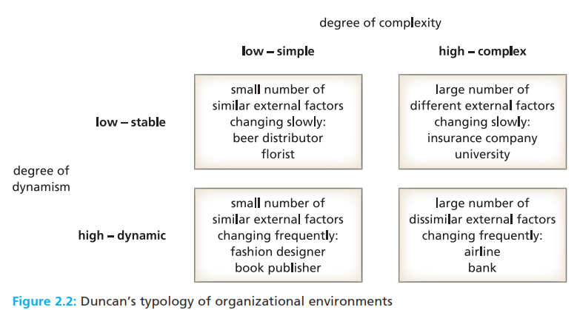
Why study an organization’s environment?
Environment complexity the range of external factors relevant to the activities of the organization; the more factors, the higher the complexity.
Environmental dynamism the pace of change in relevant factors external to the organization; the greater the pace of change, the more dynamic the environment.

Slide 5
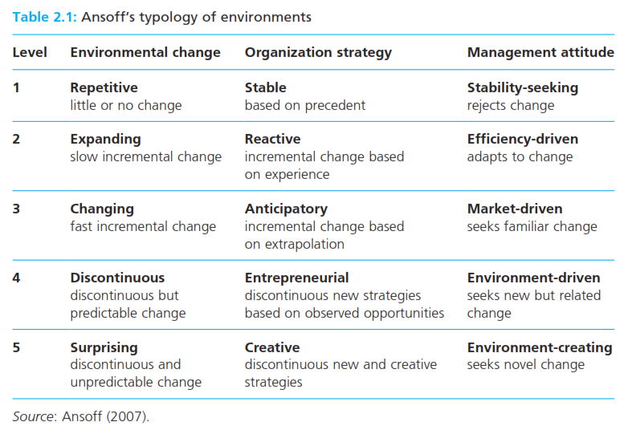
Why study an organization’s environment?
Environment complexity the range of external factors relevant to the activities of the organization; the more factors, the higher the complexity.
Environmental dynamism the pace of change in relevant factors external to the organization; the greater the pace of change, the more dynamic the environment.

Slide 6
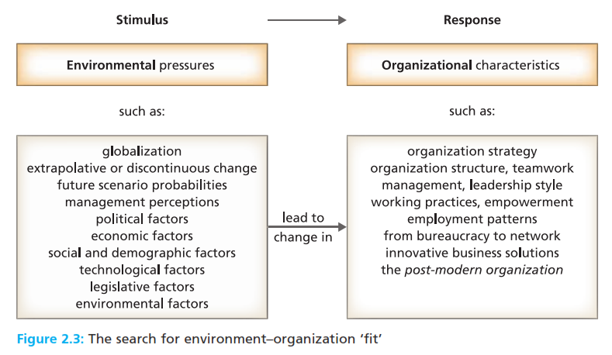
Why study an organization’s environment?
Environment complexity the range of external factors relevant to the activities of the organization; the more factors, the higher the complexity.
Environmental dynamism the pace of change in relevant factors external to the organization; the greater the pace of change, the more dynamic the environment.

Slide 7
Why study an organization’s environment?
Post modern organization a networked, information-rich, de-layered, downsized, boundaryless, high commitment organization employing highly skilled, well-paid autonomous knowledge workers.
Environmental determinism the argument that internal organizational responses are primarily determined by external environmental factors.
Strategic choice the ability of an organization to decide on the environment, or environments – that is, sectors, and parts of the world – in which it will operate.

Slide 8
Analysing the organization’s environment
Environmental scanning techniques for identifying and predicting the impact of external trends and developments on the internal functioning of an organization.
Globalization the intensification of world wide social and business relationship which link localities in such a way that local conditions are shaped by distant events.

Slide 9
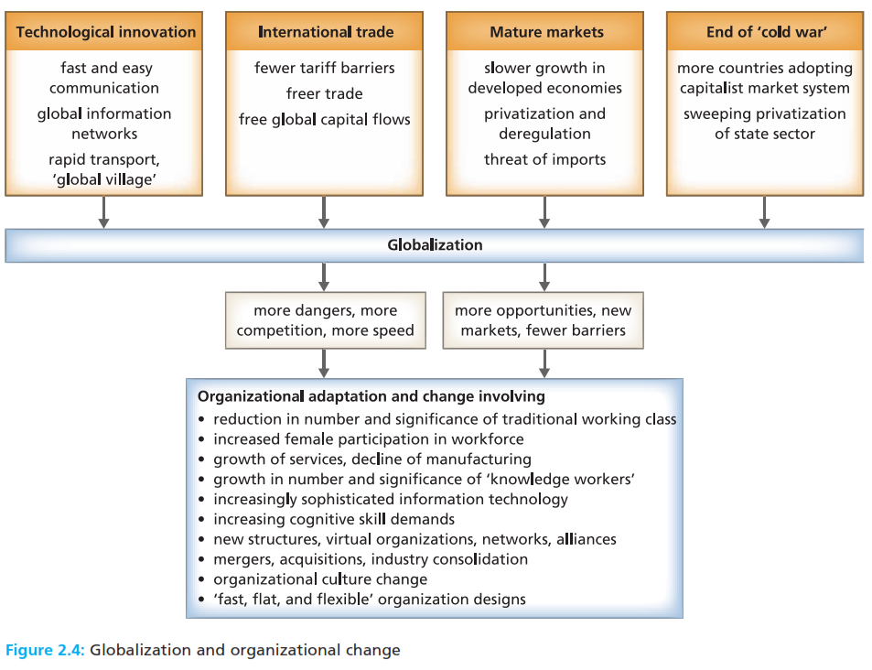
Analysing the organization’s environment
Environmental scanning techniques for identifying and predicting the impact of external trends and developments on the internal functioning of an organization.
Globalization the intensification of world wide social and business relationship which link localities in such a way that local conditions are shaped by distant events.

Slide 10
PESTLE analysis
PESTLE analysis an environmental scanning tool identifying political, economic, social, technological, legal, and ecological factors than affect an organization.

Slide 11
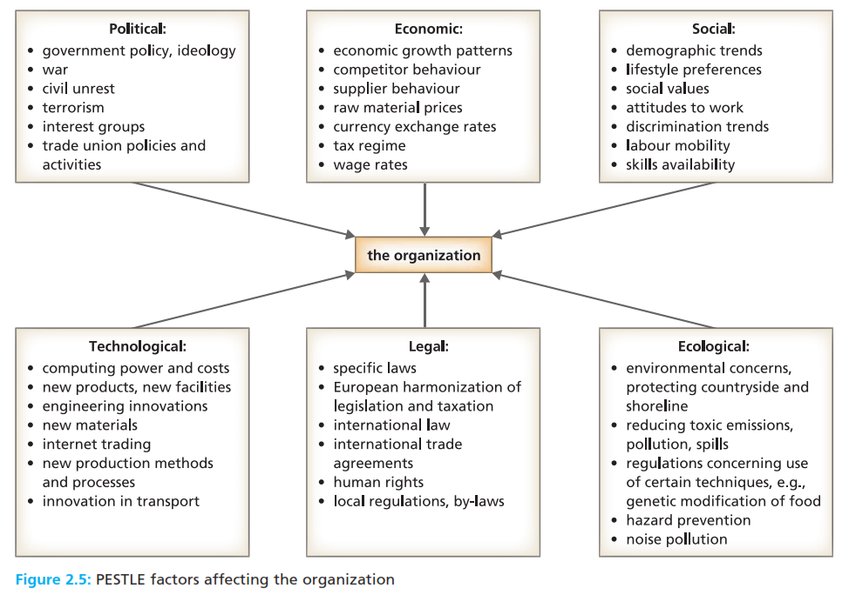
PESTLE analysis
PESTLE analysis an environmental scanning tool identifying political, economic, social, technological, legal, and ecological factors than affect an organization.

Slide 12
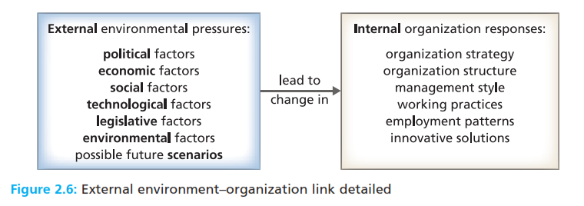
PESTLE analysis
Scenario planning the imaginative development of one or more likely pictures of the dimensions and characteristics of the future for an organization.

Slide 13
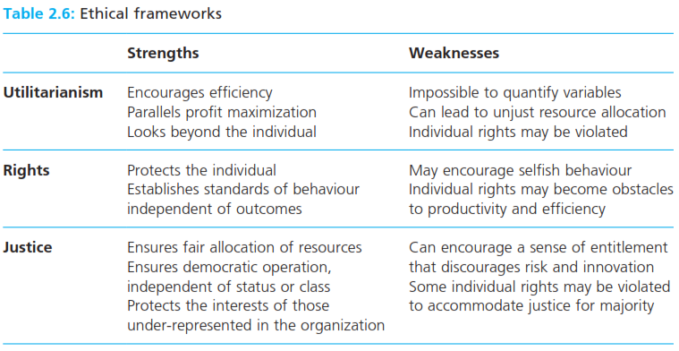
Ethical behaviour
Ethics the moral principles, values, and rules that govern our decisions and actions with respect to what is right and wrong, good and bad.

Slide 14
Business ethics and Corporate Social Responsibility
Ethical stance the extent to which an organization exceeds its legal minimum obligations to its stakeholders and to society at large.
CSR the view that organizations should act ethically, in ways that contribute to economic development, the environment, quality of working life, local communities, and the wider society.

Slide 15
Reference
Huczynski, Buchanan, 2013 , Organizational Behaviour, Pearson
Umam, Khaerul, 2012, Manajemen Organisasi, Pustaka Setia.
Wardiah, Mia Lasmi, Teori perilaku dan budaya organisasi, Pustaka Setia.

