Slide 1
Chapter 9 Social Media
Dr. Herlina Jayadianti, ST.MT

Slide 2
aDDICTION
Chatting addiction
Cybersex addiction
Auction addiction
Gamming addiction

Slide 3
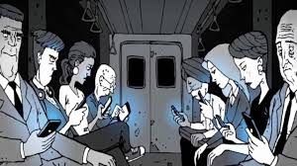
WHAT IS SOCIAL MEDIA?

Slide 4
Social Media?
Social Network
User Generated Content (UGC)
Social Bookmarking
Why You Should Care

Slide 5
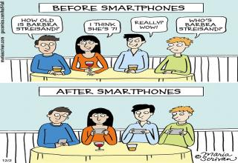
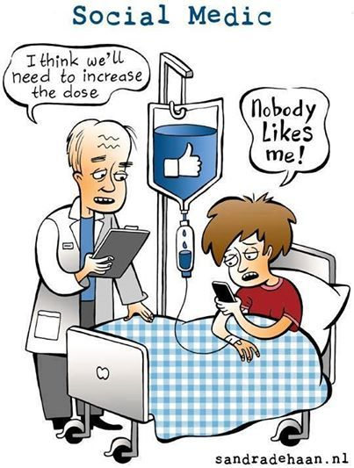
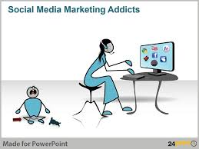
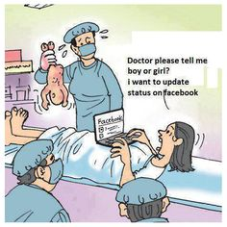
Why You Should Care ?

Slide 6
Examples
Facebook
YouTube
Myspace
Twitter
Del.icio.us
Digg
Etc…

Slide 7
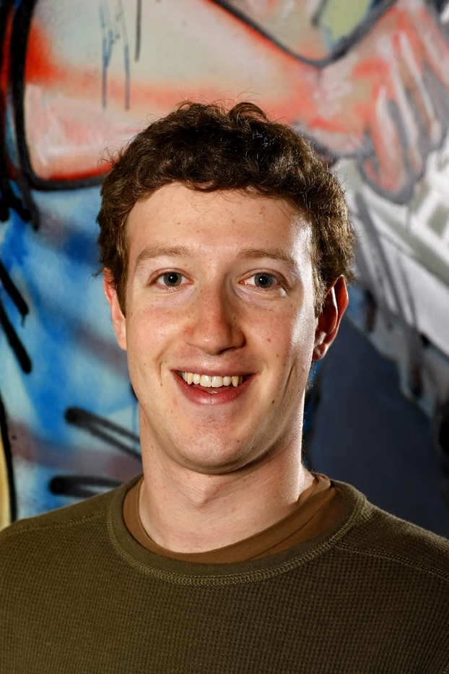
Mark Zuckerberg
Notes:
Jewish
Born and raised in Dobbs Ferry, NY
Attended Ardsley High School and the Phillips Exeter Academy (boarding school)
Recruited by Microsoft and AOL in his senior year
But choose to go to Harvard
Harvard did not distribute a student directory
He hacked into the school’s records and put up Facemash which was similar to Hot or Not
He got into a lot of trouble from the admins
Still it was the precursor to Facebook

Slide 8
Growth and Success
Mark decided to leave Harvard and work on Facebook full time
The moved around from office to office just barley getting by
By fall 2005, they received $12.7 million more financing and had 5 million monthly active users

Slide 9
User Generated Content (UGC)
Or Consumer Generated Media (CGM)
Defined: Media content that is publicly available and produced by end-users (user).
Usually supported by a social network
Examples: Blogs, Micro-blogs, YouTube video, Flickr photos, Wiki content, Facebook wall posts, Second Life…

Slide 10
What is Social Network?
Online communities of people who share interests and activities,
… or who are interested in exploring the interests and activities of others.
Examples: Facebook, MySpace, LinkedIn, Orkut
Notes:
These are what most people think of when it comes to social media.
Social Networks usually begin with catering to a specific audience and, in the case of MySpace and Facebook, open to the general public when they hit critical mass.
These are the three most popular social networks.

Slide 11
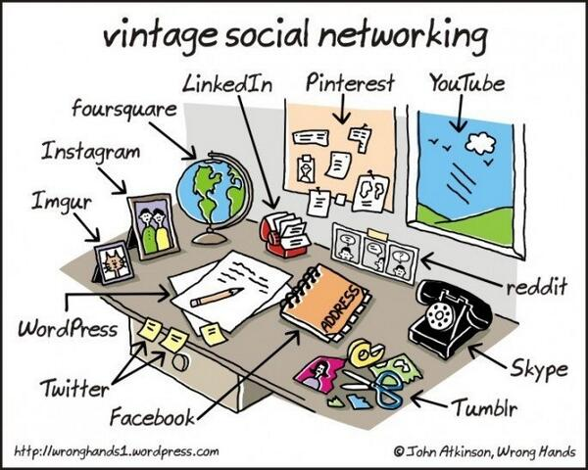

Slide 12
Social Media Principles
Who you are
Personalization
Who you know
Brows network
What you do
Generate an activity stream
Share an activity stream
Process an activity stream

Slide 13
Generate an activity stream
Automatic
Google History, Google Analytics
Blog
Micro-blog
Twitter, yammer, identi.ca
Mailing groups
Google groups
Social network tools
Facebook, Digg, FriendFeed

Slide 14
Share activity stream
Web pages
Twitter, Facebook, friendFeed…
email
Sms
twitter
IM
Twitter…
RSS Feeds

Slide 15
Process activity streaming
Overwhelming amount of information
Need for abstraction
Collaborative analysis
Automatic formatting

Slide 16
Tactics for Any Budget
Host a blog
Participate on industry leading blogs and conversations
Host or sponsor a podcast
Host/participate on discussion boards
Try Viral video
Create a group on a social network
Run media on a social network
Add social bookmarking links to your content

Slide 17
Best Practices
Attempt to leverage an existing social networks.
Avoid creating your own network surrounding your brand:
Experiment with creating networks catering to specific audiences or special interests, not brands
Listen and study the community before you enter the discussion
Converse and don’t shout
Be prepared to relinquish control of the brand
Be honest and transparent about your involvement
Learn through experimentation

Slide 18
Successful Characteristics
Motivated
Has technical experience
Determined
Creative
Persistent

Slide 20
The Nature of Technology
“Good” or “Evil” - What do you think?

Slide 21
GOOD?

Slide 22
EVIL?

Slide 23
The Nature of Technology
Technology – Good or Evil?
NEITHER!
Technology is … a tool
Special kind of tool - amplifier
Depends on how it’s used
Creates change

Slide 24
Control

Slide 25
Control
Technology impacts people’s sense of
control over their lives
Positive Aspects
Structure free time / Configure your life
Easier to establish/maintain relationships
Negative Aspects
“Do more in less time”
Privacy Issues / Identity Theft / “Phishing”

Slide 26
THANK YOU
Learning.upnyk.ac.id
Create new account
List of email
Enroll

