Slide 1
Group structure
Sistem Informasi UPN “Veteran” Yogyakarta

Slide 2
Why study group structure?
Team player a person who works willingly in cooperation with others for the benefit of the whole team.
Group structure and process
Group structure the relatively stable pattern of relationships among different group members.

Slide 3
Power structure
Power the capacity of individuals to overcome resistance on the part of others, to exert their will, and to produce results consistent with their interests and objectives
Status structure
Formal status the collection of rights and obligations associated with a position, as distinct from the person who may occupy that position.
Social status the relative ranking that a person holds and the value of that person as measured by a group.
Sociometry the study of interpersonally feelings and relationships within groups

Slide 4
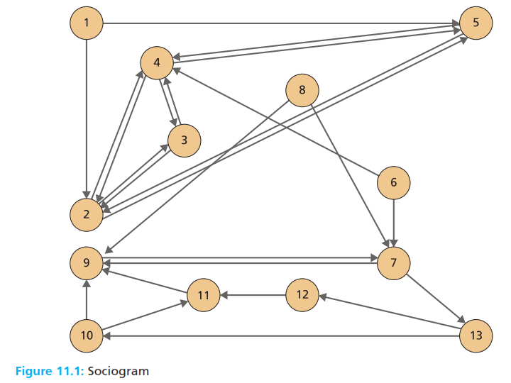
Liking structure
Sociogram a chart which shows the liking (social attraction) relationships between individual members of a group.

Slide 5
Liking structure
Communication network analysis a technique that uses direct observations to determine the source, direction, and quantity of oral communication between congregated members of a group

Slide 6
Communication structure
Communication a chart that indicates the source, direction, and quantity of oral communication between the members during a group meeting.
Communication pattern analysis a technique that uses analysis of documents, data, and voicemail transmission to determine the source, direction, and quantity of oral and written communication between the dispersed members of a group
Communication pattern chart indicates the source, direction, and quantity of oral and written communication between the dispersed members of a group.

Slide 7
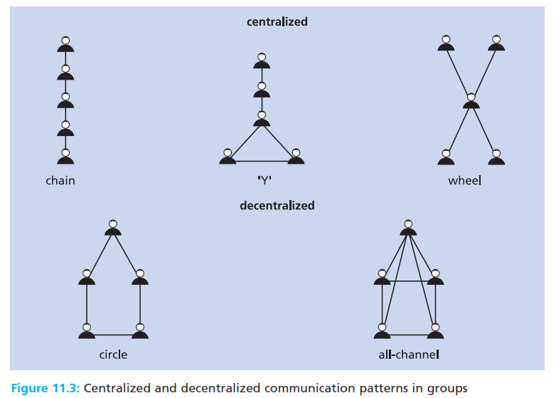
Communication structure
Communication a chart that indicates the source, direction, and quantity of oral communication between the members during a group meeting.
Communication pattern analysis a technique that uses analysis of documents, data, and voicemail transmission to determine the source, direction, and quantity of oral and written communication between the dispersed members of a group
Communication pattern chart indicates the source, direction, and quantity of oral and written communication between the dispersed members of a group.

Slide 8
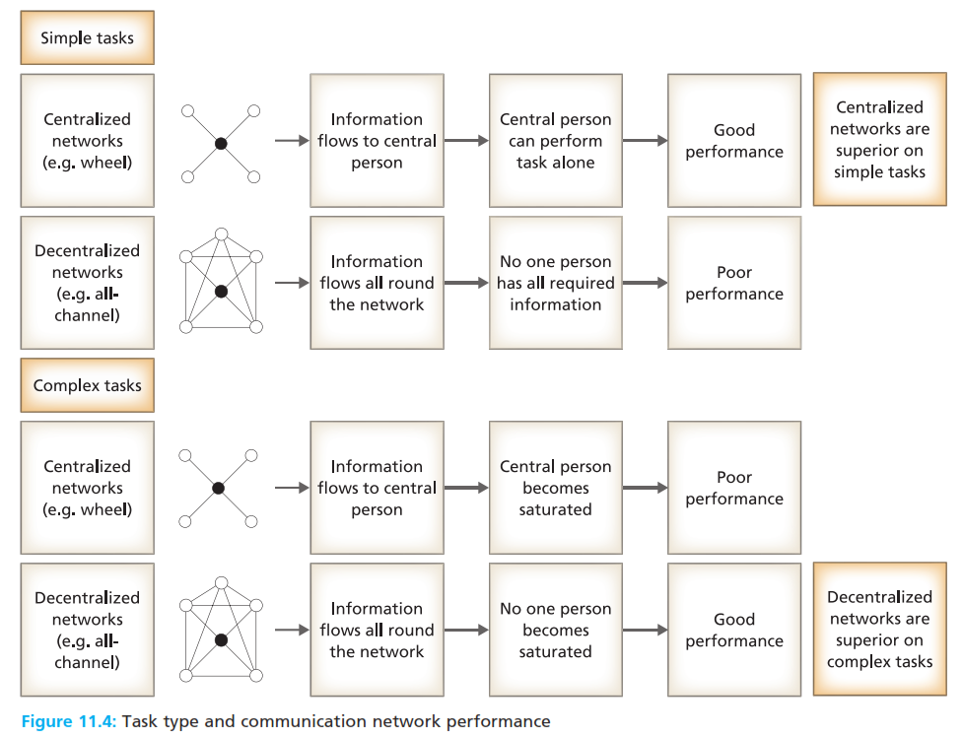
Communication structure
Communication a chart that indicates the source, direction, and quantity of oral communication between the members during a group meeting.
Communication pattern analysis a technique that uses analysis of documents, data, and voicemail transmission to determine the source, direction, and quantity of oral and written communication between the dispersed members of a group
Communication pattern chart indicates the source, direction, and quantity of oral and written communication between the dispersed members of a group.

Slide 9
Interaction Process analysis
Interaction process analysis a technique used to categorize the content speech
Task activity an oral input, made by a group member, that contributes directly to the groups work task
Maintenance activity an oral input made by a group members, that reduces confict, maximizes cohesion, and maintains relationships within a group

Slide 10
Role structure
Social role the set of expectations that others hold of an occupant of a position.
Team role an individual’s tendency to behave in preferred ways which contribute to, and interrelate with, other members within a team.

Slide 11
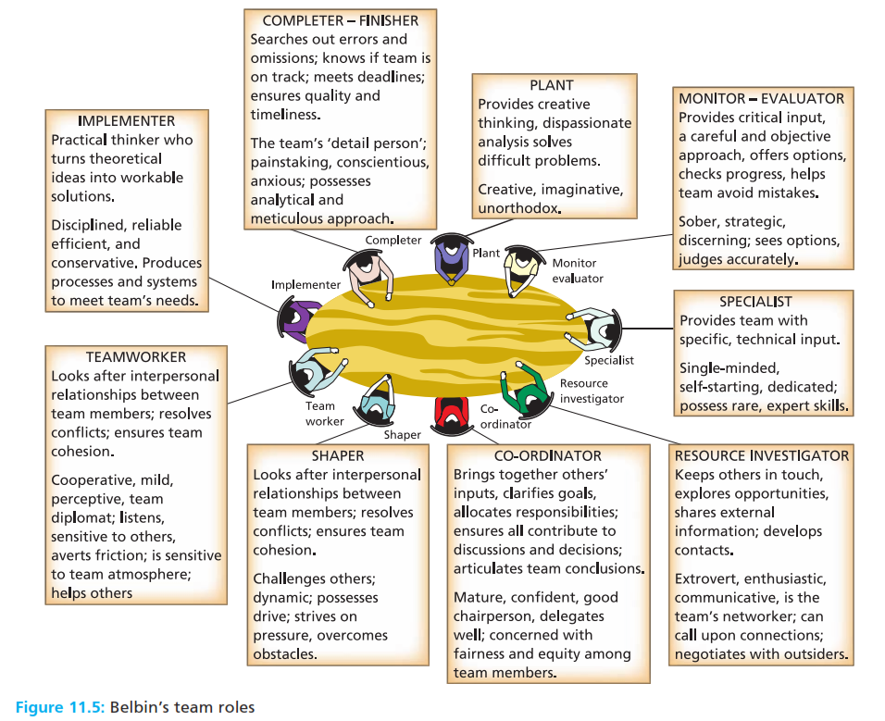
Role structure
Social role the set of expectations that others hold of an occupant of a position.
Team role an individual’s tendency to behave in preferred ways which contribute to, and interrelate with, other members within a team.

Slide 12
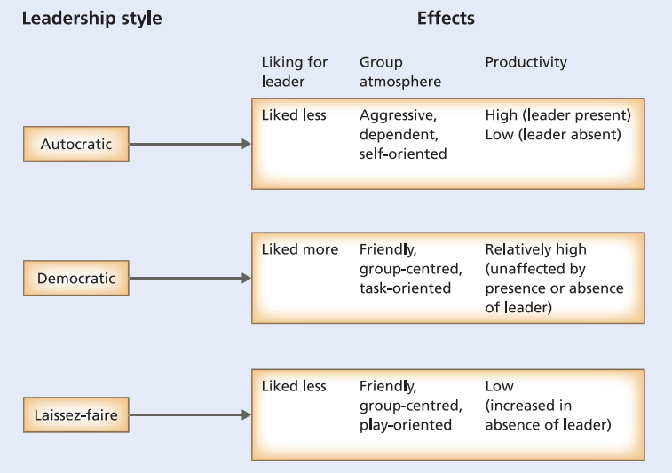
Leadership structure
Social role the set of expectations that others hold of an occupant of a position.
Team role an individual’s tendency to behave in preferred ways which contribute to, and interrelate with, other members within a team.

Slide 13
Virtual teams
Virtual team a team that rellies on technology mediated communication, while crossing boundaries of geography, time, culture, and organization, to accomplish an interdependent task.
Global virtual team a team that is nationally geographically, and culturally diverse and which communicates almost exclusively through electronic media
Synchronous communication communication that occurs when people are online at the same time, engaging in a real time conversation with others, somewhat similar to normal face to face discussions.
Asynchronous communication communication that occurs when participants start a discussion topic (or thread) and post replies to each other, and when, after delays, individuals read to catch up with the discussion. It is similar to a dialogue conducted by post.

Slide 14
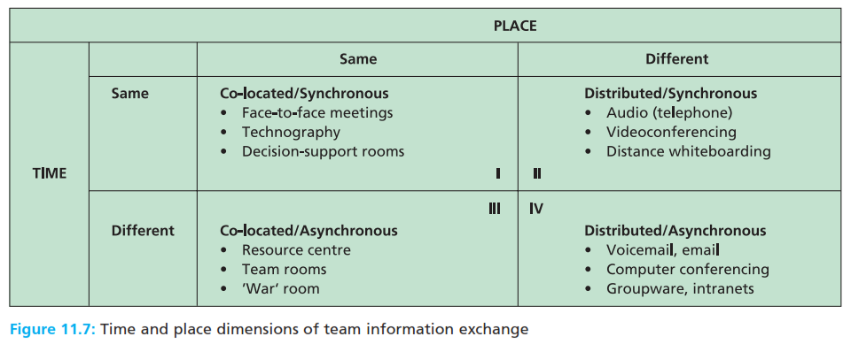
Virtual teams
Virtual team a team that rellies on technology mediated communication, while crossing boundaries of geography, time, culture, and organization, to accomplish an interdependent task.
Global virtual team a team that is nationally geographically, and culturally diverse and which communicates almost exclusively through electronic media
Synchronous communication communication that occurs when people are online at the same time, engaging in a real time conversation with others, somewhat similar to normal face to face discussions.
Asynchronous communication communication that occurs when participants start a discussion topic (or thread) and post replies to each other, and when, after delays, individuals read to catch up with the discussion. It is similar to a dialogue conducted by post.

Slide 15
Reference
Huczynski, Buchanan, 2013 , Organizational Behaviour, Pearson
Umam, Khaerul, 2012, Manajemen Organisasi, Pustaka Setia.
Wardiah, Mia Lasmi, Teori perilaku dan budaya organisasi, Pustaka Setia.

