Slide 1
MANAJEMEN PROYEK PERANGKAT LUNAK
Yuli Fauziah, S.T., M.T.

Slide 2
IT Project Management and Organizational Context

Slide 3
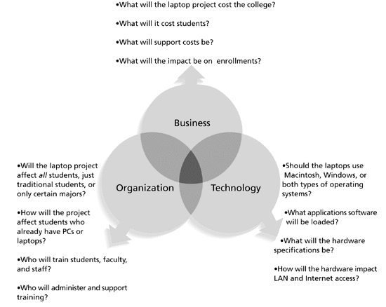
Three Sphere Model for Systems Management

Slide 4
The Organization Frames
Structural frame Focuses on roles and responsibilities, coordination, and control. Organization charts help define this frame.
Human Resources frame Focuses on providing harmony between needs of the organization and needs of people.
Political frame Assumes organizations are coalitions composed of varied individuals and interest groups. Conflict and power are key issues.
Symbolic frame Focuses on symbols and meanings related to events. Culture is important.

Slide 5
Many Organizations Focus on the Structural Frame
Most people understand what organizational charts are.
Many new managers try to change organizational structure when other changes are needed.
Three basic organizational structures:
Functional: Functional managers report to the CEO.
Project: Program managers report to the CEO.
Matrix: Middle ground between functional and project structures; personnel often report to two or more bosses; structure can be a weak, balanced, or strong matrix.

Slide 6
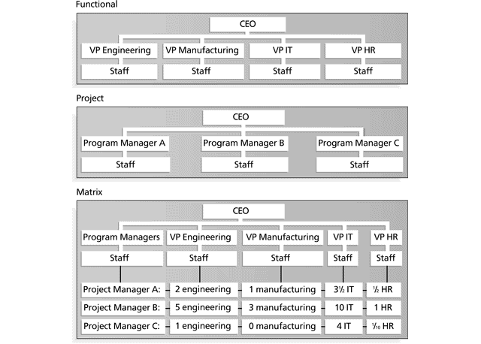
Functional, Project, and Matrix Structures

Slide 7
Functional Organization Structure
Organisasi fungsional umum ditemui pada perusahaan-perusahaan yang memproduksi suatu barang.
Keuntungan : Kesederhanaan dalam komunikasi dan efisiensi proses yang berulang.
Kerugian:
Bila menghadapi sebuah proyek antar divisi, pergerakan dari tiap anggota tim akan terbatasi oleh sekat-sekat divisi dan manajer proyek dapat merangkap menjadi manajer salah satu divisi yang mengakibatkan keputusannya terpengaruh kedudukannya pada divisi.
Komunikasi menjadi sangat terbatas (umumnya top down) dan kreativitas terbatasi oleh rangkaian persetujuan birokratis.

Slide 8
Projectized Organization Structure
Tipe organisasi ini ada pada beberapa kelompok konsultan freelancer yang bekerja secara lepas tetapi memiliki seorang koordinator. Manajer proyek memiliki kuasa yang besar selama sebuah proyek berlangsung.
Keuntungan : Kemudahan untuk memasukkan seorang konsultan luar, efisiensi dalam mengerjakan proyek, kemudahan untuk membagikan sumber daya antar proyek, fleksibilitas dan independensi yang besar dari tiap karyawannya.
Kekurangan : Setiap karyawan harus cukup memiliki motivasi, bertanggung jawab, dan terbiasa untuk mengambil inisiatif. Struktur ini tidak terlalu cocok bila perusahaan memiliki banyak aspek administrasi atau operasi.

Slide 9
Matrix Organization Structure
Kombinasi dari Struktur Organisasi Fungsional dan Struktur Organisasi Divisional dengan tujuan untuk menutupi kekurangan-kekurangan yang terdapat pada kedua bentuk Struktur Orgnisasi tersebut.
Keuntungan : Pemanfaatan sumber daya manusia yang efisien, anggota tim mempunyai pekerjaan operasional tetap setelah proyek selesai, sharing pengetahuan antar divisi yang lebih baik dari pada tipe fungsional, dan adanya keterlibatan stakeholder yang kuat.
Kekurangan : Dengan adanya dua buah atasan, karyawan bawah harus melapor pada dua atasan dan hal ini dapat membingungkan. Atasan-atasan dapat memperebutkan karyawan sehingga membingungkan mereka dalam membuat prioritas kerja dan memahami perannya. Prosedur komunikasi dan pemanfaatan sumber daya harus ada dan jelas untuk menghindari kekacauan ini.

Slide 10
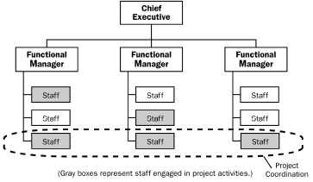
Weak Matrix
Manajer proyek memiliki kekuatan besar, peran manajer fungsional berkurang menjadi sekedar orang yang bertanggung jawab untuk menyediakan sumber daya untuk proyek seperti pelatihan anak buahnya

Slide 11
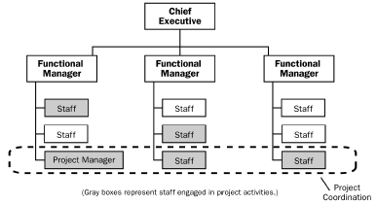
Manajer proyek yang fungsional sama-sama kuat, umumnya membutuhkan komunikasi dan prosedur yang jelas agar tidak saling memperebutkan sumber daya manusia.
Balanced Matrix

Slide 12
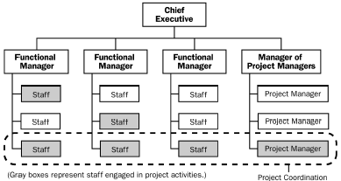
Strong Matrix
Manajer proyek hanya berfungsi sekedar untuk koordinasi proyek dan dokumentasi. Dia tidak memiliki kekuatan apapun

Slide 13
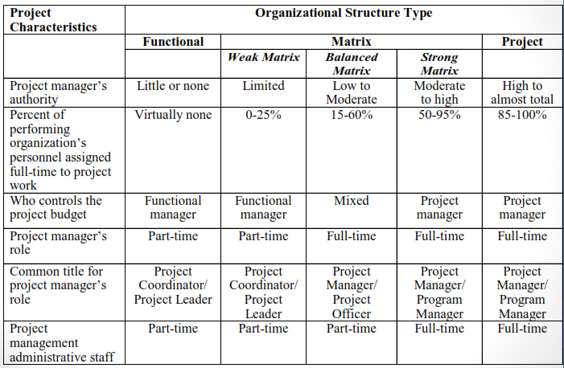
Organizational Structure Influences on Projects
PMBOK Guide, 2000, 19, and PMBOK Guide 2004, 28.

Slide 14
Portfolio vs Program
Program
Group of projects
Management is coordinated because they are related
Portfolio
Group of programs to achieve a business goal.
Programs might not be related.
It is important to serve for same business goal.

Slide 15
Example Portfolio and Program
Google will develop 3 new features/application in 5 years.
Strategic goal: to be the world’s most information technology company
Project
Program
Street View
Google Maps
Map Direction
Portfolio
Satellite View
5 Year New Features / Application
Google Scholar
Academic Profile
Journal Rating
Google Drive
Cloud Storage
Collaboration File

Slide 16
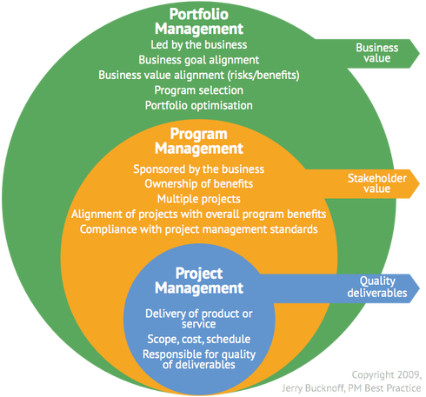

Slide 17
Project Management Office (PMO)
Department centralizes the management of projects PMO Structures:
Supportive: Supplies templates, best practices, training, lessons learned…etc. Acts as repository. (Low degree of control)
Controlling: Supports and requires compliance to tools, methods. (Moderate degree of control)
Directive: Directly manages the projects. (High degree of control)

Slide 18
PMO Jobs
Manage interdependencies between projects
Help provide resources
Terminate projects
Monitor compliance with organizational processes
Gather lessons learned
Provide templates
Provide guidance
Provide centralized communication about the projects
Be part of change control board
Be a stakeholder

Slide 19
CONSTRAINS
CUSTOMER
SATISFACTION
RISK
If there is a change on one constraint, evaluate its effect on other constraints
For example, if your schedule is shortened, there might be
Additional resources (cost increase)
Faster completion (risk increase, quality decrease)
QUALITY
RESOURCE
SCOPE
TIME
COST

Slide 20
Organizational Culture
Organizational culture is a set of shared assumptions, values, and behaviors that characterize the functioning of an organization.
Many experts believe the underlying causes of many companies’ problems are not the structure or staff, but the culture.
Ten Characteristics of Organizational Culture :
• Member identity*
• Risk tolerance*
• Group emphasis*
• People focus
• Reward criteria*
• Conflict tolerance*
• Unit integration*
• Means-ends orientation
• Control
• Open-systems focus*
*Project work is most successful in an organizational culture where these characteristics are highly prevalent (common) and where the other characteristics are balanced.

Slide 21
Stakeholder
Stakeholder adalah individu atau organisasi yang aktif terlibat dalam proyek, atau siapa saja yang bisa dipengaruhi oleh hasil penyelesaian proyek atau eksekusi proyek.
Tim manajemen proyek harus mengidentifikasi stakeholder, menentukan kebutuhan dan ekspektasinya, serta mengelola kemungkinan-kemungkinan yang dipengaruhinya guna memastikan sukses sebuah proyek.
Stakeholder meliputi:
Manajer Proyek
Pelanggan/pengguna
Organisasi Pelaksana
Anggota tim proyek
Tim manajemen proyek
Sponsor
Influencer (orang-orang yang berpengaruh)
Kantor manajemen proyek

Slide 22
Stakeholder Management
Sponsor Proyek
Project managers must take time to identify,understand, and manage relationships with all project stakeholders.
Manajer Proyek
Using the four frames of organizations can help you meet stakeholder needs and expectations
Tim
Manajemen Proyek
Tim Proyek
Senior executives and top management are very
important stakeholders.
Stakeholder Proyek
Proyek

Slide 23
Stakeholders (For Example)
Proyek E-Government Kota Yogyakarta
Stakeholders :
Semua yang bekerja pada proyek tersebut (Programer, Analis, Teknisi, dll)
Pemerintah Kota Yogyakarta
Perusahaan yang berada di sekitar Kota Yogyakarta
Penduduk yang ada disekitaran Kota Yogyakarta
………

Slide 24
Importance of Top Management Commitment
Beberapa studi menyebutkan komitmen top management sebagai salah satu faktor kunci yang terkait dengan keberhasilan proyek.
Top Management dapat membantu manajer proyek dalam:
Mengamankan sumber daya yang memadai.
Mendapatkan persetujuan untuk kebutuhan proyek yang unik tepat waktu.
Menerima kerja sama dari orang-orang di seluruh organisasi.
Belajar bagaimana menjadi pemimpin yang lebih baik.

Slide 25
Project Life Cycle
Manajer proyek atau organisasi dapat membagi proyek menjadi beberapa tahap, untuk menciptakan kontrol manajemen yang lebih baik sesuai dengan mata rantai operasional yang terus menerus dilaksanakan organisasi.
Definition
Planning
Execution
Delivery
Level of effort
1. Goals 2. Specifications 3. Tasks 4. Responsibilities 5. Teams
1. Schedules 2. Budgets 3. Resources 4. Risks 5. Staffing
1. Status reports 2. Changes 3. Quality 4. Forecasts
1. Train customer 2. Transfer documents 3. Release resources 4. Reassign staff 5. Lessons learned

Slide 26
Project Management Process Groups
A process is a series of actions directed toward a particular result.
Project management can be viewed as a number of interlinked processes.
The project management process groups include:
• Initiating processes
• Planning processes
• Executing processes
• Monitoring and controlling processes
• Closing processes
Life cycle can change from project to project, but project management process groups are same.

Slide 27
Project Phases

Slide 28
Project Phases
In the early phases of a project life cycle:
• Resource needs are usually lowest.
• The level of uncertainty (risk) is highest.
• Project stakeholders have the greatest opportunity to influence the project.
In the middle phases of a project life cycle:
• The certainty of completing a project increases.
• More resources are needed.
In the final phase of a project life cycle:
• The focus is on ensuring that project requirements were met.
• The sponsor approves completion of the project

Slide 29
Project Life Cycle IT
High Level Design
Detailed Design
Coding
Testing
Installation
Conversion
Turnover to Operations

Slide 30
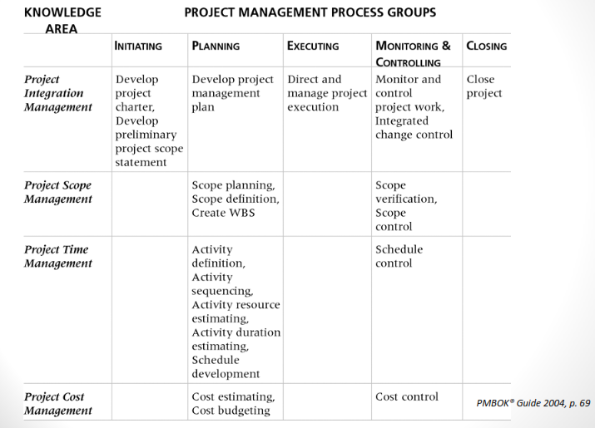
Relationships Among Process Groups & Knowledge Areas

Slide 31
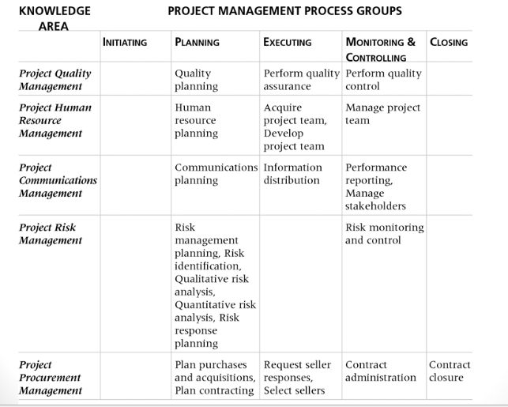
Relationships Among Process Groups & Knowledge Areas (con’t)

Slide 32
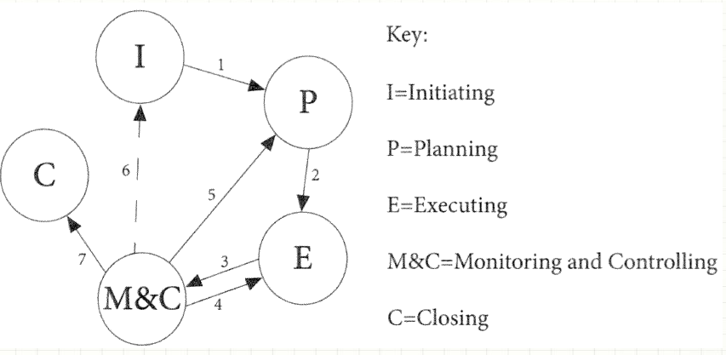
Project Management Process

Slide 33
Project Initiation
Initiating a project includes recognizing and starting a new project or project phase.
Some organizations use a pre-initiation phase, while others include items such as developing a business case as part of the initiation.
The main goal is to formally select and start off projects.
Key outputs include:
• Assigning the project manager.
• Identifying key stakeholders.
• Completing a business case.
• Completing a project charter and getting signatures on it.
Every organization has its own variations of what documents are required to initiate a project. It’s important to identify the project need, stakeholders, and main goals.

Slide 34
Project Planning
The main purpose of project planning is to guide execution.
Every knowledge area includes planning information.
Key outputs include:
A team contract.
A scope statement.
A work breakdown structure (WBS).
A project schedule, in the form of a Gantt chart with all dependencies and resources entered.
A list of prioritized risks (part of a risk register).

Slide 35
Due Date!
Stay within
Meet the
the budget
Deadline--schedule
Meet the
specifications

Slide 36
Work Breakdown Structure
Level
Program
1
Project 1
Project 2
2
Task 1.1
Task 1.2
3
Subtask 1.1.1
Subtask 1.1.2
4
Work Package 1.1.1.1
Work Package 1.1.1.2

Slide 37
Gantt Chart
Kegiatan | Minggu
 | 1 | 2 | 3 | 4 | 5 | 6 | 7 | 8
Penentuan atribut kualitas yang perlu dikendalikan
Mengumpulan data
Merancang peta control
Sosialisasi rancangan SPC
Training operator
Uji coba pelaksanaan SPC
Implementasi
Analisa penyebab cacat
Menghitung kemampuan proses
Dokumentasi

Slide 38
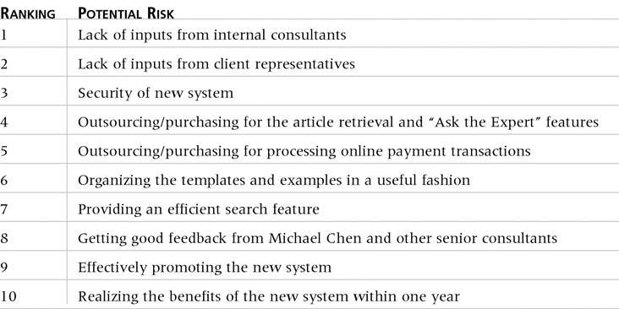
Prioritized Risk

Slide 39
Project Executing
Project execution usually takes the most time and resources.
Project managers must use their leadership skills to handle the many challenges that occur during project execution.
Many project sponsors and customers focus on deliverables related to providing the products, services, or results desired from the project.
A milestone report can keep the focus on completing major milestones.

Slide 40
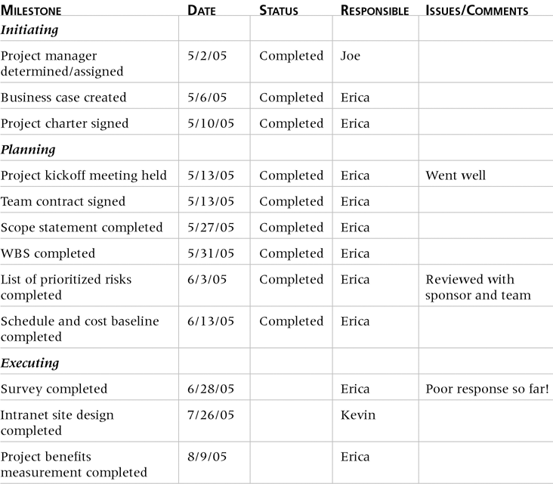
Milestone Report

Slide 41
Project Monitoring and Controlling
Involves measuring progress toward project objectives, monitoring deviation from the plan, and taking corrective action to match progress with the plan.
Affects all other process groups and occurs during all phases of the project life cycle.
Outputs include performance reports, requested changes, and updates to various plans.

Slide 42
Project Closing
Involves gaining stakeholder and customer acceptance of the final products and services.
Even if projects are not completed, they should be formally closed in order to reflect on what can be learned to improve future projects.
Outputs include project archives and lessons learned, which are part of organizational process assets.
Most projects also include a final report and presentation to the sponsor or senior management.

Slide 43
THANK YOU FOR YOUR ATTENTION

