Slide 1
UPN “VETERAN” YOGYAKARTA
E-Commerce
Chapter 3
Hari Prapcoyo,S.Kom., M.ICT
Sistem Informasi

Slide 2
E-Commerce infrastructure: the internet, web, and mobile platform
Learning objective:
Key of technology concepts behind, the internet
The current structure of the internet
The limitations of today’s internet and the potential capabilities of the internet of the future.
How the web works.
How internet and web features and services support e-commerce
The impact of mobile applications.

Slide 3
The internet : technology background
Internet : an interconnected network of thousands of networks and millions of computers linking businesses, educational institutions, government agencies, and individuals.
Web : one of the internet’s most popular services, providing access to billions, and perhaps trillions, of web pages.

Slide 4
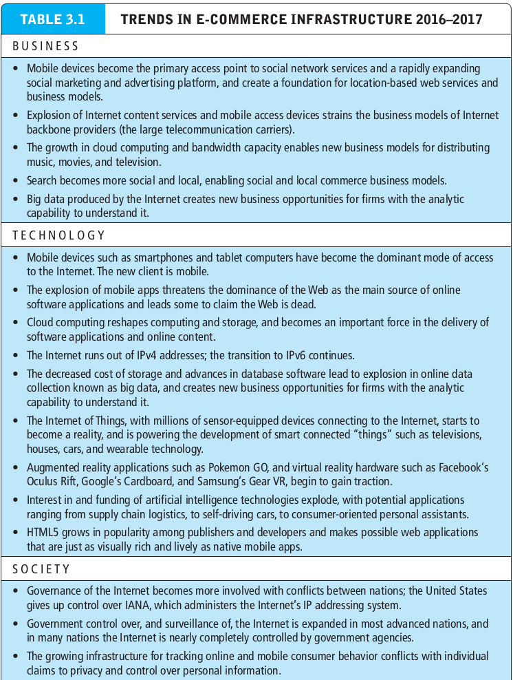
The internet : technology background
Internet : an interconnected network of thousands of networks and millions of computers linking businesses, educational institutions, government agencies, and individuals.

Slide 5
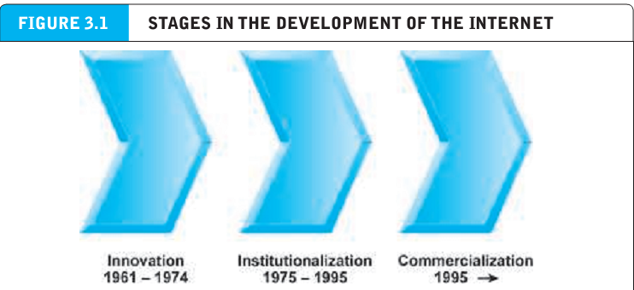
The evolution internet of the internet:1961-the present

Slide 6
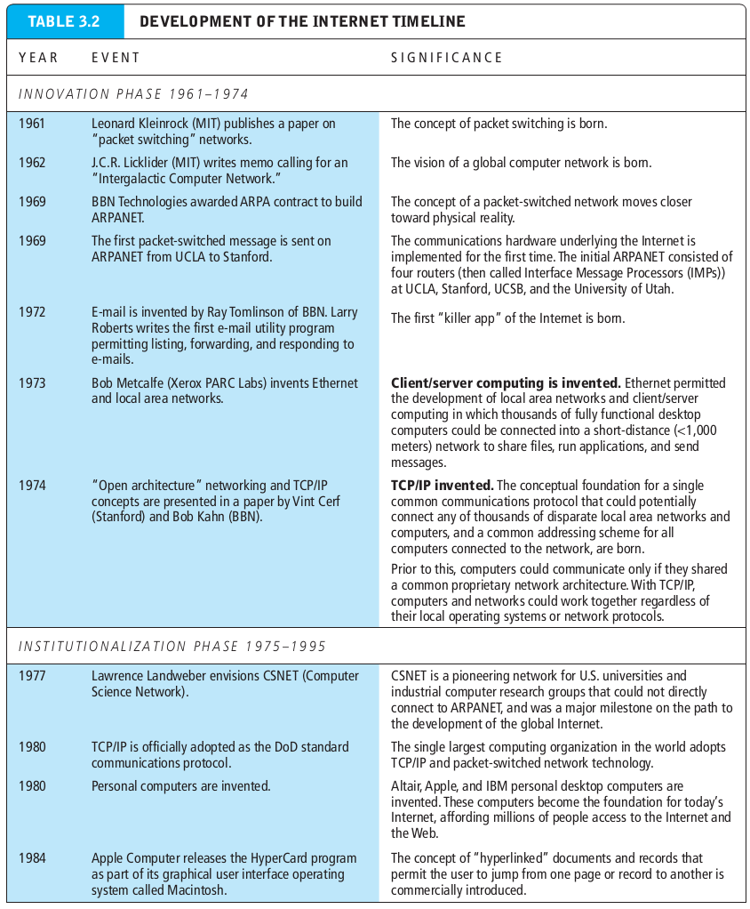
Development of the internet timeline

Slide 7
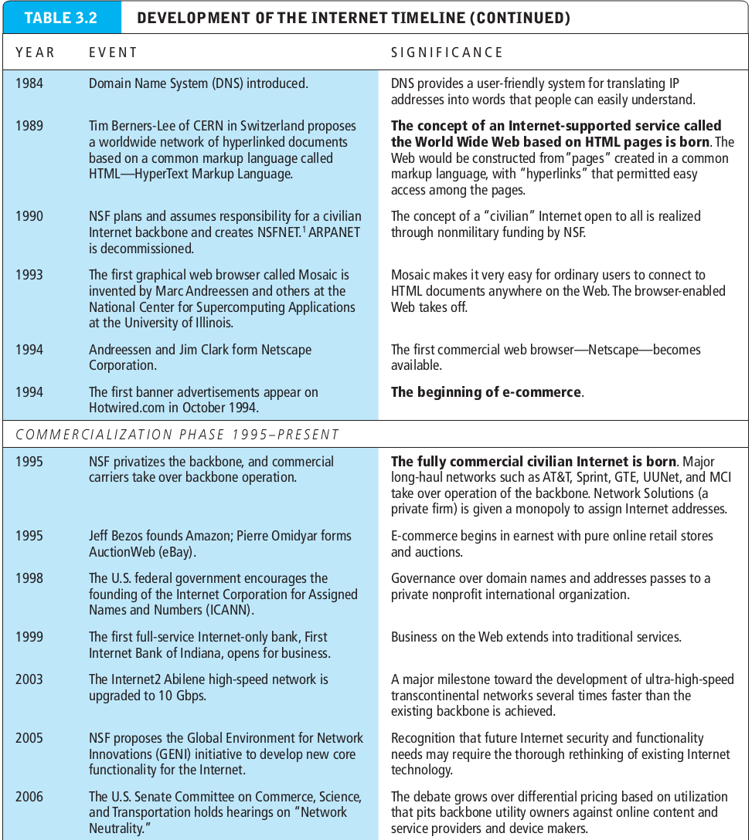
Development of the internet timeline

Slide 8
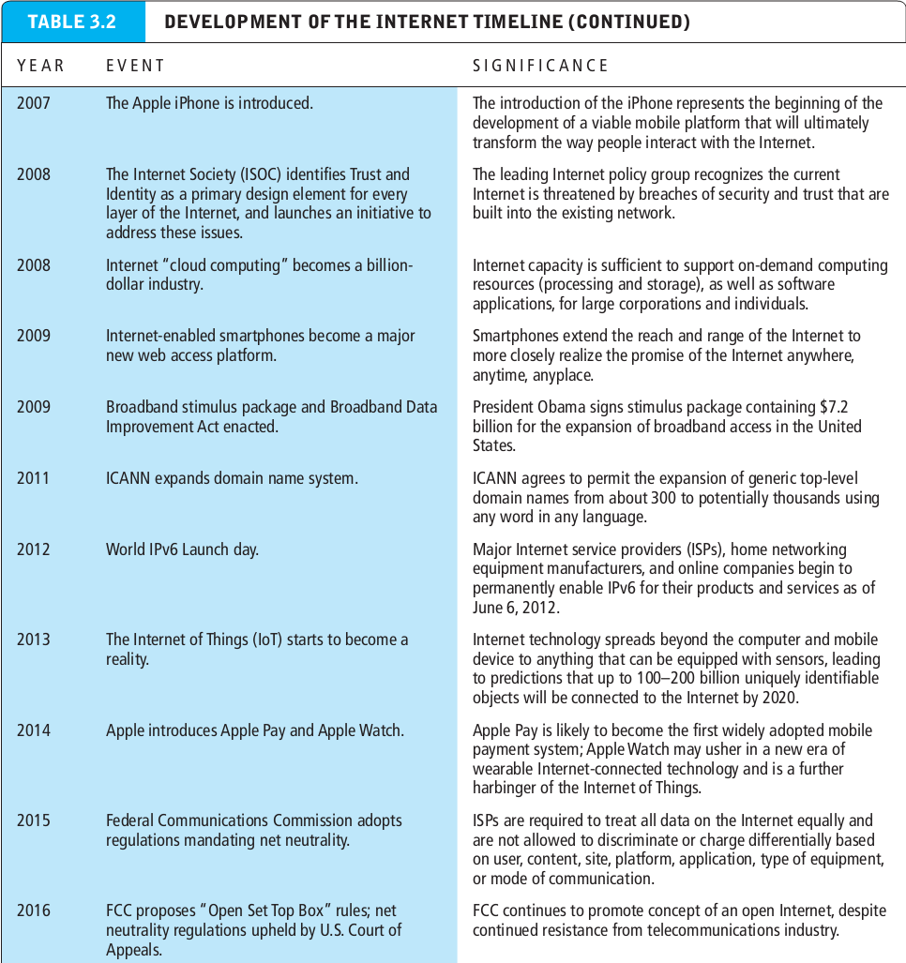
Development of the internet timeline

Slide 9
The internet : key technology concepts
Packet switching : a method of slicing digital messages into packets sending the packets along different communication paths as they become available, and then reassembling the packets once they arrive at their destination.
Packets : the discrete units into which digital messages are sliced for transmission over the internet.
Router : special purpose computer that interconnects the computer networks that make up the internet and routes packets to their ultimate destination as they travel the internet.

Slide 10
The internet : key technology concepts
Routing algorithm : computer program that ensures that packets take the best available path toward their destination.
Protocol : set of rules and standards for data transfer.
TCP/IP : core communications protocol for the internet.
TCP : establishes connections among sending and receiving computers and handles assembly and reassembly of packets.
IP : provides the internet’s addressing scheme and is responsible for delivery of packets.

Slide 11
The internet : key technology concepts
Network Interface Layer : responsible for placing packets on and receiving them from the network medium.
Internet layer : responsible for addressing, packaging, and routing messages on the internet.
Transport layer : responsible for providing communication with other protocols within TCP/IP suite.
Application layer : includes protocols used to provide user services or exchange data.
Border gateway protocol : enables exchange of routing information among system on the internet.

Slide 12
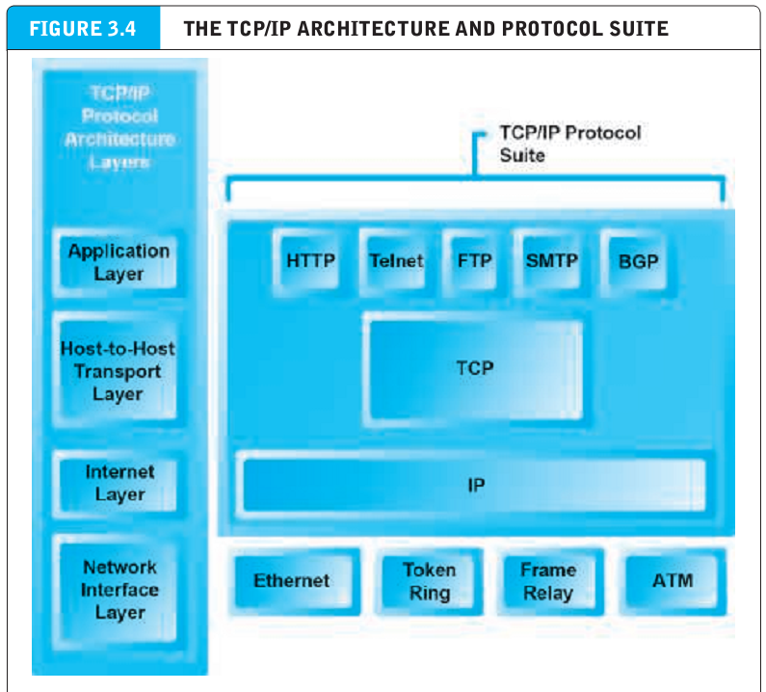
The internet : key technology concepts
Network Interface Layer : responsible for placing packets on and receiving them from the network medium.
Internet layer : responsible for addressing, packaging, and routing messages on the internet.
Transport layer : responsible for providing communication with other protocols within TCP/IP suite.
Application layer : includes protocols used to provide user services or exchange data.
Border gateway protocol : enables exchange of routing information among system on the internet.

Slide 13
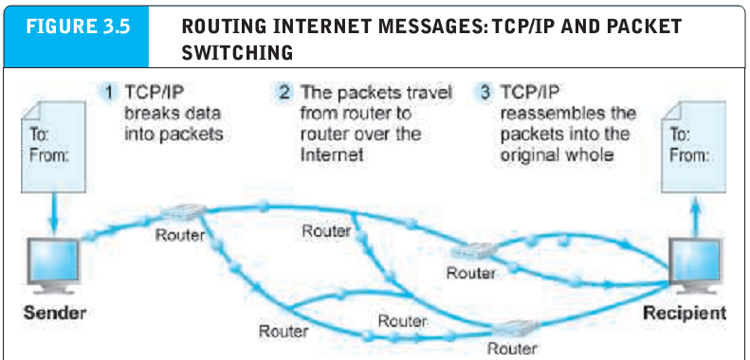
The internet : key technology concepts
IPv4 Internet address : internet address expressed as a 32-bit number that appears as a series of four separate numbers marked off by periods, such as 64.49.254.91

Slide 14
The internet : key technology concepts
IPv6 Internet address : internet address expressed as a 128-bit number.
Domain name : IP address expressed in natural language
Domain name system : system for expressing numeric IP addresses in natural language.
Uniform Resource Locator (URL) the address used by a web browser to identify the location of content on the web.

Slide 15
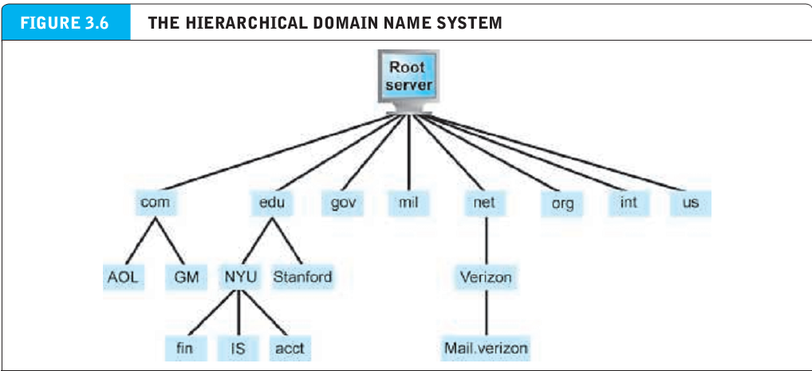
The internet : key technology concepts
IPv6 Internet address : internet address expressed as a 128-bit number.
Domain name : IP address expressed in natural language
Domain name system : system for expressing numeric IP addresses in natural language.
Uniform Resource Locator (URL) the address used by a web browser to identify the location of content on the web.

Slide 16
The internet : key technology concepts
IPv6 Internet address : internet address expressed as a 128-bit number.
Domain name : IP address expressed in natural language
Domain name system : system for expressing numeric IP addresses in natural language.
Uniform Resource Locator (URL) the address used by a web browser to identify the location of content on the web.

Slide 17
The internet : key technology concepts
Client/server computing a model of computing in which client computers are connected in a network together with one or more servers.
Client : a powerful desktop computer that is part of a network
Server : networked computer dedicated to common functions that the client computers on the network need.
Cloud computing : model of computing in which computer processing, storage, software, and other services are provided as shared pool of virtualized resources over the internet.

Slide 18
Cloud computing characteristics:
On-demand self-service : consumers can obtain computing capabilities such as server time or networks storage as needed automatically mobile platforms.
Ubiquitous network access : cloud resources can be assessed using standard network and internet devices, including mobile platforms.
Location-independent resource pooling : computing resources are pooled to serve multiple users, with different virtual resources dynamically assigned according to user demand.

Slide 19
Cloud computing characteristics:
Rapid elasticity : computing resources can be rapidly provisioned, increased, decreased to meet changing user demand.
Measured service : charges for cloud resources are based on the amount of resources actually used.
Infrastructure as a service(IaaS) : customers use processing, storage, networking, and other computing resources from third party providers called cloud service providers (CSPs) to run their information systems.

Slide 20
Cloud computing characteristics:
Software as a service(SaaS) : customers use software hosted by the vendor on the vendor’s cloud infrastructure and delivered as a service over a network.
Platform as a service(PaaS) : customers use infrastructure and programming tools supported by the CSP to develop their own applications.
Public cloud : third party service providers that own and manage large, scalable data centers that offer computing, data storage, and high speed internet to multiple customers who pay for only the resources they use.

Slide 21
Cloud computing characteristics:
Private cloud : providers similar options as public cloud but only to a single tenant.
Hybrid cloud : offers customers both a public cloud and a private cloud.

Slide 22
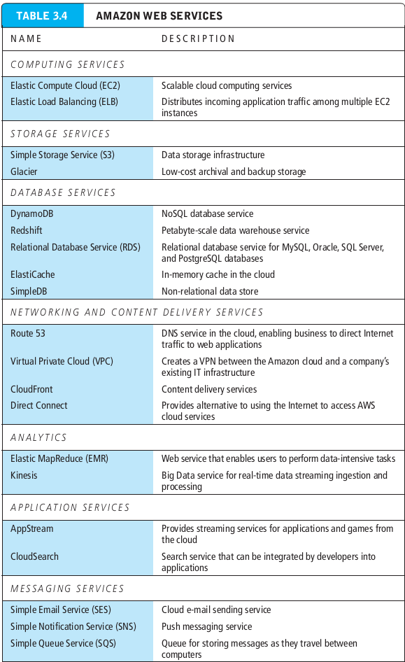
Cloud computing characteristics:
Rapid elasticity : computing resources can be rapidly provisioned, increased, decreased to meet changing user demand.
Measured service : charges for cloud resources are based on the amount of resources actually used.
Infrastructure as a service(IaaS) : customers use processing, storage, networking, and other computing resources from third party providers called cloud service providers (CSPs) to run their information systems.

Slide 23
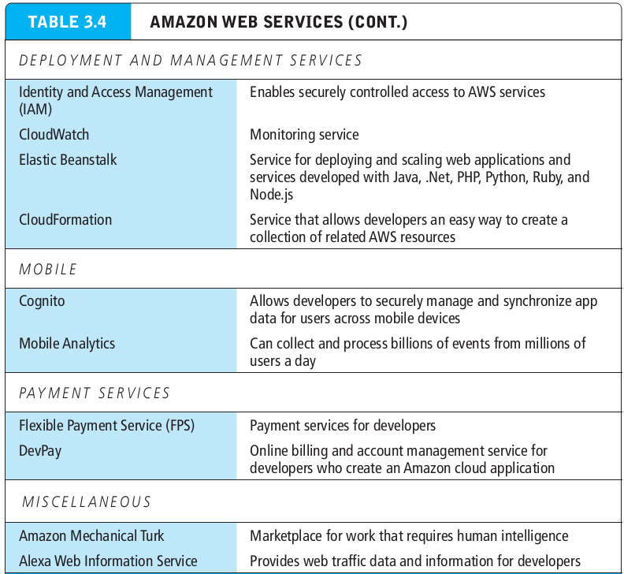
Cloud computing characteristics:
Rapid elasticity : computing resources can be rapidly provisioned, increased, decreased to meet changing user demand.
Measured service : charges for cloud resources are based on the amount of resources actually used.
Infrastructure as a service(IaaS) : customers use processing, storage, networking, and other computing resources from third party providers called cloud service providers (CSPs) to run their information systems.

Slide 24
The internet today
Network technology substrate layer : layer of internet technology that is composed of telecommunications networks and protocols.
Transport services and representation standards layer : layer of internet architecture that houses the TCP/IP protocol.
Application layer : layer of internet architecture that contains client applications.
Middleware services layer : the “glue” that ties the application to the communications networks and includes such services as security, authentication, addreses, and storage repositories.

Slide 25
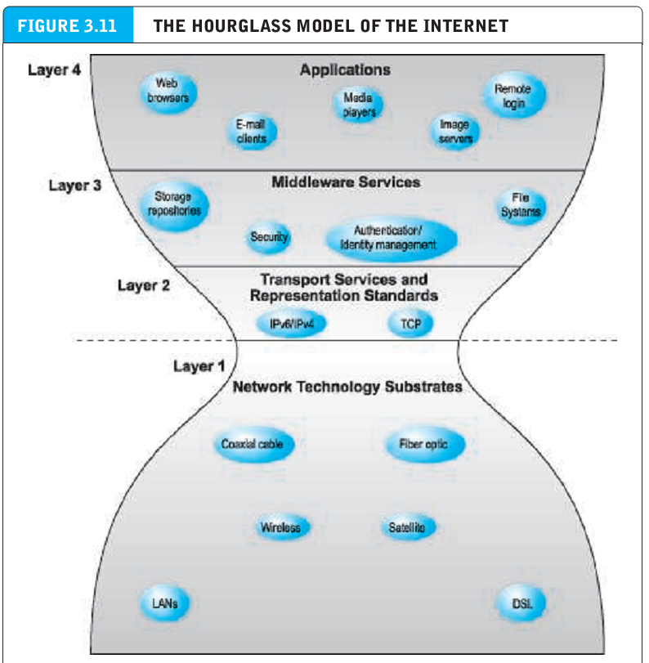
The internet today
Network technology substrate layer : layer of internet technology that is composed of telecommunications networks and protocols.
Transport services and representation standards layer : layer of internet architecture that houses the TCP/IP protocol.
Application layer : layer of internet architecture that contains client applications.
Middleware services layer : the “glue” that ties the application to the communications networks and includes such services as security, authentication, addreses, and storage repositories.

Slide 26
The internet backbone
Tier 1 Internet Service Providers (Tier 1 ISPs) : own and control the major long-haul fiber optic cable networks comprising the internet’s backbone.
Backbone : high-bandwith fiber-optic cable that transports data across the internet.
Bandwith : measures how much data can be transferred over a communication medium within a fixed period of time, is usually expressed in bits per second(bps) kilobits per second(kbps) megabits per second (mbps) or gigabits per second (gbps).

Slide 27
Limitations of the current internet
Bandwith limitations : there is insufficient capacity throughout the backbone.
Quality of service limitations : today’s information take a circuitous route to get to their final destinations.
Latency : delays in messages caused by the uneven flow of information packets through the network.
Network architecture limitations
Wired internet

Slide 28
The future internet infrastructure
Internet2 : advanced networking consortium of more than 450 member institutions wording in partnerships to facilitate the development, deployment, and use of revolutionary internet technologies.

Slide 29
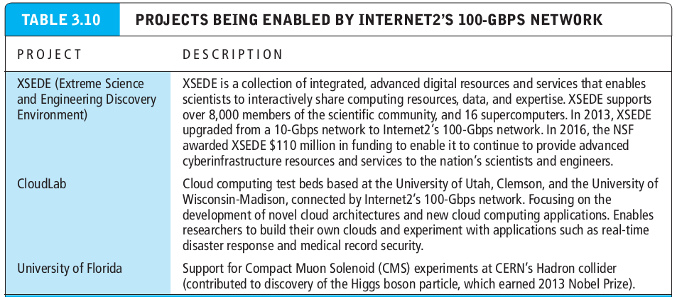
The future internet infrastructure
I

