Slide 1
Perception
Sistem Informasi UPN “Veteran” Yogyakarta

Slide 2
Why study perception?
Perception the dynamic psychological process responsible for attending to, organizing, and interpreting sensory data.
Selectivity and organization
Perceptual world the individual’s personal internal image, map, or picture of their social, physical and organizational environment.
Selective attention the ability, often exercised unconsciously, to choose from the stream of sensory data, to concentrate on particular elements, and to ignore others.
Perceptual threshold a boundary point, either side of which our senses respectively will or will not be able to detect stimuli such as sound, light or touch.
Habituation the decrease in our perceptual response to stimuli once they have become familiar.

Slide 3
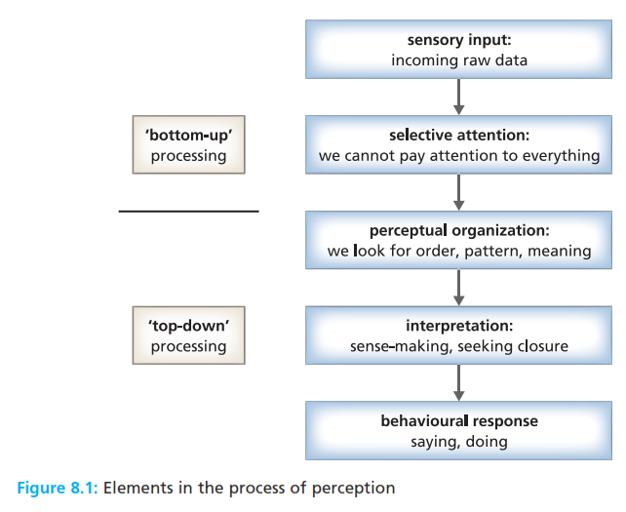
Selectivity and organization
Perception the dynamic psychological process responsible for attending to, organizing, and interpreting sensory data.

Slide 4
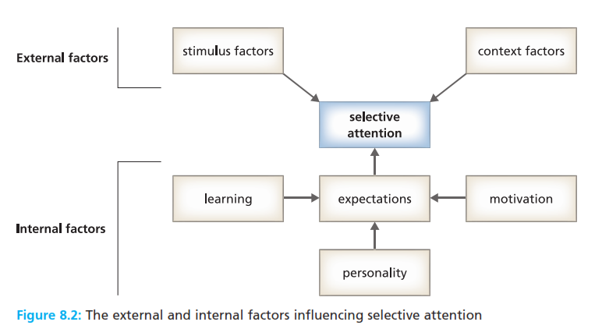
Selectivity and organization
Perception the dynamic psychological process responsible for attending to, organizing, and interpreting sensory data.

Slide 5
Selectivity and organization
Perceptual organization the process through which incoming stimuli are organized or patterned in systematic and meaningful ways.
Perceptual set an individual’s predisposition to respond to people and events in a particular manner.

Slide 6
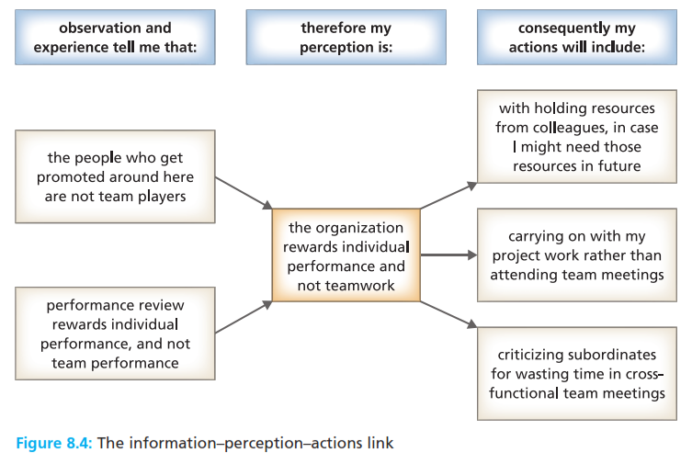
Selectivity and organization
Perceptual organization the process through which incoming stimuli are organized or patterned in systematic and meaningful ways.
Perceptual set an individual’s predisposition to respond to people and events in a particular manner.

Slide 7
Do we see to know or know to see?
Halo effect a judgement based on a single striking characteristics, such as an aspect of dress, speech, posture, or nationality.
Perceptual sets and assumptions
Stereotype a category or personality type to which we allocate people on the basis of their membership of some known group.
Self-fulfilling propechy a prediction that becomes true simply because someone expects it to happen.
Attribution the process by which we make sense of our environment through our perceptions of causality.

Slide 8
Reference
Huczynski, Buchanan, 2013 , Organizational Behaviour, Pearson
Umam, Khaerul, 2012, Manajemen Organisasi, Pustaka Setia.
Wardiah, Mia Lasmi, Teori perilaku dan budaya organisasi, Pustaka Setia.

