Slide 1
UPN “VETERAN” YOGYAKARTA
E-Commerce
Hari Prapcoyo,S.Kom., M.ICT
Chapter 2

Slide 2
E-Commerce business models and concepts
Learning objective:
Identify the key components of e-commerce business models
Describe the major B2C business models.
Describe the major B2B business models
Understand key business concepts and strategies applicable to e-commerce

Slide 3
E-Commerce business models
Business models : a set of planned activities designed to result in aa profit in a marketplace.
Business plan : a document that describes a firm’s business model
E-commerce business model : a business model that aims to use and leverage the unique qualities of the internet, the web, and the mobile platform

Slide 4
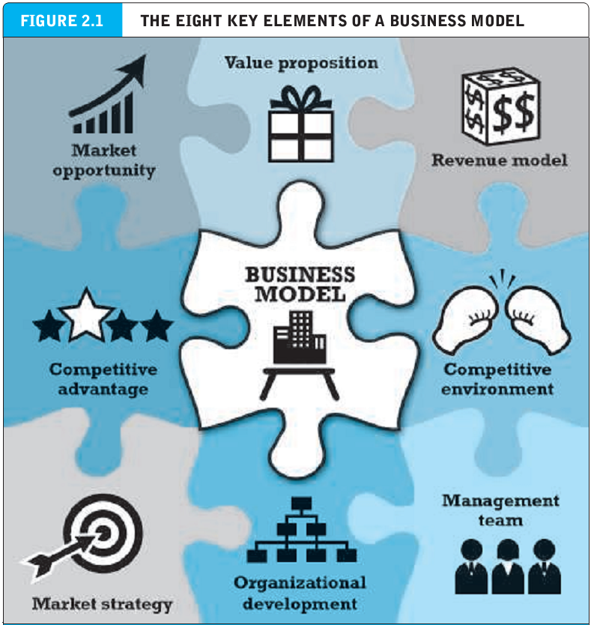
E-Commerce business models
Business models : a set of planned activities designed to result in aa profit in a marketplace.
Business plan : a document that describes a firm’s business model
E-commerce business model : a business model that aims to use and leverage the unique qualities of the internet, the web, and the mobile platform

Slide 5
Eight key elements of a business model
Value proposition : defines how a company’s or service fulfills the needs of customers
Revenue model : describes how the firm will earn revenue, produce profits, and produce a superior return on invested capital.
Advertising revenue model : a company provides a forum for advertisements and receives fees from advertisers.
Subscription revenue model : a company offers its users content or services charges a subscription fee for access to some or all of its offerings

Slide 6
Eight key elements of a business model
Freemium strategy : companies give away a certain level of product or services for free, but then charge a subscription fee for premium levels of the product or service.
Transaction fee revenue model : a company receives a fee for enabling or execution a transaction.
Sales revenue model : a company derives revenue by selling goods, information or services.
Affiliate revenue model : a company steers business to an affiliate and receives a referral fee or percentage of the revenue from any resulting sales.

Slide 7
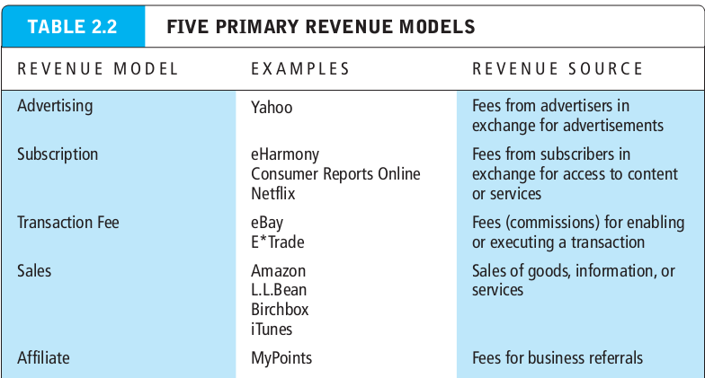
Eight key elements of a business model
Freemium strategy : companies give away a certain level of product or services for free, but then charge a subscription fee for premium levels of the product or service.
Transaction fee revenue model : a company receives a fee for enabling or execution a transaction.
Sales revenue model : a company derives revenue by selling goods, information or services.
Affiliate revenue model : a company steers business to an affiliate and receives a referral fee or percentage of the revenue from any resulting sales.

Slide 8
Eight key elements of a business model
Market opportunity : refers to the company’s intended marketspace and the overall potential financial opportunities available to the firm in that marketspace
Marketspace : the area of actual or potential commercial value in which a company intends to operate.
Competitive environment : refers to the other companies operating in the same marketspace selling similar products

Slide 9
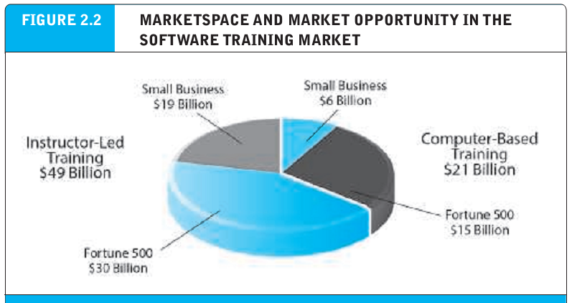
Eight key elements of a business model
Market opportunity : refers to the company’s intended marketspace and the overall potential financial opportunities available to the firm in that marketspace
Marketspace : the area of actual or potential commercial value in which a company intends to operate.
Competitive environment : refers to the other companies operating in the same marketspace selling similar products

Slide 10
Eight key elements of a business model
Competitive advantage : achieved by a firm when it can produce a superior product and/or bring the product to market at a lower price than most, or all, of its competitors.
Asymmetry : exists whenever one participant in a market has more resources than other participants.
First-mover advantage : a competitive market advantage for a firm that results from being the first into a marketplace with a serviceable product or service

Slide 11
Eight key elements of a business model
Complementary resources : resources and assets not directly involved in the production of the product but required for success, such as marketing, management, financial assets, and reputation.
Unfair competitive advantage : occurs when one firm develops an advantage based on a factor that other firms cannot purchase.
Perfect market : a market in which there are no competitive advantages or asymmetries because all firms have equal access to all the factors of production.

Slide 12
Eight key elements of a business model
Leverage : when a company uses its competitive advantages to achieve more advantage in surrounding markets.
Market strategy : the plan you put together that details exactly how you intend to enter a new market and attract new customers.
Organizational development : plan that describes how the company will organize the work that needs to be accomplished.
Management team : employees of the company responsible for making the business model work.

Slide 13
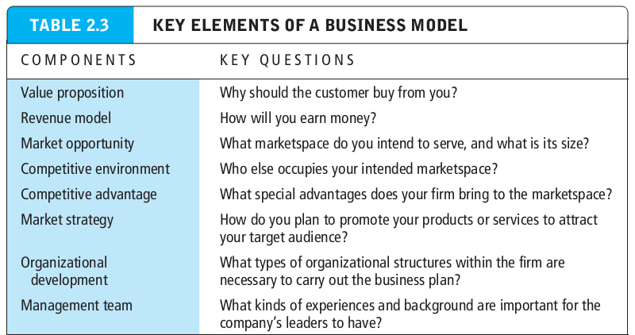
Eight key elements of a business model
Leverage : when a company uses its competitive advantages to achieve more advantage in surrounding markets.
Market strategy : the plan you put together that details exactly how you intend to enter a new market and attract new customers.
Organizational development : plan that describes how the company will organize the work that needs to be accomplished.
Management team : employees of the company responsible for making the business model work.

Slide 14
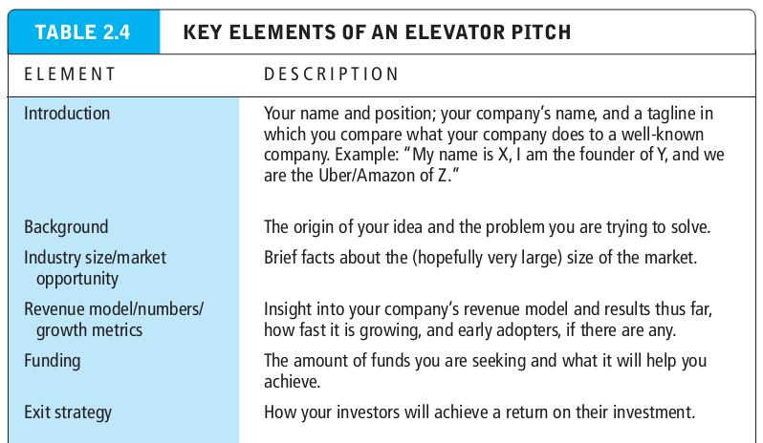
Eight key elements of a business model
Leverage : when a company uses its competitive advantages to achieve more advantage in surrounding markets.
Market strategy : the plan you put together that details exactly how you intend to enter a new market and attract new customers.
Organizational development : plan that describes how the company will organize the work that needs to be accomplished.
Management team : employees of the company responsible for making the business model work.

Slide 15
Eight key elements of a business model
Seed capital : typically, an entrepreneur’s personal funds derived from savings, credit card advances, home equity loans, or from family and friends.
Elevator pitch : short two to three minute presentation aimed at convincing investors to invest.
Incubators : typically provide a small amount of funding and also an array of services to start up companies.
Angel investors : typically wealthy individuals or a group of individuals who invest their own money in exchange for an equity share in the stock of a business; often are the first outside investors in a start up.

Slide 16
Eight key elements of a business model
Venture capital investors : typically invest funds they manage for other investors; usually later-stage investors;
Crowfunding : involves using the internet to enable individuals to collectively contribute money to support a project.

Slide 17
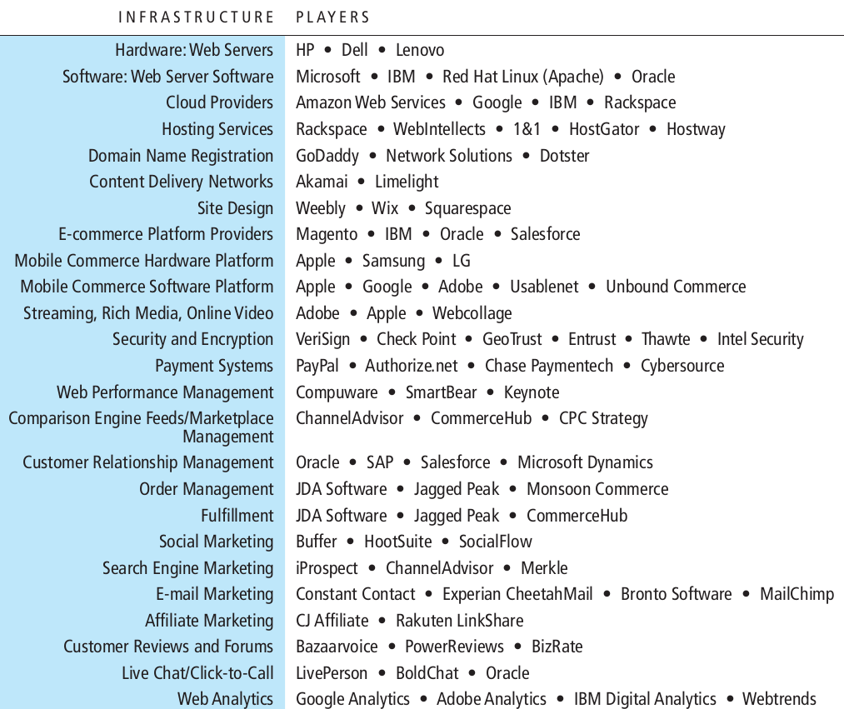
Major business to consumer(B2C) business models
E-tailer : online retail store

Slide 18
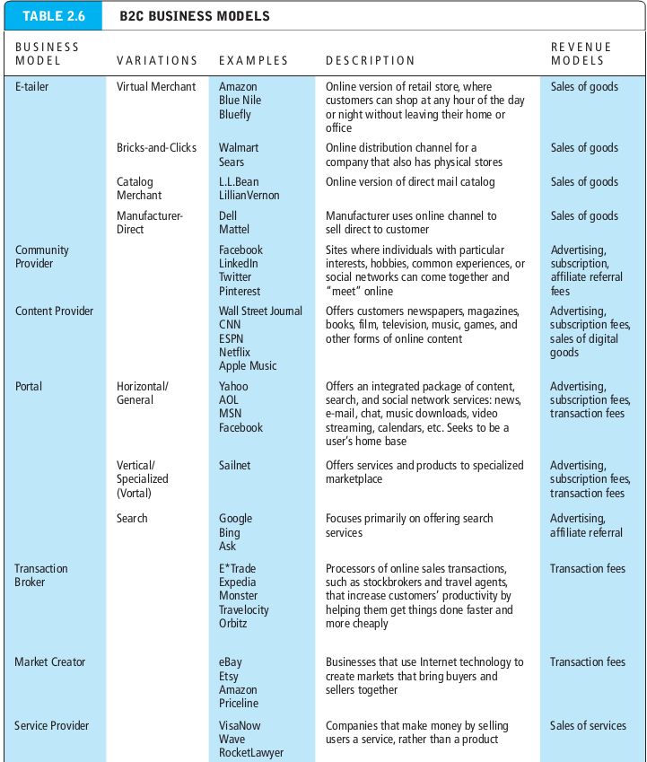
Major business to consumer(B2C) business models
E-tailer : online retail store

Slide 19
Major business to consumer(B2C) business models
E-tailer : online retail store
Barriers to entry : the total cost of entering a new marketplace.
Community provider : creates an online environment where people with similar interests can transact(buy and sell goods); shares interests, photos, and videos; communicate with like-minded people; and receive interest-related information.
Content provider : distributes information content, such as digital news, music, photos, video and artwork.
Portal : offers users powerful search tools as well as an integrated package of content and services all in one place.

Slide 20
Major business to consumer(B2C) business models
Transaction broker : processes transaction for consumers that are normally handled in person, by phone, or by email.
Market creator : builds a digital environment where buyers and sellers can meet, display products, search for products, and establish a price for products.
Service provider : offers services online.

Slide 21
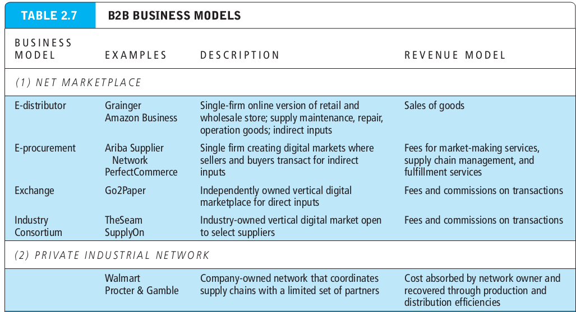
Major business to consumer(B2C) business models
Transaction broker : processes transaction for consumers that are normally handled in person, by phone, or by email.
Market creator : builds a digital environment where buyers and sellers can meet, display products, search for products, and establish a price for products.
Service provider : offers services online.

Slide 22
Major business to business(B2B) business models
E-distributor : a company that supplies products and services directly to individual business.
E-procurement firm : creates and sells access to digital markets.
B2B service provider : sells business services to other firms.
Scale economies : efficiencies that arise from increasing the size of a business.
Exchanges : an independent digital marketplace where suppliers and commercial purchasers can conduct transactions.

Slide 23
Major business to business(B2B) business models
Industry consortia : industry-owned vertical marketplaces that serve specific industries.
Private industrial network : digital network designed to coordinate the flow of communications among firms engaged in business together.

Slide 24
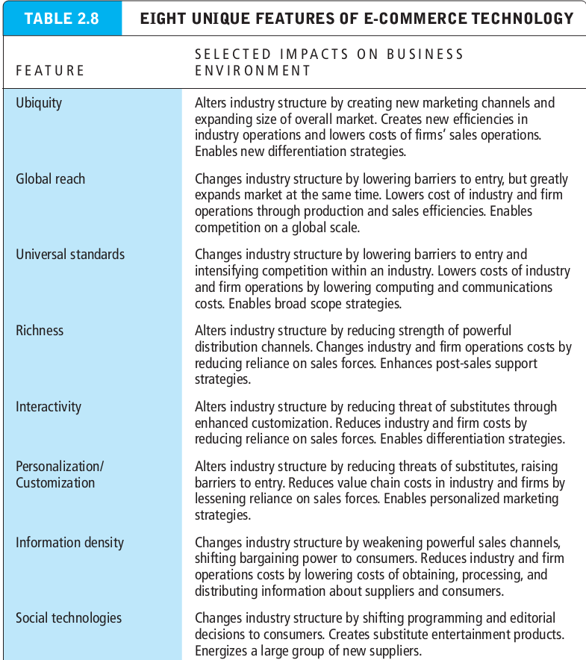
How e-commerce changes business : strategy, structure, and process.
Industry consortia : industry-owned vertical marketplaces that serve specific industries.
Private industrial network : digital network designed to coordinate the flow of communications among firms engaged in business together.

Slide 25
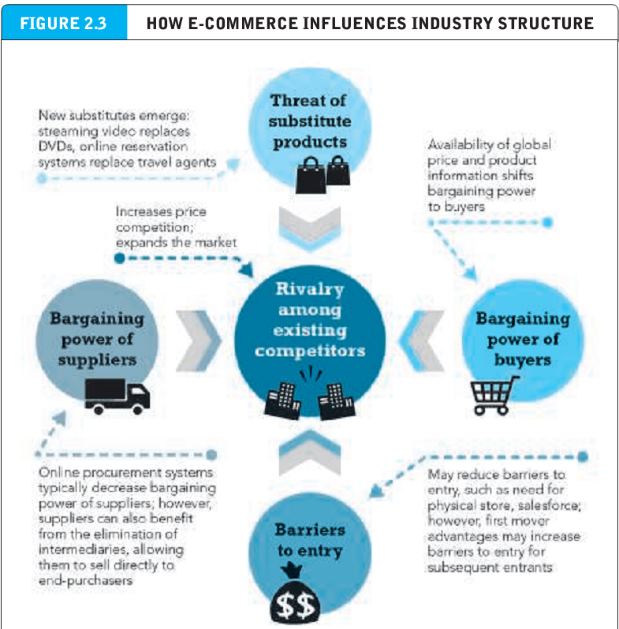
How e-commerce changes business : strategy, structure, and process.
Industry consortia : industry-owned vertical marketplaces that serve specific industries.
Private industrial network : digital network designed to coordinate the flow of communications among firms engaged in business together.

Slide 26
How e-commerce changes business : strategy, structure, and process.
Industry structure : refers to the nature of the players in an industry and their relative bargaining power.
Industry structural analysis : an effort to understand and describe the nature of competition in an industry, the nature of substitute products, the barriers to entry, and the relative strength of consumers and suppliers.
Value chain : the set of activities performed in an industry or in a firm that transforms raw inputs into final products and services.

Slide 27
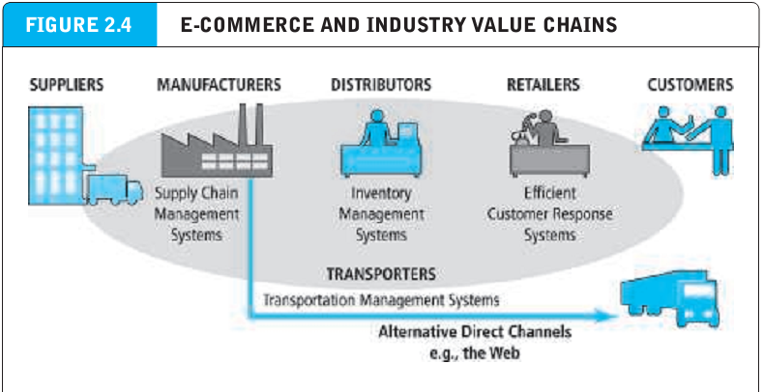
How e-commerce changes business : strategy, structure, and process.
Industry structure : refers to the nature of the players in an industry and their relative bargaining power.
Industry structural analysis : an effort to understand and describe the nature of competition in an industry, the nature of substitute products, the barriers to entry, and the relative strength of consumers and suppliers.
Value chain : the set of activities performed in an industry or in a firm that transforms raw inputs into final products and services.

Slide 28
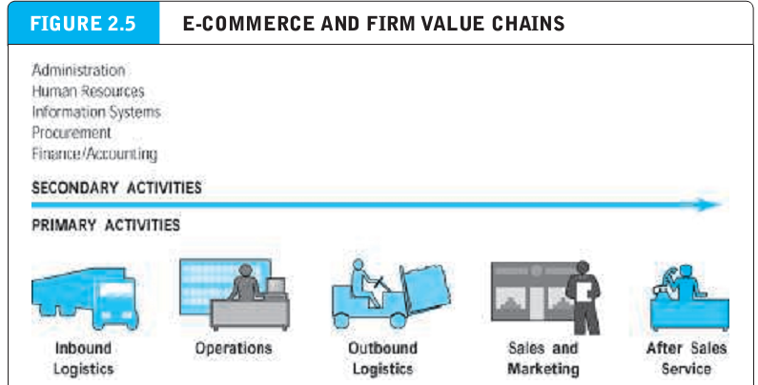
How e-commerce changes business : strategy, structure, and process.
Firm value chain : the set of activities a firm engages in to create final products from raw inputs.

Slide 29
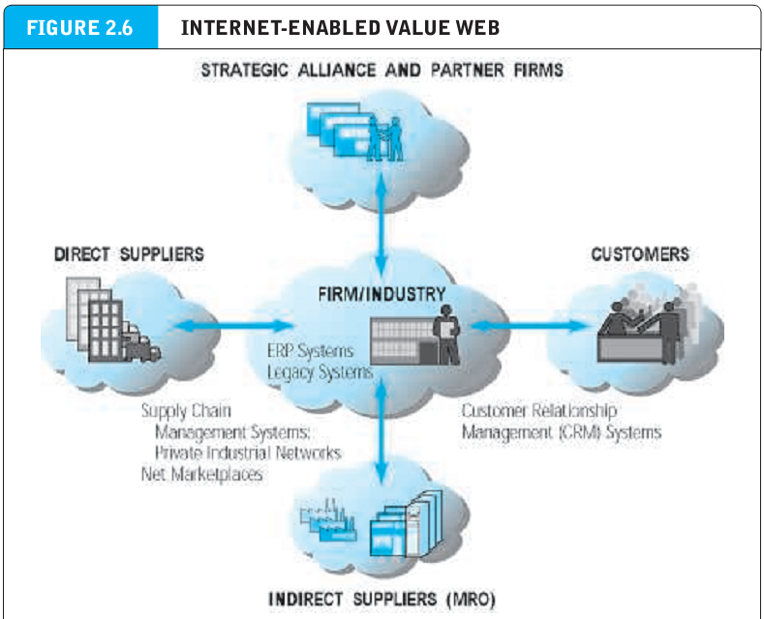
How e-commerce changes business : strategy, structure, and process.
Value web : networked business ecosystem that coordinates the value chains of several firms.

Slide 30
How e-commerce changes business : strategy, structure, and process.
Business strategy : a set of plans for achieving superior long-term returns on the capital invested in a business firm.
Profit : the difference between the price a firm is able to charge for its products and the cost of producing and distributing goods.
Differentiation : refers to all the ways producers can make their products or services unique and different to distinguish them from those of competitors.
Commoditization : a situation where there are no differences among products or services, and the only basis of choosing is price.
Strategy of cost competition : offering products and services at a lower cost than competitors.

Slide 31
How e-commerce changes business : strategy, structure, and process.
Scope strategy : competing in all markets around the globe, rather than just local, regional, or national markets.
Focus/market niche strategy : competing within a narrow market or product segment.
Customer intimacy : focuses on developing strong ties with customers in order to increase switching costs.

Slide 32
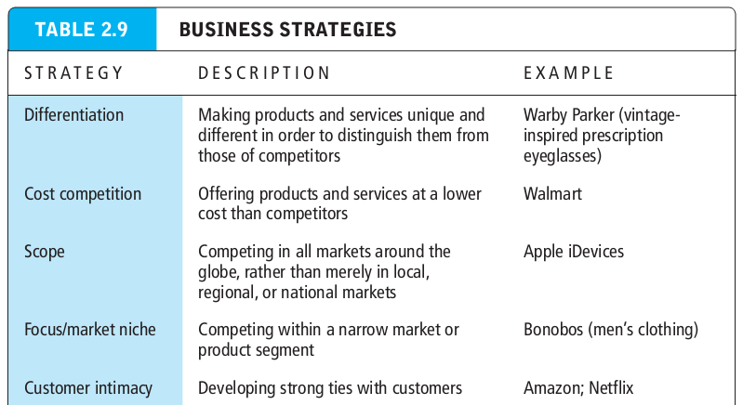
How e-commerce changes business : strategy, structure, and process.
Scope strategy : competing in all markets around the globe, rather than just local, regional, or national markets.
Focus/market niche strategy : competing within a narrow market or product segment.
Customer intimacy : focuses on developing strong ties with customers in order to increase switching costs.

Slide 33
E-commerce technology and business model disruption.
Disruptive technologies : technologies that underpin a business model disruption.
Digital disruption : a business model disruption that is driven by changes in information technology.
Sustaining technologies : technologies that enable the incremental improvement of products and services.
Disruptors : the entrepreneurs and their business firms that lead a business model disruption.

