Slide 1
UPN “VETERAN” YOGYAKARTA
E-Commerce
Chapter 8
Hari Prapcoyo,S.Kom., M.ICT
Sistem Informasi

Slide 2
Ethical, social, and political issues in e-commerce
Learning objective:
Understand e-commerce raises ethical, social, and political issues
Basic concepts related to privacy and information rights
Various forms of intellectual property and the challenges involved in protecting it
How the internet is governed and why taxation of e-commerce raises governance
Identify major public safety and welfare issues raised by e-commerce.

Slide 3
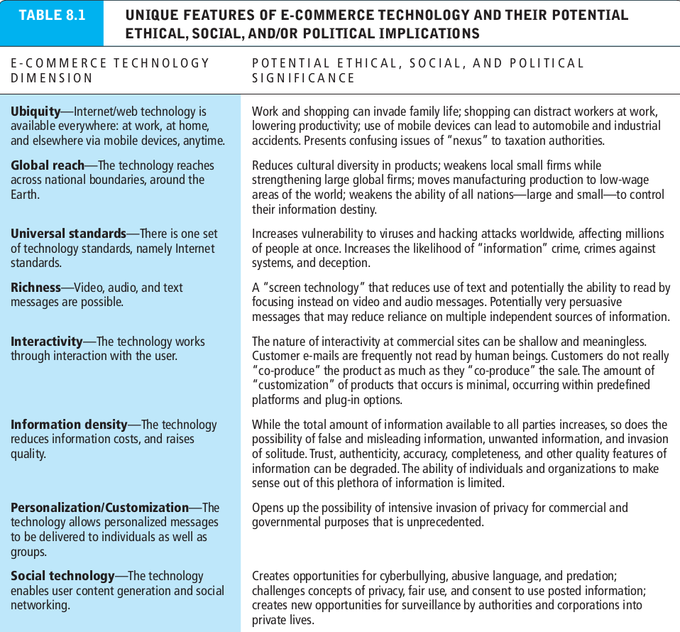
Understanding ethical, social, and political issues in e-commerce
What’s the idea? (the visioning process)
Where’s the money: business and revenue model.
Who and where is the target audience?
Characterize the marketplace
Where’s the content coming from?

Slide 4
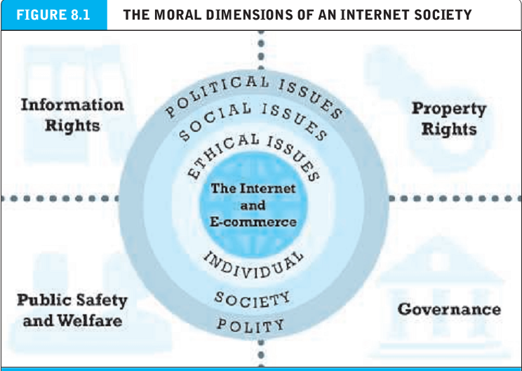
A model for organizing the issues
What’s the idea? (the visioning process)
Where’s the money: business and revenue model.
Who and where is the target audience?
Characterize the marketplace
Where’s the content coming from?

Slide 5
Basic ethical concepts : responsibility, accountability, and liability
Ethics : the study of principles that individuals and organizations can use to determine right and wrong courses of action.
Responsibility : as free moral agents individuals, organizations, and societies are responsible for the actions they take.
Accountability : individuals, organizations, and societies should be held accountable to others for the consequences of their actions.

Slide 6
Basic ethical concepts : responsibility, accountability, and liability
Liability : a feature of political systems in which a body of law is in place that permits individuals to recover the damages done to them by other actors, systems or organizations.
Due process : a process in which laws are known and understood and there is an ability to appeal to higher authorities to ensure that the laws have been correctly applied.

Slide 7
Analyzing ethical dilemmas
Dilemma : a situation in which there are at least two diametrically opposed actions, each of which supports a desirable outcome.

Slide 8
Privacy and information rights
Privacy : the moral right of individuals to be left alone, free from surveillance or interference from other individuals or organizations, including the state.
Information privacy : subset of privacy that rests on four central premises, including the moral rights to control use of information collected and to know whether information is being collected, the right to personal information due process, and the right to have personal information stored in a secure manner

Slide 9
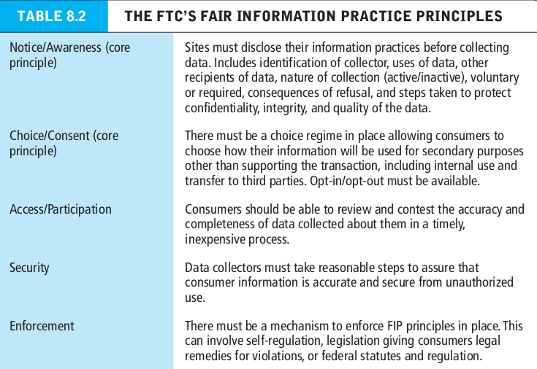
Privacy and information rights
Right to be forgotten : the claim of individuals to be able to edit and delete personal information.

Slide 10
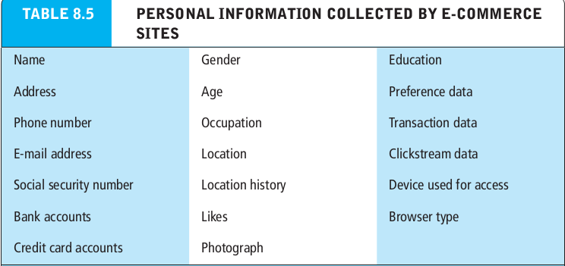
Privacy and information rights
Personally identifiable information (PII) : any data that can be used to identify, locate or contact an individual.
Anonymous information : demographic and behavioral information that doesn’t include any personal identifies.

Slide 11
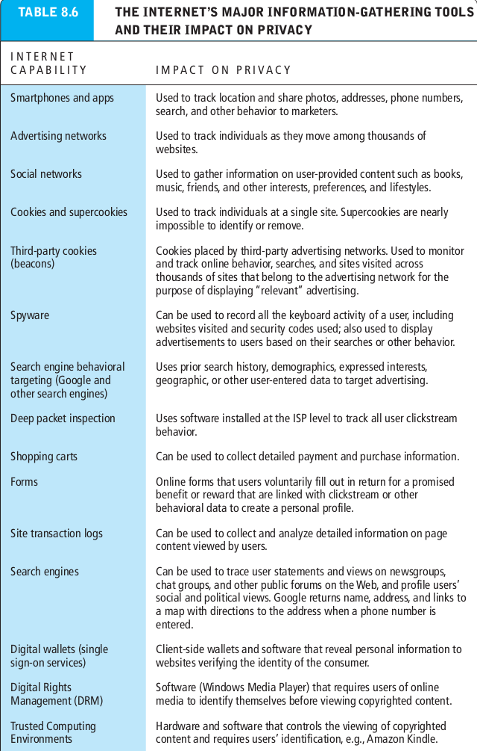
Privacy and information rights
Personally identifiable information (PII) : any data that can be used to identify, locate or contact an individual.
Anonymous information : demographic and behavioral information that doesn’t include any personal identifies.

Slide 12
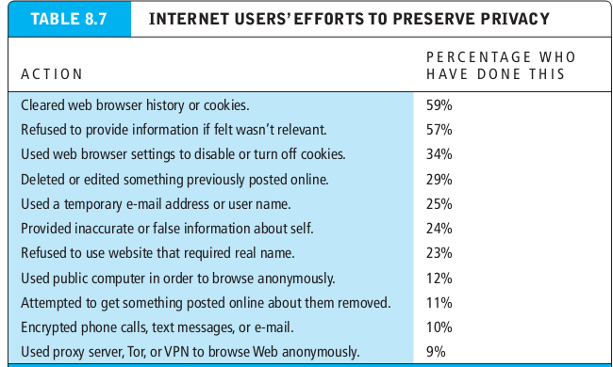
Privacy and information rights
Personally identifiable information (PII) : any data that can be used to identify, locate or contact an individual.
Anonymous information : demographic and behavioral information that doesn’t include any personal identifies.

Slide 13
Marketing: profiling, behavioral targeting, and retargeting
Profiling : the creation of digital images that characterize online individual and group behavior.
Data image : collection of data record used to create a behavioral profile of consumers.
Anonymous profiles : identify people as belonging to highly specific and targeted groups.
Personal profiles : add a personal e-mail address, postal address, and/or phone number to behavioral data.

Slide 14
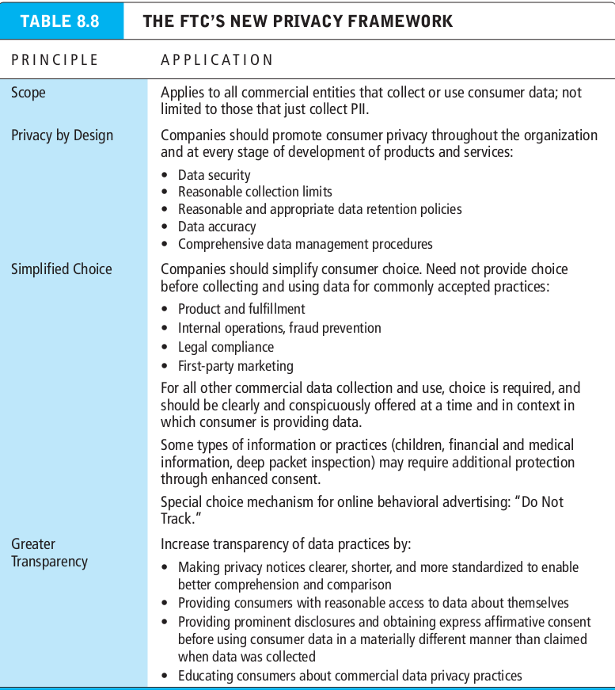
Marketing: profiling, behavioral targeting, and retargeting
Profiling : the creation of digital images that characterize online individual and group behavior.
Data image : collection of data record used to create a behavioral profile of consumers.
Anonymous profiles : identify people as belonging to highly specific and targeted groups.
Personal profiles : add a personal e-mail address, postal address, and/or phone number to behavioral data.

Slide 15
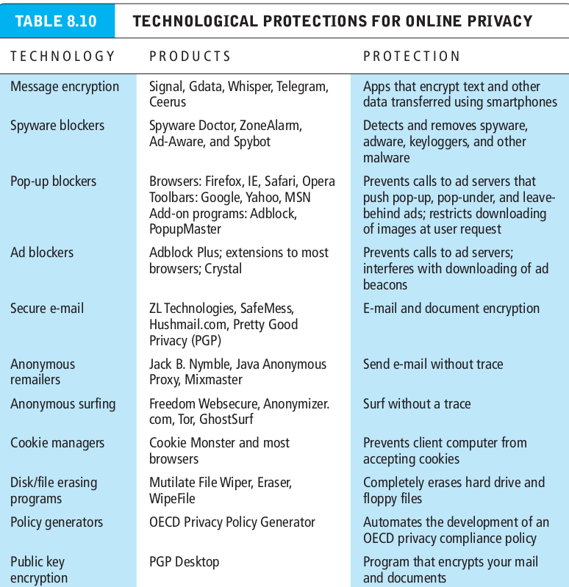
Marketing: profiling, behavioral targeting, and retargeting
Profiling : the creation of digital images that characterize online individual and group behavior.
Data image : collection of data record used to create a behavioral profile of consumers.
Anonymous profiles : identify people as belonging to highly specific and targeted groups.
Personal profiles : add a personal e-mail address, postal address, and/or phone number to behavioral data.

Slide 16
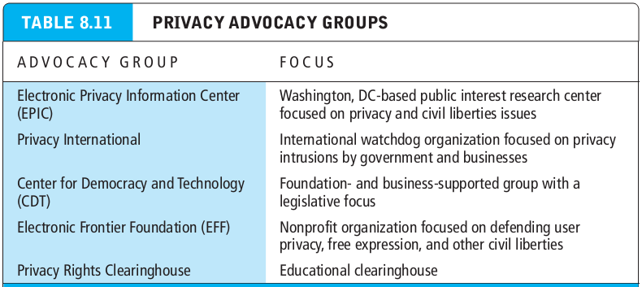
Privacy protection as a business

Slide 17
Intellectual property rights
Copyright law : protects original forms of expression such as writings, art, drawings, photographs, music, motion pictures, performances, and computer programs from being copied by others for a minimum of 70 years.
Doctrine of fair use : under certain circumstances, permits use of copyrighted material without permission.
Digital millennium copyright act (DMCA) : the first major effort to adjust the copyright laws to the internet age.

Slide 18
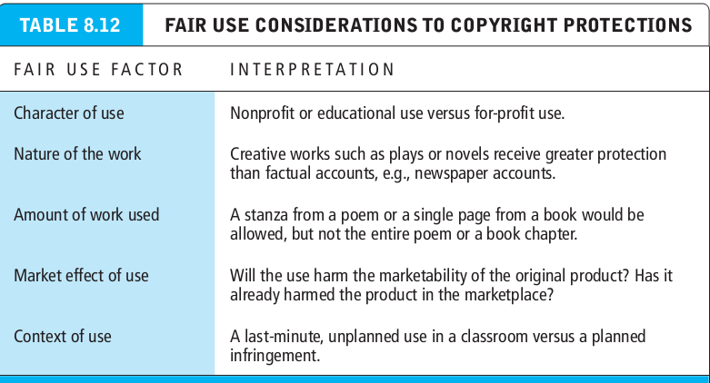
Intellectual property rights
Copyright law : protects original forms of expression such as writings, art, drawings, photographs, music, motion pictures, performances, and computer programs from being copied by others for a minimum of 70 years.
Doctrine of fair use : under certain circumstances, permits use of copyrighted material without permission.

Slide 19
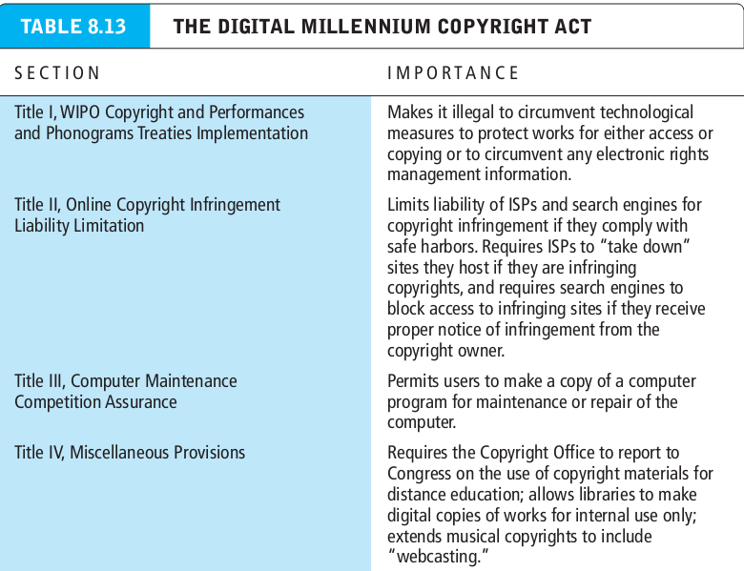
Intellectual property rights
Copyright law : protects original forms of expression such as writings, art, drawings, photographs, music, motion pictures, performances, and computer programs from being copied by others for a minimum of 70 years.
Doctrine of fair use : under certain circumstances, permits use of copyrighted material without permission.

Slide 20
Intellectual property rights
Patent : grants the owner an exclusive monopoly on the ideas behind an invention for 20 years.

Slide 21
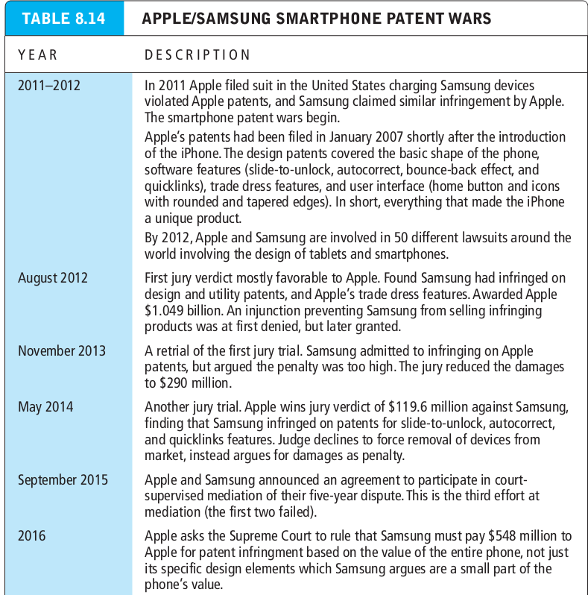
Intellectual property rights
Patent : grants the owner an exclusive monopoly on the ideas behind an invention for 20 years.

Slide 22
Intellectual property rights
Trademark : a mark used to identify and distinguish goods and indicate their source.

Slide 23
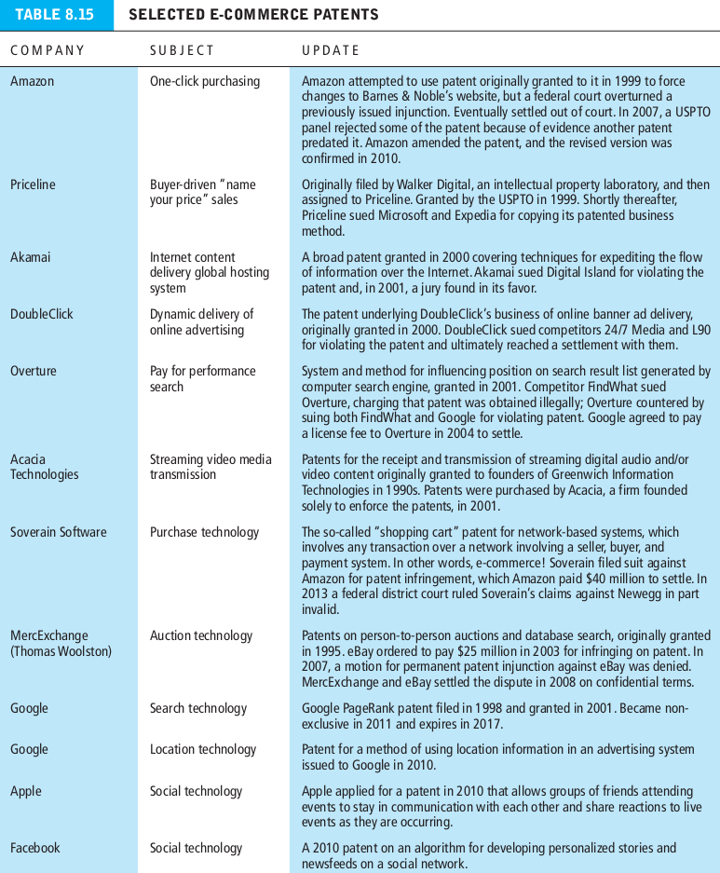
Intellectual property rights
Trademark : a mark used to identify and distinguish goods and indicate their source.

Slide 24
Intellectual property rights
Dilution : any behavior that would weaken the connection between the trademark and the product.
Anticybersquatting consumer protection act (ACPA) : creates civil liabilities for anyone who attempts in bad faith to profit from an existing famous or distinctive trademark by registering an internet domain name that is identical or confusingly similar to, or “dilutive” of, that trademark.
Cybersquatting : involves the registration of an infringing domain name, or other internet use of an existing trademark, for the purpose of extorting payments from the legitimate owners.

Slide 25
Intellectual property rights
Cyberpiracy : involves the same behavior as cybersquatting, but with the intent of diverting traffic from the legitimate site to an infringing site.
Linking : building hypertext links from one site to another site.
Deep linking : involves bypassing the target site’s home page, and going directly to a content page.
Framing : involves displaying the content of another website inside your own website within a frame or window.
Trade secret : information that is secret, has commercial value and has been protected by its owner.

Slide 26
Governance
Governance : has to do with social control, who will control e-commerce, what elements will be controlled, and how will the controls be implemented.
Net neutrality : the concept that internet service providers should treat all internet traffic equally

