Slide 1
UPN “VETERAN” YOGYAKARTA
E-Commerce
Chapter 11
Hari Prapcoyo,S.Kom., M.ICT
Sistem Informasi

Slide 2
B2B E-commerce: supply chain management and collaborative commerce
Learning objective:
Discuss the evolution and growth of B2B e-commerce, as well as its potential benefits and challenges
Understand how procurement and supply chain relate to B2B e-commerce
Identify major trends in supply chain management and collaborative commerce
Understand the different characteristics and types of net marketplaces.
Understand the objectives of private industrial networks, their role in supporting collaborative commerce, and the barriers to their implementation.

Slide 3
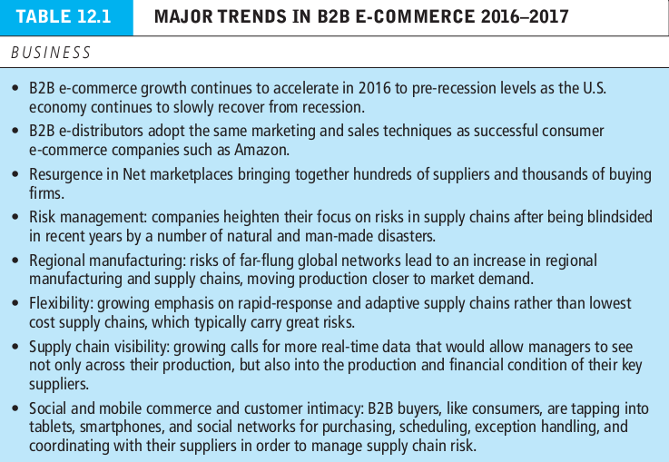
An overview of B2B e-commerce
Social network : involves a group of people shared social interaction common ties among members and people who share an area for some period of time.
Online social network : an area online, where people who share common ties can interact with one another.

Slide 4
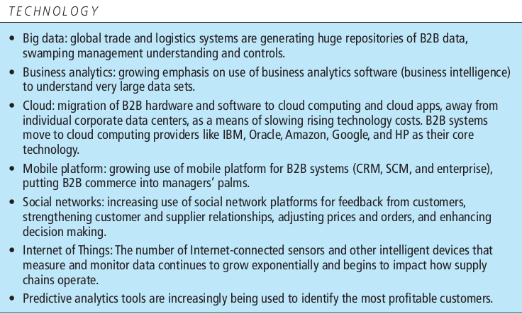
An overview of B2B e-commerce
Social network : involves a group of people shared social interaction common ties among members and people who share an area for some period of time.
Online social network : an area online, where people who share common ties can interact with one another.

Slide 5
An overview of B2B e-commerce
Social network : involves a group of people shared social interaction common ties among members and people who share an area for some period of time.
Online social network : an area online, where people who share common ties can interact with one another.

Slide 6
An overview of B2B e-commerce
Supply chain competition : differentiating a firm’s products or prices on the basis of superior supply chain management
B2B commerce : all types of inter-firm trade
B2B e-commerce (B2B digital commerce) : that portion of B2B commerce that is enabled by the internet and mobile apps.
Supply chain : the links that connect business firms with one another to coordinate production.

Slide 7
An overview of B2B e-commerce
Automated order entry systems : involve the use of telephone modems to send digital orders
Seller side solutions : seller biased markets that are owned by, and show only goods from a single seller
Electronic data interchange (EDI) : a communication standard for sharing business documents and settlement information among a small number of firms.

Slide 8
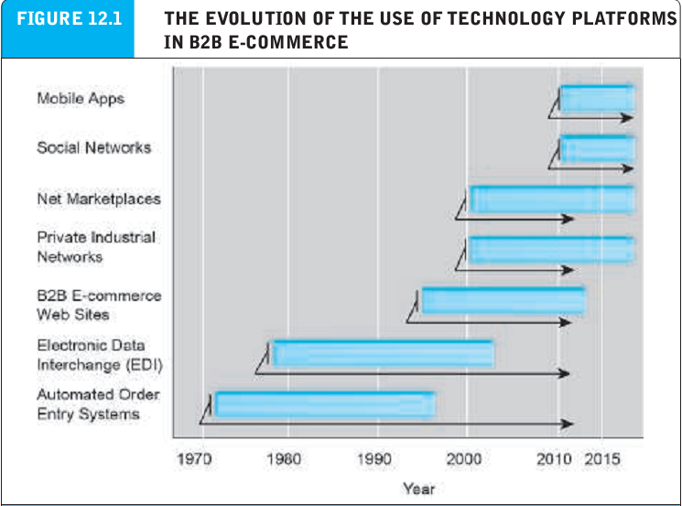
The evolution of B2B e-commerce
Supply chain competition : differentiating a firm’s products or prices on the basis of superior supply chain management
B2B commerce : all types of inter-firm trade
B2B e-commerce (B2B digital commerce) : that portion of B2B commerce that is enabled by the internet and mobile apps.
Supply chain : the links that connect business firms with one another to coordinate production.

Slide 9
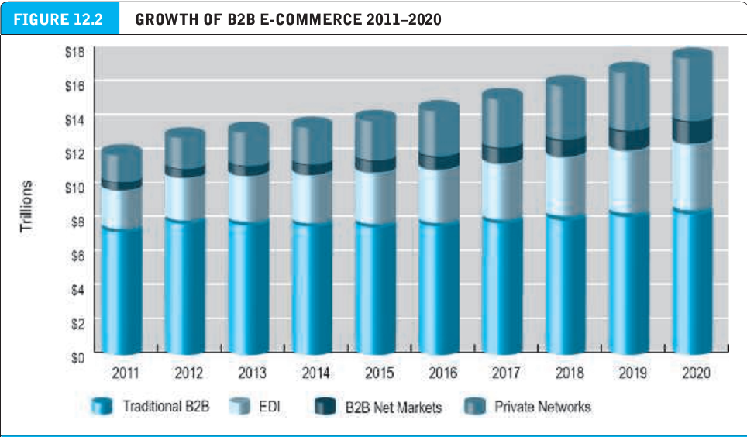
The evolution of B2B e-commerce
Supply chain competition : differentiating a firm’s products or prices on the basis of superior supply chain management
B2B commerce : all types of inter-firm trade
B2B e-commerce (B2B digital commerce) : that portion of B2B commerce that is enabled by the internet and mobile apps.
Supply chain : the links that connect business firms with one another to coordinate production.

Slide 10
Potential benefits and challenges of B2B e-commerce
Lower administrative costs
Lower search costs for buyers
Reduce inventory costs by increasing competition among suppliers
Lower transaction costs by eliminating paperwork and automating parts of the procurement process
Increase production flexibility
Improve quality of products by increasing cooperation among buyers and sellers
Decrease product cycle time by sharing designs and production schedules with suppliers

Slide 11
Potential benefits and challenges of B2B e-commerce
Increase opportunities for collaborating with suppliers and distributors
Create greater price transparency
Increase the visibility and real time information sharing among all participants in the supply chain network

Slide 12
The procurement process and supply chains
Procurement process : how firms purchase goods they need to produce goods for consumers.
Direct goods : goods directly involved in the production process.
Indirect goods : all other good not directly involved in the production process
MRO goods : products for maintenance, repair, and operations.

Slide 13
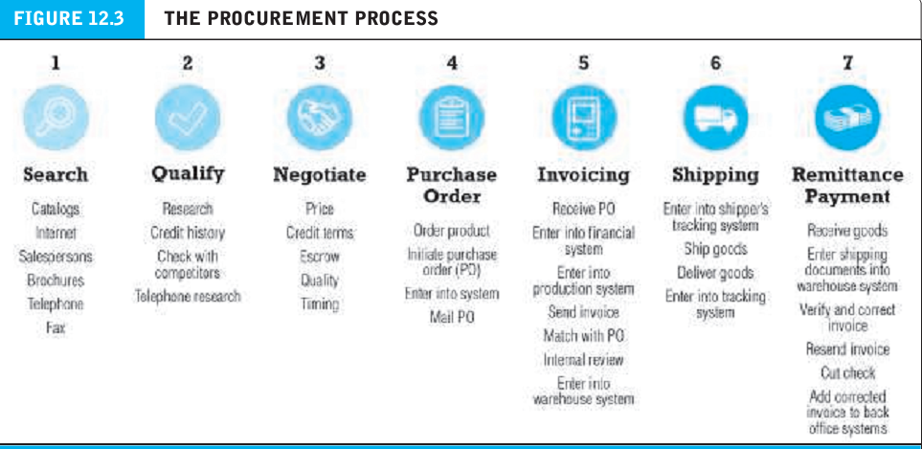
The procurement process and supply chains

Slide 14
Types of procurement
Contract purchasing : involves long term written agreements to purchase specified products, under agreed-upon terms and quality, for an extended period of time.
Spot purchasing : involves the purchase of goods based on immediate needs in larger marketplaces that involves many suppliers.

Slide 15
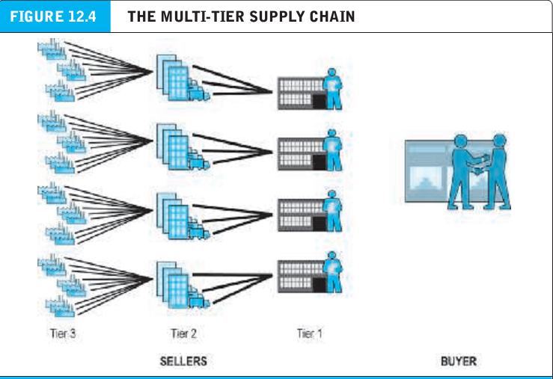
Multi-tier supply chains
Multi-tier supply chain : the chain of primary, secondary, and tertiary suppliers.

Slide 16
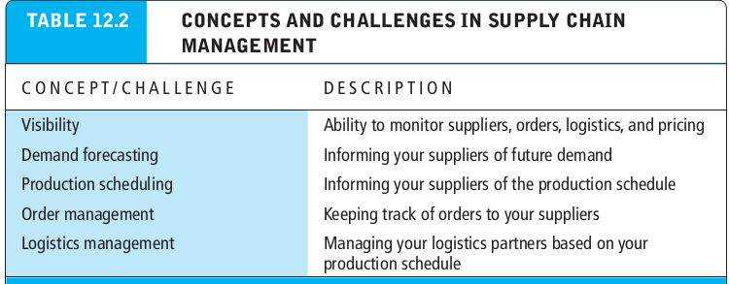
Multi-tier supply chains
Supply chain visibility : the extent to which purchasing firms can monitor second and third suppliers activities.

Slide 17
The role of existing legacy computer systems and enterprises systems in supply chains
Legacy computer systems : older mainframe systems used to manage key business processes within a firm in a variety of functional areas.
Enterprise systems : corporate-wide systems that relate to all aspects of production, including finance, human resource and procurement.

Slide 18
Trends in supply chain management and collaborative commerce
Supply chain management(SCM) : refers to a wide variety of activities that firms and industries use to coordinate the key players in their procurement process.
Just-in-time production : a method of inventory cost management that seeks to reduce excess inventory to a bare minimum.
Lean production : a set of production methods and tools that focuses on the elimination of waste throughout the customer value chain.

Slide 19
Supply chain simplification
Supply chain simplification : involves reducing the size of the supply chain and working more closely with a smaller group of strategic supplier firms to reduce both product costs and administrative costs, while improving quality.
Tight coupling : a method for ensuring that suppliers precisely deliver the ordered parts, at a specific time and particular location, to ensure the production process is not interrupted for lack of parts.
Adaptive supply chain : allows companies to react to disruptions in the supply chain in a particular region by moving production to a different region.

Slide 20
Supply chain simplification
Accountable supply chain : one where the labor conditions in low-wage underdeveloped producer countries are visible and morally acceptable to ultimate consumers in more developed industrial societies.
Sustainable supply chain : involves using the most efficient environment regarding means of production, distribution and logistics.

Slide 21
Supply chain management systems
Supply chain management (SCM) systems : continuously link the activities of buying, making, and moving products from suppliers to purchasing firms, as well as integrating the demand side of the business equation by including the order entry system in the process.
Collaborative commerce : the use of digital technologies to permit organizations to collaboratively design, develop, build, and manage products through their life cycles.

Slide 22
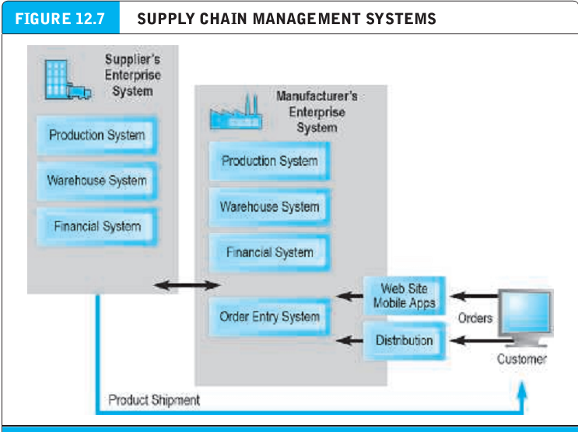
Supply chain management systems
Supply chain management (SCM) systems : continuously link the activities of buying, making, and moving products from suppliers to purchasing firms, as well as integrating the demand side of the business equation by including the order entry system in the process.

Slide 23
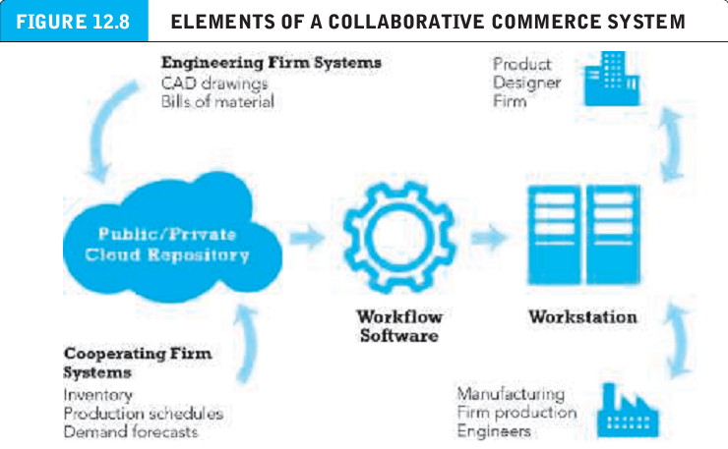
Collaborative commerce
Supply chain management (SCM) systems : continuously link the activities of buying, making, and moving products from suppliers to purchasing firms, as well as integrating the demand side of the business equation by including the order entry system in the process.

Slide 24
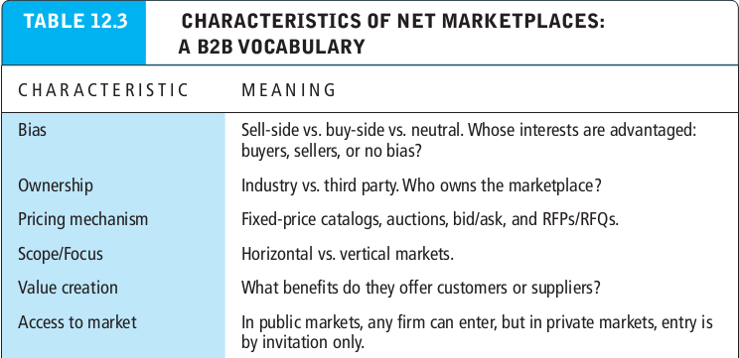
Net marketplaces : the selling side of B2B
Supply chain management (SCM) systems : continuously link the activities of buying, making, and moving products from suppliers to purchasing firms, as well as integrating the demand side of the business equation by including the order entry system in the process.

Slide 25
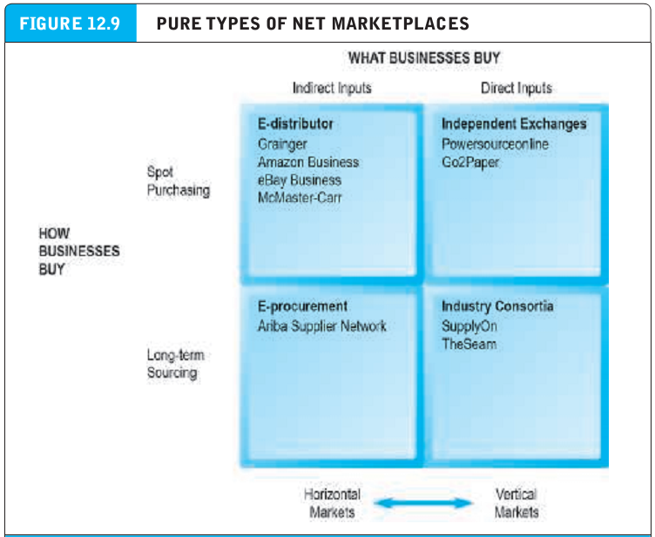
Characteristics of net marketplaces
Supply chain management (SCM) systems : continuously link the activities of buying, making, and moving products from suppliers to purchasing firms, as well as integrating the demand side of the business equation by including the order entry system in the process.

Slide 26
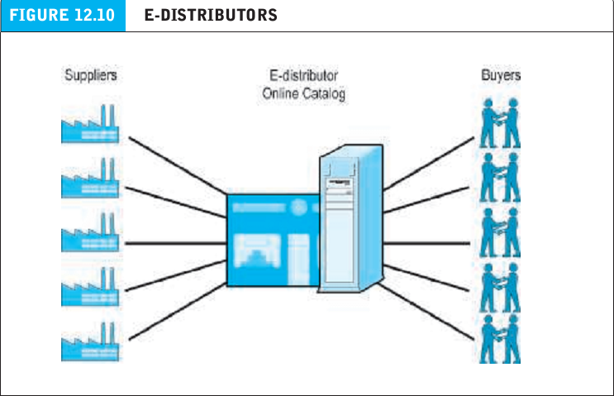
Characteristics of net marketplaces
E-distributor : provides an online catalog that represents the products of thousands of direct manufacturers.

Slide 27
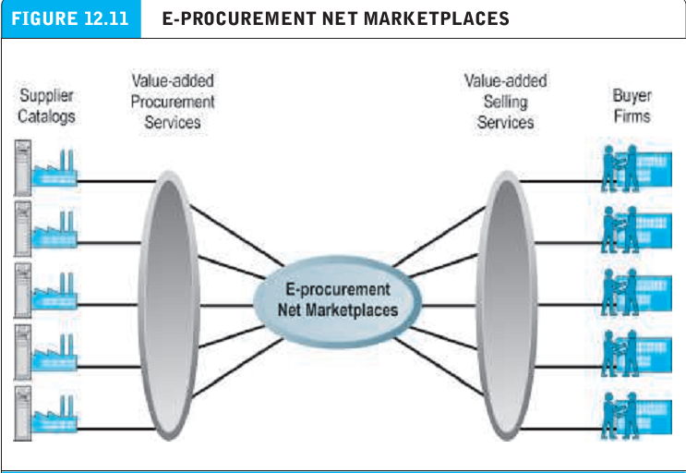
Characteristics of net marketplaces
E-procurement net marketplace : independently owned intermediary that connects hundreds of online suppliers offering millions of maintenance and repair parts to business firms who pay fees to join the market.

Slide 28
Characteristics of net marketplaces
Value chain management (VCM) services : include automation of firm’s entire procurement process on the buyer side and automation of the selling business processes on the seller side.
Exchange : independently owned online marketplace that connect hundreds to potentially thousands of suppliers and buyers in a dynamic, real time environment.

