Slide 1
UPN “VETERAN” YOGYAKARTA
E-Commerce
Hari Prapcoyo,S.Kom., M.ICT
Chapter 1

Slide 2
The revolution is just begining
Learning objective:
Define e-commerce
Unique feature e-commerce
Major types of e-commerce
Understand the evolution e-commerce
Underlying the study of e-commerce
Academic disciplines contributing e-commerce

Slide 3
Introduction to e-commerce
E-commerce the use of internet, the web, and mobile apps and browsers running on mobile devices to transact business. More formally, digitally enabled commercial transaction between and among organizations and individuals.
The difference between e-commerce & e-business
E-business the digital enabling of transactions and processes within a firm, involving information systems under the control of the firm.

Slide 4
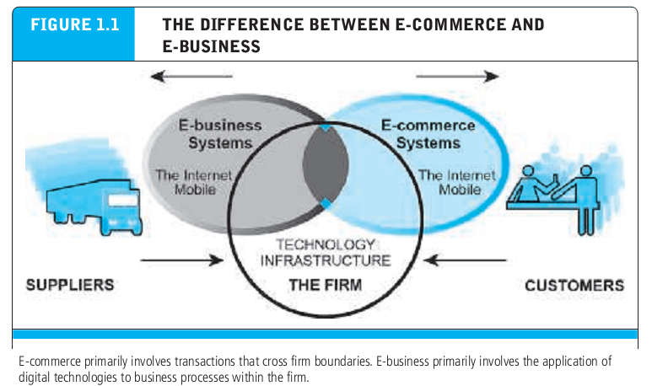
The difference between e-commerce & e-business

Slide 5
Technological building blocks underlying e-commerce : the internet, web, and mobile platform
Internet : worldwide network of computer networks built on common standards.
World wide web (the web) : an information system running on internet infrastructure that provides access to billions of web pages.
Mobile platform : provides the ability to access the internet from a variety of mobile devices such as smartphones, tablets, and other ultra lightweight laptop computers.

Slide 6
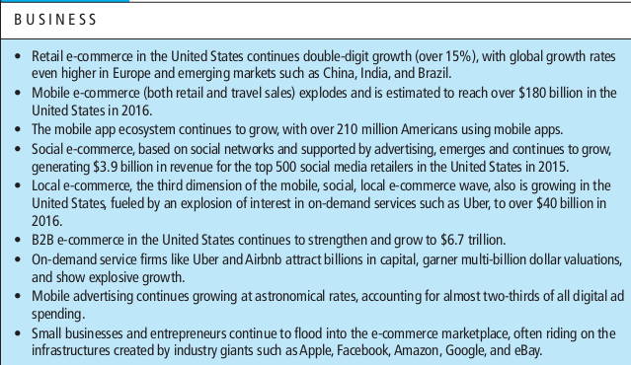
Major trends in e-commerce

Slide 7
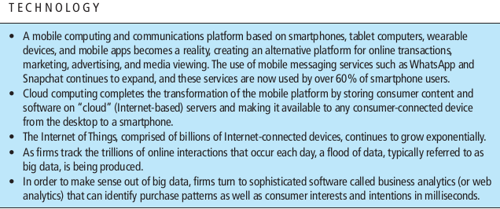
Major trends in e-commerce

Slide 8
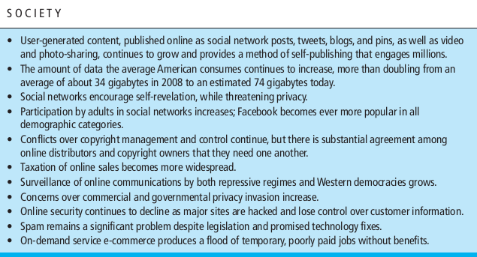
Major trends in e-commerce

Slide 9
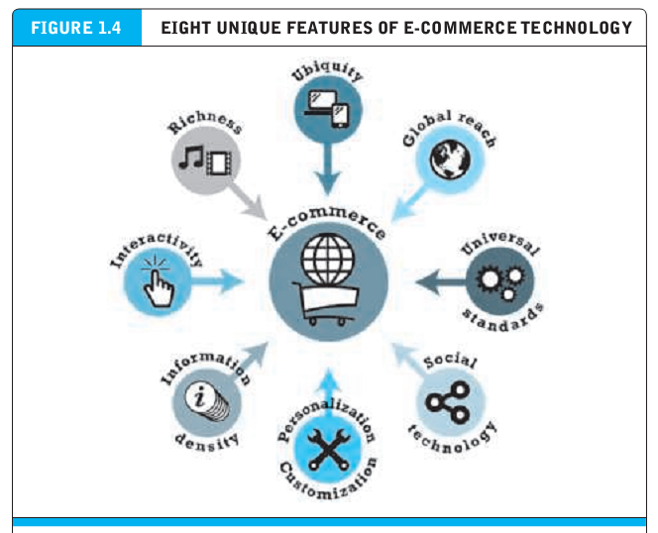
Unique features of e-commerce technology

Slide 10
Unique features of e-commerce technology
Information asymmetry : any disparity in relevant market information among parties in a transaction.
Marketplace : physical space you visit in order to transact
Ubiquity : available just about every-where, at all times
Marketspace : marketplace extended beyond traditional boundaries and removed from a temporal and geographic location.
Reach : the total number of users or customers an e-commerce business can obtain

Slide 11
Unique features of e-commerce technology
Universal standards : standards that are shared by all nations around the world
Richness : the complexity and content of message
Interactivity : technology that allows for two-way communication between merchant and consumer
Information density : the total amount and quality of information available to all market participants.
Personalization : the targeting of marketing messages to specific individuals by adjusting the message to a person’s name, interest, and past purchases.

Slide 12
Unique features of e-commerce technology
Customization : changing the delivered product or service based on a user’s preferences or prior behavior

Slide 13
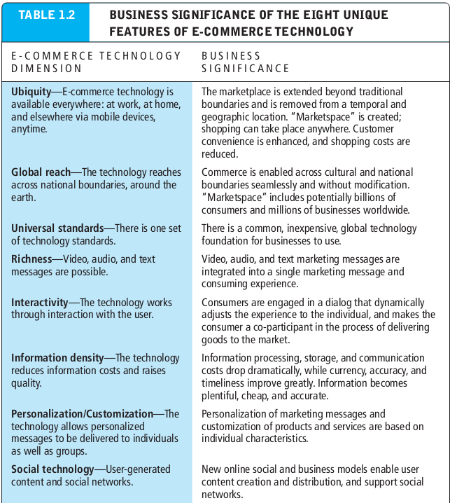
Unique features of e-commerce technology
Customization : changing the delivered product or service based on a user’s preferences or prior behavior

Slide 14
Types of e-commerce
Business to consumer (B2C) online business selling to individual consumers
Business to business (B2B) online business selling to other business
Consumer to consumer (C2C) consumers selling to other consumers.
Mobile e-commerce (M-Commerce) use of mobile devices to enable online transactions
Social e-commerce e-commerce enabled by social networks and online social relationships
Local e-commerce e-commerce that is focused on engaging the consumer based on his or her current geographic location

Slide 15
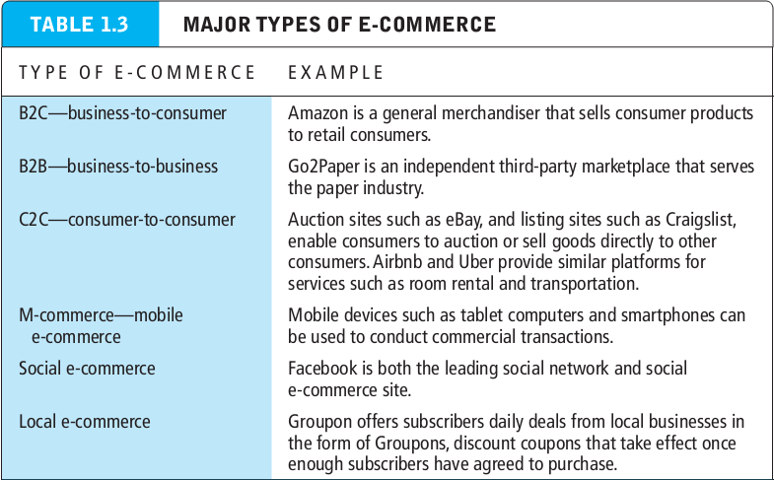
E-commerce brief history
B

Slide 16
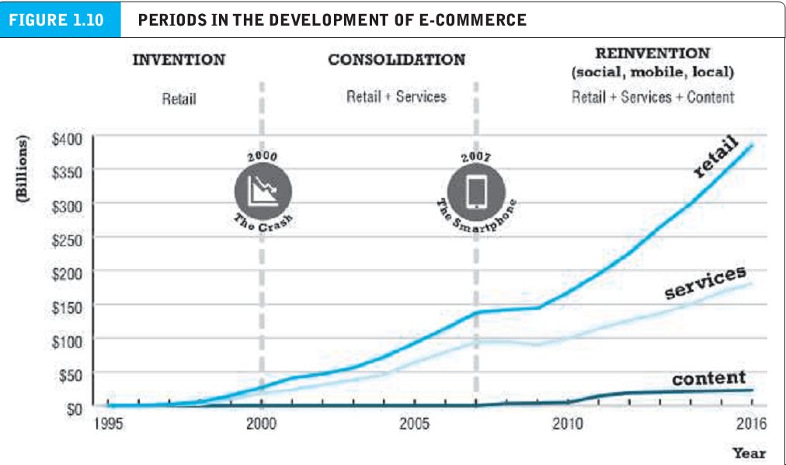
E-commerce brief history (1995-2000 : Invention)

Slide 17
E-commerce brief history (1995-2000 : Invention)
Disintermediation : displacement of market middlemen who traditionally are intermediaries between producers and consumers by a new direct relationship between producers and consumers.
Friction-free commerce : a vision of commerce in which information is equally distributed, transaction costs are low, prices can be dynamically adjusted to reflect actual demand, intermediaries decline, and unfair competitive advantages are eliminated.
First mover : a firm that is first to market in a particular area and that moves quickly to gather market share

Slide 18
E-commerce brief history (1995-2000 : Invention)
Network effect : occurs where users receive value from the fact that everyone else uses the same tool or product.
E-commerce brief history (2001-2006 : consolidation)
Web 2.0 : set of application and technologies that enable user-generated content

Slide 19
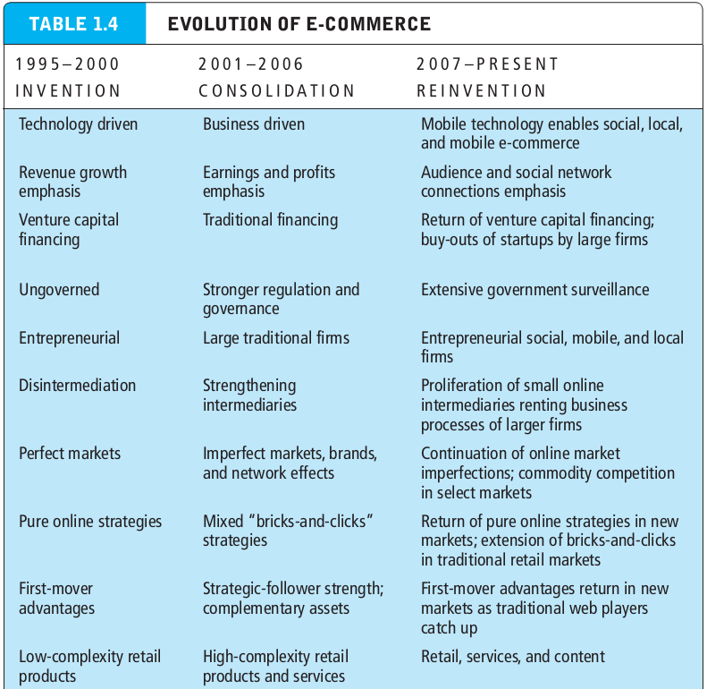
E-commerce brief history (2001-2006 : consolidation)
Web 2.0 : set of application and technologies that enable user-generated content

Slide 20
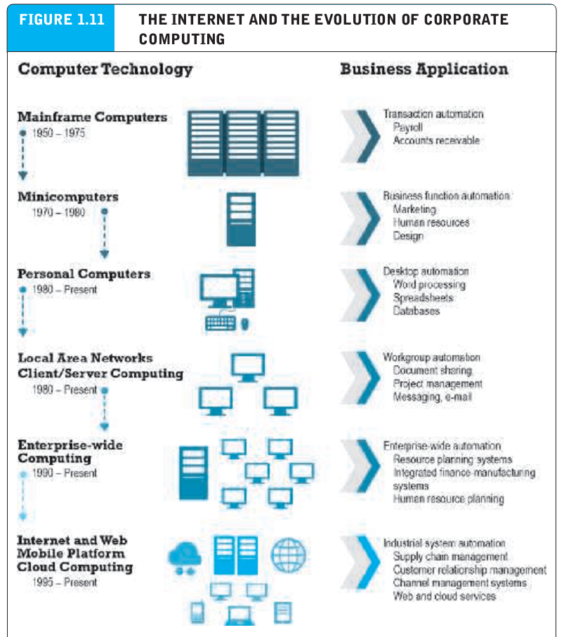
Understanding e-commerce: organizing themes
Technology : infrastructure

Slide 21
Understanding e-commerce: organizing themes
Business : basic concepts
Society : Taming the juggernaut
Academic disciplines concerned with e-commerce
Technical approaches
Behavioral approaches

