Slide 1
Communication
Sistem Informasi UPN “Veteran” Yogyakarta

Slide 2
Why study communication?
Communication is central to understanding organizational behavior for several reasons:
Communication affects organizational performance and invidual career prospects.
Very few people work alone, and the job of most managers involves interacting with other people, often more than 90 per cent of their time
Communication is seen as a problem in many organizations
In an increasingly diverse multicultural society, sensitivy to the norms and expectations of other cultures is vital to effective cross cultural communication.
New ttechnology is radically changing our patterns of communication

Slide 3
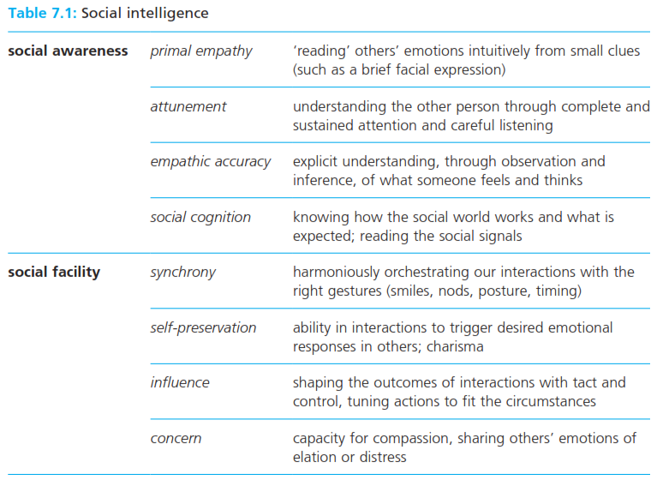
Why study communication?
Social Intelligence the ability to understand the thoughts and feelings of others and to manage our relationships accordingly.

Slide 4
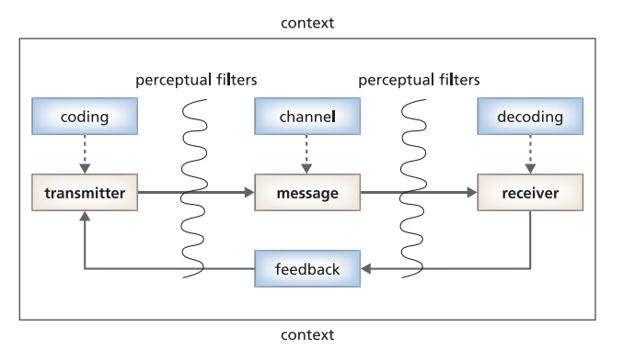
Interpersonal communication?
Communication process the transmission of information, and the exchange of meaning, between at least two people.

Slide 5
Interpersonal communication?
Coding the stage in the interpersonal communication process in which the transmitter chooses how to express a message for transmission to someone else
Decoding the stage in the interpersonal communication process in which the recipient interprets a message transmitted to them by someone else.
Perceptual filters individual characteristics, predispositions, and preoccupations that interfere with the effective transmission and receipts of messages
Noise factors outside the communication process which interfere with or distract attention from the transmission and reception of the intended meaning
Feedback processes through which the transmitter of a detects whether and how that message has been received and decoded.

Slide 6
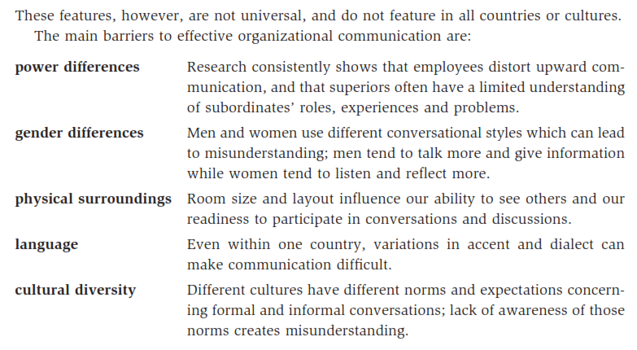
Interpersonal communication?
Coding the stage in the interpersonal communication process in which the transmitter chooses how to express a message for transmission to someone else
Decoding the stage in the interpersonal communication process in which the recipient interprets a message transmitted to them by someone else.
Perceptual filters individual characteristics, predispositions, and preoccupations that interfere with the effective transmission and receipts of messages
Noise factors outside the communication process which interfere with or distract attention from the transmission and reception of the intended meaning
Feedback processes through which the transmitter of a detects whether and how that message has been received and decoded.

Slide 7
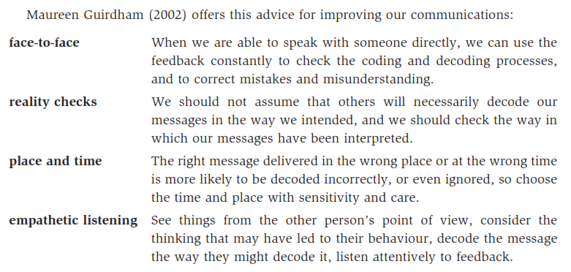
Interpersonal communication?
Coding the stage in the interpersonal communication process in which the transmitter chooses how to express a message for transmission to someone else
Decoding the stage in the interpersonal communication process in which the recipient interprets a message transmitted to them by someone else.
Perceptual filters individual characteristics, predispositions, and preoccupations that interfere with the effective transmission and receipts of messages
Noise factors outside the communication process which interfere with or distract attention from the transmission and reception of the intended meaning
Feedback processes through which the transmitter of a detects whether and how that message has been received and decoded.

Slide 8
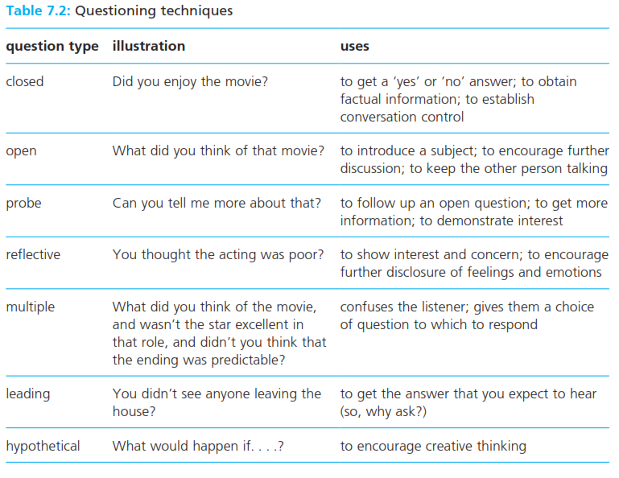
Verbal communication?
Coding the stage in the interpersonal communication process in which the transmitter chooses how to express a message for transmission to someone else
Decoding the stage in the interpersonal communication process in which the recipient interprets a message transmitted to them by someone else.
Perceptual filters individual characteristics, predispositions, and preoccupations that interfere with the effective transmission and receipts of messages
Noise factors outside the communication process which interfere with or distract attention from the transmission and reception of the intended meaning
Feedback processes through which the transmitter of a detects whether and how that message has been received and decoded.

Slide 9
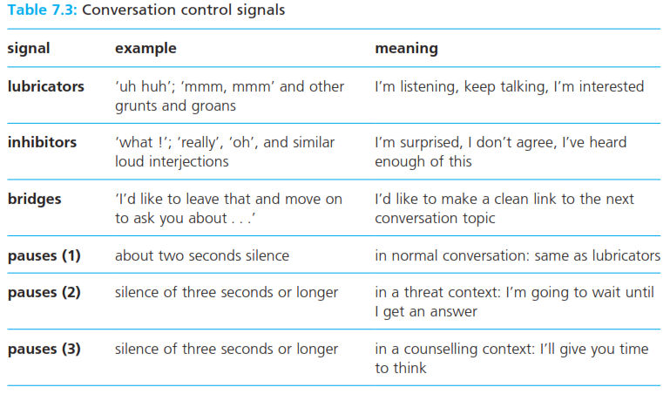
Verbal communication?
Coding the stage in the interpersonal communication process in which the transmitter chooses how to express a message for transmission to someone else
Decoding the stage in the interpersonal communication process in which the recipient interprets a message transmitted to them by someone else.
Perceptual filters individual characteristics, predispositions, and preoccupations that interfere with the effective transmission and receipts of messages
Noise factors outside the communication process which interfere with or distract attention from the transmission and reception of the intended meaning
Feedback processes through which the transmitter of a detects whether and how that message has been received and decoded.

Slide 10
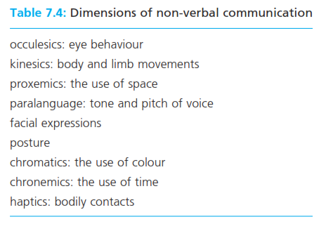
Non-verbal communication?
Non verbal communication the process of coding meaning through behaviours such as facial expressions, limb gestures, and body postures.

Slide 11
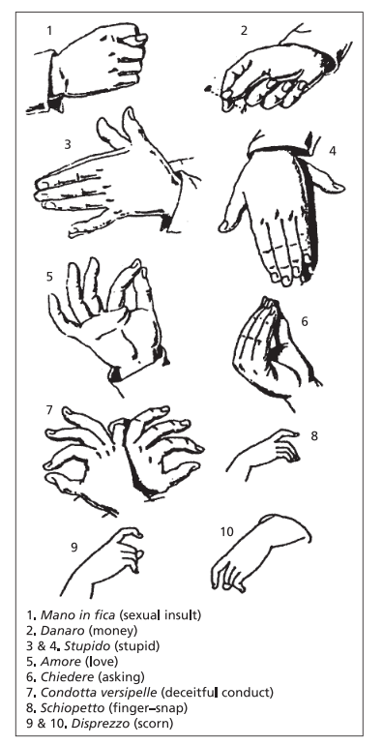
Non-verbal communication?
Non verbal communication the process of coding meaning through behaviours such as facial expressions, limb gestures, and body postures.

Slide 12
Non-verbal communication?
Power tell non verbal signals that indicate to others how important and dominant someone is, or how powerful they would like us to think they are.
Cultural differences in communication style
High context culture a culture whose members rely heavily on a range of social and non-verbal clues when communicating with others and interpreting their messages
Low context culture a culture whose members focus on the written and spoken word when communication with others and interpreting their messages.

Slide 13
Impression management
Impressiona management the processes through which we control the image or impression that others have of us.
Emotional intelligence
Emotional intelligence the ability to identify, integrate, understand, and reflectively manage one’s own and other people’s feelings.

Slide 14
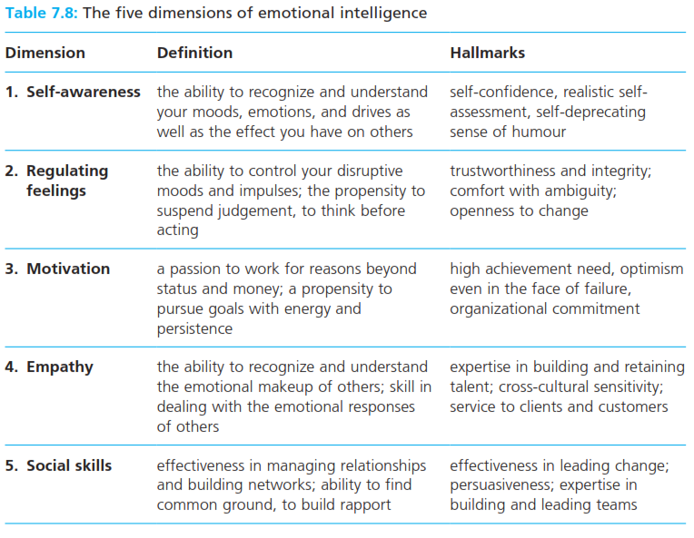
Emotional intelligence
Impressiona management the processes through which we control the image or impression that others have of us.

Slide 15
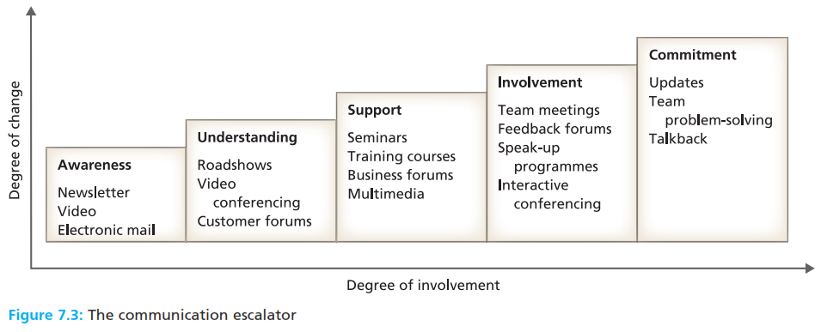
Organizational communication

Slide 16
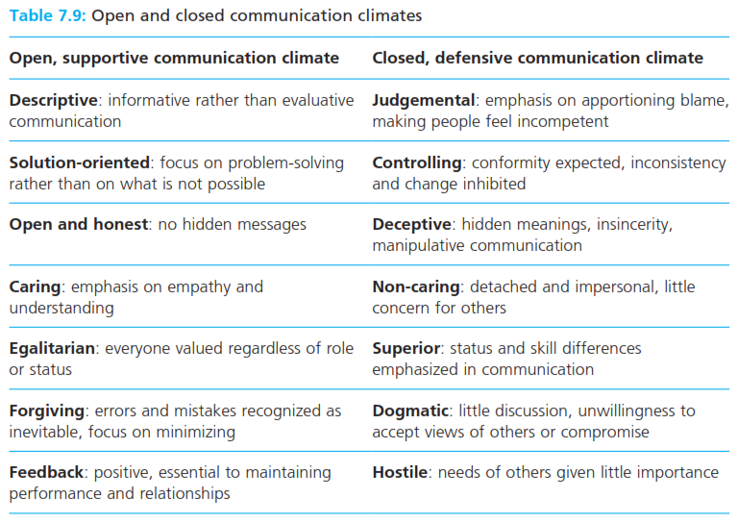
Organizational communication
Communication climate the prevailing atmosphere in an organization – open or closed in which ideas and information are exchanged.

Slide 17
Reference
Huczynski, Buchanan, 2013 , Organizational Behaviour, Pearson
Umam, Khaerul, 2012, Manajemen Organisasi, Pustaka Setia.
Wardiah, Mia Lasmi, Teori perilaku dan budaya organisasi, Pustaka Setia.

