Slide 1
UPN “VETERAN” YOGYAKARTA
E-Commerce
Chapter 4
Hari Prapcoyo,S.Kom., M.ICT
Sistem Informasi

Slide 2
Building an E-commerce presence : websites, mobile sites, and apps
Learning objective:
Developing and building e-commerce presence
Choosing web server and e-commerce merchant server software
Choosing the most appropriate hardware for an e-commerce
Additional tool that can improve website performance
Important considerations involved in developing a mobile website and building mobile applications

Slide 3
Imagine your e-commerce presence
What’s the idea? (the visioning process)
Where’s the money: business and revenue model.
Who and where is the target audience?
Characterize the marketplace
Where’s the content coming from?

Slide 4
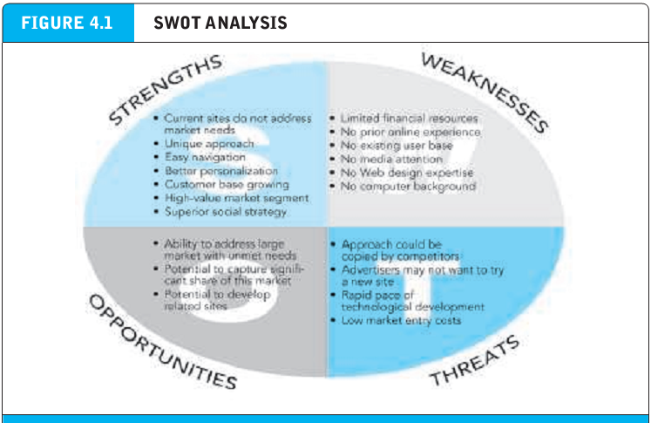
Know yourself : conduct a SWOT analysis
.

Slide 5
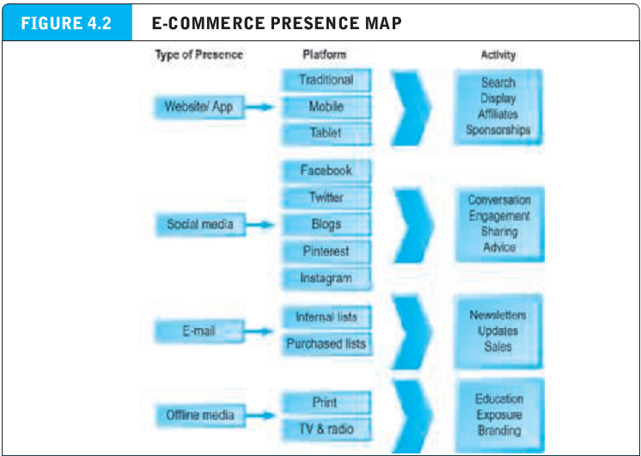
E-commerce presence map
.

Slide 6
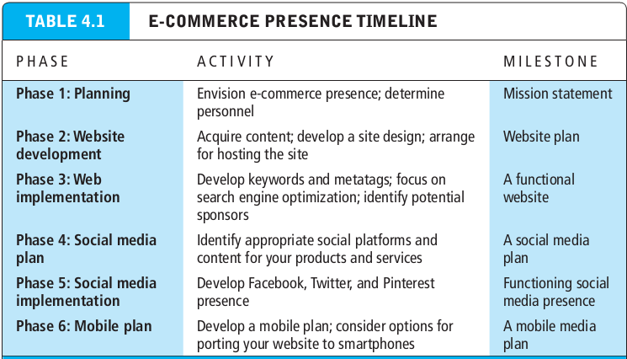
Develop a timeline: milestones
.

Slide 7
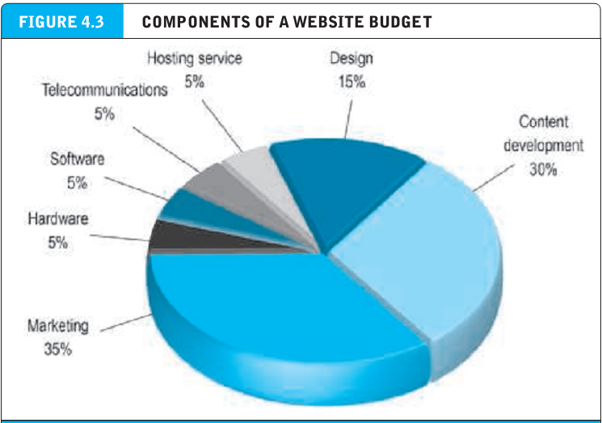
Develop a timeline: milestones
.

Slide 8
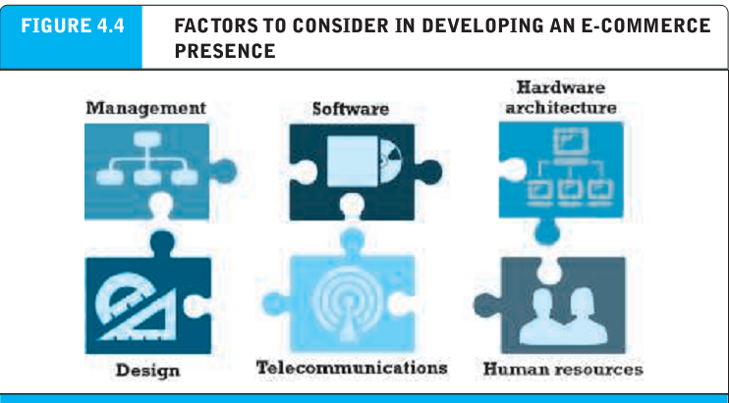
Building an e-commerce presence : a systematic approach
.

Slide 9
Planning : the systems development life cycle
Systems development life cycle (SDLC) a methodology for understanding the business objectives of any system and designing an appropriate solution.
System development life cycle :
System analysis / planning
System design
Building the system
Testing
Implementation

Slide 10
System analysis
Business objectives : capabilities you want your site to have.
System functionalities : type of information systems capabilities you will need to achieve your business objectives.
Information requirements : the information elements that the system must produce in order to achieve the business objectives.

Slide 11
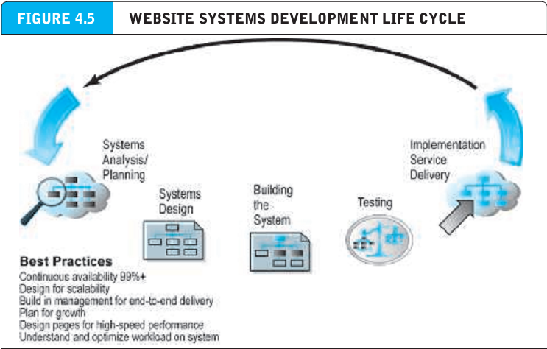
System analysis
Business objectives : capabilities you want your site to have.
System functionalities : type of information systems capabilities you will need to achieve your business objectives.
Information requirements : the information elements that the system must produce in order to achieve the business objectives.

Slide 12
System design : hardware & software platforms
System design specification : description of the main components in a system and their relationships to one another.
Logical design : describes the flow of information at your e-commerce site, the processing functions that must be performed, the databases that will be used, the security and emergency backup procedures that will be used in the system.
Physical design : translates the logical design into physical components.

Slide 13
Building the system : in house versus outsourcing
Outsourcing : hiring an outside vendor to provide the services you cannot perform with in house personnel.
Host your own versus outsourcing
Co-location : when a firm purchases or leases a web server (and has total control over its operation) but locates the server in a vendor’s physical facility. The vendor maintains the facility, communications lines and the machinery

Slide 14
Testing the system
Unit testing : involves testing the site’s program modules one at a time
System testing : involves testing the site as a whole, in a way the typical user will use the site.
Acceptance testing : verifies that the business objectives of the system as originally conceived are in fact working
A/B testing (split testing) involves showing two versions of a web page or website to different users to see which one performs better.
Multivariate testing : involves identifying specific elements, creating versions for each element, and then creating a unique combination of each element and version to test.

Slide 15
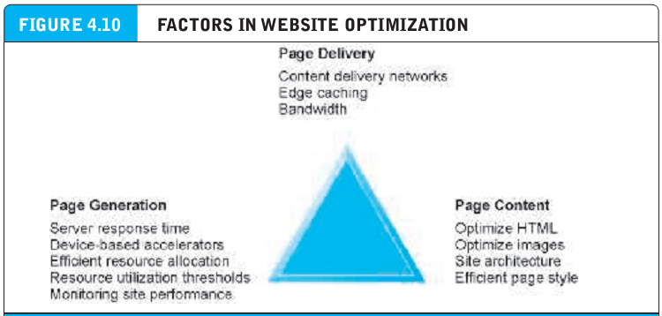
Implementation and maintenance
Benchmarking : a process in which the site is compared with those of competitors in terms of response speed, quality of layout and design.
Factors in optimizing website performance

Slide 16
Choosing software
System architecture : the arrangement of software, machinery, and tasks in an information system needed to achieve a specific functionality.
Two tier architecture : e-commerce system architecture in which a web server responds to requests for web server provides backend data storage.
Multi-tier architecture : e-commerce system architecture in which the web server is linked to a middle-tier layer that typically includes a series of application servers that perform specific tasks as well as a backend layer of existing corporate systems.

Slide 17
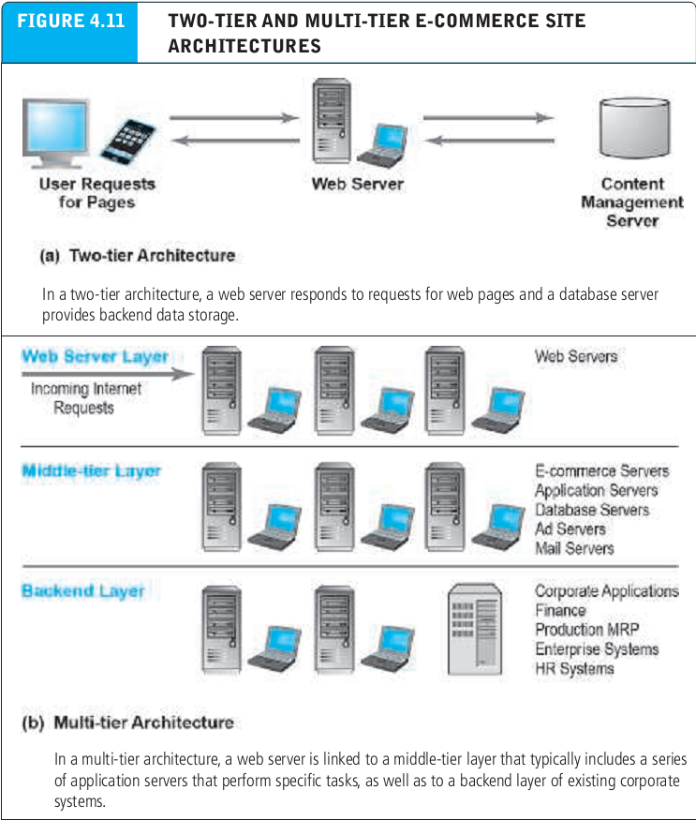
Choosing software
System architecture : the arrangement of software, machinery, and tasks in an information system needed to achieve a specific functionality.
Two tier architecture : e-commerce system architecture in which a web server responds to requests for web server provides backend data storage.

Slide 18
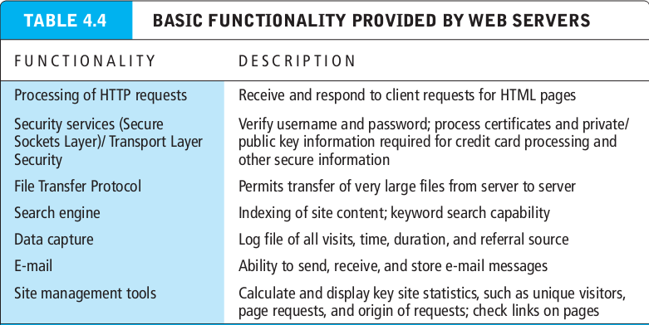
Web server software
Site management tools : verify that links on pages are still valid and also identify orphan files.

Slide 19
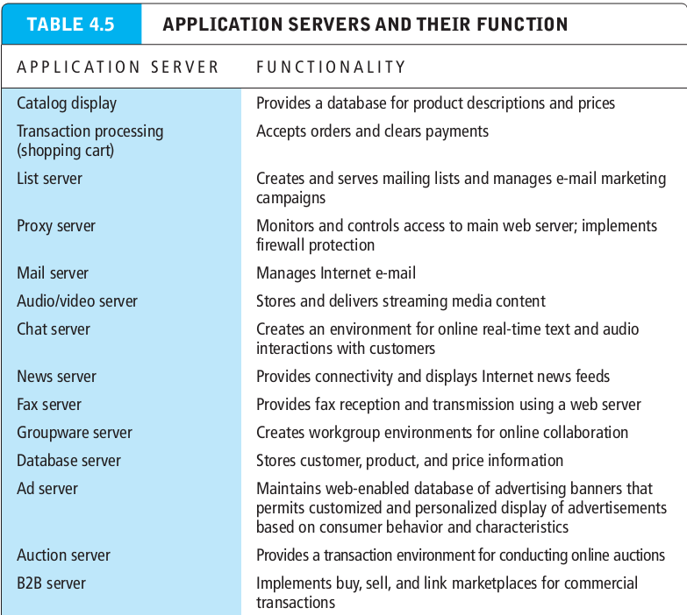
Web server software

Slide 20
E-commerce merchant server software functionality
E-commerce merchant server software : software that provides the basic functionality needed for online sales, including an online catalog, order taking via online shopping cart, and online credit card processing.
Online catalog : list of product available on a website
Shopping cart : allows shoppers to set aside desired purchases in preparation for checkout, review what they have selected, edit their selections as necessary, and then actually make the purchase by clicking a button.

Slide 21
Choosing hardware
Hardware platform : refers to all the underlying computing equipment that the system uses to achieve its e-commerce functionality.

Slide 22
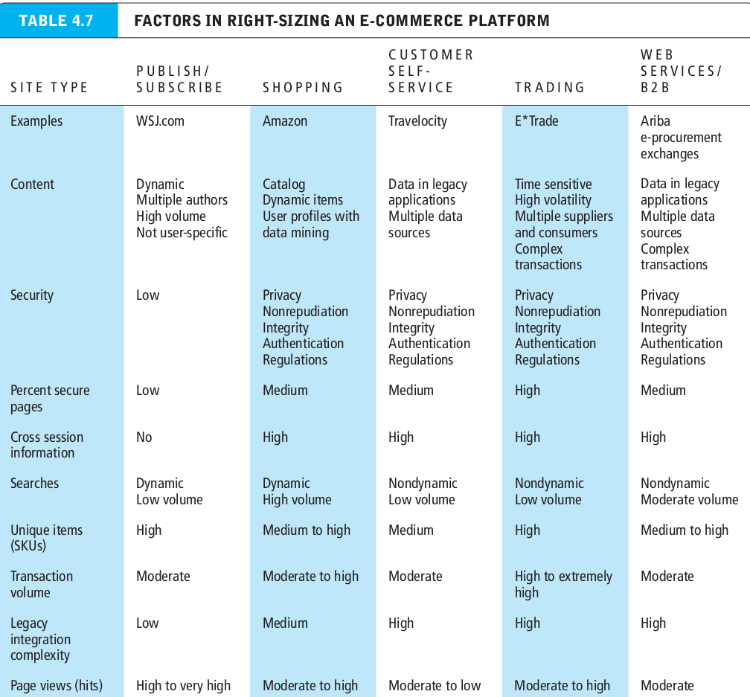
Choosing hardware
Hardware platform : refers to all the underlying computing equipment that the system uses to achieve its e-commerce functionality.

Slide 23
Right-sizing your hardware platform: the supply side
Scalability : the ability of a site to increase in size as demand warrants
Vertical scalling : increasing the processing power of individual components.
Horizontal scalling : employing multiple computers to share the workload.

Slide 24
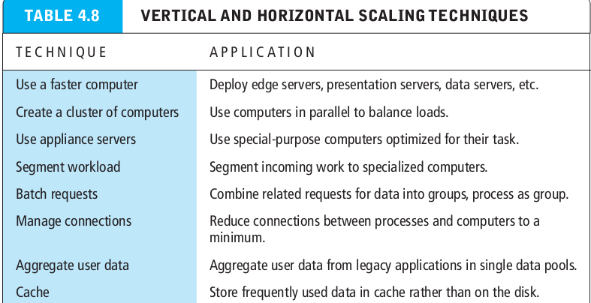
Right-sizing your hardware platform: the supply side
Scalability : the ability of a site to increase in size as demand warrants
Vertical scalling : increasing the processing power of individual components.
Horizontal scalling : employing multiple computers to share the workload.

Slide 25
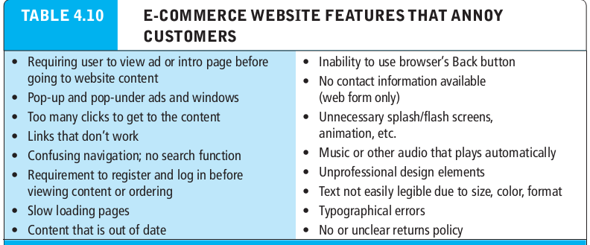
Other e-commerce site tools
Scalability : the ability of a site to increase in size as demand warrants
Vertical scalling : increasing the processing power of individual components.
Horizontal scalling : employing multiple computers to share the workload.

Slide 26
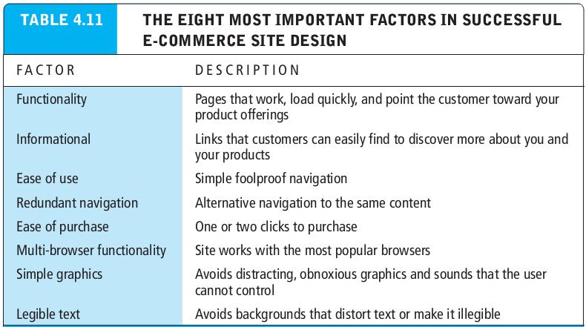
Other e-commerce site tools
Scalability : the ability of a site to increase in size as demand warrants
Vertical scalling : increasing the processing power of individual components.
Horizontal scalling : employing multiple computers to share the workload.

Slide 27
Developing a mobile website and building mobile applications
Mobile website : version of a regular desktop website that is scaled down in content and navigation.
Mobile web app : application the mobile web browser built into a smartphone or tablet computer.
Native app : application designed specifically to operate using the mobile device’s hardware and operating system.
Hybrid app : has many of the features of both a native app and a mobile web app.

Slide 28
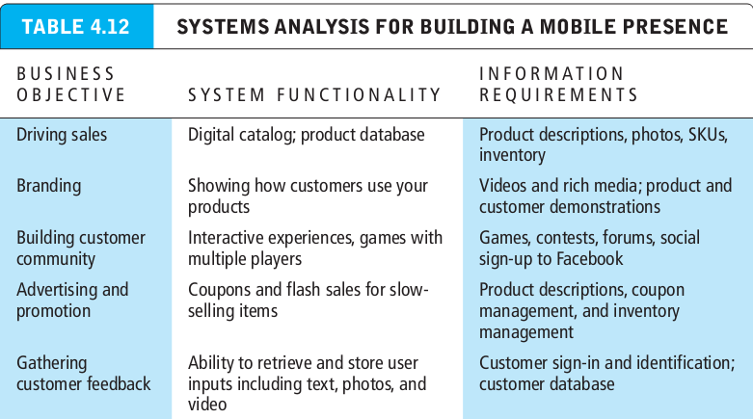
Developing a mobile website and building mobile applications
Mobile website : version of a regular desktop website that is scaled down in content and navigation.
Mobile web app : application the mobile web browser built into a smartphone or tablet computer.
Native app : application designed specifically to operate using the mobile device’s hardware and operating system.
Hybrid app : has many of the features of both a native app and a mobile web app.

Slide 29
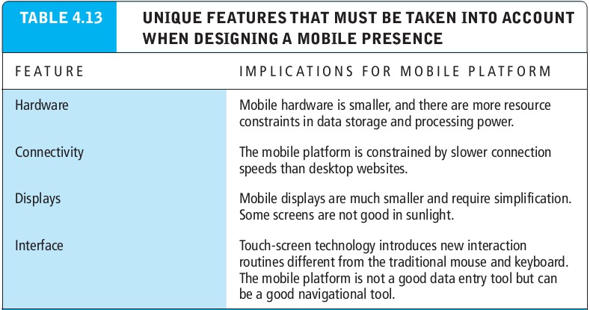
Developing a mobile website and building mobile applications
Mobile website : version of a regular desktop website that is scaled down in content and navigation.
Mobile web app : application the mobile web browser built into a smartphone or tablet computer.
Native app : application designed specifically to operate using the mobile device’s hardware and operating system.
Hybrid app : has many of the features of both a native app and a mobile web app.

