Slide 1
UPN “VETERAN” YOGYAKARTA
E-Commerce
Chapter 5
Hari Prapcoyo,S.Kom., M.ICT
Sistem Informasi

Slide 2
E-commerce security and payment systems
Learning objective:
Scope of e-commerce crime and security problems
The key security threats in the e-commerce environment
Internet communication channel, protect networks, servers and clients
Policies, procedure and laws in creating security
E-commerce payment systems

Slide 3
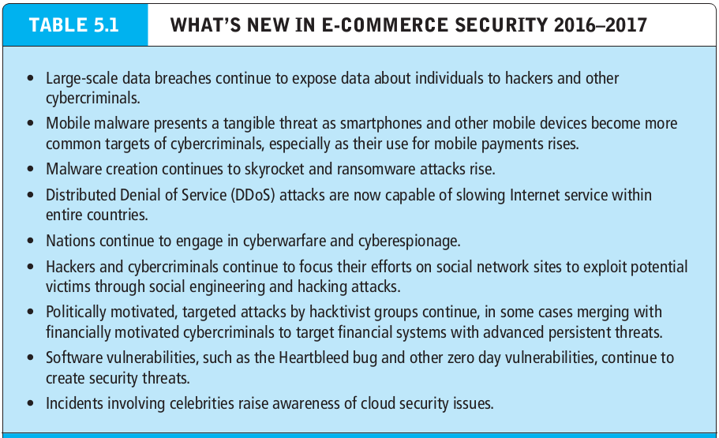
Imagine your e-commerce presence
What’s the idea? (the visioning process)
Where’s the money: business and revenue model.
Who and where is the target audience?
Characterize the marketplace
Where’s the content coming from?

Slide 4
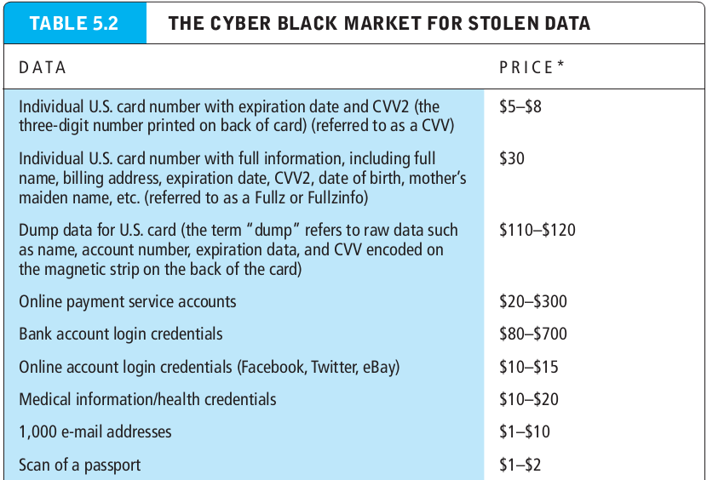
The e-commerce security environment
What’s the idea? (the visioning process)
Where’s the money: business and revenue model.
Who and where is the target audience?
Characterize the marketplace
Where’s the content coming from?

Slide 5
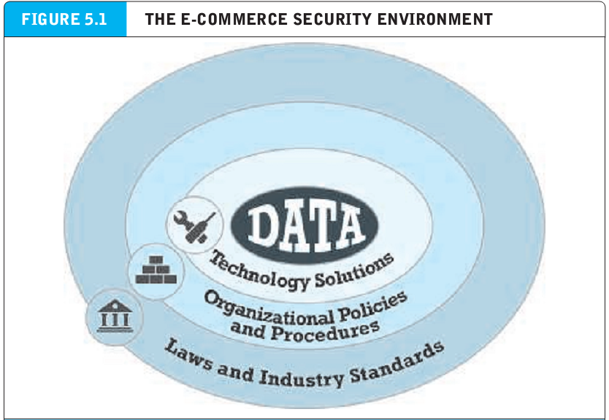
What is good e-commerce security?
What’s the idea? (the visioning process)
Where’s the money: business and revenue model.
Who and where is the target audience?
Characterize the marketplace
Where’s the content coming from?

Slide 6
Dimension of e-commerce security?
Integrity : the ability to ensure that information being displayed on a website or transmitted or received over the internet has not been altered in any way by an authorized party.
Nonrepudiation : the ability to ensure that e-commerce participants do not deny (i.e repudiate) their online actions.
Authenticity : the ability to ensure that messages and data are available only to those who are authorize to view them.

Slide 7
Dimension of e-commerce security?
Privacy : the ability to control the use of information about oneself.
Availability : the ability to ensure that an e-commerce site continues to function as intended

Slide 8
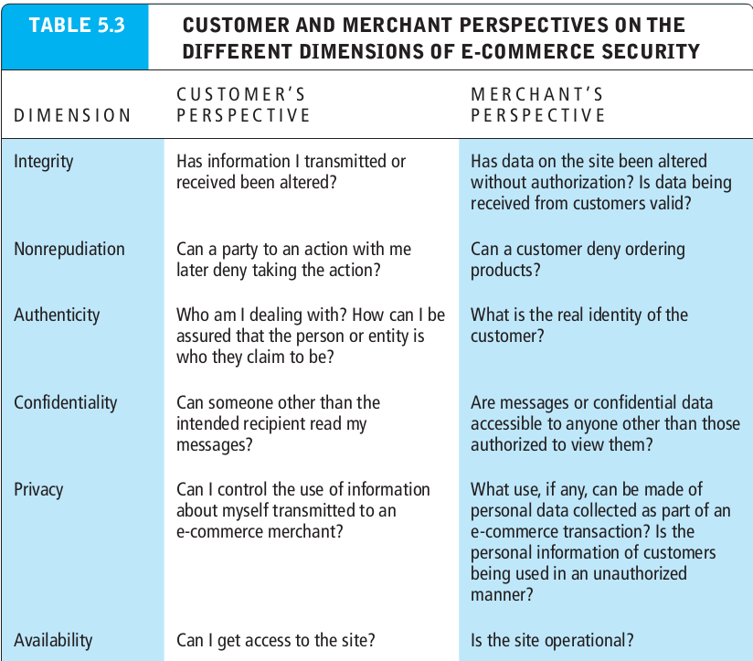
Dimension of e-commerce security?
Privacy : the ability to control the use of information about oneself.
Availability : the ability to ensure that an e-commerce site continues to function as intended

Slide 9
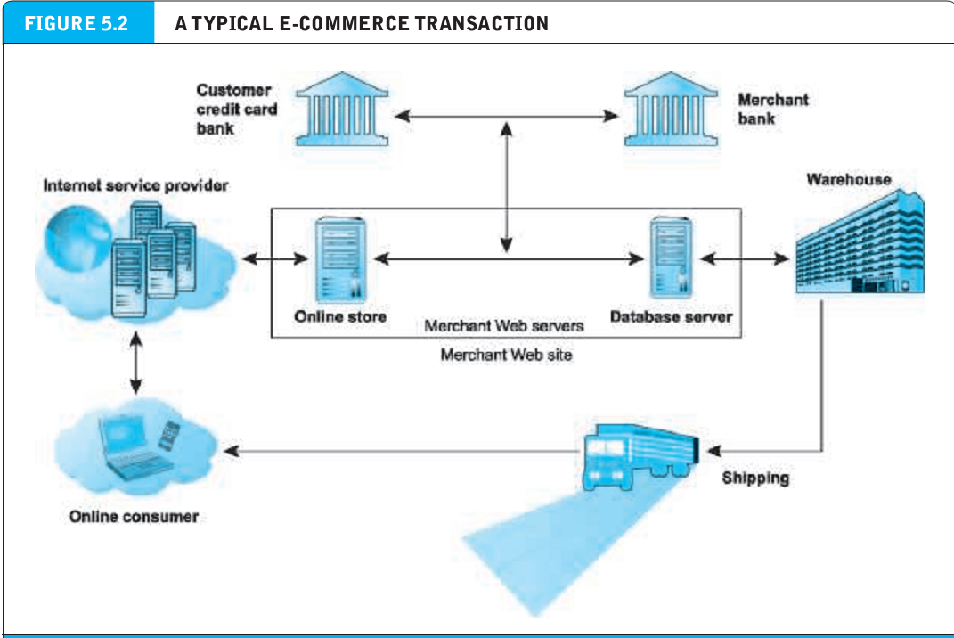
Security threats in the e-commerce environment

Slide 10
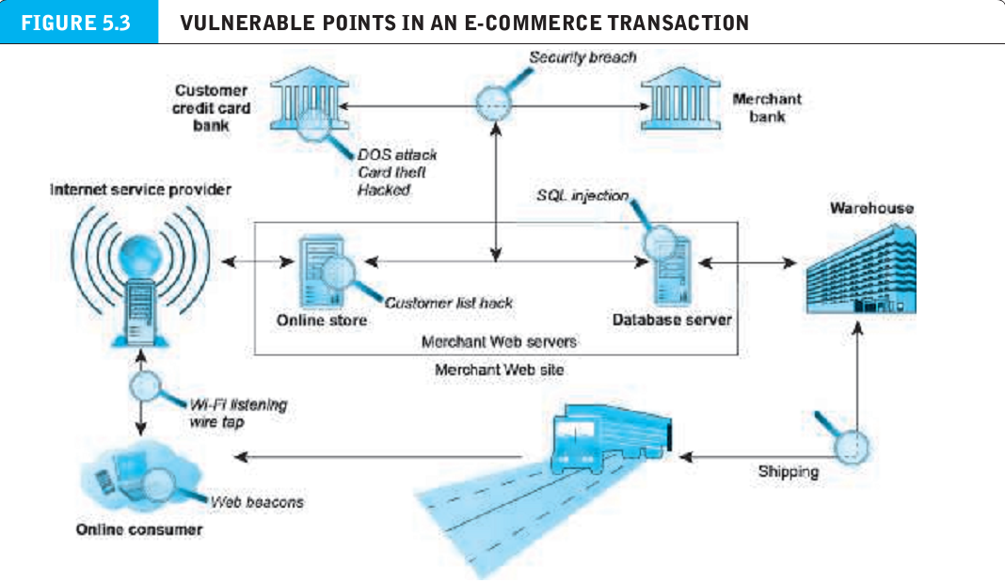
Security threats in the e-commerce environment

Slide 11
Security threats in the e-commerce environment
Malicious code / software (malware) : includes a variety of threats such as viruses, worms, Trojan horses, and bots.
Exploit kit : collection of exploits bundled together and rented or sold as a commercial product.
Maladvertising : online advertising that contains malicious code.
Drive by download : malware that comes with a downloaded file that a user requests.
Virus : a computer program that has the ability to replicate or make copies of itself, and spread to other files.

Slide 12
Security threats in the e-commerce environment
Worm : malware that is designed to spread from computer to computer.
Ransomware (scareware) : malware that prevents you from accessing your computer or files and demands that you pay a fine.
Trojan horse : appears to be benign, but then does something other than expected. Often a way for viruses or other malicious code to be introduced into a computer system.
Backdoor : feature of viruses, worms and Trojans that allows an attacker to remotely access a compromised computer.

Slide 13
Security threats in the e-commerce environment
Bot : type of malicious code that can be covertly installed on a computer when connected to the internet. Once installed, the bot responds to external commands sent by the attacker.
Botnet : collection of captured computers.

Slide 14
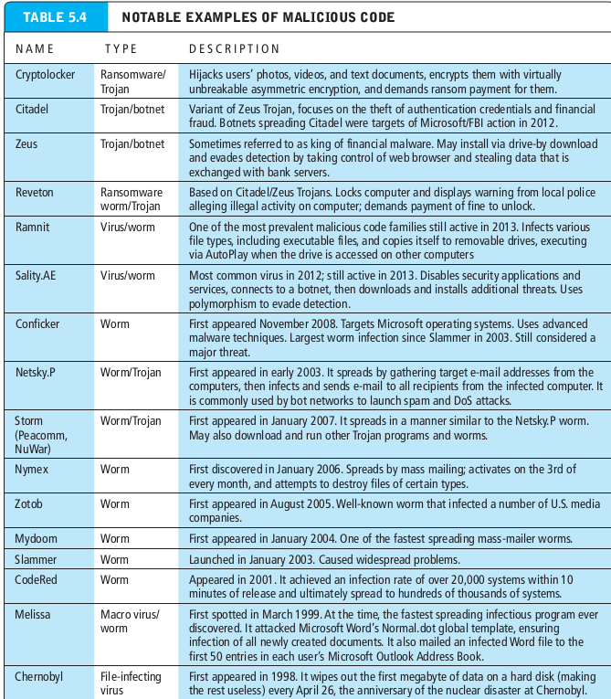
Security threats in the e-commerce environment

Slide 15
Potentially unwanted programs(PUPS)
Potentially unwanted program (PUP) program that installs itself on a computer, typically without the user’s informed consent.
Adware : a PUP that serves pop-up ads to your computer
Browser parasite : a program that can monitor and change the settings of a user’s browser.
Spyware : a program used to obtain information such as a user’s keystrokes, e-mail, instant messages, and so on.
Social engineering : exploitation of human fallibility and gullibility to distribute malware.
Phishing : any deceptive, online attempt by a third party to obtain confidential information for financial gain.

Slide 16
Hacking, cybervandalism, and hacktivism
Hacker : an individual who intends to gain unauthorized access to a computer system.
Cracker : within the hacking community, a term typically used to denote a hacker with criminal intent.
Cybervandalism : intentionally disrupting, defacing, or even destroying a site.
Hacktivism : cybervandalism and data theft for political purposes.
White hats : “good” hackers who help organization locate and fix security flaws.
Black hats : hackers who act with the intention of causing harm.
Grey hats : hackers who believe they are pursuing some greater good by breaking in and revealing system flaws.

Slide 17
Data breaches
Data breach : occurs when an organization loses control over its information to outsiders.
Identify fraud : involves the unauthorized use of another person’s personal data for illegal financial benefit.
Spoofing : involves attempting to hide a true identity by using someone else’s email or IP address.
Pharming : automatically directing a web link to an address different from the intended one, with the site masquerading as the intended destination.
Spam (junk) websites : also referred to as link farms, promise to offer products or services, but in fact are just collections of advertisements.

Slide 18
Denial Of Service(DOS) & Distributed Denial Of Service (DDOS) attacks.
DOS : flooding a website with useless traffic to inundate and overwhelm the network.
DDOS : using numerous computer to attack the target network from numerous launch points.

Slide 19
Poorly designed software
SQL injection attack : takes advantage of poorly coded web application software that fails to properly validate or filter data entered by a user on a web page.
Zero day vulnerability : software vulnerability that has been previously unreported and for which no patch yet exists.
Heartbleed bug : flaw in OpenSSL encryption system that allowed hackers to decrypt an SSL session and discover user names, password, and other user data.

Slide 20
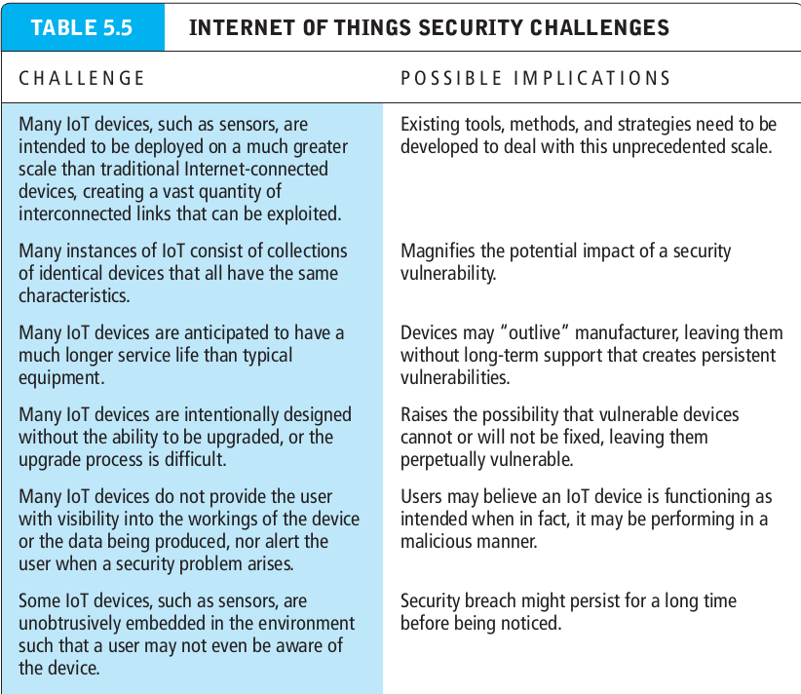
IOT security issues

Slide 21
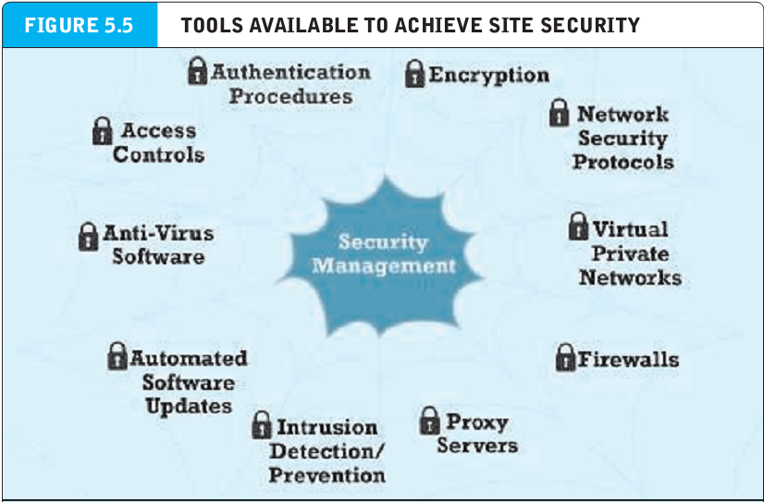
IOT security issues

Slide 22
Technology solutions (Protecting internet communications)
Encryption : the process of transforming plain text or data into chipper text that cannot be read by anyone other than the sender and the receiver. The purposes of encryption is (a)to secure stored information and (b)to secure information transmission.
Cipher text : text that has been encrypted and thus cannot be read by anyone other than the sender and the receiver.
Key (cipher) any method for transforming plain text to cipher text.
Substitution cipher : every occurrence of a given letter is replaced systematically by another letter.

Slide 23
Technology solutions (Protecting internet communications)
Transposition cipher : the ordering of the letters in each word is changed in some systematic way.
Symmetric key cryptography(secret key cryptography) both the sender and the receiver use the same key to encrypt and decrypt the message.
Data Encryption Standard(DES) developed by the NSA and IBM. Uses a 56-bit encryption key.
Advanced Encryption Standard(AES) the most widely used symmetric key algorithm, offering 128, 192, and 256 bit keys
Public key cryptography : two mathematically related digital keys are used : a public key and a private key. The private key is kept secret by the owner, and the public key is widely disseminated. Both keys can be used to encrypt and decrypt a message. However, once the keys are used to encrypt a message that same key cannot be used to unencrypt the message.

Slide 24
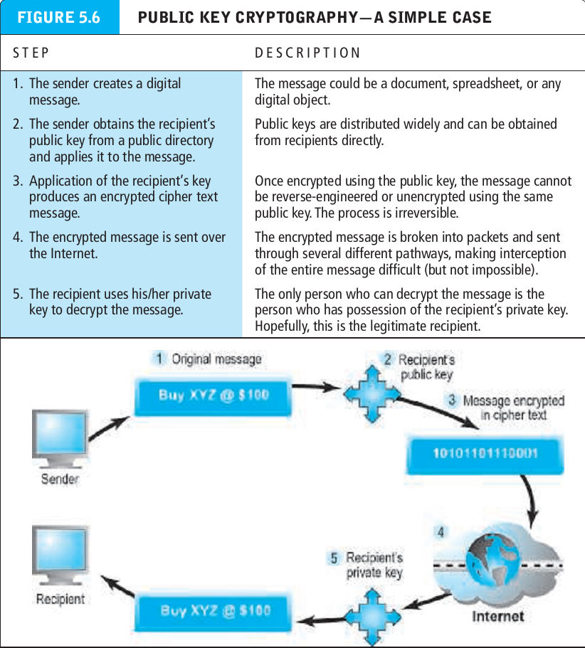

Slide 25
Public Key cryptography using digital signature & hash digest
Hash function : an algorithm that produces a fixed-length number called a hash or message digest
Digital signature (e-signature) : “signed” cipher text that can be sent over the internet.
Digital envelope : a technique that uses symmetric encryption for large documents, but public key cryptography to encrypt and send the symmetric key.

Slide 26
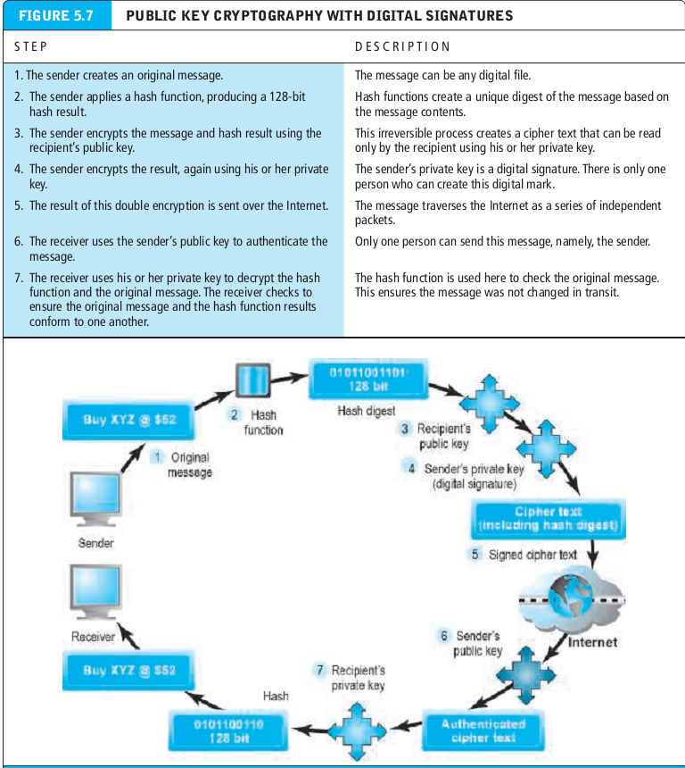
Public Key cryptography using digital signature & hash digest
Hash function : an algorithm that produces a fixed-length number called a hash or message digest
Digital signature (e-signature) : “signed” cipher text that can be sent over the internet.

Slide 27
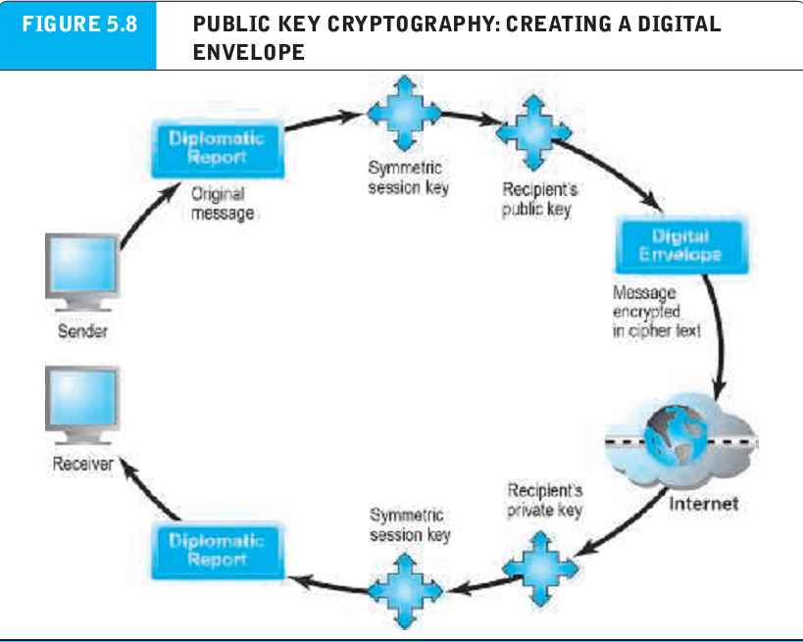
Public Key cryptography using digital signature & hash digest
Hash function : an algorithm that produces a fixed-length number called a hash or message digest
Digital signature (e-signature) : “signed” cipher text that can be sent over the internet.

Slide 28
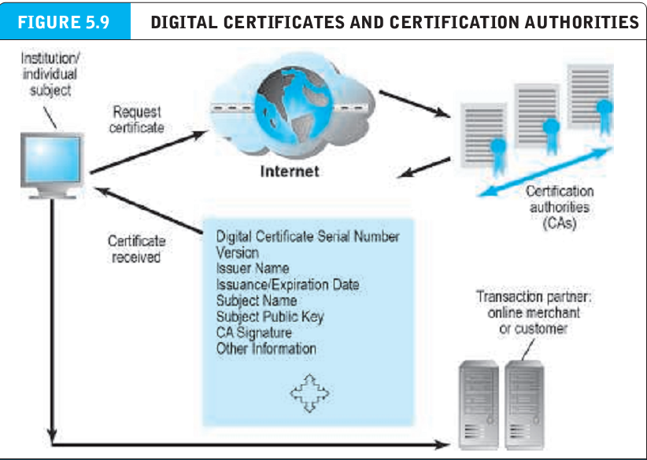
Public Key cryptography using digital signature & hash digest
Hash function : an algorithm that produces a fixed-length number called a hash or message digest
Digital signature (e-signature) : “signed” cipher text that can be sent over the internet.

Slide 29
Digital certificates and publie key infrastructure (PKI)
Digital certificate : a digital document issued by a certification authority that contains a variety of identifying information.
Certification authority (CA) : a trusted third party that issues digital certificates.
Public Key Infrastructure (PKI) : CAs and digital certificate procedures that are accepted by all parties.

Slide 30
Securing channels of communication
Secure negotiated session : a client-server session in which the URL of the requested document, along with the contents, contents of forms, and the cookies exchanged, are encrypted.
Session key : a unique symmetric encryption key chosen for a single secure session.
Virtual Private Networks (VPN) : allows remote users to securely access internal networks via the internet using the point to point tunneling protocol (PPTP).

Slide 31
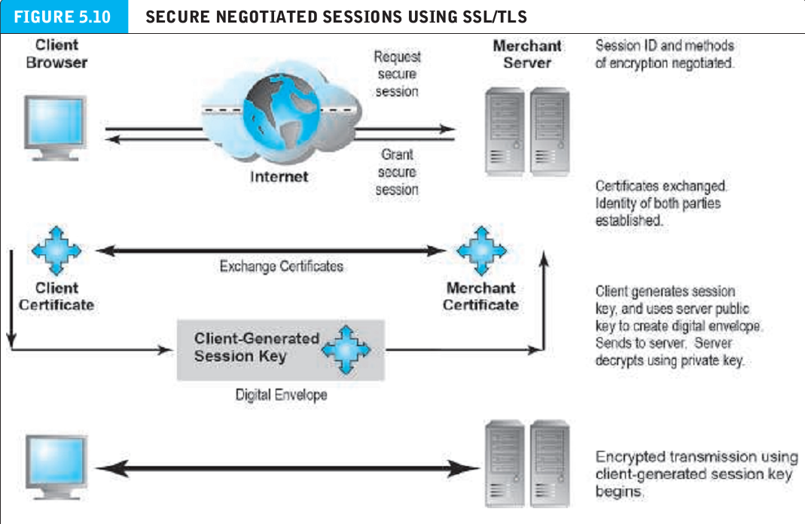
Securing channels of communication
Secure negotiated session : a client-server session in which the URL of the requested document, along with the contents, contents of forms, and the cookies exchanged, are encrypted.
Session key : a unique symmetric encryption key chosen for a single secure session.
Virtual Private Networks (VPN) : allows remote users to securely access internal networks via the internet using the point to point tunneling protocol (PPTP).

