Slide 1
Work design
Sistem Informasi UPN “Veteran” Yogyakarta

Slide 2
Why study work design?
this chapter examines the roots of the design of jobs that we see in today’s organizations. Only a handful of theories can claim to be truly revolutionary, and to have had an enduring and worldwide impact on organizational thought and management practice.

Slide 3
Birth of scientific management
Rationalism the theory that reason is the foundation of certainty in knowledge.
Scientific management a form of job design which stresses short, repetitive work cycles; detailed, prescribed task sequences; a separation of task conception from task execution; and motivation based on economic rewards.
Systematic soldiering the conscious and deliberate restriction of output by operators.
Initiative and incentive system a form of job design in which management gives workers a task to perform and provides them with the financial incentive to complete it, but then leaves them to use their own initiative as to how they will perform it.

Slide 4
Development of Taylorism
Time and motion studies measurement and recording techniques used to make work operations more efficient.

Slide 5
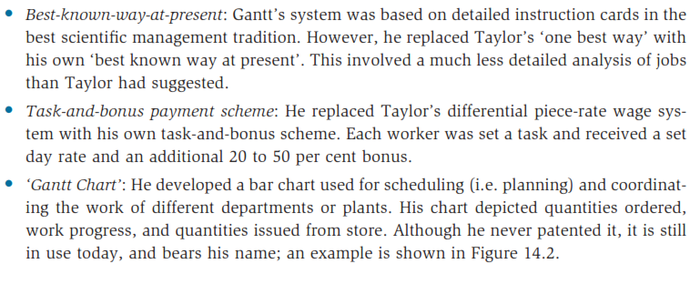
Gantt’s contributions
Time and motion studies measurement and recording techniques used to make work operations more efficient.

Slide 6
Fordism
Fordism a form of work design that applies scientific management principles to workers’ jobs; the installation of single-purpose machine tools to manufacture standardized parts; and mechanized assembly line.
Mass production a form of work design that includes mechanical pacing of work, no choice of tools or methods, repetitiveness, minute subdivision of product minimum skills requirement, and surface mental attention.

Slide 7
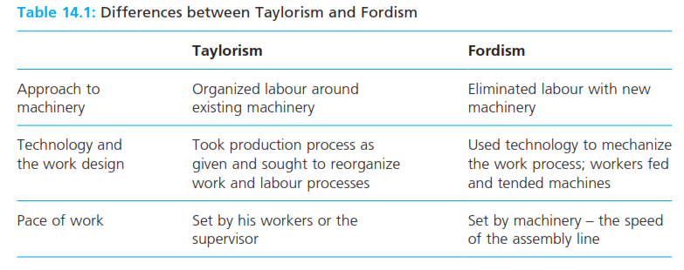
Fordism
Fordism a form of work design that applies scientific management principles to workers’ jobs; the installation of single-purpose machine tools to manufacture standardized parts; and mechanized assembly line.
Mass production a form of work design that includes mechanical pacing of work, no choice of tools or methods, repetitiveness, minute subdivision of product minimum skills requirement, and surface mental attention.

Slide 8
After Ford : the deskilling debate
Mcdonaldization a form of work design aimed at achieving efficiency, calculability, predictability, and control through non human technology, to enhance organizational objectives by limiting employee discretion and creativity.

Slide 9
Back to the future?
Instrumental orientation an attitude that sees work as an instrument to the fulfilment of other life goals.
Introjection a formerly external regulation or value that has been ‘taken in’ and is now enforced through internal pressures such as guilt, anxiety, or related self-esteem dynamics.
Identification the incorporation of another’s thoughts, feelings and actions into one’s self-esteem, thereby transforming oneself.

Slide 10
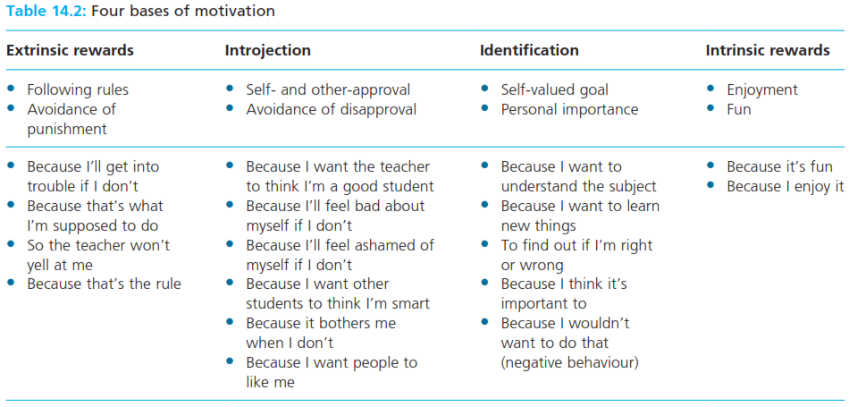
Back to the future?
Instrumental orientation an attitude that sees work as an instrument to the fulfilment of other life goals.
Introjection a formerly external regulation or value that has been ‘taken in’ and is now enforced through internal pressures such as guilt, anxiety, or related self-esteem dynamics.
Identification the incorporation of another’s thoughts, feelings and actions into one’s self-esteem, thereby transforming oneself.

Slide 11
Back to the future?
Concertive control control exercised by the workers themselves who collaborate to develop the means of their own control by negotiating a consensus which shapes their own behavior according to a set of core values such as those of the corporate vision statement.
Chimerial control a combination of management pressure exercised vertically on the individual through bureaucracy, technology, surveillance, and the manipulation of culture, and team pressure exercised horizontally through the group norms and sanctions.

Slide 12
Reference
Huczynski, Buchanan, 2013 , Organizational Behaviour, Pearson
Umam, Khaerul, 2012, Manajemen Organisasi, Pustaka Setia.
Wardiah, Mia Lasmi, Teori perilaku dan budaya organisasi, Pustaka Setia.

