Slide 1
UPN “VETERAN” YOGYAKARTA
E-Commerce
Chapter 9
Hari Prapcoyo,S.Kom., M.ICT
Sistem Informasi

Slide 2
Online retail and services
Learning objective:
Understand the environment in which the online retail sector operates today.
How to analyze the economic viability of an online firm.
The challenges faced by the different type of online retailers
The major features of the online service sector.
The trends taking place in the online financial services industry.
Identify current trends in online career services industry

Slide 3
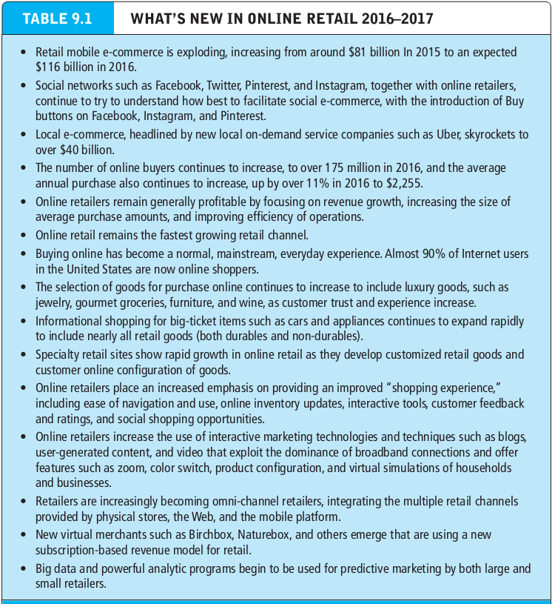
The online retail sector
What’s the idea? (the visioning process)
Where’s the money: business and revenue model.
Who and where is the target audience?
Characterize the marketplace
Where’s the content coming from?

Slide 4
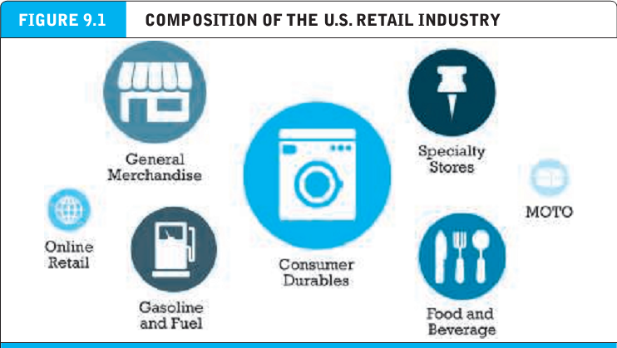
The online retail sector
What’s the idea? (the visioning process)
Where’s the money: business and revenue model.
Who and where is the target audience?
Characterize the marketplace
Where’s the content coming from?

Slide 5
The online retail sector
Omni channel : retailers that sell products through a variety of channels and integrate their physical stores with their website and mobile platform.

Slide 6
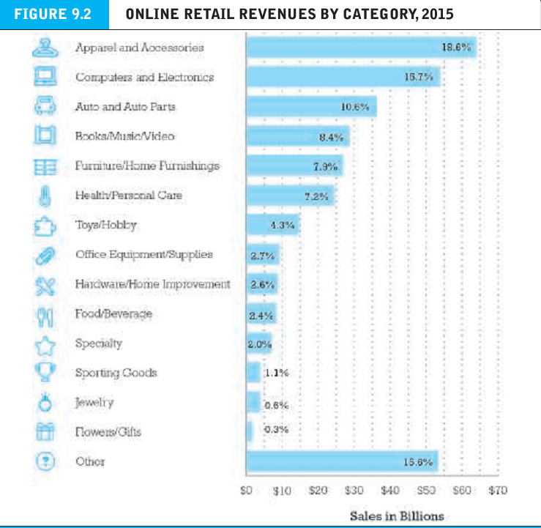
The online retail sector
Omni channel : retailers that sell products through a variety of channels and integrate their physical stores with their website and mobile platform.

Slide 7
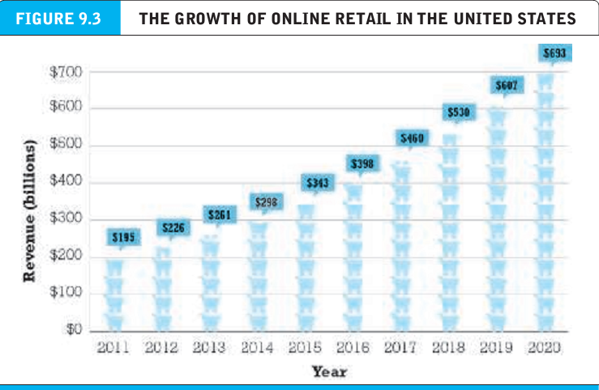
The online retail sector
Omni channel : retailers that sell products through a variety of channels and integrate their physical stores with their website and mobile platform.

Slide 8
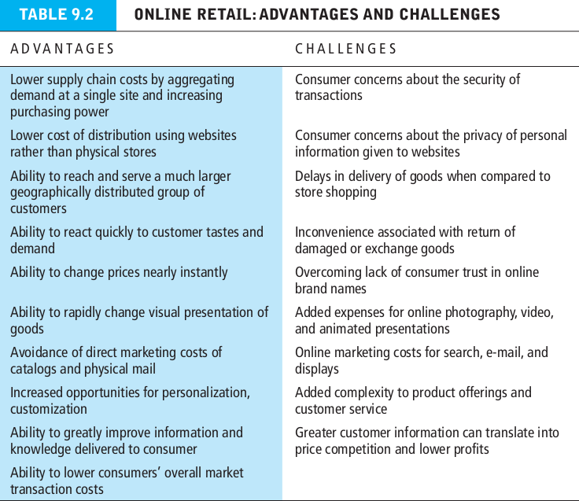
The online retail sector
Omni channel : retailers that sell products through a variety of channels and integrate their physical stores with their website and mobile platform.

Slide 9
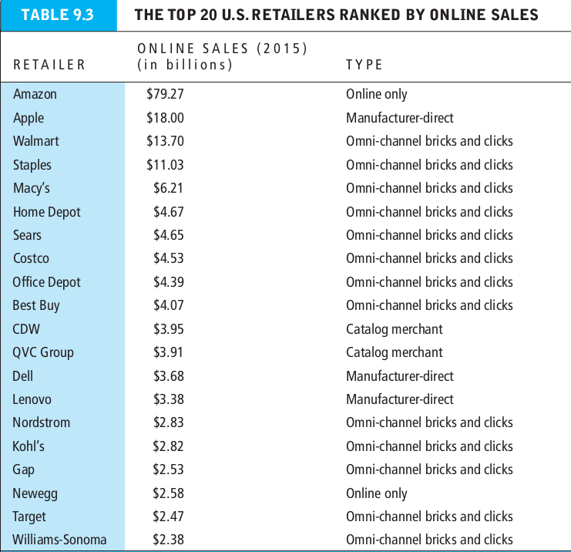
The online retail sector
Omni channel : retailers that sell products through a variety of channels and integrate their physical stores with their website and mobile platform.

Slide 10
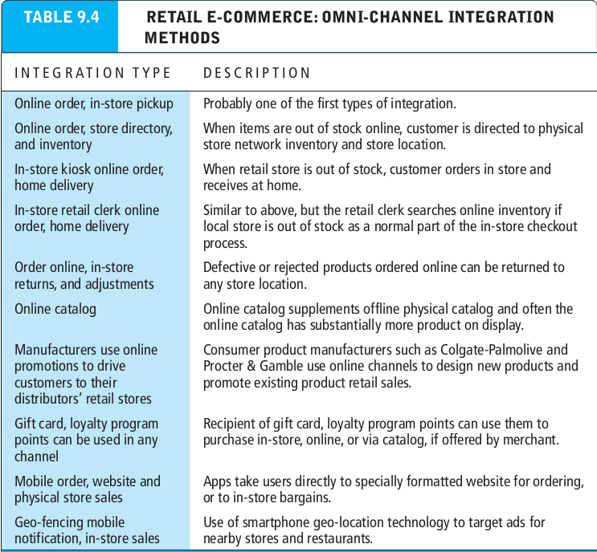
The online retail sector
Omni channel : retailers that sell products through a variety of channels and integrate their physical stores with their website and mobile platform.

Slide 11
Analyzing the viability of online firms
Economic viability : refers to the ability of firms to survive as profitable business firms during a specified period.
Strategic analysis
Barriers to entry
Power of suppliers
Power of customers
Existence of substitute products
Industry value chain
Nature of infra-industry competition

Slide 12
Financial analysis
Gross margin : gross profit divided by net sales
Operating margin : calculated by dividing operating income or loss by net sales revenue.
Net margin : the percentage of its gross sales revenue the firm is able to retain after all expenses are deducted; calculated by dividing net income or loss by net sales revenue.
Balance sheet : provides a financial snapshot of a company on a given date and show its financial assets and liabilities.
Assets : refers to stored value

Slide 13
Financial analysis
Current assets : assets such as cash, securities, account receivable, inventory or other investments that are likely to be able to be converted to cash within one year.
Liabilities : outstanding obligations of the firm
Current liabilities : debts of the firm that will be due within one year.
Long term debt : liabilities that are not due until the passage of a year or more.
Working capital : firm’s current assets minus current liabilities.

Slide 14
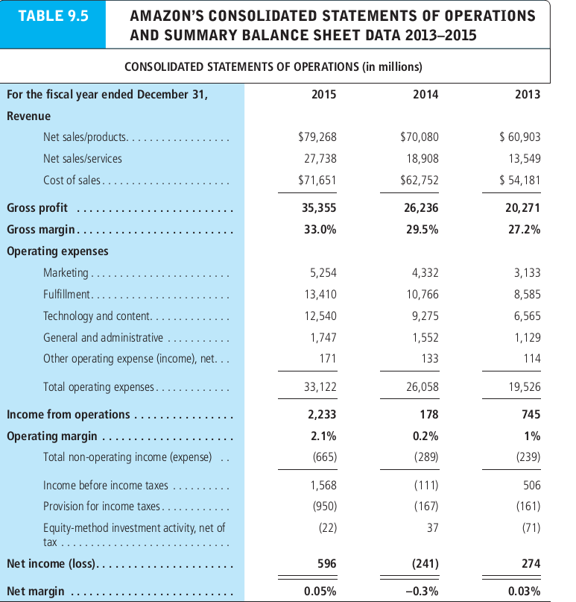
Financial analysis
Current assets : assets such as cash, securities, account receivable, inventory or other investments that are likely to be able to be converted to cash within one year.
Liabilities : outstanding obligations of the firm
Current liabilities : debts of the firm that will be due within one year.
Long term debt : liabilities that are not due until the passage of a year or more.
Working capital : firm’s current assets minus current liabilities.

Slide 15
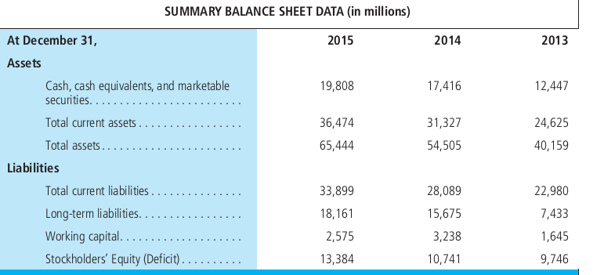
Financial analysis
Current assets : assets such as cash, securities, account receivable, inventory or other investments that are likely to be able to be converted to cash within one year.
Liabilities : outstanding obligations of the firm
Current liabilities : debts of the firm that will be due within one year.
Long term debt : liabilities that are not due until the passage of a year or more.
Working capital : firm’s current assets minus current liabilities.

Slide 16
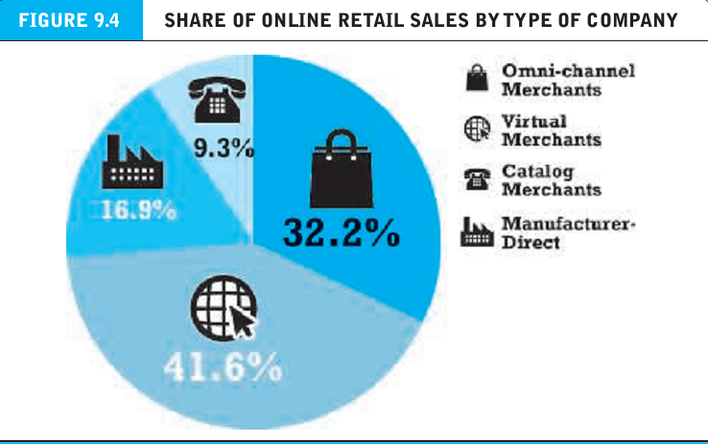
E-commerce in action : e-tailing business models

Slide 17
E-commerce in action : e-tailing business models
Catalog merchants: established companies that have a national offline catalog operation that is their largest retail channel, but who have recently developed online capabilities.
Manufacturer-direct : single or multi channel manufacturers who sell directly online to consumers without the intervention of retailers.
Channel conflict : occurs when retailers of products must compete on price and currency of inventory directly against the manufacturers.

Slide 18
E-commerce in action : e-tailing business models
Supply-push model : products are made prior to orders received based on estimated demand.
Demand pull model : products are not built until an order is received.

Slide 19
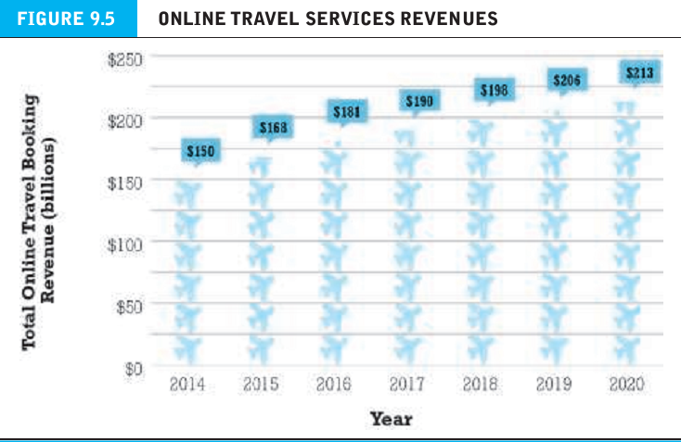
Online travel services
Transaction brokering : acting as an intermediary to facilitate a transaction.

Slide 20
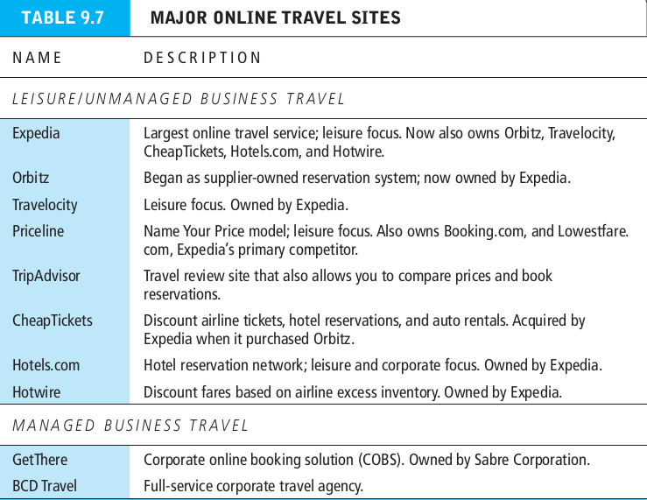
Online travel services
Transaction brokering : acting as an intermediary to facilitate a transaction.

