Slide 1
Individuals in group
Sistem Informasi UPN “Veteran” Yogyakarta

Slide 2
Why study individuals in groups?
The enthusiasm of management for groups and teams in the workplace is tempered by the research of social scientist who see them possessing a darker side, one which becomes evident when manifested in the behavior of some mobs and crowds on the street.

Slide 3
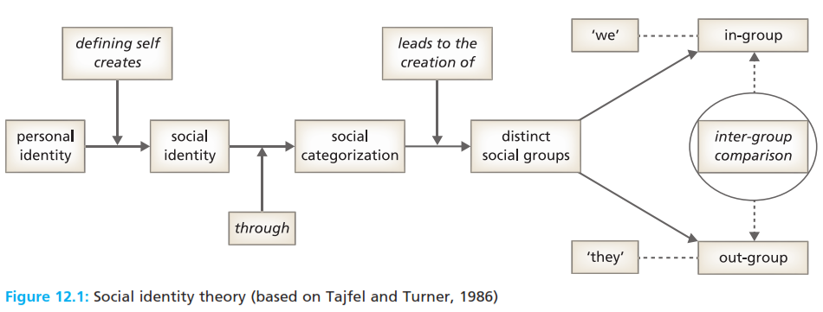
The individual and the group
Social identity that part of the self-concept which comes from our membership of groups and which contributes to our self-esteem.
Social categorization classifying the people we meet on the basis of how similar to or different from the way that we see ourselves they are.
Self categorization perceiving ourselves as sharing the same social identity as other category members, and behaving in ways consistent with that category stereotype.

Slide 4
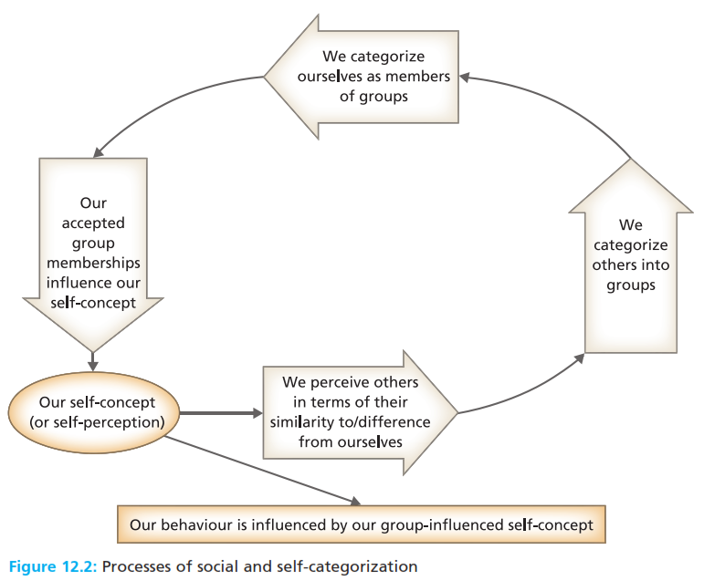
The individual and the group
Self esteem that part of the self which is concerned with how we evaluate ourselves.

Slide 5
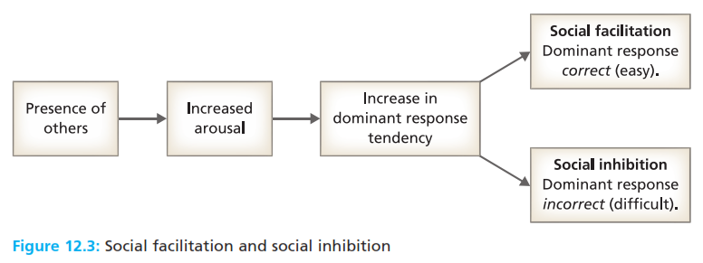
Group influences on individuals’ perceptions
Social representations the beliefs, ideas, and values about objects, people, and events that are constructed by current group members, and which are transmitted to its new members.
Shared frame of reference assumptions held in common by group members,which shape their thinking decisions, actions, and interactions, while being constantly defined and reinforced through those interactions.

Slide 6
Group influences on individuals’ perceptions
Social influence the process whereby attitudes and behaviours are changed by the real or implied presence of others.
Social facilitation the effect of the presence of other people enhancing an individual’s performance.
Social inhibition the effect of thre presence of other people reducing an individual’s performance.
Synergy the positive or negative result of the interaction of two or more components, producing an outcome that is different from the sum of the individual components.
Social compensation persons increasing their effort, and working harder when in a group
Social loafing the tendency for individuals to exert less effort when working as part of a group than when working alone

Slide 7
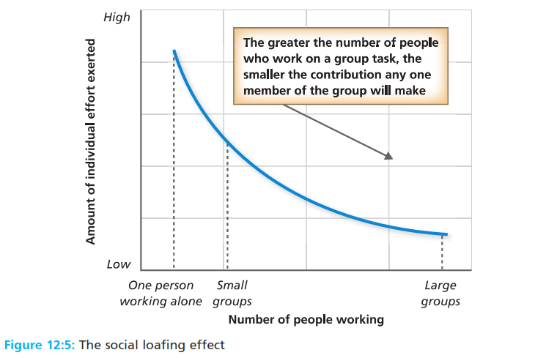
Group influences on individuals’ perceptions
Social influence the process whereby attitudes and behaviours are changed by the real or implied presence of others.
Social facilitation the effect of the presence of other people enhancing an individual’s performance.
Social inhibition the effect of thre presence of other people reducing an individual’s performance.
Synergy the positive or negative result of the interaction of two or more components, producing an outcome that is different from the sum of the individual components.
Social compensation persons increasing their effort, and working harder when in a group
Social loafing the tendency for individuals to exert less effort when working as part of a group than when working alone

Slide 8
Group influences on individuals’ perceptions
Free rider a member who obtains benefits from team membership without bearing a proportional share of the costs for generating that benefit.
Group influences on individuals’ behaviour
Group norm an expected mode of behavior or belief that is established either formally or informally by a group
Pivotal norms socially defined standards relating to behavior and beliefs that are central to a group’s objective and survival
Peripheral norms socially defined standards relating to behavior and beliefs that are important but not crucial to a groups’ objective and survival.

Slide 9
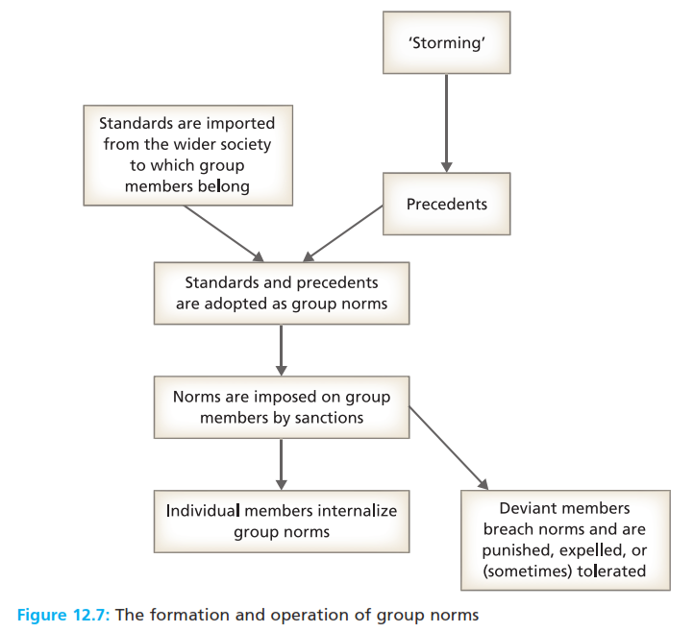
Group influences on individuals’ perceptions
Free rider a member who obtains benefits from team membership without bearing a proportional share of the costs for generating that benefit.
Group influences on individuals’ behaviour
Group norm an expected mode of behavior or belief that is established either formally or informally by a group
Pivotal norms socially defined standards relating to behavior and beliefs that are central to a group’s objective and survival
Peripheral norms socially defined standards relating to behavior and beliefs that are important but not crucial to a groups’ objective and survival.

Slide 10
Group influences on individuals’ behaviour
Group Santion a pusnishment or a reward given by members to others in the group in the process of enforcing groups norms.

Slide 11
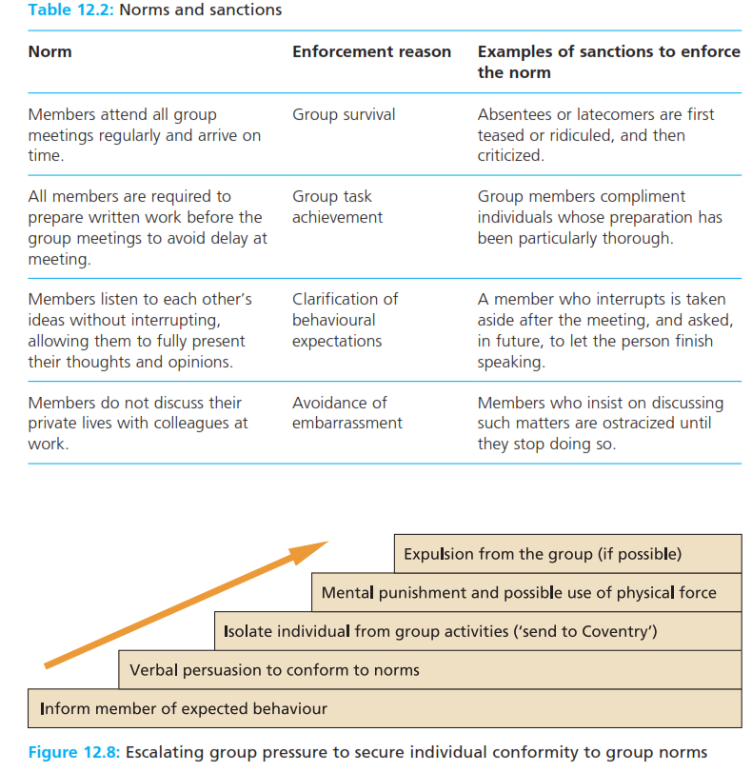
Group influences on individuals’ behaviour
Group Santion a pusnishment or a reward given by members to others in the group in the process of enforcing groups norms.

Slide 12
Group influences on individuals’ behaviour
Conformity a change in an individual’s beliefs or behavior in response to real or imagined group pressure
Obedience a situation in which an individual changes their behavior in responses to direct command from another.
Group cohesion the number and strength attitudes between individual group members
Group socialization the process whereby members learn the values, symbols, and expected behaviours of the group to which they belong.

Slide 13
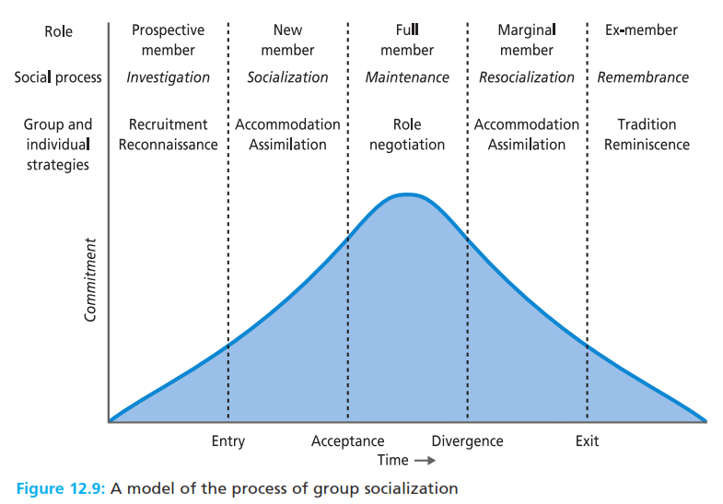
Group influences on individuals’ behaviour
Conformity a change in an individual’s beliefs or behavior in response to real or imagined group pressure
Obedience a situation in which an individual changes their behavior in responses to direct command from another.
Group cohesion the number and strength attitudes between individual group members
Group socialization the process whereby members learn the values, symbols, and expected behaviours of the group to which they belong.

Slide 14
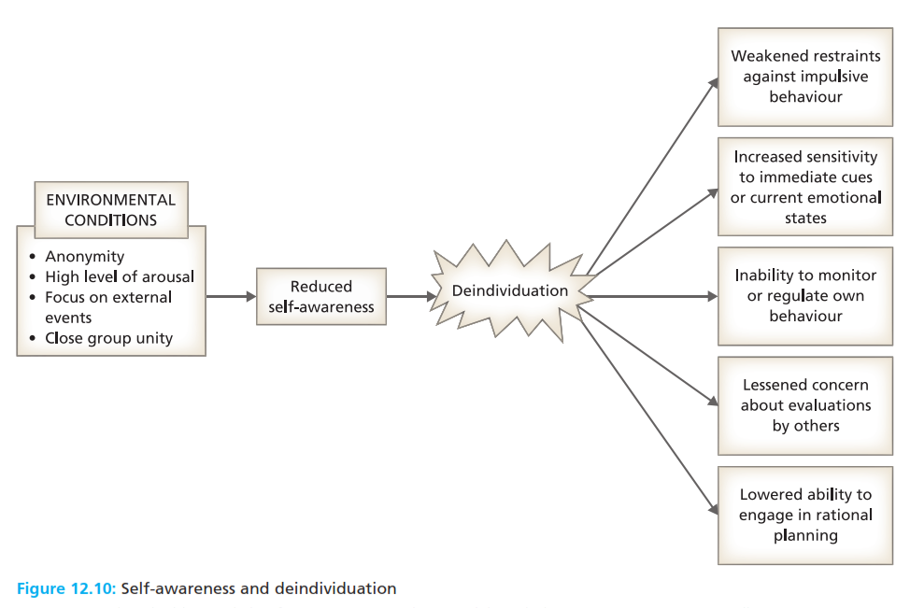
Deindividuation
Deindividuation an increase state of anonymity that loosens normal constraints on individual’’s behavior, reducing their sense of responsibility, and leading to an increase in impulsive and antisocial acts.

Slide 15
Individual influences on group attitudes and behaviour
Compliance a majority’s influence over a minority
Conversion a minority’s influence over a majority

Slide 16
Reference
Huczynski, Buchanan, 2013 , Organizational Behaviour, Pearson
Umam, Khaerul, 2012, Manajemen Organisasi, Pustaka Setia.
Wardiah, Mia Lasmi, Teori perilaku dan budaya organisasi, Pustaka Setia.

