Slide 1
Inclusive Agribusiness
Discussion
Jelaskan tentang Inclusive Agribusiness model pada kasus agribisnis kakao

Slide 2
Michael Porter mengemukakan bahwa aktivitas-aktivitas dalam organisasi memberikan nilai tambah jasa dan produk pada proses organisasi dan seharusnya semua aktivitas berjalan pada level optimum jika organisasi mendapatkan keunggulan bersaing yang riil.
Jika organisasi dijalankan dengan efisien maka nilai yang diperoleh akan melebihi biaya yang dikeluarkan.
Value Chain
Inclusive Agribusiness menggunakan konsep Value Chain

Slide 3
FIRM INFRASTRUTURE
how to use inclusive business models to integrate people at the base of the global economic pyramid into value chains.
HUMAN RESOURCE MANAGEMENT
PROFIT MARGIN
SUPPORT ACTIVITIES
TECHNOLOGY
PROCUREMENT
INBOUND
LOGISTIC
OPERATIONS
OUTBOUND
LOGISTIC
MARKETING
AND
SALES
Service after
SALES
PROFIT MARGIN
VALUE CHAIN
PRIMARY ACTIVITIES

Slide 5
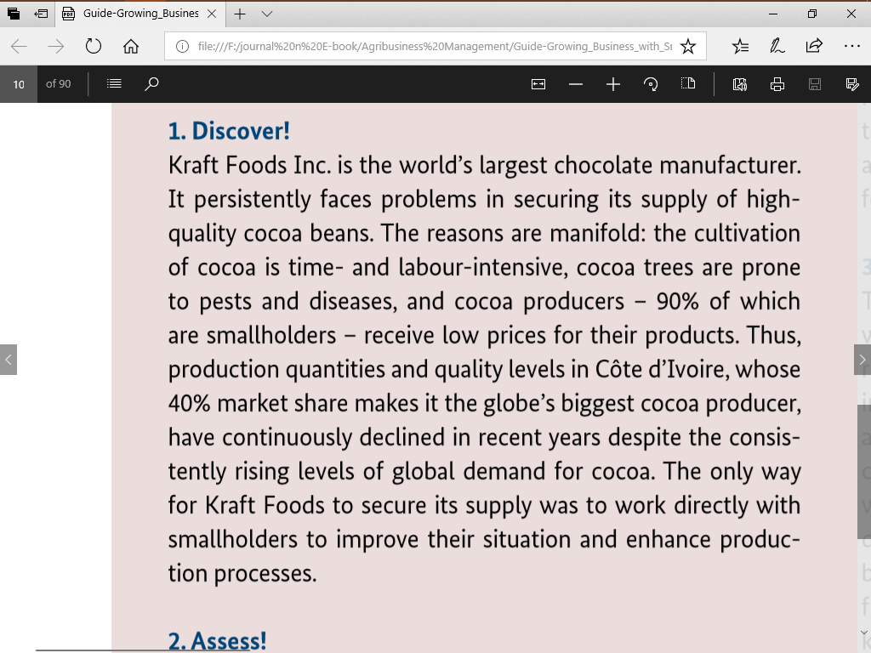

Slide 7
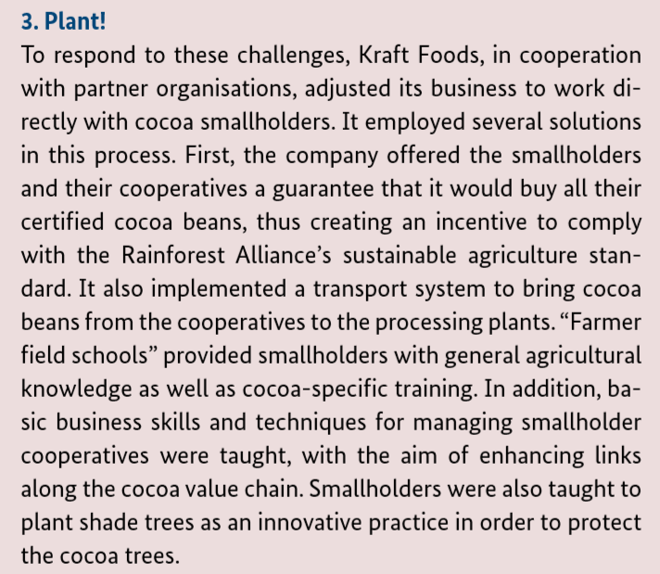

Slide 10
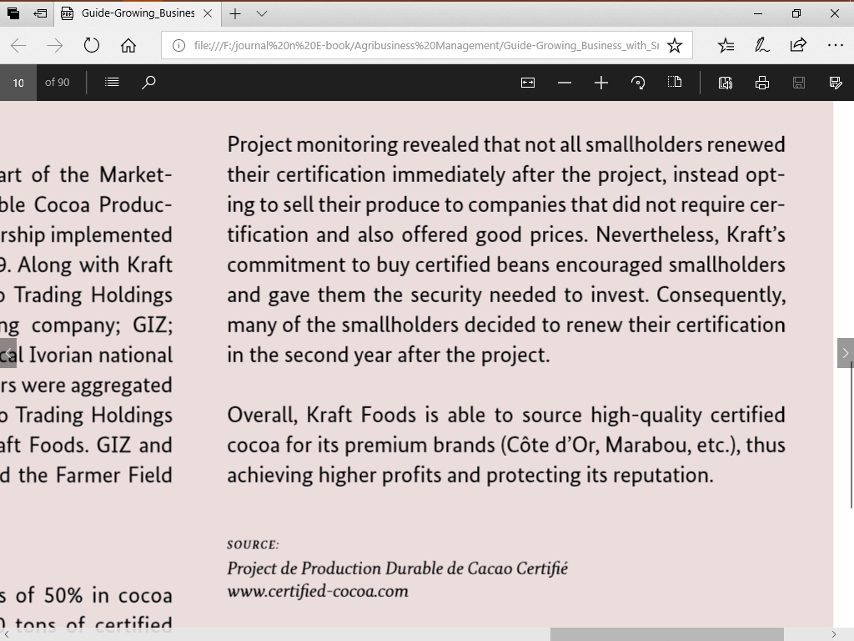

Slide 11
Discover!
The inclusive agribusiness opportunity

Slide 12
Inclusive agribusiness along the value chain

Slide 13
Opportunities to engage with smallholders along the value chain

Slide 15
The smallholder context and its challenges
Assess!

Slide 16
Just As A Field’s Soil And Weather Conditions Must Be Assessed, Evaluating Local Market Conditions And The Smallholder Business Partners’ Situation Must Form The Basis For Any New Inclusive Agribusiness Development.
Such An Assessment Will Also Help Identify Any Structural Challenges That Need To Be Addressed.
Five Common Challenges Have Been Identified: A Lack Of Market Information, A Lack Of Skills, Insecurity, Insufficient Resources And Gaps In Local Infrastructure.

Slide 17
The Mirror Of Relationship Challenges Between A Company And Smallholders

Slide 18
companies selling to smallholders don’t know what kind of products and features smallholders demand, what they are willing to pay, or how best to market their products.
Companies sourcing from smallholders don’t know who offers what products, in what quantities and at what qualities, at what prices, and where.
Lack of
market information
Smallholders face difficulties accessing up-to-date information on issues such as market prices for their products, weather forecasts, potential business partners beyond the local level, available inputs, modern production and marketing technologies, and agricultural practices.
Companies have difficulties obtaining vital information on smallholder markets

Slide 19
Smallholders Are Generally Unaware Of Up-to-date Agricultural Practices And Post-harvest Management Techniques, A Condition Reflecting Their Additional Lack Of Access To Information.
Lack of skills
They Often Lack Basic Business Skills Such As Accounting, Cash-flow Management, And The Ability To Engage In Medium-term Strategy Development.

Slide 20
Third, Other Farm Risk-management Tools Such As Savings, Resilient Crops, Or Irrigation Systems Are Often Either Similarly Unavailable Or Too Costly.
Smallholders Face Considerable Levels Of Daily Insecurity, Making It Difficult For Them To Plan For The Future, Enter Long-term Commitments, Invest And Take Additional Risks.
First, Smallholder Incomes Are Not Only Low, But Also Irregular And Insecure, Especially When Opportunities To Diversify Income Sources Are Scarce
Second, Most Developing Countries Offer Very Limited Access To Social Safety Nets Or Insurance Coverage Able To Absorb Losses If Harvests Fail Or Prices Are Unexpectedly Low.
Insecurity
Fourth, Markets In The Rural Areas Of Developing Countries Are Usually Mostly Informal. Contract-enforcement Support Systems Such As Courts Or The Police Are Out Of Reach, Unreliable, Or Too Costly And Time-consuming To Be Of Practical Effect.

Slide 21
Smallholders Generally Lack Productive Assets And Financial Resources. Lacking Access To Adequate Savings And Credit Services, It Is Consequently Difficult For Smallholders To Improve Their Already Poor Resource Base.
Insufficient
resources

Slide 22
Many rural areas are difficult to reach, as roads are absent or in poor condition.
Gaps in infrastructure
Long transport times affect the quality of fresh products. Ports often have limited capacity and are outdated, and railway lines are often poorly maintained.

Slide 23
Plant!

Slide 24
When planting, farmers select the strongest seeds available to make sure their field will produce high yields and can deal with adverse environmental conditions.
For inclusive agribusinesses, Five core solutions have been identified that relate to innovations, production factors, knowledge, rules and value chain links.

Slide 25
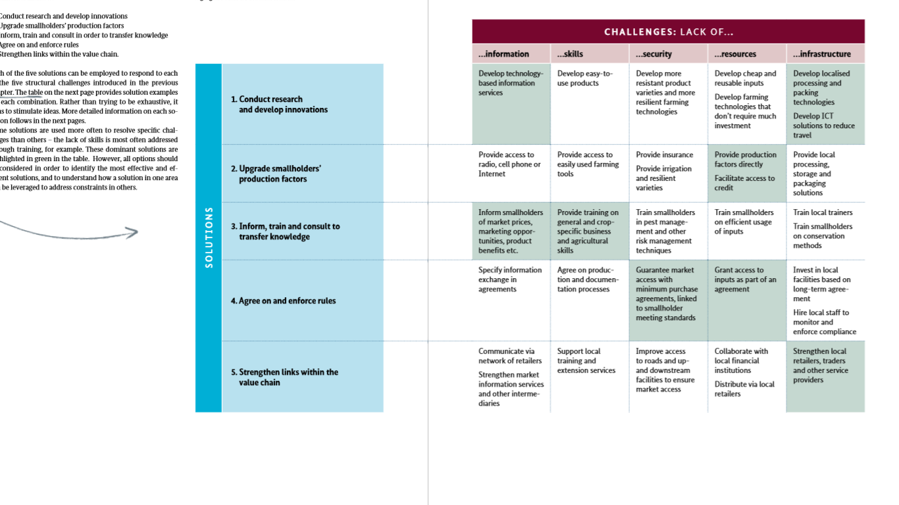

Slide 26
Companies sourcing from smallholder farmers need to know what products are being produced, and what inputs and practices are being used. Participatory approaches are critical in order to understand other relevant issues and potential solutions from the perspective of the business partners
Solution 1:
Conduct research and develop innovations
Innovative Technologies Can Range From IT Solutions To Cropping Systems.
Research And Development Can Hence Be A Critical Enabler For Inclusive Agribusiness.

Slide 27
Companies Can Help Smallholders Access, Finance And Upgrade Production Factors Including Seed, Feed, Fertilisers, Crop Protection Products, Irrigation Systems And Machinery.
Solution 2:
Upgrade smallholders’ production factors
Thus, They Help Increase The Productivity Of Their Smallholder Business Partners.
Companies that source from smallholders often provide production factors as part of their business relationship in order to get the quantities and quality required.
Other companies also sell production factors to smallholders as their core business, and facilitate access via financial services or provide additional upgrades to make their own products more attractive.

Slide 28
General Agronomic Education Teaches Smallholders Agricultural Best Practices And General Farm Management Techniques.
Compliance training teaches smallholders to implement processes required to meet various standards and obtain certification. For example, cocoa producers were trained by Kraft Foods** to comply with the Rainforest Alliance’s Sustainable Agriculture Standard.
Product-specific training focuses on the cultivation and management of a particular crop or livestock.
For instance, Nestlé teaches smallholders to understand the connection between cow nutrition and milk quality.
Solution 3:
Inform, train and consult to transfer knowledge
Business training provides smallholders with skills to manage their farm as a business, including accounting, stock management, cash flow management, and investment, planning and strategy techniques.
Farmer-organisation capacity building educates smallholders on how to organise and manage cooperatives.

Slide 29
Clear rules are an important part of establishing common ground between the company and its smallholder business partners. These rules need to provide both sides with strong incentives to comply with commitments, especially in informal markets where contracts are not easily enforced.
Meeting
Solution 4:
Agree on and enforce rules

Slide 30
Forging new and stronger connections between the various elements of a value chain will help inclusive agribusiness processes become more reliable and efficient.
Solution 5:
Strengthen links within the value chain
Companies can strengthen these links either by building new facilities or by upgrading existing local systems and enterprises. This may involve upgrading local shops, constructing new collection points, or implementing self-run logistics and distribution systems.
Strengthening these links helps bring the company and its smallholder business partners closer together.

Slide 31
Nurture!
Three levels of collaboration
Like fertiliser, collaborating with other actors nurtures solutions and helps inclusive agribusinesses to grow.

Slide 35
Harvest!
Share the benefits and review results
At the end of the season, farmers harvest the fruits of their labour, assess the results, and share benefits among the family and other participants.

Slide 36
ICT-based real-time monitoring
SAP in Ghana

Slide 37
4 dimensions should be considered in sharing the harvest:
Ownership: Who owns the business and production factors?
Voice: Who takes business decisions? Who can influence decisions?
Risks: How are commercial, political and reputational risks shared, managed and mitigated?
Rewards: How are economic costs and benefits shared?
Sharing benefits

