Slide 1
Group formation
Sistem Informasi UPN “Veteran” Yogyakarta

Slide 2
Why study groups?
Work groups and teams have become a nearly ubiquitous part of contemporary management practice in the majority of prominent organizations in the world.

Slide 3
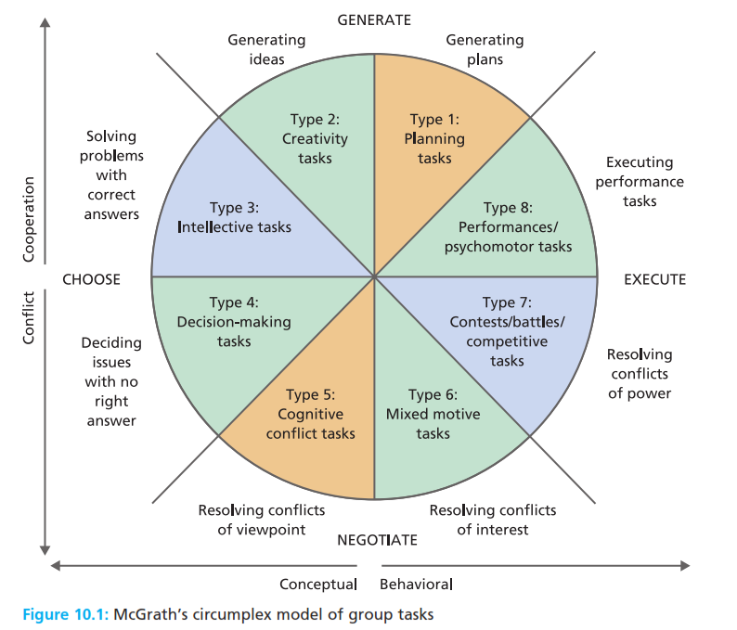
Why study groups?
Work groups and teams have become a nearly ubiquitous part of contemporary management practice in the majority of prominent organizations in the world.

Slide 4
Definitions of groups?
Group two or more people, in face to face interaction, each aware of their group membership and interdependence, as they strive to achieve their goals.
Group dynamics the forces operating within groups that affect their performance and their member’s satisfaction.
Aggregate a collection of unrelated people who happen to be in close physical proximity for a short period of time.

Slide 5
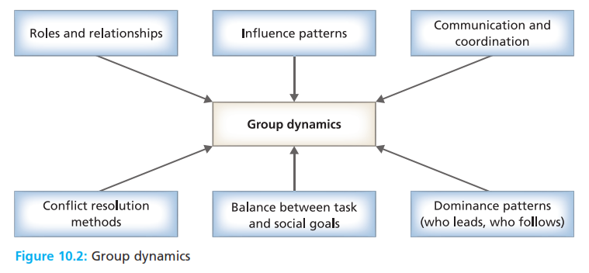
Definitions of groups?
Group two or more people, in face to face interaction, each aware of their group membership and interdependence, as they strive to achieve their goals.
Group dynamics the forces operating within groups that affect their performance and their member’s satisfaction.

Slide 6
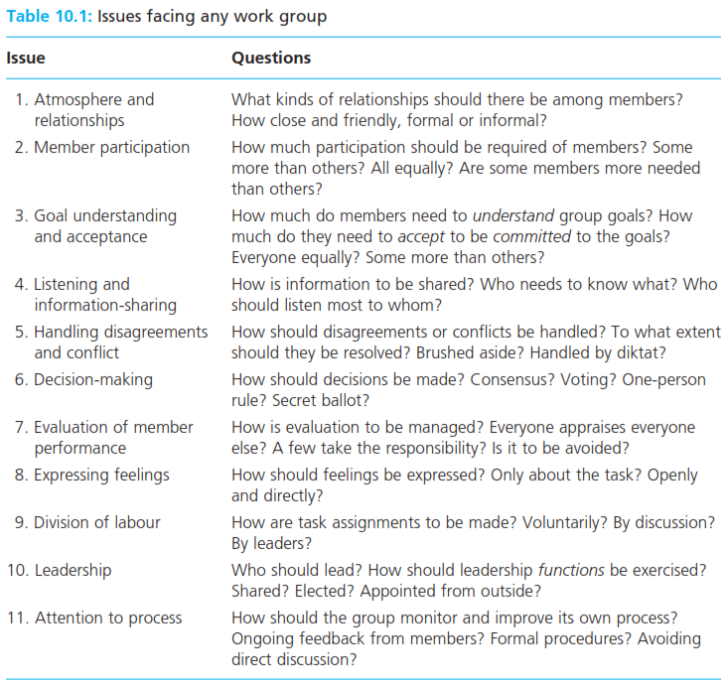
Definitions of groups?
Group two or more people, in face to face interaction, each aware of their group membership and interdependence, as they strive to achieve their goals.
Group dynamics the forces operating within groups that affect their performance and their member’s satisfaction.

Slide 7
Types of group tasks?
Additive task a task whose accomplishment depends on the sum of all group members efforts.
Conjunctive task a task whose accomplishment depends on the performance of the group’s least talented member
Disjunctive task a task whose accomplishment depends on the performance of the group’s most talented member

Slide 8
The Hawthorne studies
Hawthorne effect the tendency of people being observed to behave differently than they otherwise would.
Human relations approach a school of management thought which emphasizes the importance of social processes at work

Slide 9
Formal and informal groups
Formal group a group that has been consciously created by management to accomplish a defined task that contributes to the organizational’s goal
Informal group collection of individuals who became a group when they develop interdependencies, influence, one another’s behavior, and contribute to mutual need satisfaction.
Group self organization the tendency of groups to form interests, develop autonomy and establish identities.

Slide 10
Group formation
Activities in Homan’s theory, the physical movements and verbal and non verbal behaviours engaged in by group members
Interaction in Homan’s theory, the two way communications between group members.
Sentiments in Homan’s theory, the feelings, attitudes, and beliefs held by group members towards others.

Slide 11
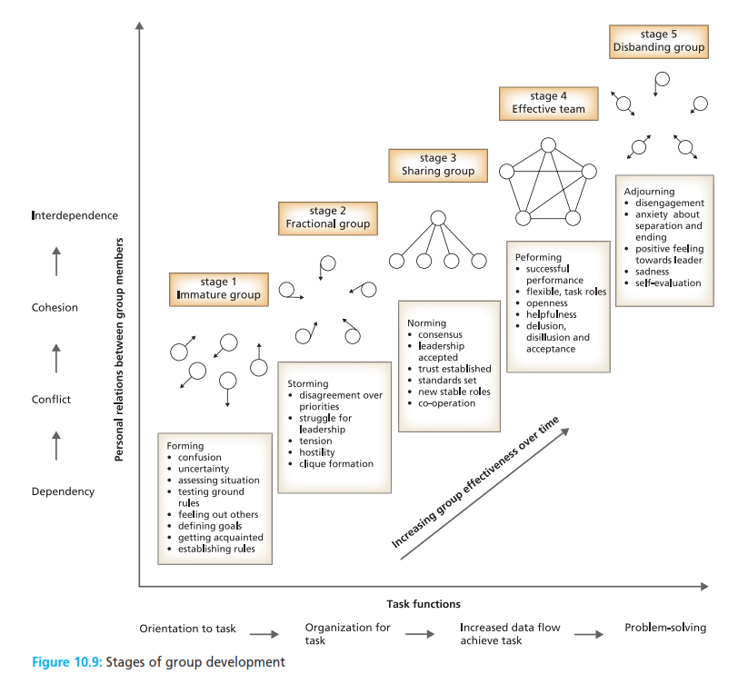
Group Development
.

Slide 12
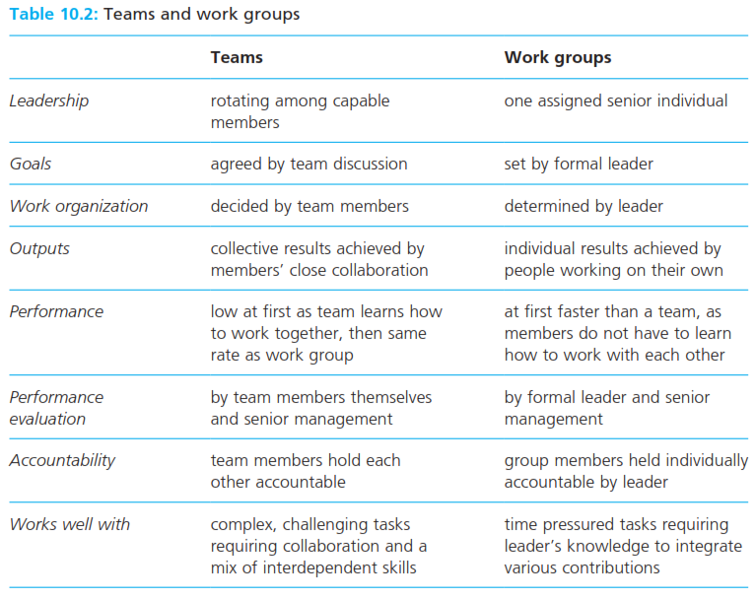
Group and Teams
.

Slide 13
Reference
Huczynski, Buchanan, 2013 , Organizational Behaviour, Pearson
Umam, Khaerul, 2012, Manajemen Organisasi, Pustaka Setia.
Wardiah, Mia Lasmi, Teori perilaku dan budaya organisasi, Pustaka Setia.

